Slide 1
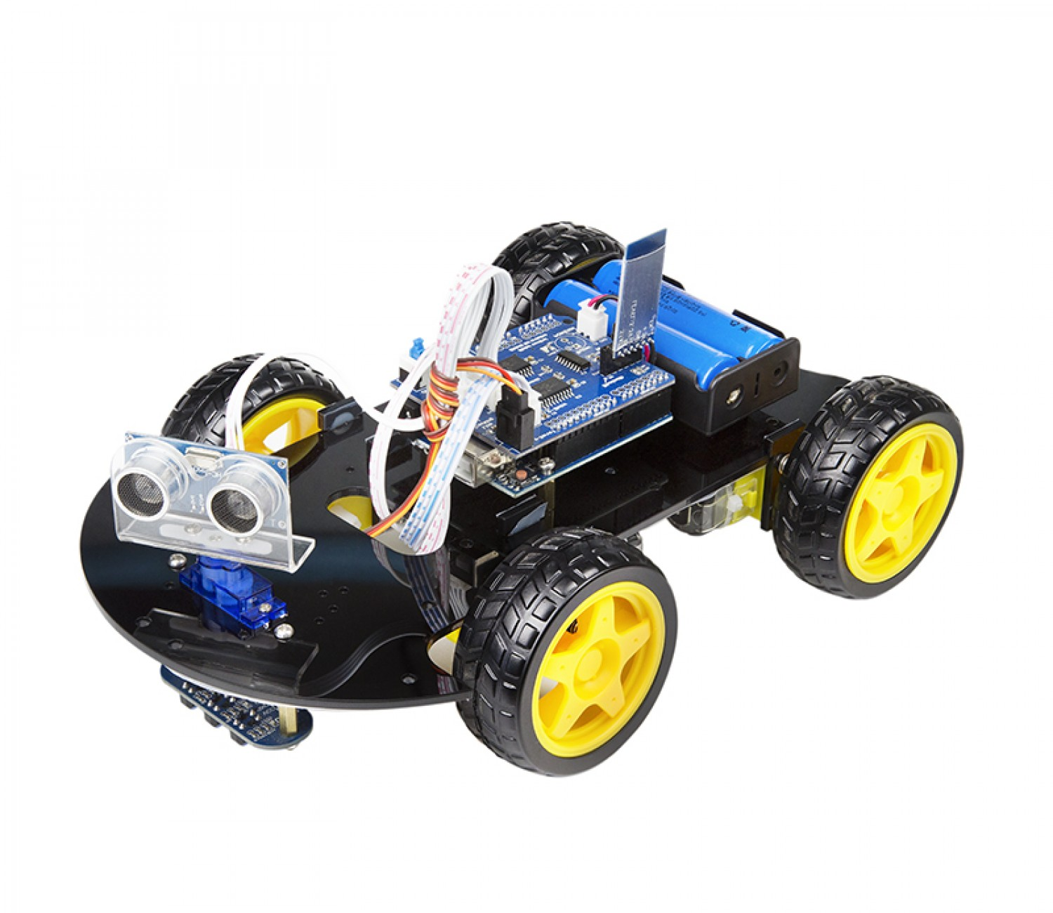
AUTOMATED BOOK MANAGEMENT SYSTEM
E/15/016 ANOJAN S.
E/15/171 KAPILRAJH R.
E/15/351 THAKSHAJINI S.

Slide 2

MOTIVATION & BACKGROUND
One of the biggest problems in libraries, there is no automated system to keep track of all books.
The workers waste a lot of time in arranging books in their respective book shelfs.
The books are misplaced due to human errors as the workers are not reliable.
The workers are unable to carry that many books at a time and they are not always available in the libraries.
If there are more than one copies for a book, it is difficult to distinguish them.

Slide 3
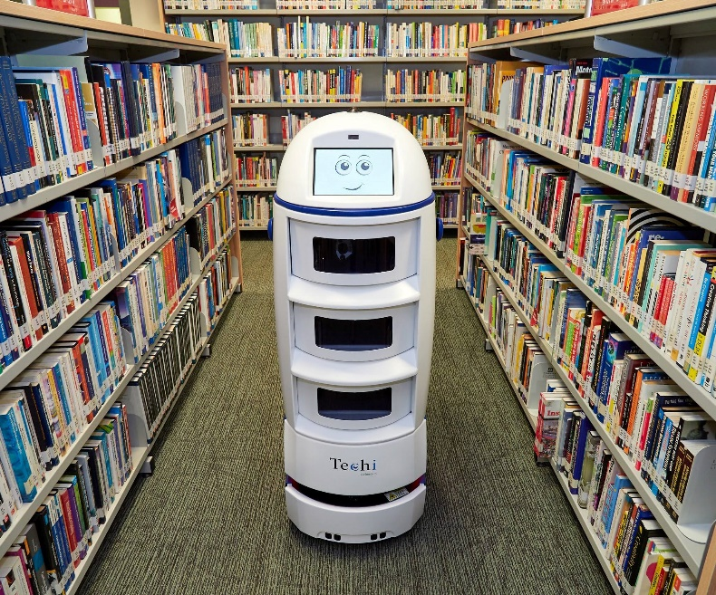
SOLUTIONS
Making an automated book picking robot to help the workers in the library.
The robot saves time and reduces human effort.
It reduces human error and manages the books in an efficient and effective way.
It is always available in the library.
It is reliable.
It ensures the security of the library and keeps the book safe.

Slide 4
HOW IT WORKS
The robot will be able to work as an integrated electro mechanical system designed for a specific purpose to arrange the books efficiently.
Wi-Fi module is used to send the signals to the robot about the location to where it should go.
The sensors placed in the robot detects the path in which it should travel.
Barcode is used to access the details of books and the LCD displays the destination of each books.
The robot gives an alert signal when it reaches the book shelf.

Slide 5




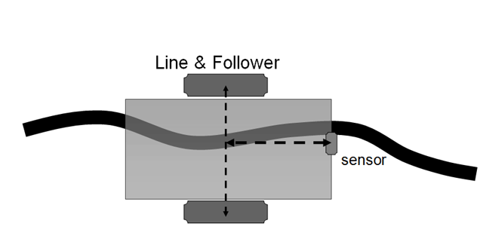
Admin
Server

Slide 6
SCOPE AND LIMITATIONS
Only the librarian can operate our robot.
It can access the Wi-Fi signal within the library.
This system can be used in
Libraries
Big book stalls in malls

Slide 7
MILESTONES
Identifying the problems and finding solutions
Proposing the ideas
1st week 2nd week 3rd week 4th week
Analysing the required components & preparing the budget
Starting to make the hardware

Slide 8
MILESTONES
Developing the hardware parts & Fixing the components
Adding more features and completing the product
Week 5-9 Week 10-12 Week 13-15
Creating the web application & Combining with the hardware

Slide 9


TECHNOLOGY STACK
Arduino for embedded system
HTML , CSS , JavaScript for Frontend

Slide 10



TECHNOLOGY STACK
Java based Spring Boot to design REST-API for Backend
MySQL for database

Slide 11
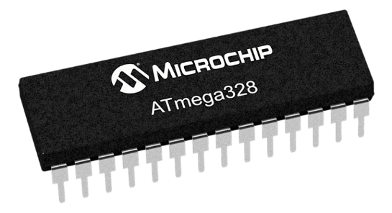
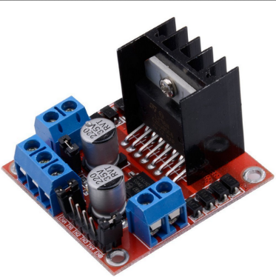
HARDWARE COMPONENTS
a simple, low-powered, low-cost micro-controller
L298N is a dual H-Bridge motor driver which allows speed and direction control of two DC motors at the same time.

Slide 12
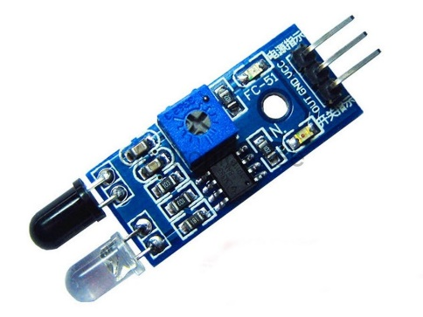
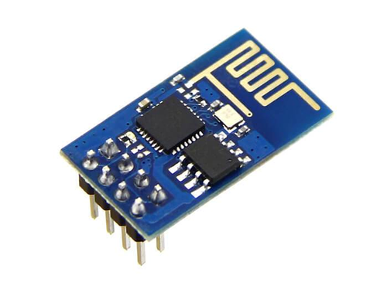
HARDWARE COMPONENTS
IR Line tracking sensors just follows lines, or the light reflected on a surface.
The ESP8266 Wi-Fi Module is a self contained SOC with integrated TCP/IP protocol stack that can give any microcontroller access to your Wi-Fi network.

Slide 13
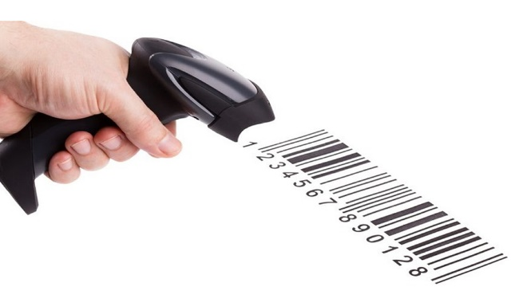
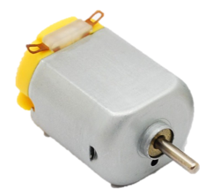
HARDWARE COMPONENTS
Barcode reader is used to capture and read information contained in a bar code .
DC Motors are used for rotating and controlling the wheels of the robot.

Slide 14
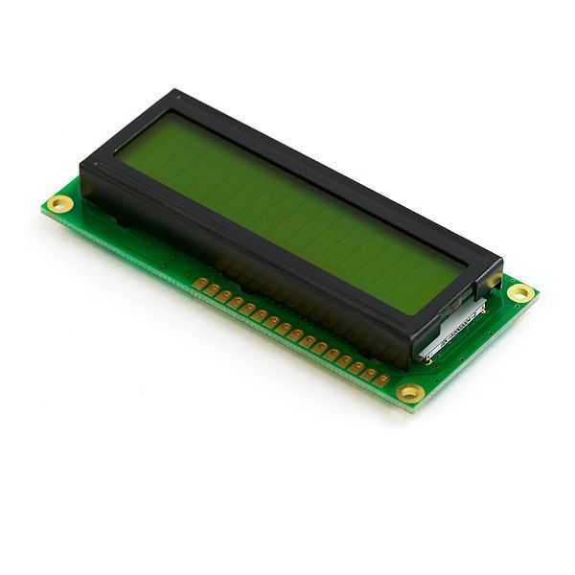
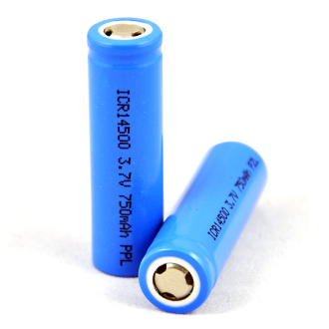
HARDWARE COMPONENTS
LCD is used to display the destination for each books
Batteries are used for power requirements.

Slide 15
ESTIMATED BUDGET
Arduino UNO : 1000/=
Barcode Reader : 3500/=
ESP8266 Wi-Fi Module : 500/=
4-wheel Robot Smart Car Chassis Kit : 1500/=
3-IR Line Tracking Sensors : 300/=
L298N Motor Driver Module : 300/=
2-Battery(3.7V) + Battery Holder : 500/=
Wires : 100/=
Total : 7700/=

Slide 16
DEMONSTRATION PLAN
Making a line following robot.
Creating a web application.
Accessing the book details using barcode reader.
Communicating with the robot using Wi-Fi.
Making the robot to reach the destination carrying the books.

Slide 17
Questions??

Slide 18
THANK YOU

