Slide 1
E CHECKUP
GROUP 01
E/15/330
E/15/366
E/15/373

Slide 2
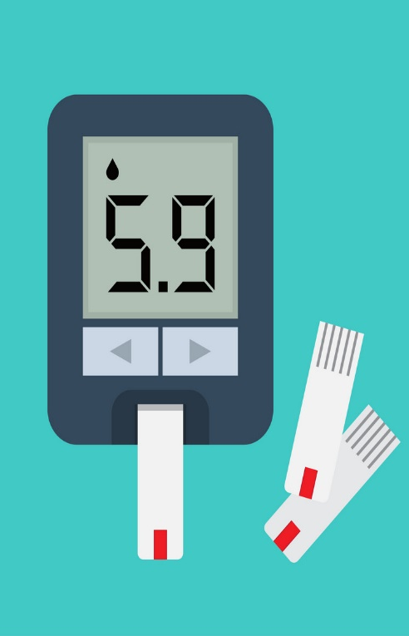
Introduction
Our Project is to measure various biometric parameters of a patient’s body and provide the data needed to a doctor.
We are planning to accomplish this by making an Embedded system and a Mobile application.
Biometric parameters are sensed by several sensors and Those data will be sent to mobile application.
From the mobile application data will be sent to doctors and they will send feedback about the patient’s records.

Slide 3




Who
Needs
E-Checkup
The people could not go to clinic for regular checkup.
The doctors who have no time to check their patients.

Slide 4




WHY
E-CHECKUP
Usually doctors check some selected parameters for regular checkup. Our embedded device too can check these parameters.
This can reduce the difficulties of patients and work load of a doctor.
Doctors can view patient old records to take decisions.

Slide 5

System Overview
ALLPPT Layout
Clean Text Slide
for your Presentation
Data is generated by sensors these data is processed and digitalized by the embedded system and it will sent the data to the mobile applications via wi fi module.
Data is stored on the mobile app and the patient will upload it with his personal comments.
In the mobile app patient can view the history of checkup details and the doctor’s feedback.

Slide 6

System Overview
Doctors examine many patients history and provide feedback for those.
If any measurements are extremely high the red alert will be given to the doctors and they will give priority to these notifications.

Slide 7
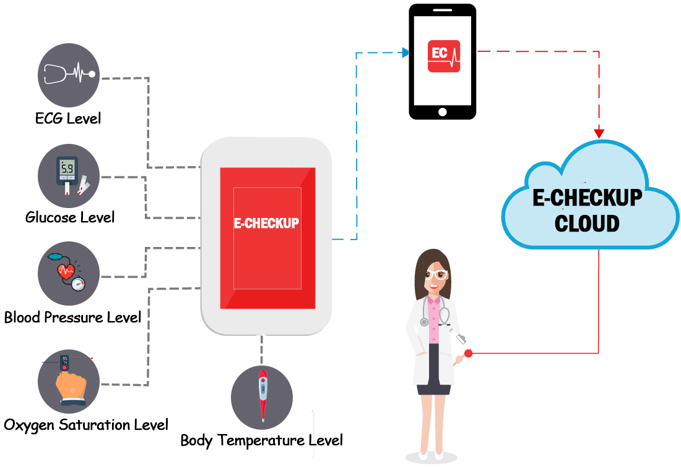
Data Flow

Slide 8





Data Flow
05
04
03
02
01

Slide 9
SENSORS
ECG Module
Thermistor
Ambient Light Sensor
Infrared LED
Oxygen Saturation Sensor
Communication Method
WIFI Module

Slide 10
Overview
Blood Pressure
Glucose Level
Oxygen Saturation Level
Body Temperature
ECG

Slide 11
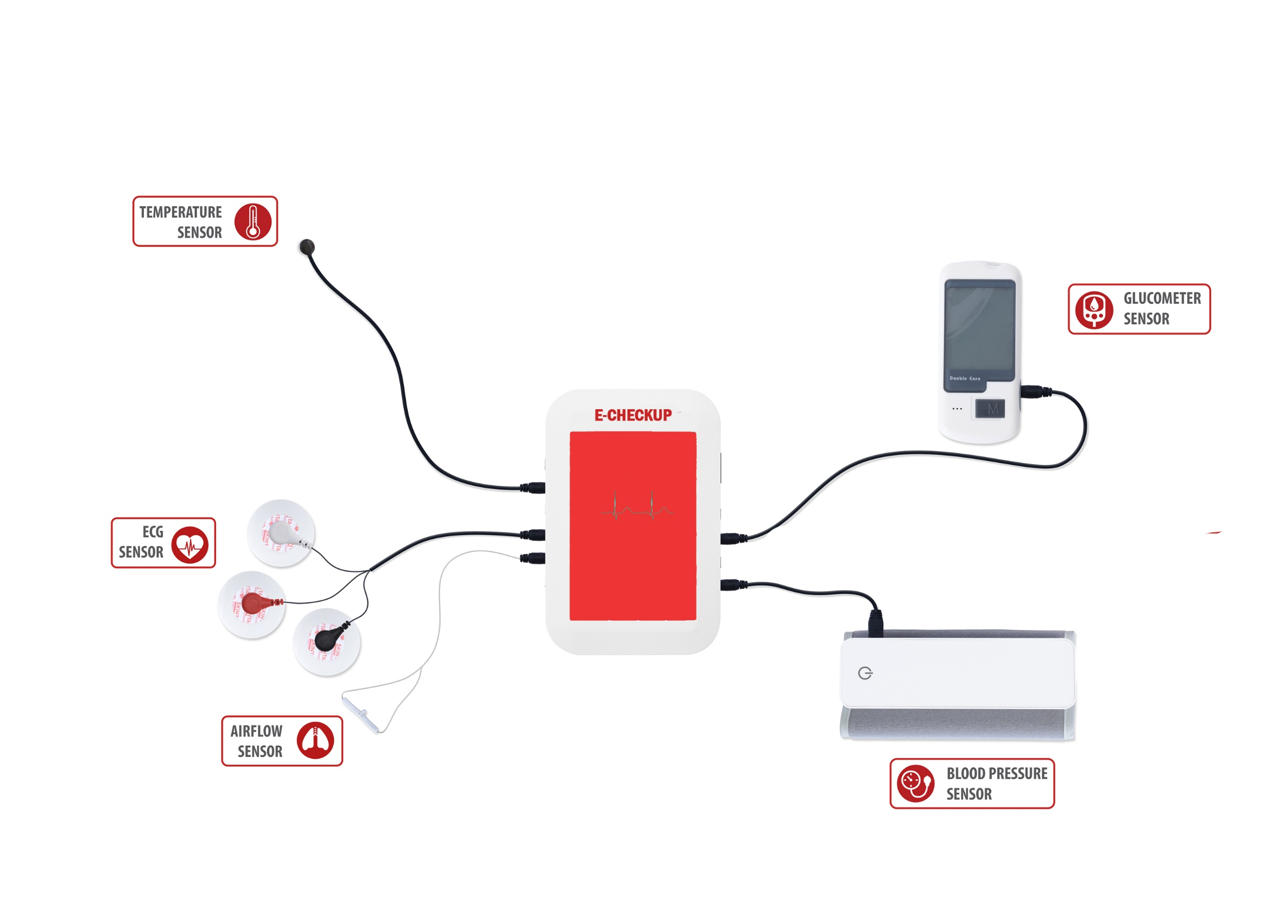
Final Output Design

Slide 12
BUDGET
ITEMS | COST
ECG Module | 1800.00
WIFI Module | 500.00
Thermistor | 150.00
Ambient Light Sensor x2 | 1000.00
Infrared LED x2 | 40.00
Oxygen Saturation Sensor | 250.00
Other expenses | 1000.00
TOTAL | 4740.00

Slide 13
Project Timeline
Selecting Project
Gathering Requirements
Preparing Project Proposal
Preparing Front end
Preparing Back end
2nd week
4th week
6th week
8th week
Final Presentation
Network & Security
Building Embedded device
Building Embedded device
16th week
14th week
12th week
10th week

Slide 14
Thank You

