Slide 1
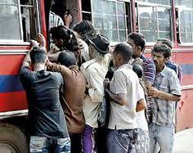
Why people Hate public Transportation ?

Slide 2

What’s the Problem?
Sri Lanka has the second highest road density in Asia (173.8 km/km²)
Once CTB was the largest omnibus company in the world (Wikipedia)
But Still people don’t use the public transportation very much

Slide 3


Our Solution
Safer Travel Utility

Slide 4
What You See from Outside
Web App
Tracker
Mobile App

Slide 5




Application DB
Web App api
Mobile App api
Google API Services
Service API
TMS
Tracker
Tracker
Tracker
Tracker
Tracker

Slide 6

What You Don’t See from Outside
S
E
R
V
I
C
E
A
P
I
TMS DB
Tracker 1
MQTT Broker
Tracker 2
TMS Backend
Tracker 3
TMS Web Console

Slide 7

Why MQTT
Light weight
Flexible
Secure
Scalable
Low bandwidth

Slide 8
What’s Inside the Tracker
Power bus
Data bus
GPS + GSM Module
(A9G chip)
IMU Module
(MPU 6050)
Magnetometer
(hmc5883l)
Microcontroller
(STM32F103)
Barometric Pressure Sensor
(BMP 280)
12v to 3.7v SMPS Module
DC Input
Battery Lion 3.7v

Slide 9
S
E
R
V
I
C
E
A
P
I
Application DB
Web App API
Mobile App API
Google API Services

Slide 10




Slide 11




Slide 12
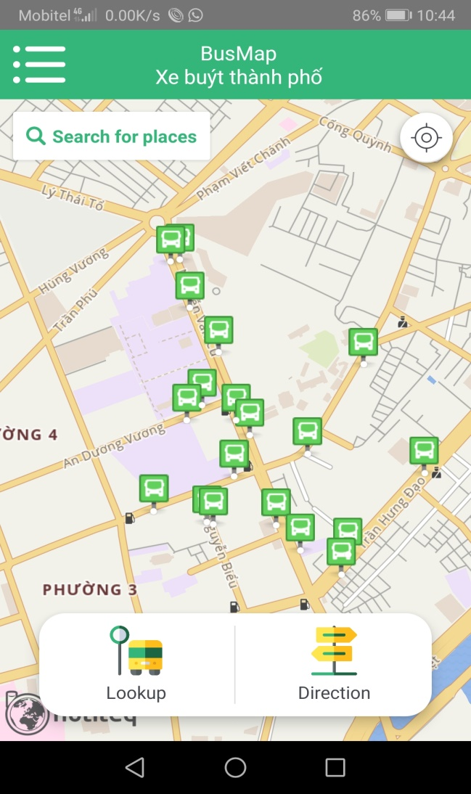
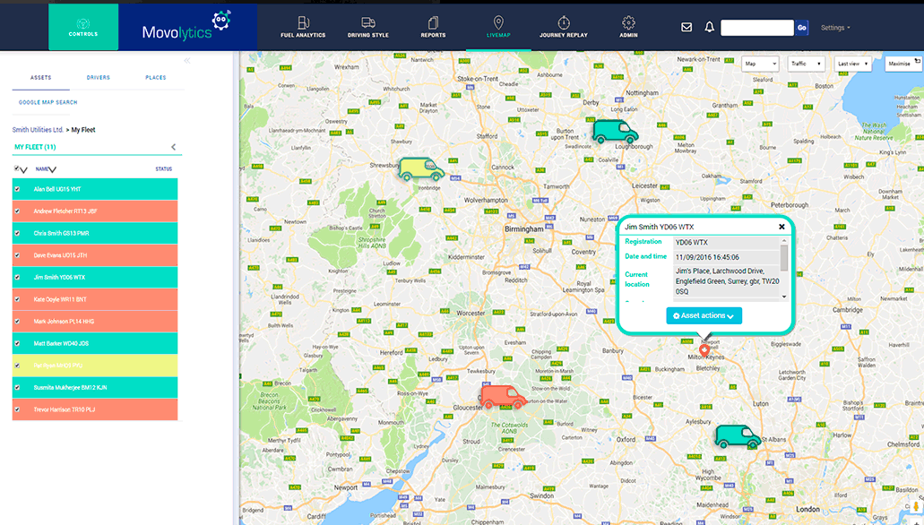
SaVy

Slide 13
Bill Of Materials Per Unit
Item | No Of Units | Price/Unit | cost
MPU 6050 | 1 | 390 | 390
BMP 280 | 1 | 330 | 330
HMC 5983 | 1 | 750 | 750
A9G | 1 | 3000 | 3000
STM32F103C8T6 | 1 | 750 | 750
LM2596 Adjustable Buck Converter | 1 | 180 | 180
Li Ion Battery | 1 | 220 | 220
Enclosure Box | 1 | 290 | 290
Total |  |  | 5910

Slide 14
TIMELINE
Week7
Week11
Final
week3
Tracker
YOUR HEADING
YOUR HEADING
TMS
2015
2018
WEB UI
YOUR HEADIG
Mobile APP

Slide 15

How we going to demonstrate

Slide 16


Slide 17


