Slide 1
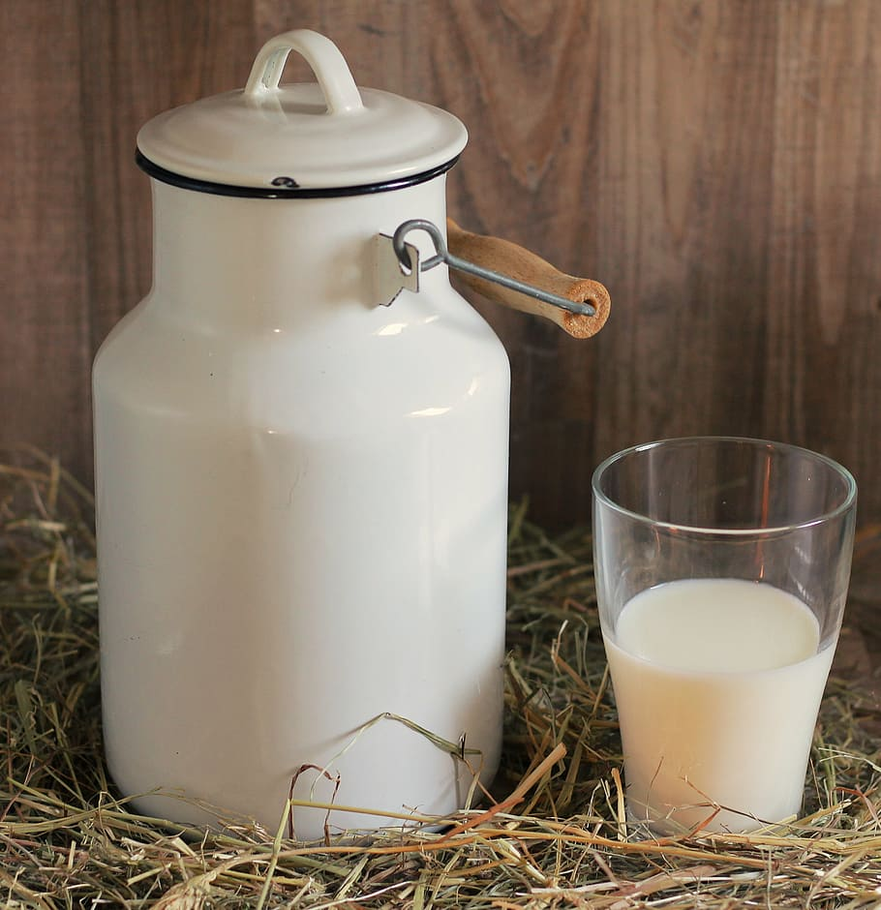
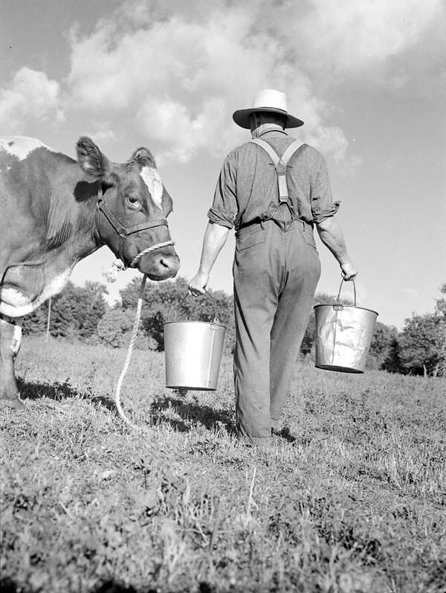

Healthy Milk Collecting System
Group 20
E/17/012 Amarasinghe R A A U
E/17/038 Chandrasekara C M A
E/17/101 Gunathilaka S P A U

Slide 2

Background
There are many dairy products like Milk, Yoghurt , Ice cream, Cheese, Buffalo curd produced as;
Factory based productions
Small scale productions
Required Quality in raw milk:
PH between 6.5 and 6.7
Average Density : 1.03 g/cm3 at 20°C.
Milk adulterants
Water
Urea
Formalin etc
Testing raw milk ensures you are receiving a high-quality product
Testing is very important !

Slide 3



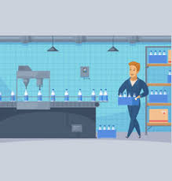


Problem
Bad dairy product
Consumption
Fall ill
Quality is very important in dairy related products.
Dairy collectors measure only few parameters when buying milk from the dairy farmers.
Financial deals are happening in a traditional way.
Small scale manufacturers do not use technology
based methods to measure the quality of milk.
Milk processing
Bad milk
Good milk

Slide 4

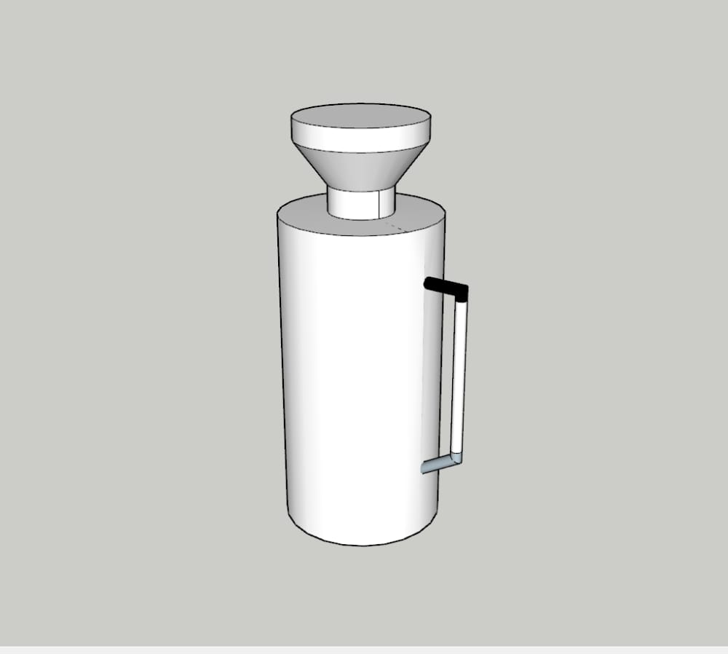
Our solution
A Portable device
Measures important quality parameters of milk at the same time
(Acidity, temperature,Fat rate)
Detects milk Adulterants
Calculates financial value according to the quality parameters and manage financial records of users

Slide 5
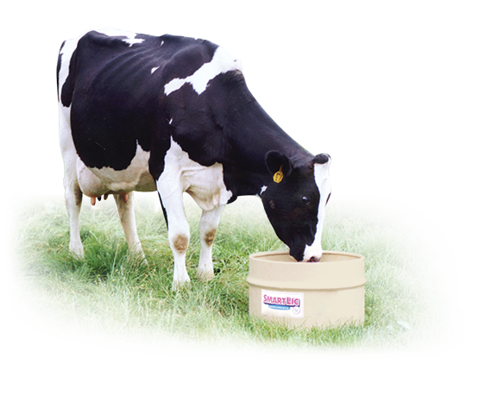
Impact
A positive impact specially for small scale dairy industry
Impact towards healthy products

Slide 6

Target Audience
Milk collectors
Small scale manufacturers
Future entrepreneurs
“As a small scale manufacturer, How can I improve my business?”
“branded products are not always good. but we tend to buy branded food item as so many customers consume their products”

Slide 7
Identifying users
Collector
Dairy Farmer
Healthy Milk Collecting System
Guest User
Admin

Slide 8
Roles of Users
Collector
login/registration
Add records
View records
Edit records with permission of farmer
Get monthly financial record
Get details about our product/updates
Dairy Farmer
login/registration
View records
Get monthly financial record
Get details about our product/updates
Admin
Control user activities
Support users
Update users about product details
Guest user
Get details about our product/updates
Ability to contact collectors/ farmers
View dairy product details

Slide 9
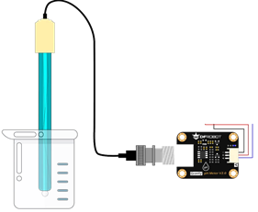
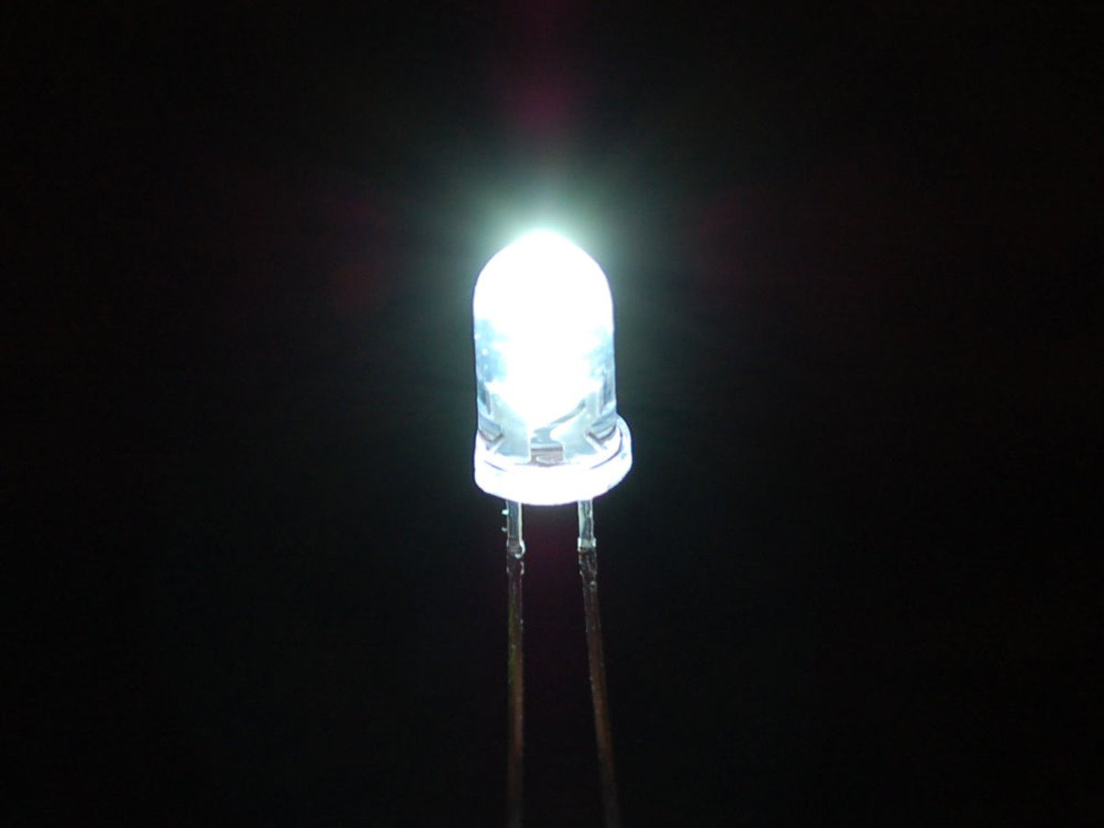
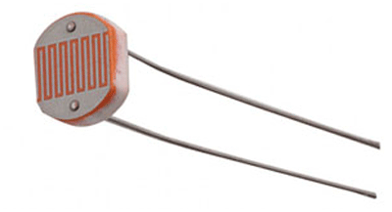
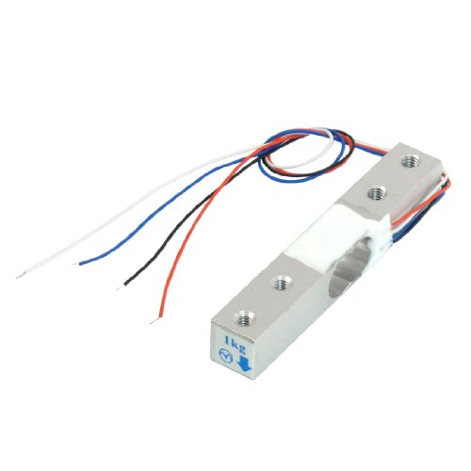
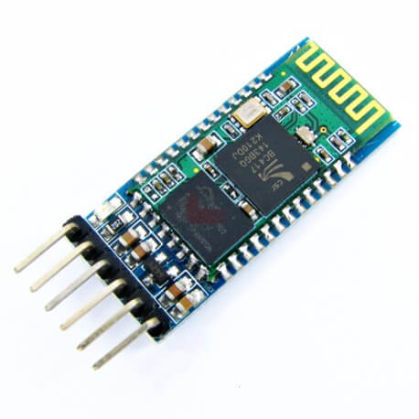
Hardware Components
PH meter sen-0161
Accuracy: ± 0.1pH (25 ⁰C )
Response Time: < 1min
LED
LDR
Load cell
HC-05 Bluetooth module
0-10 kg range
High accuracy
Input Voltage: DC 5V
Communication Method: Serial Communication

Slide 10
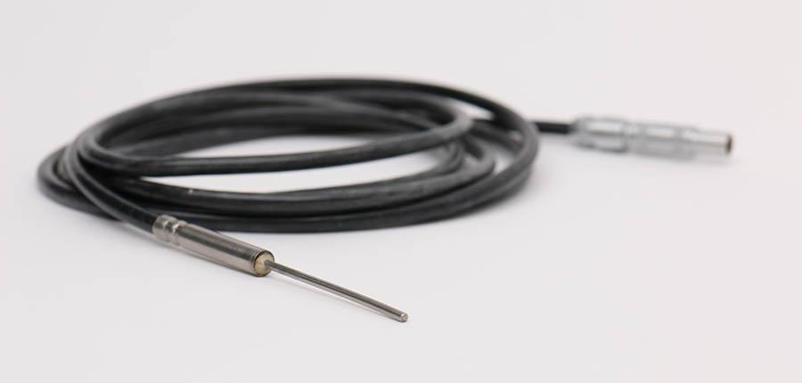
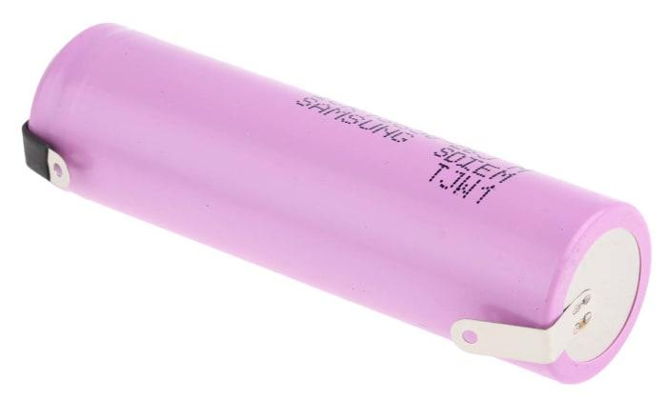
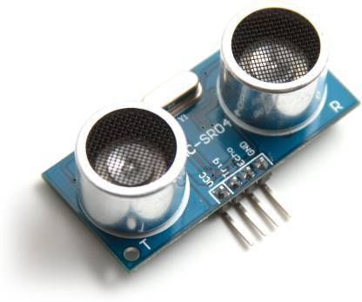
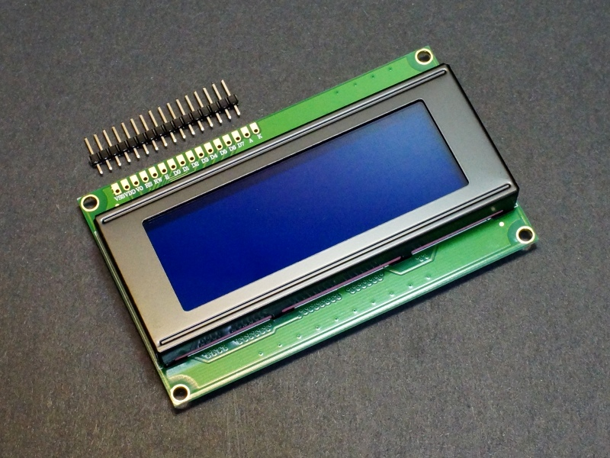
Temperature sensor-DS18B20
• ±0.5°C Accuracy from
-10°C to +85°C
• Programmable
10 V Power Supply
Rechargable
Ultrasonic distance sensor HC-SR04
Working Voltage DC 5 V
Range 2cm-4m
LCD 20x4 Display
80 characters
+ 5 V power

Slide 11
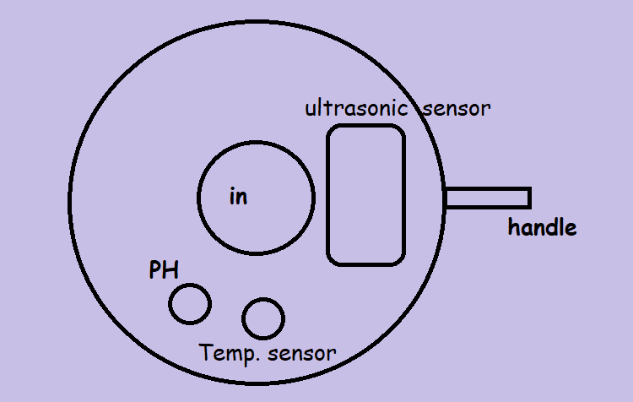
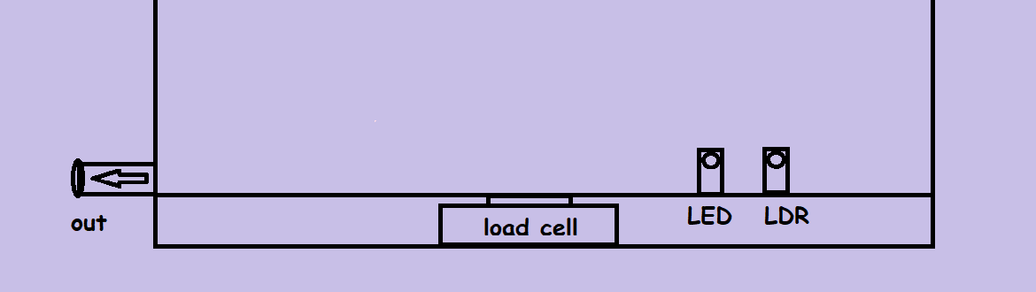
Top view
Cross section view at the bottom

Slide 12
sensors
Main unit
PH meter
ATmega328p
Microcontroller
LCD display
Ultrasonic sensor
Control signals
Load cell
Bluetooth module
Temperature sensor
Power Supply
LDR

Slide 13
PH
D
C
B
A
Grade
Density
Price = Volume x Quality rate
(in Litres) (price per L)
FAT

Slide 14




Data flow
Sensors
Main unit
Bluetooth
Web/mobile applications
Collector’s mobile

Slide 15
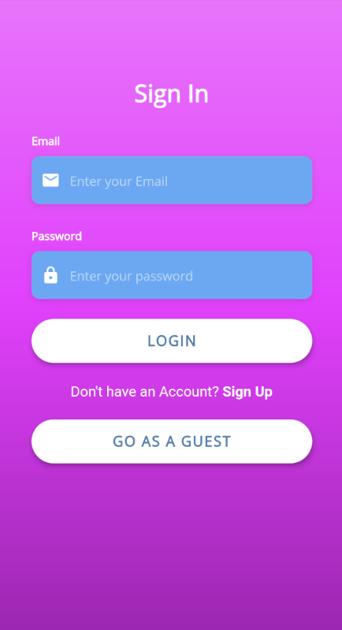
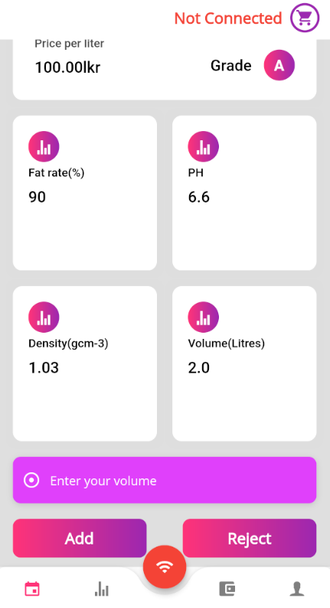
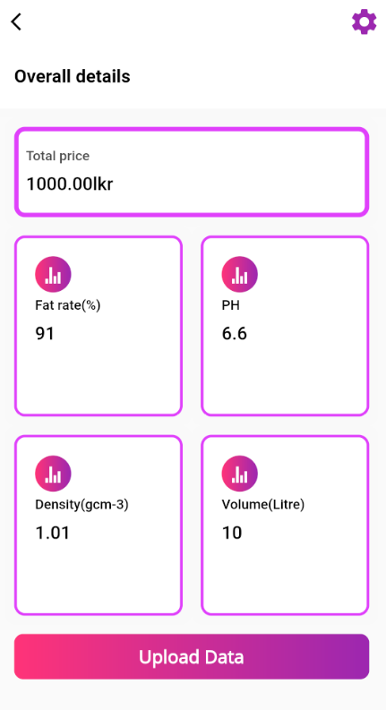
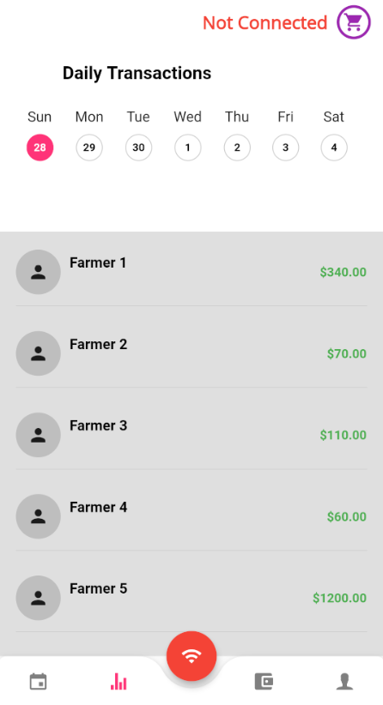
Mobile Application UI

Slide 16

Security & Privacy Concerns
Secure Login System with token authentication
Privacy in Financial information
It is not possible to insert wrong parameter values to the system
Maintaining the transparency of the financial deals

Slide 17



Technologies
Can use across different platforms
(Android / IOS/Web)
The Potential Ability to Go Beyond Mobile
Similar to Native App Performance
Powerful data and relationship management
Fully-managed infrastructure
Flexible schema management
MVC Architecture Support
MySQL Database
Secure Migration System
Effective ORM

Slide 18
Project Timeline
Week 6
Week 8
Week 10
Week 12
Week 13
Project Planning
Backend Design
Application design
Hardware Design
Cloud Deployment
Week 14
Week 15
Integration
Testing

Slide 19
Budget
item | quantity | price(LKR) | irem | quantity | price(LKR)
ATmega328p | 1 | 1700 | Bluetooth module | 1 | 800
Load cell | 1 | 1700 | 20x4 LCD display | 1 | 700
PH sensor | 1 | 3000 | Cost for model | 1 | 2000
DS18B20 | 1 | 400 | Resistors | 10 | 100
Ultrasonic sensor | 1 | 800 | 10 V power supply | 1 | 1000
LDR | 1 | 500 | Wires & others | 1 | 200
LED | 10 | 200 |  | Total cost | 13100

Slide 20
Demonstration plan
Screen recordings of mobile & web App user interfaces
Model design of hardware unit

Slide 21
Q & A

Slide 22
THANK YOU

