Slide 1

Review of AISY Research Paper
E/17/038 Anuruddha
E/17/101 Anjalee
E/17/292 Rilwan

Slide 2
Overview
a deep learning-based framework for profiling side-channel analysis
enables the users to run the analyses and report the results efficiently
Maintain results’ reproducible nature
Use supervised machine learning - multi class classification
Use deep neural network with softmax output layer

Slide 3
Advantages
Maintain results’ reproducible nature
Easy to use - built on top of Keras library
Integrated Database
Provide a web application
One-click Script Generation
State-of-the-art side-channel analysis
Team work

Slide 4
Profiling and Attacking
In SCA, the profiling phase is the same as the training in ML
In the attack phase, the goal is to make predictions about the classes
Aims to reveal the secret key k*. For this partial guessing entropy is used in AISY framework

Slide 5
General Design
Current framework version is 1.0
Open-source
Currently, the AISY framework supports deep learning-based SCA for the AES cipher with 128-bit key

Slide 6
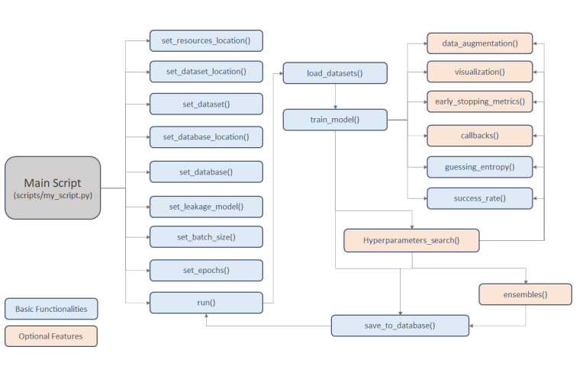
Framework flow

Slide 7
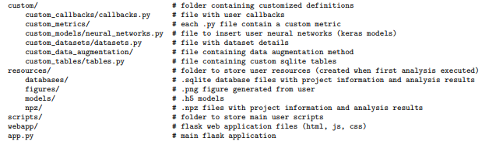
Layout

Slide 8
Datasets
Currently 5 datasets are supported in the framework
only format currently supported is .h5, where datasets need to be generated according to the ASCAD database description
ASCAD Fixed Key
target - an 8-bit AVR microcontroller running a masked AES-128 implementation, where the side-channel is electromagnetic emanation
Profiling - 50 000 traces
Testing - 10 000 traces
Provides the preselected window of 700 samples to attack first masked byte

Slide 9
Datasets (Continued)
ASCAD Random Keys
Target - same as ASCAD Fixed Key dataset
Profiling - Has random keys, 200 000 traces
Testing - a fixed key, 100 000 traces
Provides the preselected window of 1 400 samples to attack first masked key byte
CHES CTF 2018
Target - masked AES-128 encryption running on a 32-bit STM microcontroller
Profiling - contains a fixed key, 45 000 traces
Testing - fixed key different from the key configured for training and validation set, 5 000 traces
Each trace consists of 2 200 samples

Slide 10
Datasets (Continued)
AES HD
Target - unprotected hardware implementation of AES-128 implemented on Xilinx Virtex-5 FPGA of a SASEBO GII evaluation board
Contains 50 000 traces
Each trace has 1250 samples
AES HD ext
AES HD extended dataset
Contains 500 000 traces
Each trace has 1250 samples

Slide 11

Standard Metrics
Guessing Entropy
To compute guessing entropy, a user must define the key rank calculation definition
Success Rate
Automatically computed together with guessing entropy
Accuracy
Loss
estimated for each epoch during training

Slide 12
Neural Network Models
Allows deep learning analysis with multilayer perceptron and convolution neural networks
To allow easier usage of the AISY framework, authors also implemented several state-of-the-art architectures
(1) ASCAD mlp
(2) ASCAD cnn
(3) methodology cnn ascad
(4) methodology cnn aeshd
(5) methodology cnn aesrd
(6) methodology cnn dpav4 [43]

Slide 13
Leakage Models
Supports 4 different leakage models
(01) Bit - results in 2 classes
(02) Hamming weight - results in 9 classes
(03) Hamming distance - results in 9 classes, need to consider 2 states that are XOR- ed to obtain the intermediate value
(04) Identity - considers value of intermediate state, results in 256 classes

Slide 14
Visualization
provides an input gradient visualization feature
allows the visual verification of main input samples learned from the input traces
Input gradient can be visualized as:
(01) the sum of input gradients, providing the sum of input gradients computed for all used profiling traces and all the processed epochs
(02) the input gradient computed for all used profiling traces for each epoch in a heatmap plot.

Slide 15
Data Augmentation
allows easy configuration of data augmentation techniques during model training
allows small modifications in side-channel traces during training - improves the model generalization
Implements two data augmentation techniques:
(01) Shifts - every trace is randomly shifted
(02) Gaussian noise - every trace is combined with the Gaussian noise with a specific mean and standard deviation values

Slide 16
Hyperparameter Search
Two options to conduct hyperparameter tuning in the AISY framework
Implements two data augmentation techniques:
(01) Random search - need to define the minimal, maximal, and step value for every hyperparameter
(02) Grid search - have to define all hyperparameter values to examine

Slide 17
Main Features of AISY framework
SCA Metrics (guessing entropy and success rate)
Gradient Visualization
Data Augmentation
Grid Search
Random Search
Early Stopping
Ensemble

Slide 18
…contd
Custom Callbacks
Confusion Matrix
Easy Neural Network Definitions
Data Augmentation
GUI - plots, tables
Automatically generate scripts
Fully reproducible scripts

Slide 19

Q & A

Slide 20

Thank You

