Slide 1
DATABASE MANAGEMENT SYSTEM FOR A CAR RENTAL COMPANY
PRESENTATION

Slide 2
INTRODUCTION
DESCRIPTION
USERS
ACCESS ROLES

Slide 3
DESCRIPTION
The Car Rental Company keeps track of VEHICLEs, VEHICLE_OWNERs, PACKAGEs, CUSTOMERs, BOOKINGs and TRANSACTIONs.
Entity type VEHICLE has a unique id, license plate number, engine serial number. Other attributes include category, name, total kms, last service date, last service kms, gps link, max passengers, owner id , registered date and availability.
Entity type VEHICLE_OWNER has a unique id. Company keeps track of name, address, email, registered date and account details of each vehicle renter.
Entity type PACKAGE has all details about the packages offered by the company. Each package is uniquely identified either by the id or the name. Other attributes include vehicle category, key money, daily rent, max kms per day, and charge per extra km.
Company keeps details about registered CUSTOMERs uniquely identified by the nic. Other details include name, address, email, driving license number and registered date.

Slide 4
Company keeps track of all BOOKINGs uniquely identified by an id. Other attributes include booking done date, package id, vehicle id, customer nic, booked date, return date and completed.
Entity type TRANSACTION is keeping information about completed bookings. Other data include start meter reading, end meter reading, extra kms, total rent, damage, amount to pay, description and owner commision.

Slide 5
USERS AND ROLES
COMPANY ADMINISTRATION
Company administration has access to
Register new Vehicle Renters, Vehicles, Customers.
Make Bookings for customers
Get a View about a particular Vehicle, Renter, Booking, Transaction or a Customer.
Get views of all bookings made by any particular customer or on any vehicle.
Make updates to existing data about any of the above .
Can view all the bookings on a particular day or details about vehicles to be returned on a particular day

Slide 6
CUSTOMERS
Customers can interact with the company using a web interface.
They can go to the company website and view details about vehicles and packages offered by the company. Customers also have the ability to check the available vehicles on a required period of time.
Registered customers can book available vehicles online.
New customers can register online by filling out the form and book vehicles
Any changes regarding earlier Registration Details or Booking(cancelations, change dates, vehicle etc) should done by contacting the company administration. Online access for such events is not provided.

Slide 7
DESIGN JUSTIFICATION
CONCEPTUAL MODEL
LOGICAL MODEL
PHYSICAL MODEL

Slide 8
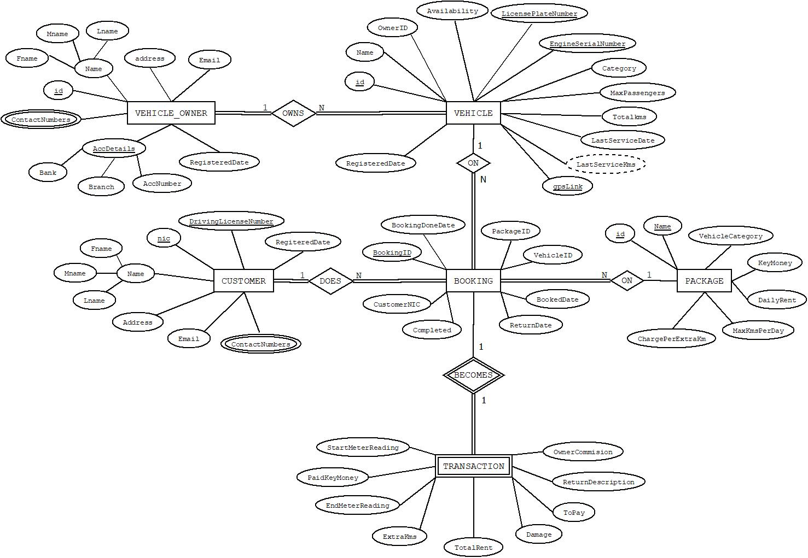
CONCEPTUAL MODEL

Slide 9
IMPLEMENTATION CHOICES

Slide 10
CHOICE OF DATABASE
Mysql
TOOLS AND TECHNOLOGIES
Xampp server
Html
Css
Php
C#
Netframes

Slide 11
VIEWS, STORED PROCEDURES
To Register new Vehicles, Renters and Customers.
Check availability of a Vehicle on a particular time period.
Make a booking on a vehicle when book date and return date and customer nic are given. Package is selected based on the vehicle and number of days of the booking.
Customer can give the nic number when renting the vehicle. Whether the customer is registered, has a booking on the particular day or not are detected by the system.
A view about details of the booking can be provided.
Customer can ask for a view of all his Bookings. In such cases a stored procedure is called to get the view
When the vehicle is rented it is inserted on TRANSACTION, start meter reading is automated to set as total kms of the vehicle.

Slide 12
When a vehicle is returned a stored procedure is called to calculate Rents etc and update the corresponding transaction.
A view can be provided regarding all transaction details using procedures.

Slide 13
TRIGGERS
To auto fill Vehicle, Booking, Vehicle Renter ids.
To update Booking and set completed as yes.
To auto update total kms of the vehicle

