Slide 1
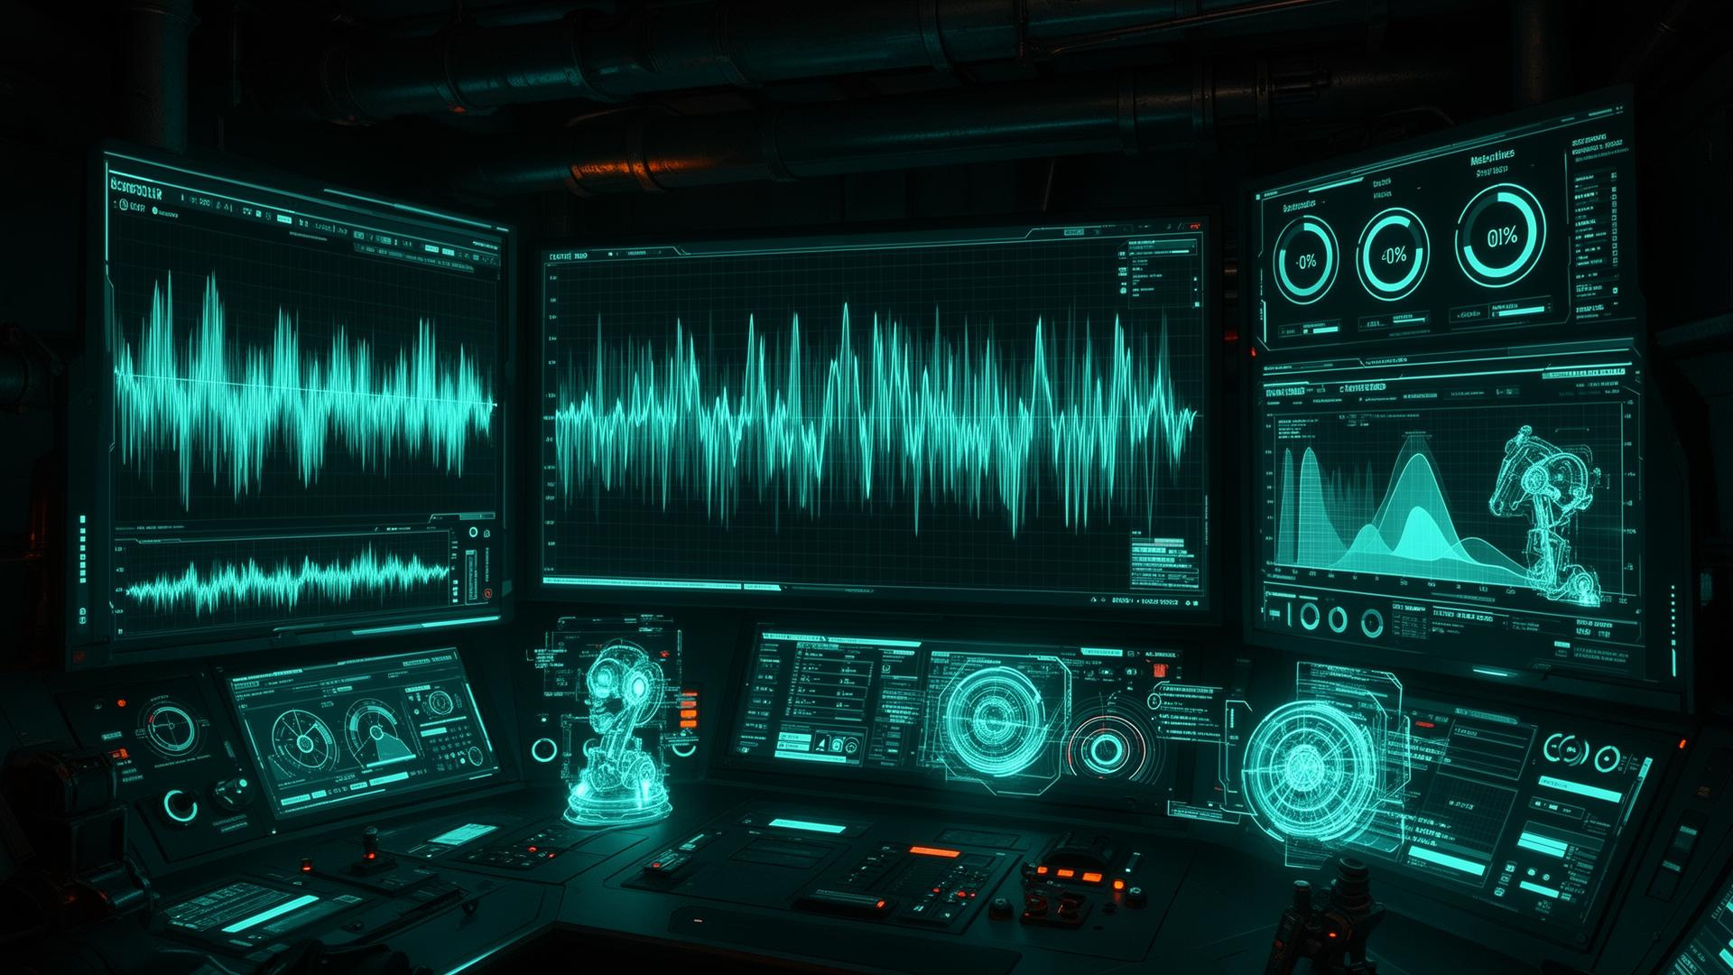


INVICTUS
PERA
SAM
Industrial Sound Analysis Manager with Acoustic AI
CO 2060 : Software Systems Design Project
Team : Invictus

Slide 2


INVICTUS
WHY
SAM ?
PROBLEM:
Machines such as laptop/PC cooling fans, vehicle engines, pumps, and industrial assets often fail without early warning. Traditional maintenance is usually reactive (repair after failure), which can cause overheating, downtime, and higher repair cost.
TARGET USERS:
Laptop/PC users
IT technicians (data center / office PC maintenance)
Maintenance technicians (industrial machines)
Fleet/asset managers (vehicles, factories)
Sound engineers.

Slide 3


INVICTUS
PROPOSED
1.
MINIMAL VIABLE PRODUCT (MVP)
SOFTWARE SOLUTION
User uploads/records machine audio (10-second clip).
Runs the anomaly detection model.
Returns Normal/Abnormal + confidence score.
Stores results and history.
2.
IN SCOPE (SEMESTER 3)
User and Company/Technician Registration.
Dataset handle (Kaggle with Colab).
Feature extraction pipeline, baseline anomaly model, backend API endpoint.
Simple frontend dashboard.
Company/Technician visible on map
abnormal
3.
OUT SCOPE (SEMESTER 3)
Centralized management.
Enhanced communications (users → technician).
Improved documentation management.
Reporting and analytics.
Full mobile application.

Slide 4


INVICTUS
REQUIREMENT
SPECIFICATION
1.
FUNCTIONAL REQUIREMENTS:
Upload/record audio clip (WAV/MP3) via UI.
Extract features (MFCC/log-mel spectrogram) on server.
Run anomaly detection model and output score + label.
Store prediction results with timestamp and metadata
View history and download basic report (CSV/PDF optional).
Human feedback (technicians).
2.
NON-FUNCTIONAL REQUIREMENTS:
Scalability: Designed to support multiple assets and large logs.
Usability: Simple 3-step workflow (Upload? Analyze? Result).
Reliability: Must not crash on noisy audio.
Security: Validate uploads, limit file size, sanitize filenames, and secure API keys.
Privacy: Store minimum user data.
Low latency: Analysis result within few seconds. (like laptop fans)

Slide 5
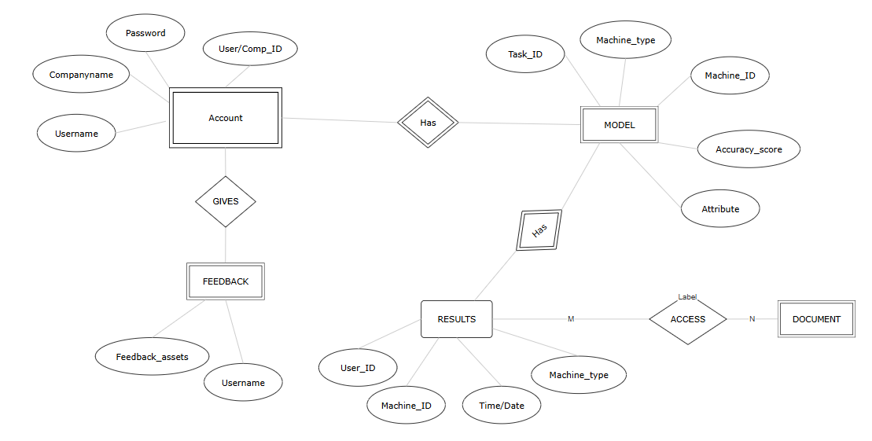

INVICTUS
ER
DIAGRAM
Updated until MVP
UML DIAGRAM :
Click here

Slide 6
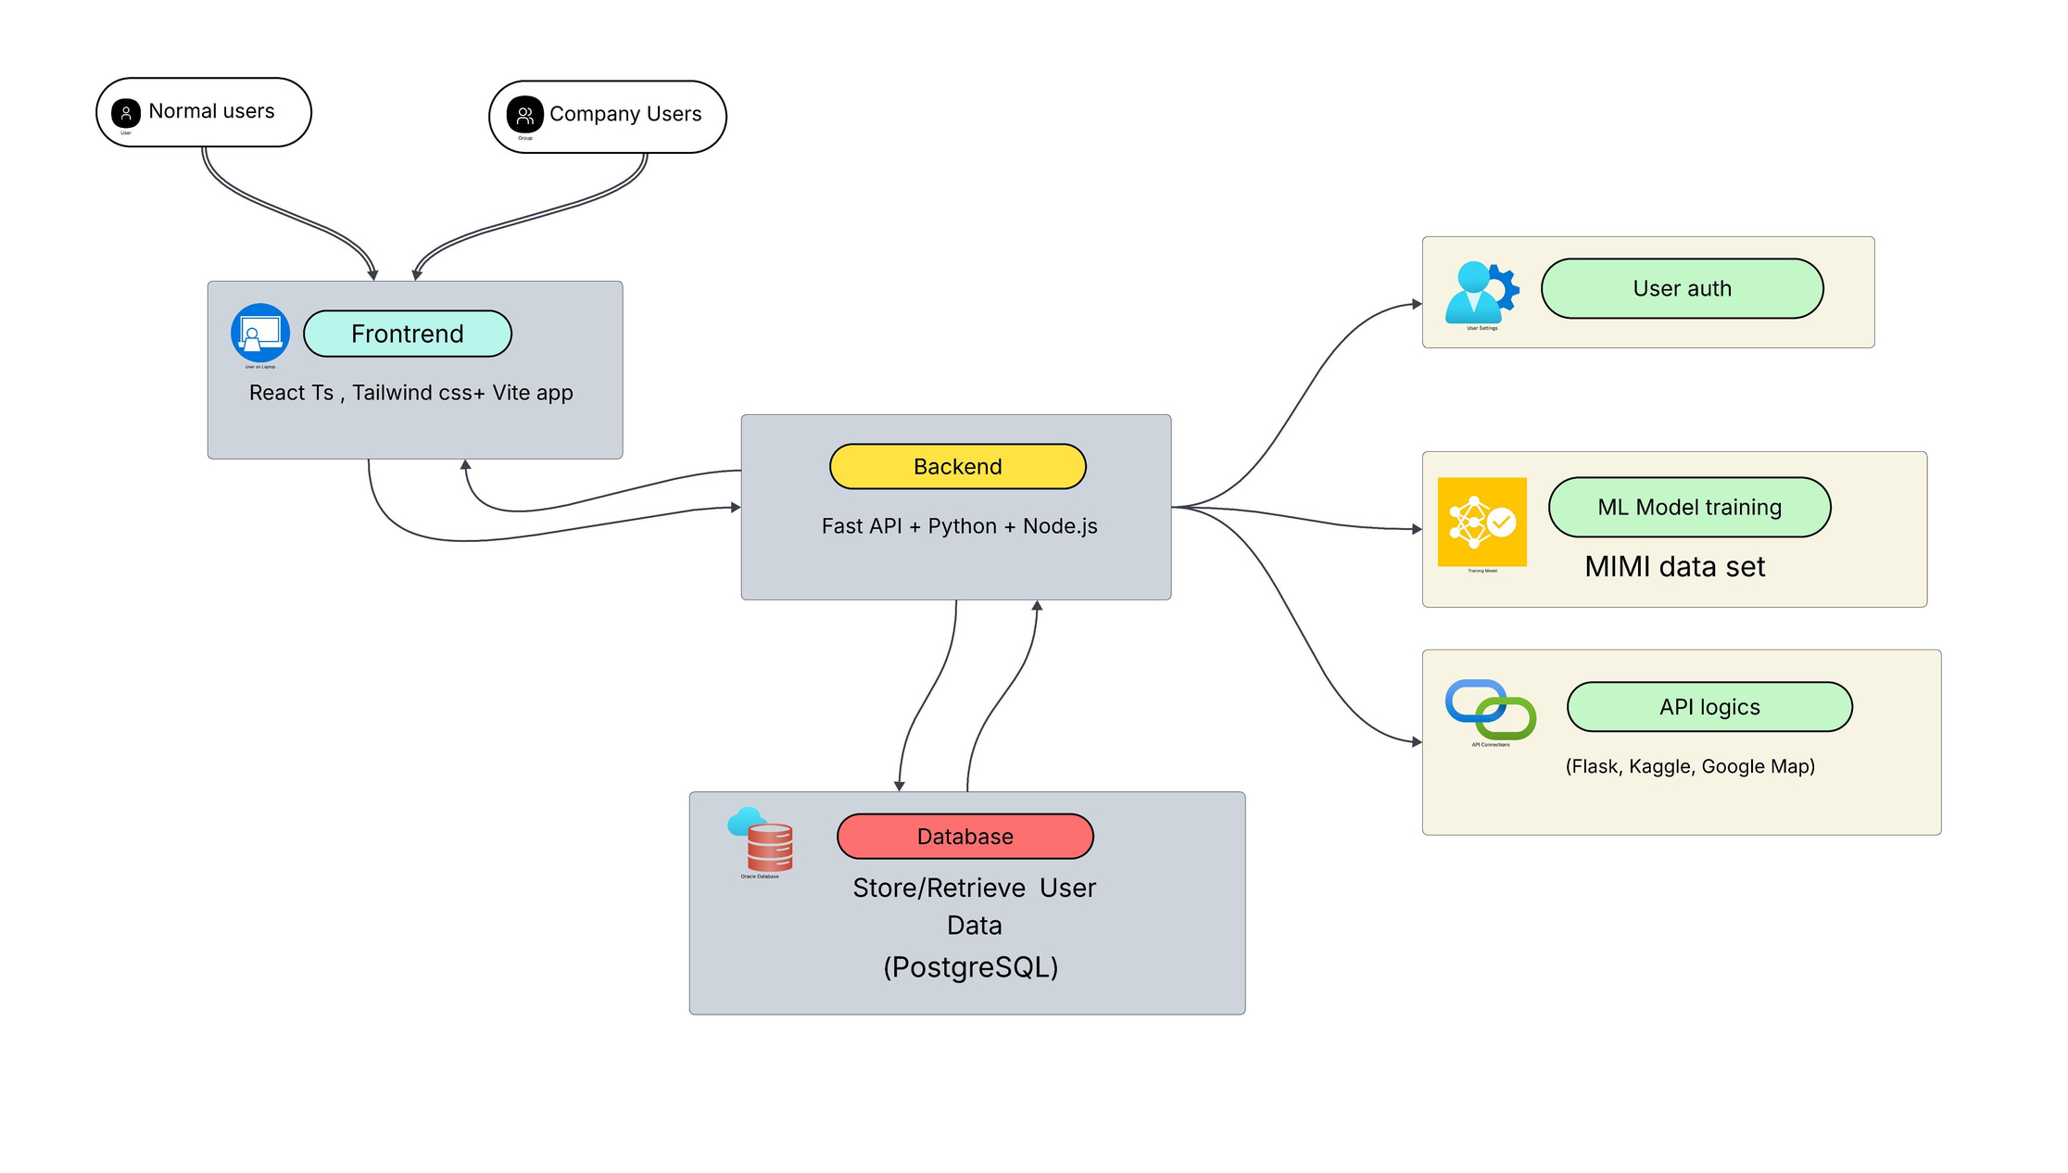
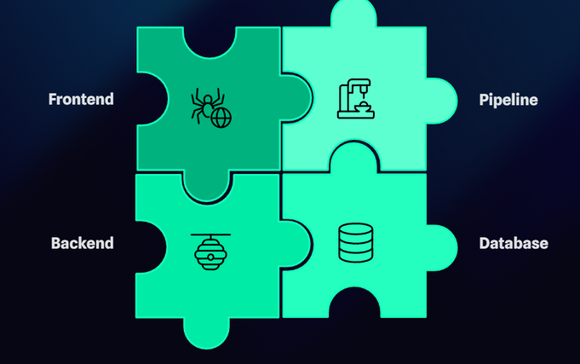
INVICTUS
SYSTEM
ARCHITECTURE
(HIGH-LEVEL)

Slide 7
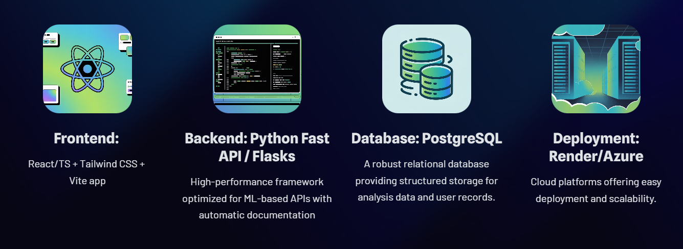
INVICTUS
TECHNOLOGY
STACK

Slide 8

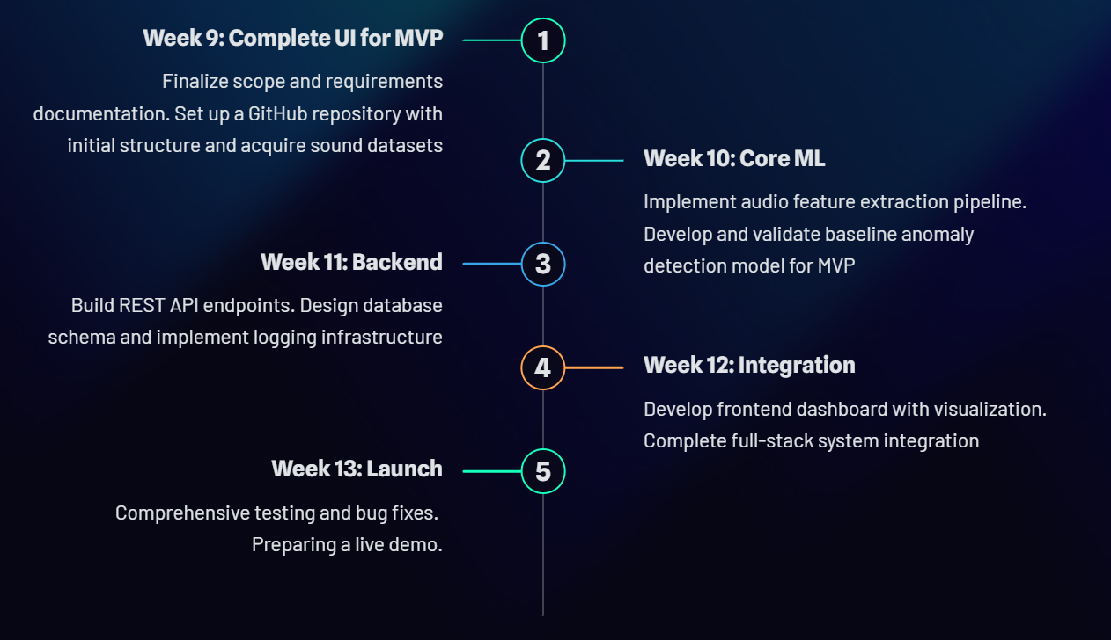
PROJECT
TIMELINE
INVICTUS

Slide 9
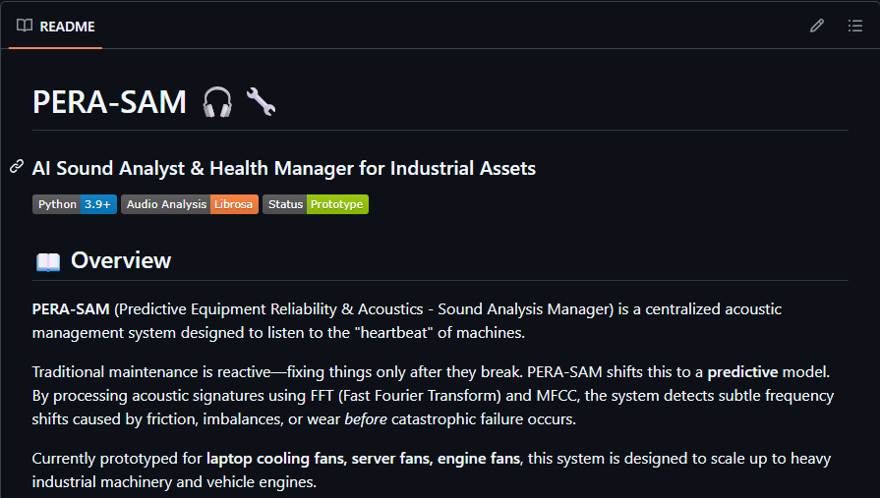

INVICTUS
BIG THINGS
IN FUTURE
README.md file
So Team Invictus has a good vision for what the next step PERA-SAM can do!
Edge device and IoT deployment
Enterprise-grade security features
Real-time audio streaming analysis
... soon !
Click to GitHub Repo:
https://github.com/cepdnaclk/e22-co2060-PERA-SAM

Slide 10





Dileka
sandaruwan
Dhanushka
kavindaya
CN Portfolio
CN Portfolio
E/22/336
E/22/188
Pahan
prabash
CN Portfolio
E/22/396
Bhagya
karunanayake
CN Portfolio
E/22/184
PERA-SAM

