Slide 1




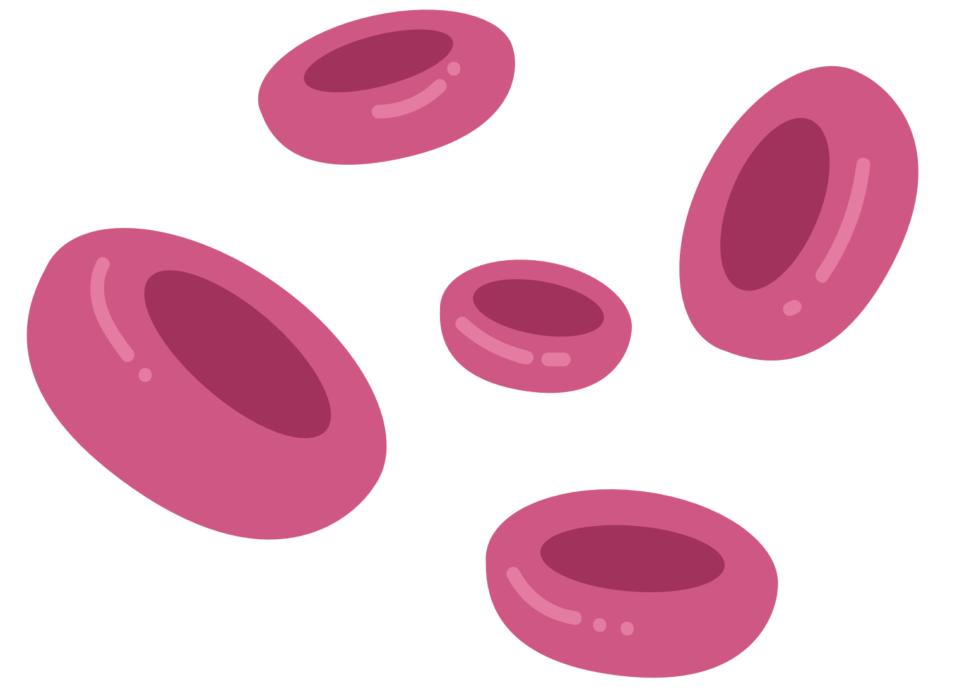


HOPEDROP
BLOOD BANK MANAGEMENT SYSTEM
2YP - DevDynamos Team

Slide 2
Project Background
  High blood wastage caused by manual tracking and inconsistent inventory control.
  Critical delays during emergencies when stock and compatibility info are unavailable.
  Fragmented management across multiple blood banks makes resource allocation difficult.

Slide 3
Target Users
  Blood bank staff
  Hospital staff & nurses
  Regular & emergency blood donors
  Healthcare operations Administrators
  Blood camp organizers

Slide 4
System Architecture & Tech Stack
🖥 Frontend
🗄 Database & Infra
⚙ Backend
React 19 + Vite 7
• React Router DOM v7 – SPA routing
• Axios – REST API communication
• Tailwind CSS + SCSS – Styling
• Framer Motion – Animations
• Recharts – Data visualisation
• Leaflet – Interactive maps
• html5-qrcode / qrcode.react
• JWT (jwt-decode) – Auth
• SweetAlert2 – Notifications
Django 5.2 + DRF 3.16
• Django REST Framework – APIs
• SimpleJWT – Token auth
• Django Jazzmin – Admin UI
• WhiteNoise – Static files
• django-cors-headers – CORS
• phonenumber-field – Phone
• django-rest-passwordreset
• Gunicorn – WSGI Server
• Coverage.py – Test coverage
SQLite (dev) / PostgreSQL
• Docker – Containerisation
• GitHub Actions – CI/CD
• Makefile – Task automation
Authentication
• JWT Access + Refresh tokens
• Token Blacklist on logout
• Role-based access control
• 5 user roles enforced

Slide 5
Project Summary
Completed
In Progress
✅ Custom JWT auth with role-based access (5 roles)
✅ Donor portal: registration, QR ID, eligibility, donation history
✅ Blood camp: event management, donor QR scanning, collection workflow
✅ Blood inventory: full CRUD with 4-stage approval workflow
✅ Hospital management & inventory dashboard
✅ Doctor blood request: multi-stage lifecycle (Pending → Fulfilled)
✅ Expiry alert system with automated daily checks
✅ Lab / Staff dashboard with quality-check workflow
✅ Admin dashboard: analytics, charts (Recharts), hospital management
✅ Notification workflow system for donors
✅ Inter-hospital blood transfer tracking
✅ Dockerised deployment with GitHub Actions CI/CD
⏳ Email notifications
⏳ Production PostgreSQL migration
📊 Stats
• 136 Pull Requests
• 227+ Total Commits
• 4 Contributors
• 5 distinct user roles
• 15+ Django models

Slide 6
Challenges and Solutions
Real-time Expiry Alerts ✅ Needed automated detection of expiring blood units
JWT Token Management ✅ Implemented token blacklisting + rotating refresh tokens with 15-min access token lifetime
Blood Lifecycle Complexity ✅ CampBloodCollection bridging model with explicit status state machine

Slide 7
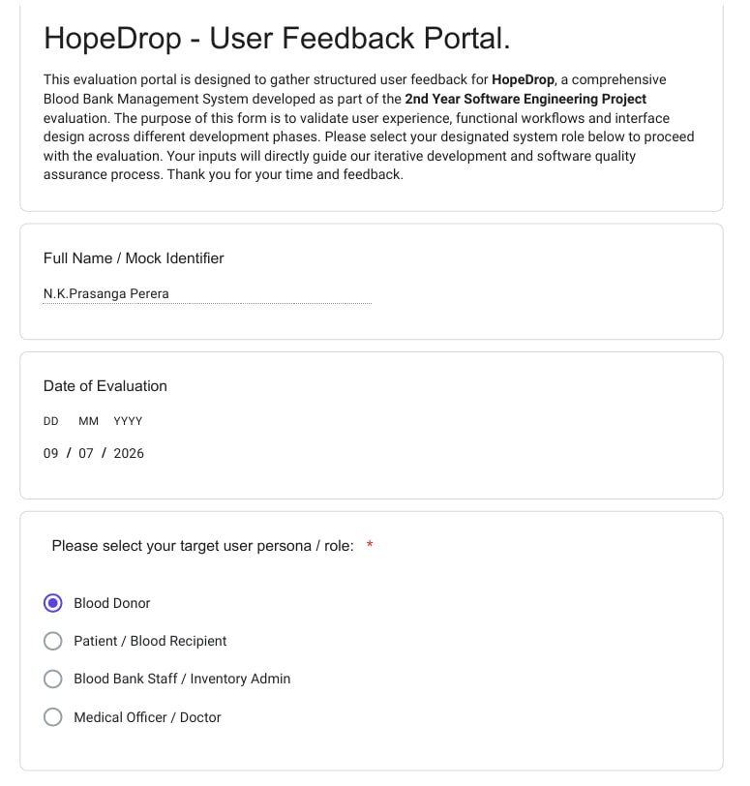
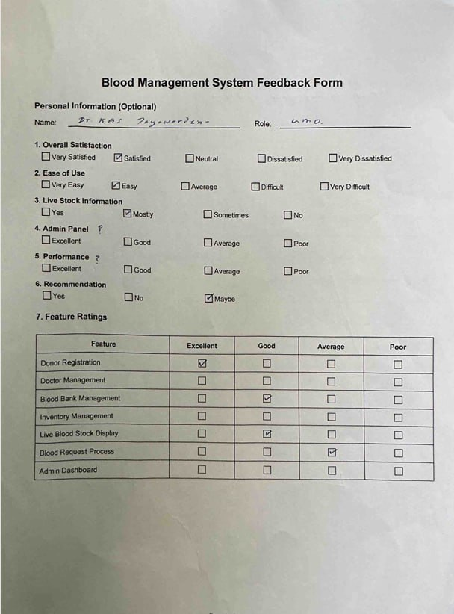
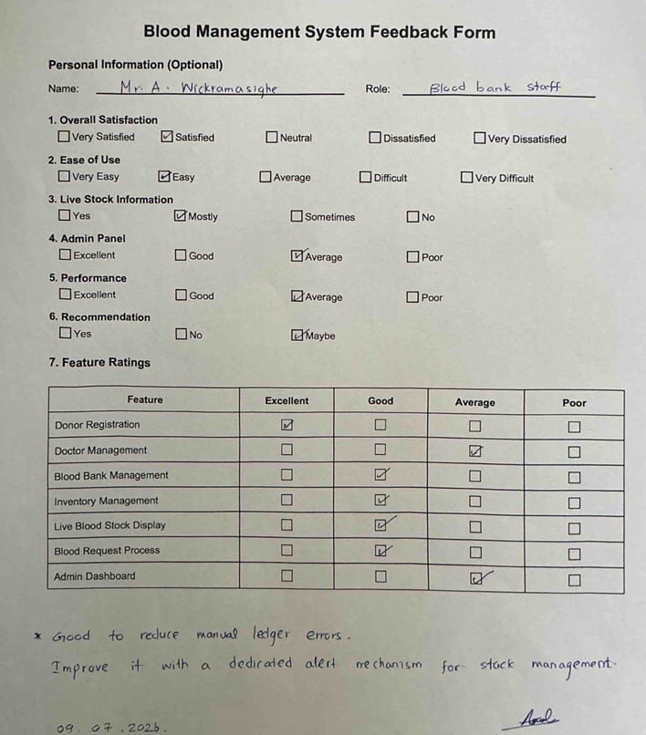
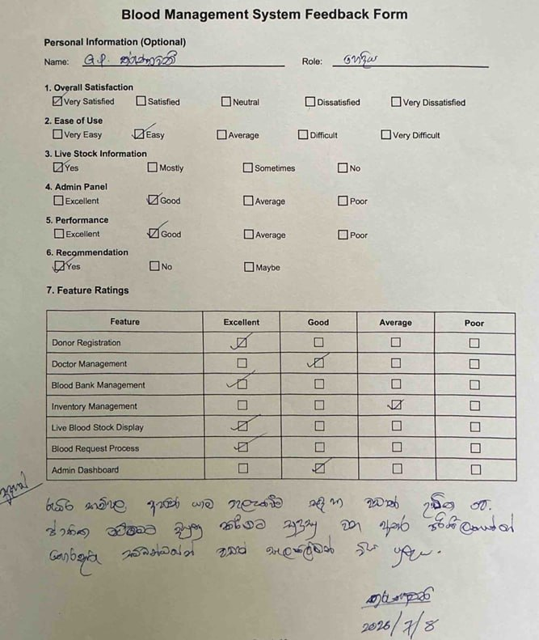
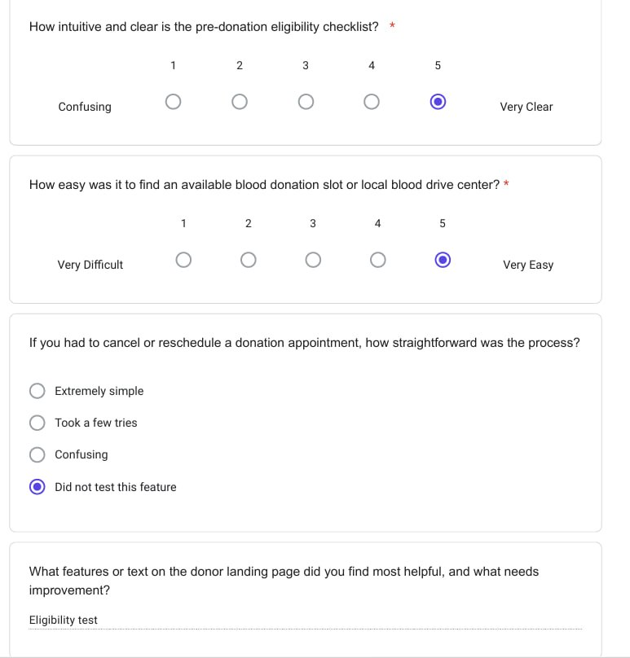
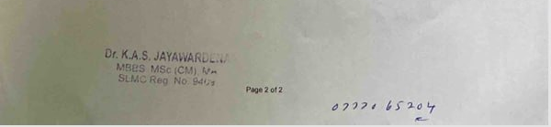
Customer Feedback

Slide 8
How Feedback Shaped Our System
🩸 Donor Feedback
🏥 Doctor Feedback
Users wanted to see eligibility countdown → Added '90-day rule' eligibility checker with next-donation-date display
Requested QR code for easy camp check-in → Implemented UUID-based QR ID per donor
Wanted history of past donations → Built full donation history with certificate ID
Doctors needed priority levels on requests → Added NORMAL / HIGH / CRITICAL urgency flags
Wanted status tracking in one place → Built request tracking dashboard with live status updates
🔬 Staff Feedback
👑 Admin Feedback
Staff requested audit trail for inventory changes → Implemented 4-stage approval with reviewer FKs + notes
Needed alerts for near-expiry blood → Built ExpiryAlert model with 7-day and 3-day thresholds
Admin needed cross-hospital visibility → Implemented National Inventory Dashboard with Recharts
Wanted camp-to-hospital blood tracking → Added camp destination hospital and transit lifecycle
devdynamos

Slide 9
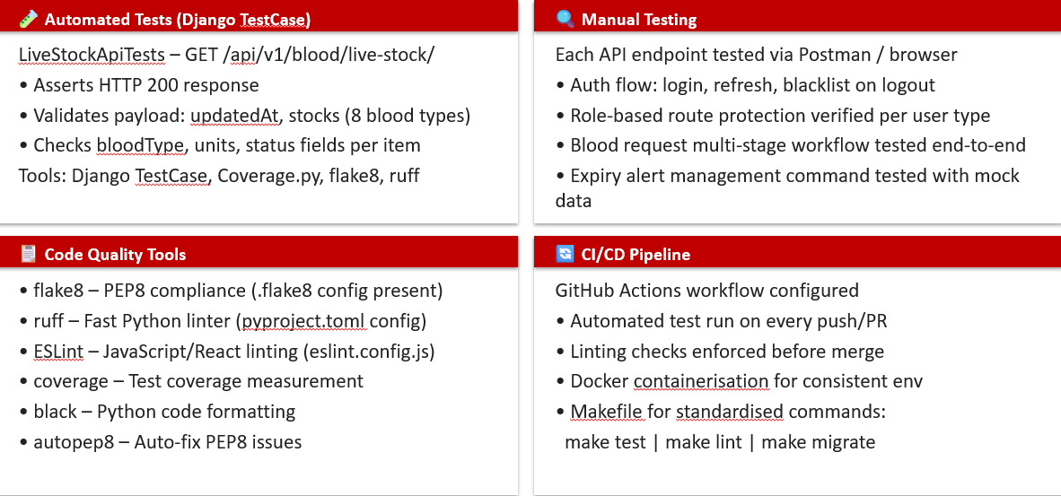
Testing Strategy & Evidence

Slide 10
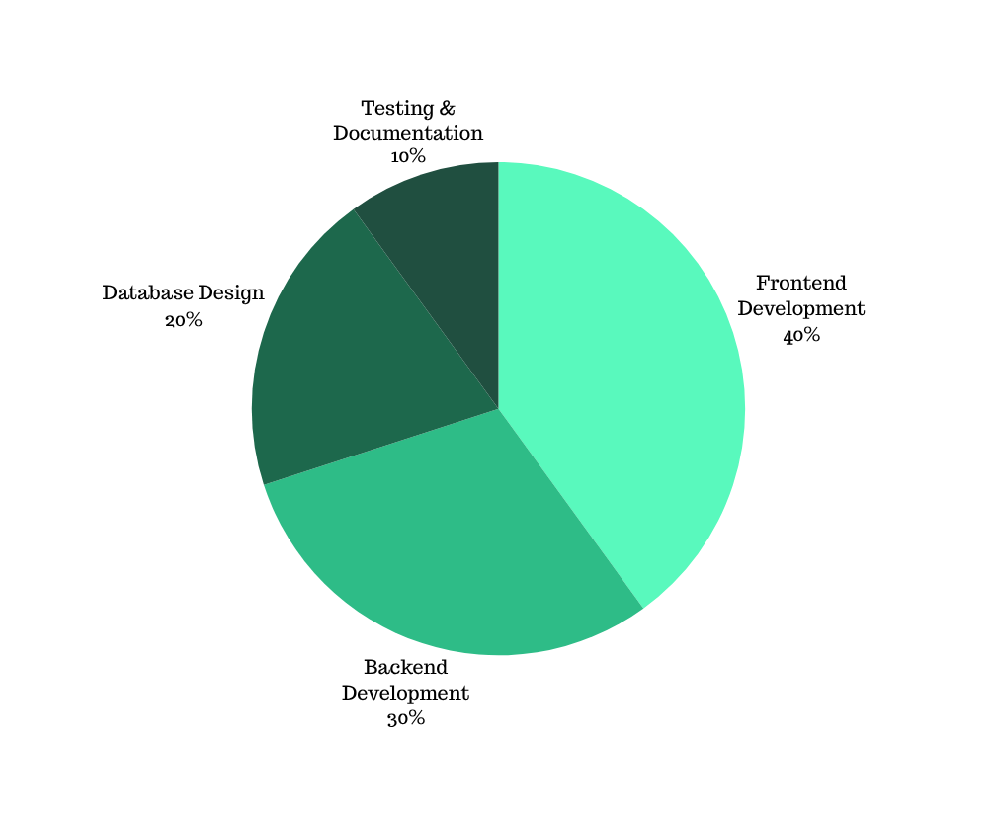
Collaboration
Evidence
  Total commits - 227
  Closed Issues - 21
  Pull Requests - 115
  Code Reviews - 80
  Active Contributors - 4

Slide 11
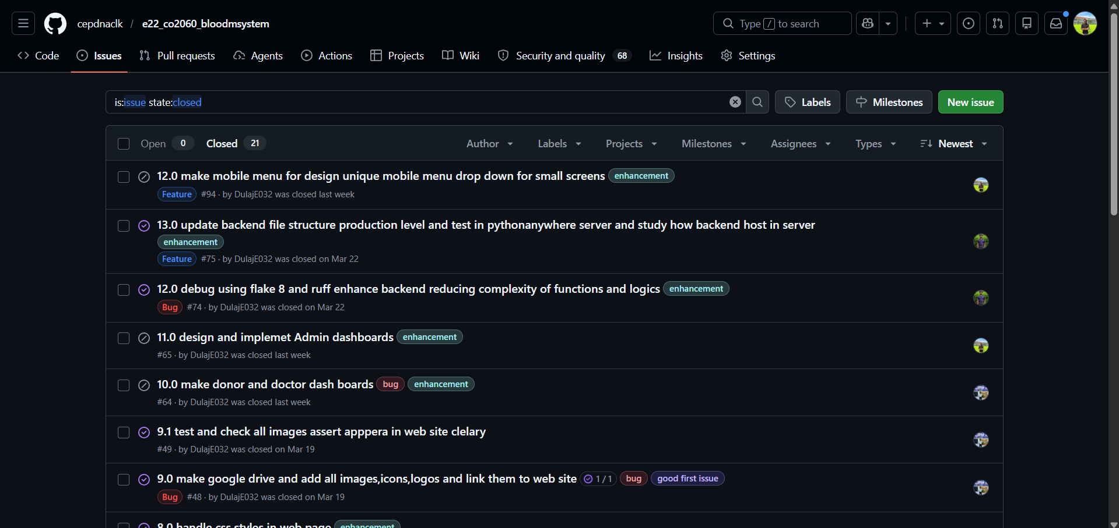
GitHub commit history
https://github.com/cepdnaclk/e22_co2060_bloodmsystem/issues?q=is%3Aissue%20state%3Aclosed

Slide 12
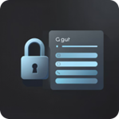


Live Demonstration

Slide 13
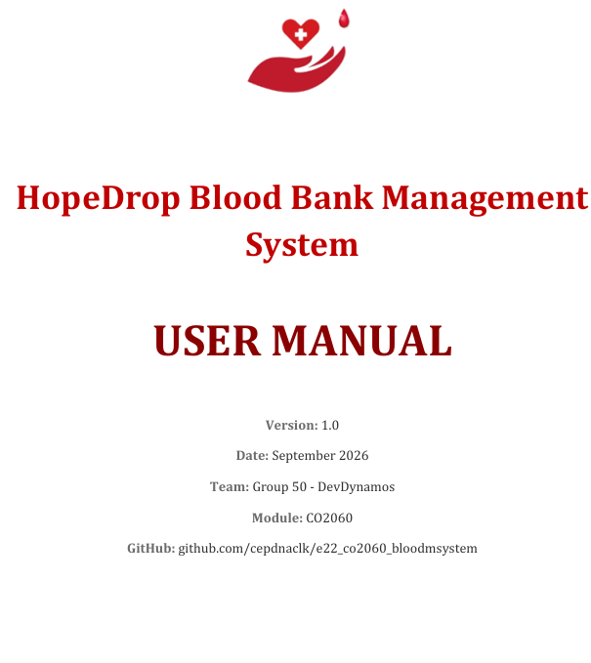
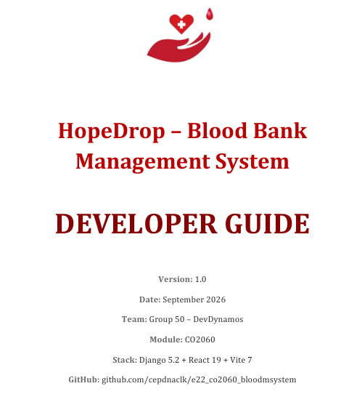
Deployment & Professional Deliverables
📖 User Manual
🛠 Developer Guide
E - Portfolios
  https://www.thecn.com/GS896
  https://www.thecn.com/DA1139
  https://www.thecn.com/SK2527
  https://www.thecn.com/HW688
🌐 Project Page
💻 GitHub Repository - cepdnaclk/e22-co2060-bloodmsystem

Slide 14
Thank You

