Slide 1
OrthoFlow
Digitization and workflow automation
of orthodontic case records
CO2060 Milestone 4 evaluation
E23G20
G.N.N.N. Madusanka E/23/214
S.A.A. Upek E/23/407
D.J. Thotagamuwa E/23/403
01
Notes:
20 seconds. Introduce E23G20 and the clinical record problem. The full evaluation allows ten minutes including demonstration. Main talk target is seven minutes with approximately three minutes for the demo. Sources: user project brief and docs/data/index.json. Team roster is confirmed from the project, but individual contribution attribution needs team confirmation.

Slide 2
The clinical problem and target users
Paper and fragmented records
Who uses OrthoFlow
History, examination findings and radiographs can become separated.
Repeated typing and manual follow-up make longitudinal care harder to track.
Staff and clinicians manage records and appointments.
Students read assigned cases.
Administrators manage accounts.
Patients receive email reminders. A dedicated patient-login role remains outside the current implementation.
02
Notes:
40 seconds. Explain the context from the supplied project brief: Department of Community Dental, Faculty of Dental Sciences, working with Dr. HSK Ratnatilake and her team. This is project context, not a claim of signed customer acceptance. Explain the users without inventing a patient portal.

Slide 3
Completion against the original plan
Original requirement | Current implementation
Digital patient records | Staged registration and structured clinical examination
Radiographs in the patient folder | Patient-linked image uploads and protected retrieval
Trace patient history | Activity history and linked clinical record revisions
Upcoming appointment reminders | Email-only scheduler, delivery status and manual retry
Additional workflows: clinician scheduling, student access, consent evidence, retention and discharge.
03
Notes:
45 seconds. All four requested functional areas exist in the implementation. Distinguish implemented features from clinical deployment acceptance. Sources: backend routes, shared field definitions, clinical workspace, reminder service, and docs/testing/results.md. SMS was removed at project request.

Slide 4
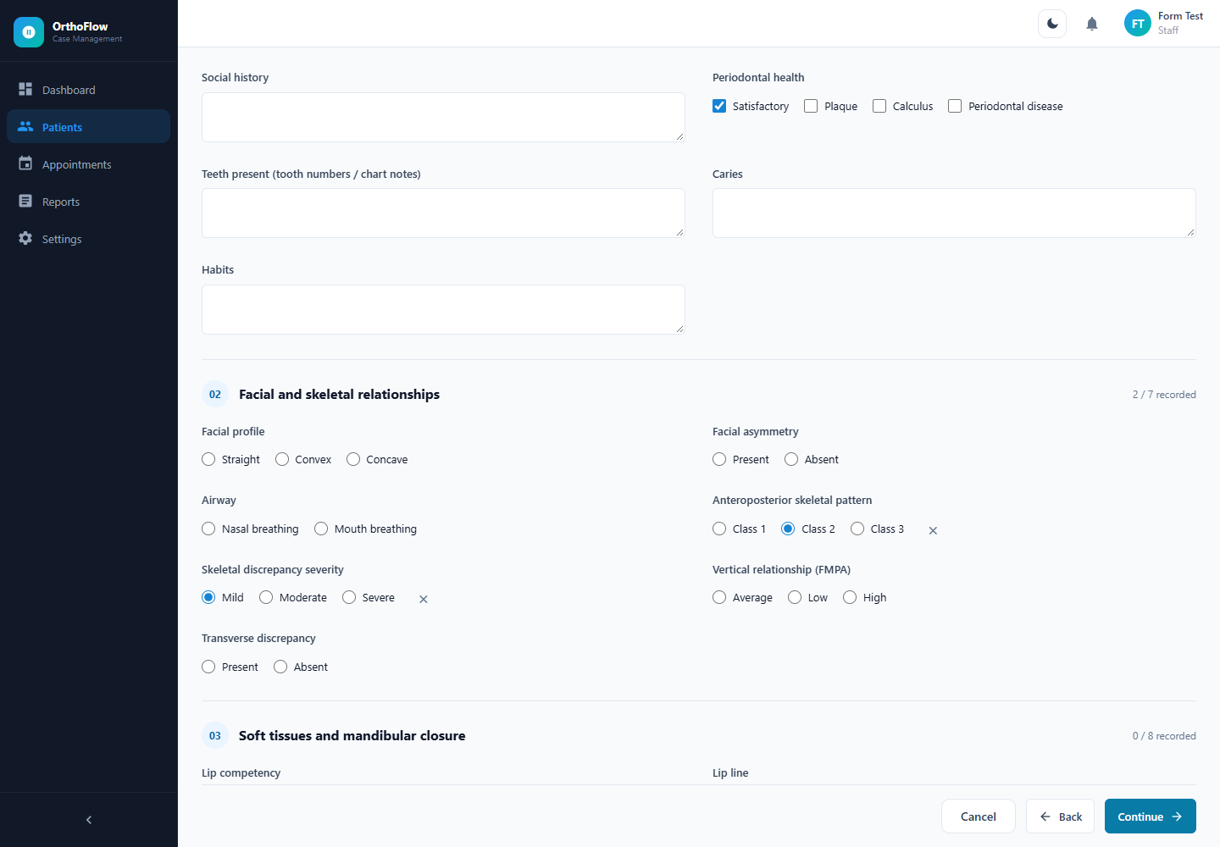
Structured clinical records
Less repeated typing
Selectable clinical findings
Conditional fields
Validated measurements
Traceable revisions
Test screenshot with fictional data
04
Notes:
30 seconds. Walk through the seven examination topics and conditional choices. The image is from a mocked Playwright test using fictional records. Mention that clinical treatment revisions retain prior versions. Sources: code/shared/caseHistoryFields.json, code/frontend/src/ClinicalWorkspace.jsx, docs/testing/evidence/runs/2026-09-24T18-15-06-097Z-ui/case-history-check/1440-light.png.

Slide 5
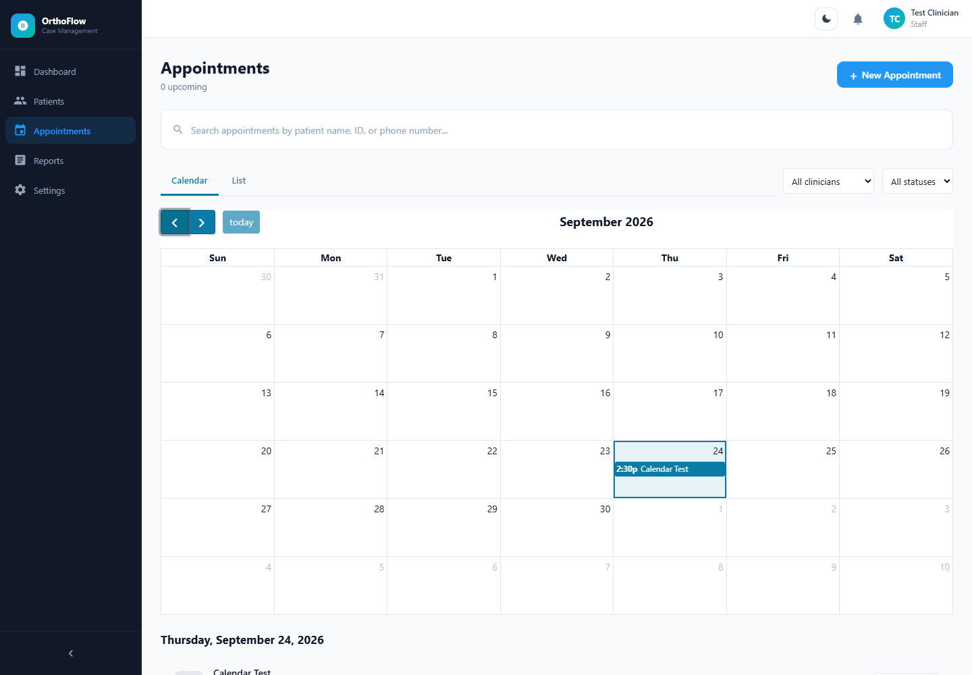
Appointment reminders
24 hour reminder window
Default scan interval: 5 minutes
Patient and clinician emails
Delivery status and panel notifications
Cancelled or completed cases excluded
The backend must remain running. SMTP acceptance does not prove inbox receipt.
05
Notes:
35 seconds. Explain scheduler startup scan and default five-minute polling. A future eligible appointment within 24 hours can be processed. A late booking cannot provide a full day of notice. Assigned clinician and patient emails are separate delivery targets. Backend uptime and SMTP configuration are required. Sources: appointmentReminderService.js and emailService.js. Screenshot contains fictional data.

Slide 6
Engineering challenges and resolutions
Challenge | Implemented response
Complex paper examination form | Shared field definitions and conditional selections
Conflicting appointment bookings | Server-side overlap checks and transaction coordination
Duplicate automatic reminders | Per-recipient delivery state and retry behavior
Database administration and persistence | PostgreSQL storage with Prisma schema migrations
Remaining risk: external email delivery and database persistence are not one atomic transaction.
06
Notes:
40 seconds. Explain how each implementation choice addresses the problem without claiming benchmarks. PostgreSQL is the database and Prisma remains the ORM. Sources: prisma/schema.prisma, shared clinical field definitions, appointmentRoutes.js, appointmentReminderService.js.

Slide 7
Feedback and resulting changes
Recorded project request | Change in the application
Reduce typing during registration | Checkboxes, radio options and numbered clinical sections
Remove unwanted SMS features | Email-only reminder workflow
Improve navigation and appearance | Patient tabs, staged forms and synchronized themes
Customer evidence still needs confirmation
Attach a dated clinician note, message or usability record before attributing these changes to customer feedback.
07
Notes:
35 seconds. These changes are traceable to requests in the project conversation. Do not describe them as direct clinician feedback unless dated meeting notes or messages support that attribution. The original paper form informed field organization. A verified customer-feedback artifact must be added before claiming customer acceptance.

Slide 8
Team collaboration evidence
Git commit author | Selected contribution | Date / commit
Nirod Nikeshala | Add frontend and backend | 02 May 2026 / 4b0e22c
SAAnudaUpek | Student dashboard and patient list | 03 May 2026 / 209f707
Damuthu Thotagamuwa | Update backend and frontend | 03 May 2026 / 1fe6eda
Shared repository and individual portfolios
github.com/cepdnaclk/e23-co2060-OrthoFlow
Portfolios: thecn.com/SU528 | DT965 | GM772
08
Notes:
35 seconds. Public GitHub history retrieved from https://api.github.com/repos/cepdnaclk/e23-co2060-OrthoFlow/commits on 25 September 2026. Selected commit authors and messages demonstrate activity, not full ownership. Sources: https://github.com/cepdnaclk/e23-co2060-OrthoFlow/commit/4b0e22cba8ff0792f0ec0d18bd3a3b5922dc8189 ; https://github.com/cepdnaclk/e23-co2060-OrthoFlow/commit/209f707725648461fe17af29d1baa9c2ce886b80 ; https://github.com/cepdnaclk/e23-co2060-OrthoFlow/commit/1fe6edaf025d7a7f54392cedd1c4b1ad442da388 . Team-provided portfolio links: https://www.thecn.com/SU528 ; https://www.thecn.com/DT965 ; https://www.thecn.com/GM772 . Portfolio content could not be verified. The latest public commit returned was 06fd5f6, 3 May 2026; September local testing is separate evidence. Suggested speaking split: background, implementation, testing. Do not infer equal effort from commit counts.

Slide 9
Testing approach and tools
Level | Tools | What it checks
Unit | Node test runner and assert | Validation, reminders and test DB guard
API integration | Express, Prisma, PostgreSQL | Persistence, permissions and conflicts
Browser | Playwright with Edge | Registration, clinical workflows and calendar
Build and manual | Vite and recorded checklist | Compilation and planned human acceptance
Each runner invocation saves timestamped logs and a result summary. Browser runs also save screenshots.
09
Notes:
40 seconds. Explain layers and their limits. Unit tests mock Prisma and email. Browser tests intercept APIs and therefore do not prove end-to-end database behavior. API integration scripts require a separate test database. Sources: scripts/run-tests.cjs and docs/testing/test-plan.md.

Slide 10
Verified automated outcomes
16
6
unit tests passed
browser viewport scenarios passed
Check | Recorded outcome
Registration and clinical workflow | Passed at desktop and mobile sizes
Calendar filters, retry and themes | Passed at desktop and mobile sizes
Production build | Passed with bundle-size warning
API integration functionality | Not run in this verification
Verified run: 24 September 2026 UTC. Browser checks use mocked APIs.
10
Notes:
40 seconds. Source: docs/testing/results.md and run logs from 24 September 2026 UTC. Unit tests: 16 passed, zero failed. Three browser scripts pass at 1440 and 390 pixels with both themes, making six viewport scenarios, not six unit tests. Build passes with a bundle-size warning. Database integration functionality was not executed during this verification because no separate test database was configured.

Slide 11
Bug resolution and regression evidence
Observed issue | Fix | Retest
Calendar failed to render | Aligned FullCalendar package versions | Calendar suite passed
Crowded mobile heading and hidden event title | Wrapped heading and adjusted event layout | 390 px regression passed
Saved automated evidence
PASS 1440px: calendar, filters, navigation, list, retry, themes, overflow.
PASS 390px: calendar, filters, navigation, list, retry, themes, overflow.
11
Notes:
35 seconds. Sources: docs/testing/bug-log.csv and latest UI run 03.txt. The prior FullCalendar error was DayTableView constructor error caused by mixed major package versions. Fix aligned React, daygrid and interaction packages to 6.1.21 and refreshed Vite cache. Mobile fix wrapped headings and used compact block events. Both viewport checks passed after changes. These logs are evidence, not fabricated customer reports.

Slide 12
Live demonstration and remaining checks
Live demonstration
Remaining verification
1. Register a fictional patient
2. Open examination and treatment history
3. Review a booking and reminder status
4. Show a saved automated test log
Dedicated database integration run
Clinician acceptance records
Controlled inbox delivery and restore check
Deployment security review
User Manual and Developer Guide are available for handover.
12
Notes:
25 seconds for transition, then allow approximately three minutes for live demonstration. Use fictional records. Show registration choices, patient tabs and appointments. Do not send mail to a real patient during evaluation. Open saved test evidence if asked. Outstanding before clinical deployment: configured integration run, clinician acceptance, controlled real inbox check, restore verification and security hardening. Sources: docs/testing/results.md and developer guide.

Slide 13
Evidence reference for the viva
Evidence | Location in the project
Unit and browser run summaries | docs/testing/evidence/runs/
Coverage scope and limitations | docs/testing/results.md
Manual testing records | docs/testing/manual-test-cases.csv
Bug fixes and regression references | docs/testing/bug-log.csv
Setup and handover documentation | docs/deliverables/
Coverage statement
caseHistory.js reached 100% measured coverage. The reminder source is excluded from that report.
13
Notes:
Appendix. Show only if asked. Unit coverage log reports 100% for caseHistory.js across line, branch and function measures. The VM-loaded reminder module is excluded and testEnvironment.cjs has 62.5% line coverage. Never describe this as whole-project coverage. Manual and acceptance cases remain Not run. Sources are the listed project files. The recorded safety rejection is expected behavior, not proof of integration functionality.

