Slide 1
Stereo Disparity & Relative Depth Estimation
Computer Vision Project • CO5430 • Group G03 • Project P12
University of Peradeniya • Department of Computer Engineering

Slide 2
01
1. Project Overview
What the system does and the core computer-vision problem
THE PROBLEM
KEY IDEA
Estimate 3D scene depth from a pair of rectified, horizontally displaced 2D images.
d(x,y) = xL − xR
Z(x,y) = f · B / d(x,y)
• Input: left image IL and right image IR
• Find corresponding pixels and compute disparity
• Convert disparity into metric depth when calibration is known
• Use normalized inverse disparity for relative depth when calibration is unavailable
Close objects → high disparity
Background → disparity approaches 0

Slide 3
02
2. Mathematical Formulation
Disparity and depth relationship
For rectified stereo images, corresponding points share the same vertical coordinate.
d(x, y) = xL − xR
Z(x, y) = (f · B) / d(x, y)
• d = disparity; Z = scene depth; f = focal length; B = stereo baseline
• Without calibrated f and B, normalized inverse disparity gives relative depth: Zrel ∝ 1/d

Slide 4
03
3. Modeling Architecture
Classical stereo matching benchmarked against RAFT-Stereo
INPUT
CLASSICAL CV
DEEP LEARNING
OUTPUT
Left Image
+
Right Image
StereoBM
Feature Extractor
Disparity Map
Fixed window
SAD + WTA
Very fast
1D Epipolar Correlation
Colorized Map
Multi-Scale ConvGRU
RMSE • AbsRel
StereoSGBM
8-path dynamic
programming
P1 / P2 penalties
Convex Upsampling
Bad-3px • EPE
32 recurrent iterations

Slide 5
04
4. Algorithmic Breakdown
How each method produces the disparity map
StereoBM
StereoSGBM
RAFT-Stereo
• Slides a fixed K×K window along scanlines
• Minimizes Sum of Absolute Differences (SAD)
• Winner-Take-All selects the best match
• Extremely fast (~6 ms CPU in the benchmark)
• Can create block artifacts and fail in textureless regions
• Semi-global matching approach
• Birchfield-Tomasi matching
• 8 independent 1D dynamic-programming paths
• Smoothness penalties P1 and P2
• Improves accuracy but is slower than StereoBM
• Multi-scale residual CNN feature extraction
• 1D epipolar correlation pyramid
• Multi-level ConvGRU refinement
• 32 recurrent iterations
• Learned convex upsampling preserves edges

Slide 6
05
5. Quantitative Benchmark
Middlebury 2021 — artroom1
Method
RMSE ↓
AbsRel ↓
Bad-3px ↓
Speed
StereoBM
42.18 px
0.2841
38.74%
~6 ms CPU
StereoSGBM
38.64 px
0.2378
30.23%
~28 ms CPU
RAFT Pre-trained
4.82 px
0.0142
5.89%
~85 ms GPU
RAFT Fine-Tuned
3.98 px
0.0091
4.46%
~85 ms GPU
Result: fine-tuned RAFT-Stereo gives the lowest error across the reported accuracy metrics.
BEST: RAFT Fine-Tuned

Slide 7
06
6. Built Interface
Gradio 5 web interface connected to the stereo-depth inference pipeline
USER FLOW
PRODUCT EXPERIENCE
• Upload the left and right stereo images
• Select the disparity method
• Configure available visualization / inference options
• Click “Compute Disparity”
• View the generated colorized disparity and statistics
• Responsive browser-based interface
• Drag-and-drop image uploads
• Colormap options for disparity visualization
• Interactive output instead of running notebook cells
• Designed for direct demonstration and evaluation

Slide 8
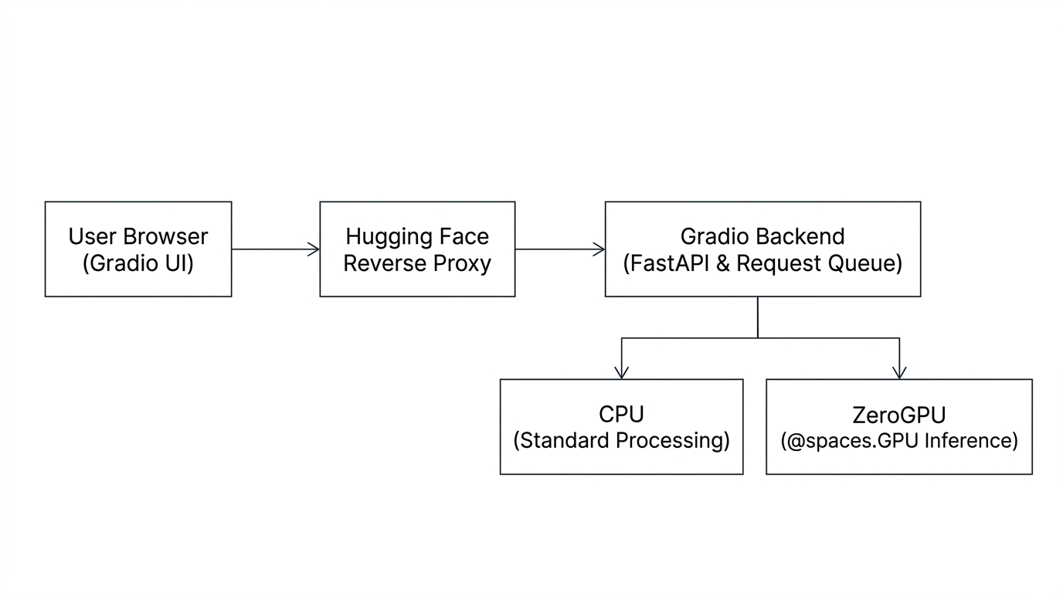
7. Hugging Face + Gradio Architecture
07
What happens behind the interface

Slide 9
11
Thank you

