Slide 1
CO5430 Image Processing & Computer Vision
Vehicle & Pedestrian Tracking in Video Sequences
M3: Prototype & Preliminary Results
M.R.A. Rahman (E/23/282) A. Piraveen (E/23/273) M.M.M.A. Nular (E/23/249) V. Thanush (E/23/392)
G07

Slide 2
Working Method & Implementation
Detection: YOLOv8n
Tracking: SORT Algorithm
• Architecture: CSP-DarkNet + PAN-FPN + Decoupled Head
• Pretrained on COCO (80 classes), fine-tuned on MOT16
• Input: 640×640 px (auto-resized from 1920×1080)
• Output: [x1,y1,x2,y2, confidence, class_id]
• Confidence threshold: 0.30 | NMS IoU: 0.45
• Classes trained: 0=pedestrian, 1=car
• Training: 50 epochs, batch=16, Google Colab T4 GPU
• Estimated training time: ~30 min on T4
• State vector: [cx, cy, aspect_ratio, height, vx, vy, va, vh]
• Kalman Filter: predicts next position using constant-velocity model
• Hungarian Algorithm: globally optimal detection-to-track matching
• IoU cost matrix: match only if overlap >= 0.30
• max_age=3: track survives 3 frames without detection
• min_hits=3: track only shown after 3 confirmed matches
• New detection with no match → new track ID assigned
• Self-contained implementation (no external sort package)

Slide 3
Preliminary Evaluation Metrics
Metric | Current Status | Initial Target Baseline | What it Means
mAP@50 (Detection) | 0.892 | 0.65 - 0.80 | Mean Average Precision at IoU=0.50
mAP@50-95 (Strict) | 0.579 | Target > 0.40 | Averaged over IoU thresholds (harder to score high)
Precision (Pedestrian) | 0.938 | Target > 0.70 | Fraction of predicted boxes that are correct
Recall (Pedestrian) | 0.809 | Target > 0.70 | Fraction of real pedestrians successfully found
Note: Validated on 1,062 frames (val split), 16,081 pedestrian instances. Results saved to /content/runs/detect/val

Slide 4
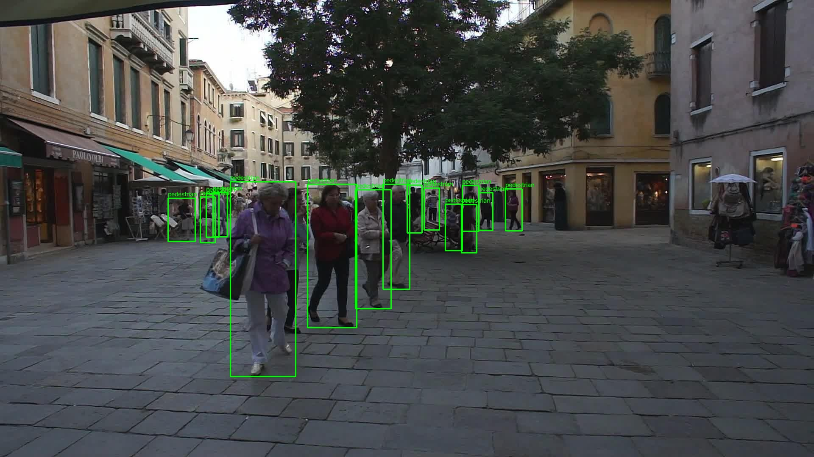
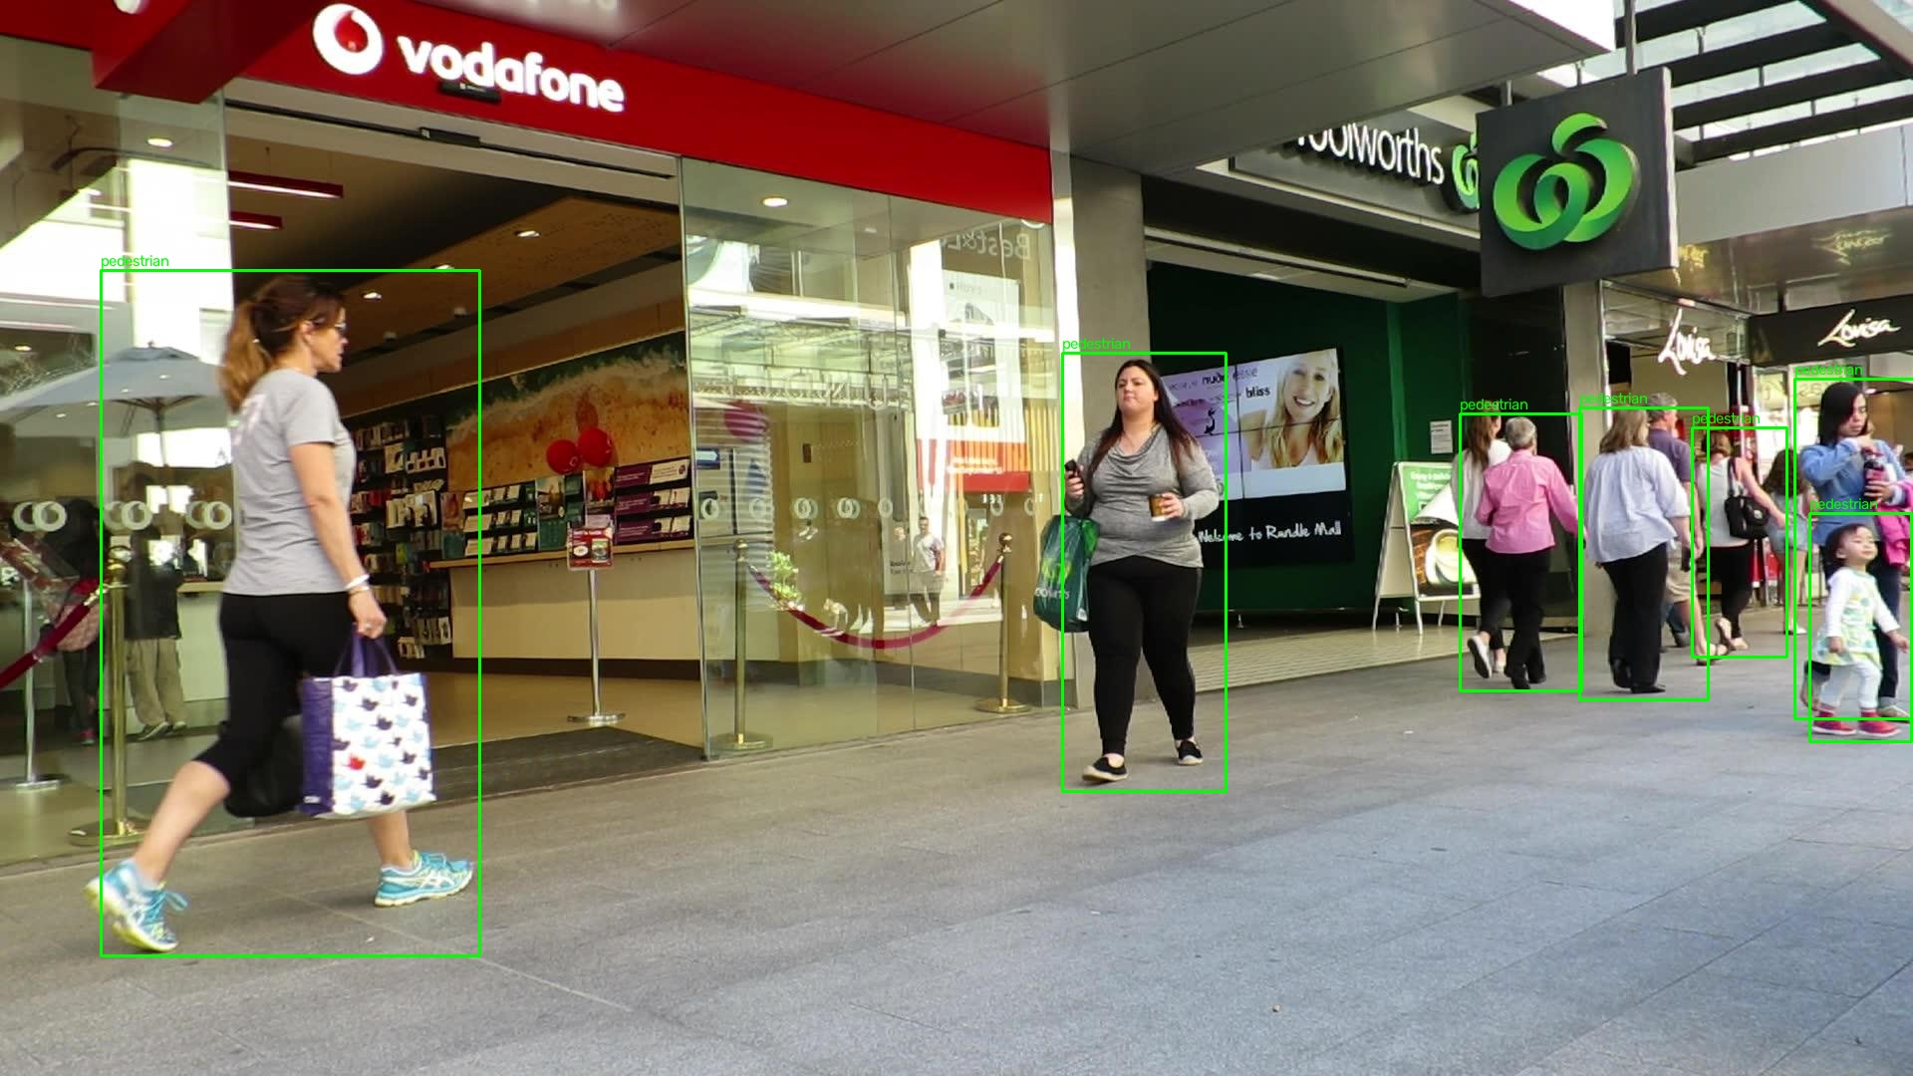
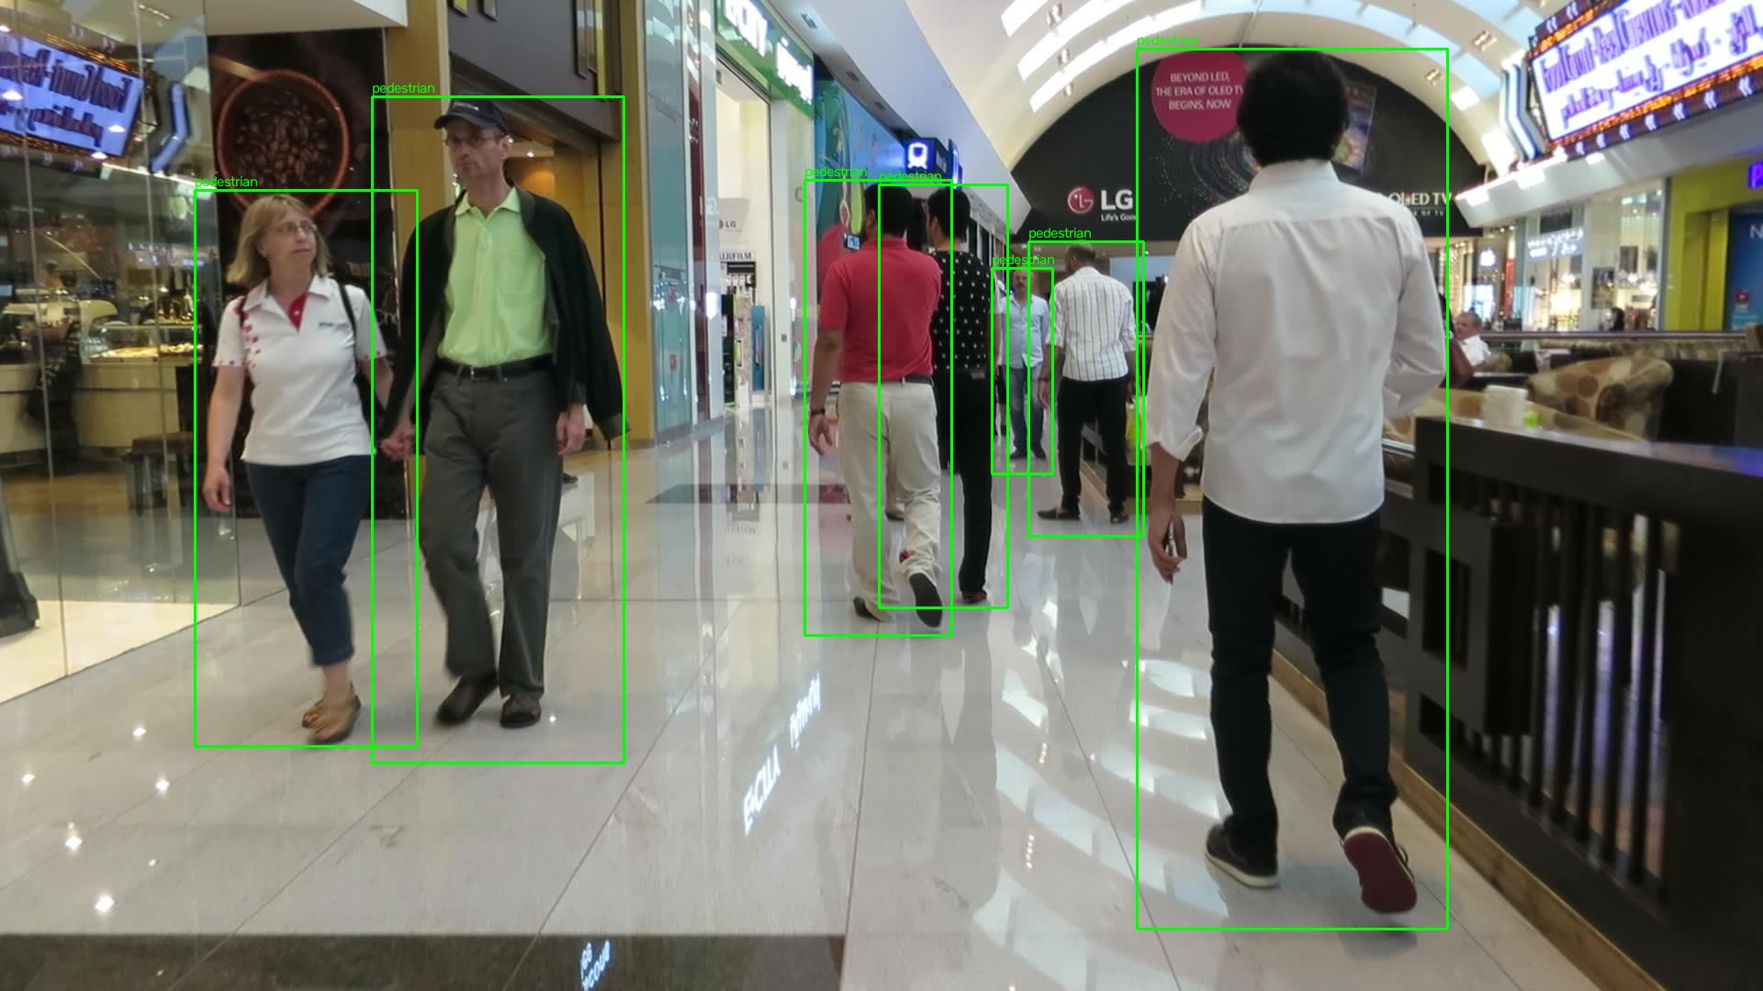
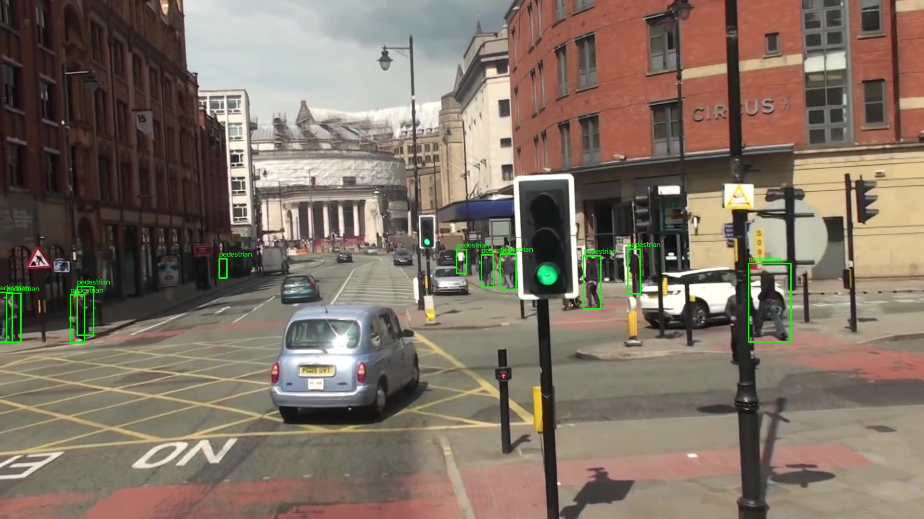
Qualitative Results
MOT16-02 (Venice plaza) – Dense crowd
MOT16-09 (Rundle Mall) – Mall Walkaway
MOT16-11 (Dubai Mall) – Indoor scene
MOT16-13 (UK street) – Outdoor+ vehicle

Slide 5
Failure Cases & Observations
Issue | Impact/ Fix
1. Zero Car Annotations: MOT16 is predominantly pedestrian. 0 car labels survived the visibility >= 0.3 filter. | • Impact: trained model detects pedestrians only car tracking not functional at M3 • Fix for M4: add supplementary data (e.g., UA-DETRAC vehicle dataset)
2. Occlusion Failures: Overlapping pedestrians cause merged boxes. SORT assigns new IDs after max_age frames. | • Impact: ID switches inflate the ID switch metric in MOTA • Fix for M4: DeepSORT adds appearance re-ID to match same person after occlusion
3. Small Distant Objects: YOLOv8n (nano) misses small targets (~10x10 px). | • Impact: false negatives on small targets, reducing recall • Fix: use YOLOv8s/m (larger model), or higher input resolution (1280px)
4. Temporal Split Gap: Last 20% of frames used for validation shifts scene content, which may slightly lower reported metrics compared to a random split. | Expected: slight metric drop vs. random split accepted trade-off

Slide 6
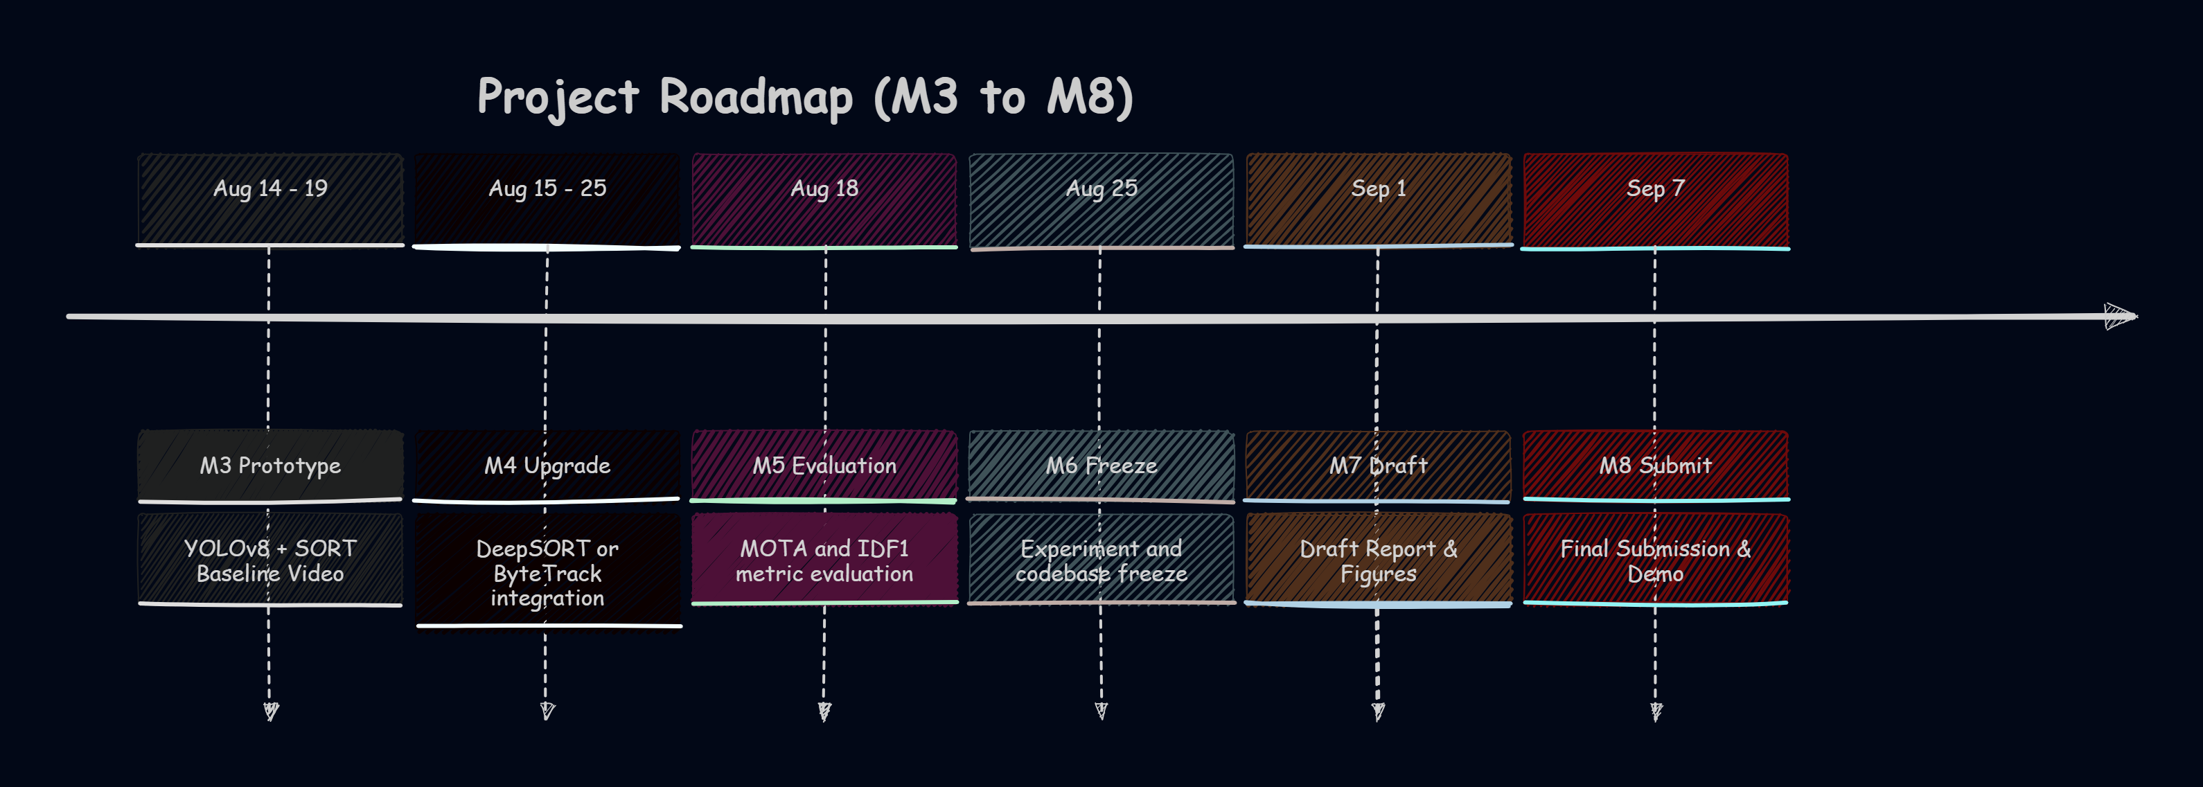
Planned Improvements & Next Steps

Slide 7
Repository Status & Summary
Git Commit History
M3 Deliverables Status
ae1e6f4
M3: YOLOv8+SORT tracking pipeline
Aug 14
[OK] sort_tracker.py
SORT (Kalman+Hungarian)
[OK] run_tracker.py
Full tracking pipeline
95d54b5
Updated progress report (M2 slides)
Jul 26
[OK] dataset_colab.yaml
Colab training config
[OK] Colab cells
8-cell training notebook
[WIP] best.pt
Trained model weights
b29aabc
Initial preprocessing scripts
Jul 26
[WIP] MOT16-02_tracked.mp4
Output tracking video
0fc9527
M2: MOT16 → YOLO preprocessing pipeline
Jul 26
Key Files in Repo
data/preprocessing/preprocess.py
data/preprocessing/verify_labels.py
src/tracking/sort_tracker.py
src/tracking/run_tracker.py
data/yolo_dataset/dataset_colab.yaml
ROADMAP.md
0d79b5e
Add project roadmap
Jul
9845b39
First commit
Jul

