Slide 1
CO5430 — Image Processing & Computer Vision
Vehicle & Pedestrian Tracking in Video Sequences
M3: Prototype & Preliminary Results
M.R.A. Rahman (E/23/282) · A. Piraveen (E/23/273) · M.M.M.A. Nular (E/23/249) · V. Thanush (E/23/392)
Group G07 | August 2026

Slide 2
Slide 1: Working Method & Implementation
Two-stage pipeline: YOLOv8n detection + SORT tracking
IMG
DET
BOX
TRK
OUT
Input Frames
→
YOLOv8n Detector
→
Bounding Boxes
→
SORT Tracker
→
Tracked Video
MOT16 JPEGs 1920×1080
Fine-tuned on 4,254 train frames
[x1,y1,x2,y2] conf ≥ 0.30
Kalman Filter + Hungarian Algo
Boxes + IDs per frame
Detection: YOLOv8n
Tracking: SORT Algorithm
• Architecture: CSP-DarkNet + PAN-FPN + Decoupled Head
• Pretrained on COCO (80 classes), fine-tuned on MOT16
• Input: 640×640 px (auto-resized from 1920×1080)
• Output: [x1,y1,x2,y2, confidence, class_id]
• Confidence threshold: 0.30 | NMS IoU: 0.45
• Classes trained: 0=pedestrian, 1=car
• Training: 50 epochs, batch=16, Google Colab T4 GPU
• Estimated training time: ~30 min on T4
• State vector: [cx, cy, aspect_ratio, height, vx, vy, va, vh]
• Kalman Filter: predicts next position using constant-velocity model
• Hungarian Algorithm: globally optimal detection-to-track matching
• IoU cost matrix: match only if overlap >= 0.30
• max_age=3: track survives 3 frames without detection
• min_hits=3: track only shown after 3 confirmed matches
• New detection with no match → new track ID assigned
• Self-contained implementation (no external sort package)
CO5430 – Group G07 | University of Peradeniya | August 2026

Slide 3
Slide 2: Preliminary Evaluation Metrics
YOLOv8n trained on MOT16 | mAP evaluated on validation split (1,062 frames)
0.892
0.579
0.938
0.809
50
mAP@50 (val, epoch 50)
mAP@50-95 (strict)
Precision (pedestrian)
Recall (pedestrian)
Epochs Completed
Training completed on Google Colab T4 GPU | Epoch 1 mAP50: 0.832 → Epoch 50 mAP50: 0.892 (converged well)
What These Metrics Mean
Training Setup & Actual Results
• mAP@50: mean Average Precision at IoU=0.50 (standard detection benchmark)
• mAP@50-95: averaged over IoU thresholds 0.50→0.95 (stricter — harder to score high)
• Precision: of all boxes our model predicted, what fraction were correct?
• Recall: of all real pedestrians in the image, what fraction did we find?
• High precision = few false alarms | High recall = few misses
• We aim for: mAP@50 > 0.65 for acceptable detection quality
Model:
YOLOv8n (nano)
Pretrained on:
COCO 2017
Fine-tuned on:
MOT16 train (4,254 frames)
Validation set:
MOT16 val (1,062 frames)
Epochs:
50 / 50 completed
Batch size:
16 | Image size: 640 px
GPU:
Google Colab T4
box_loss (ep50):
0.6501 (ep1: 1.388)
cls_loss (ep50):
0.3668 (ep1: 1.189)
mAP@50 achieved:
0.892 (target was > 0.65)
CO5430 – Group G07 | University of Peradeniya | August 2026

Slide 4
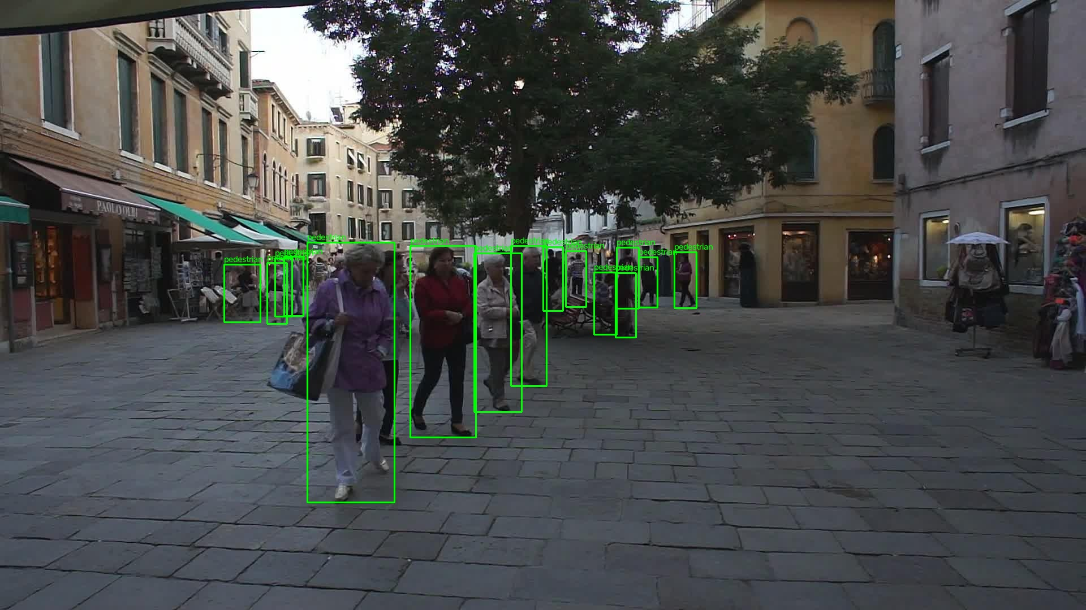
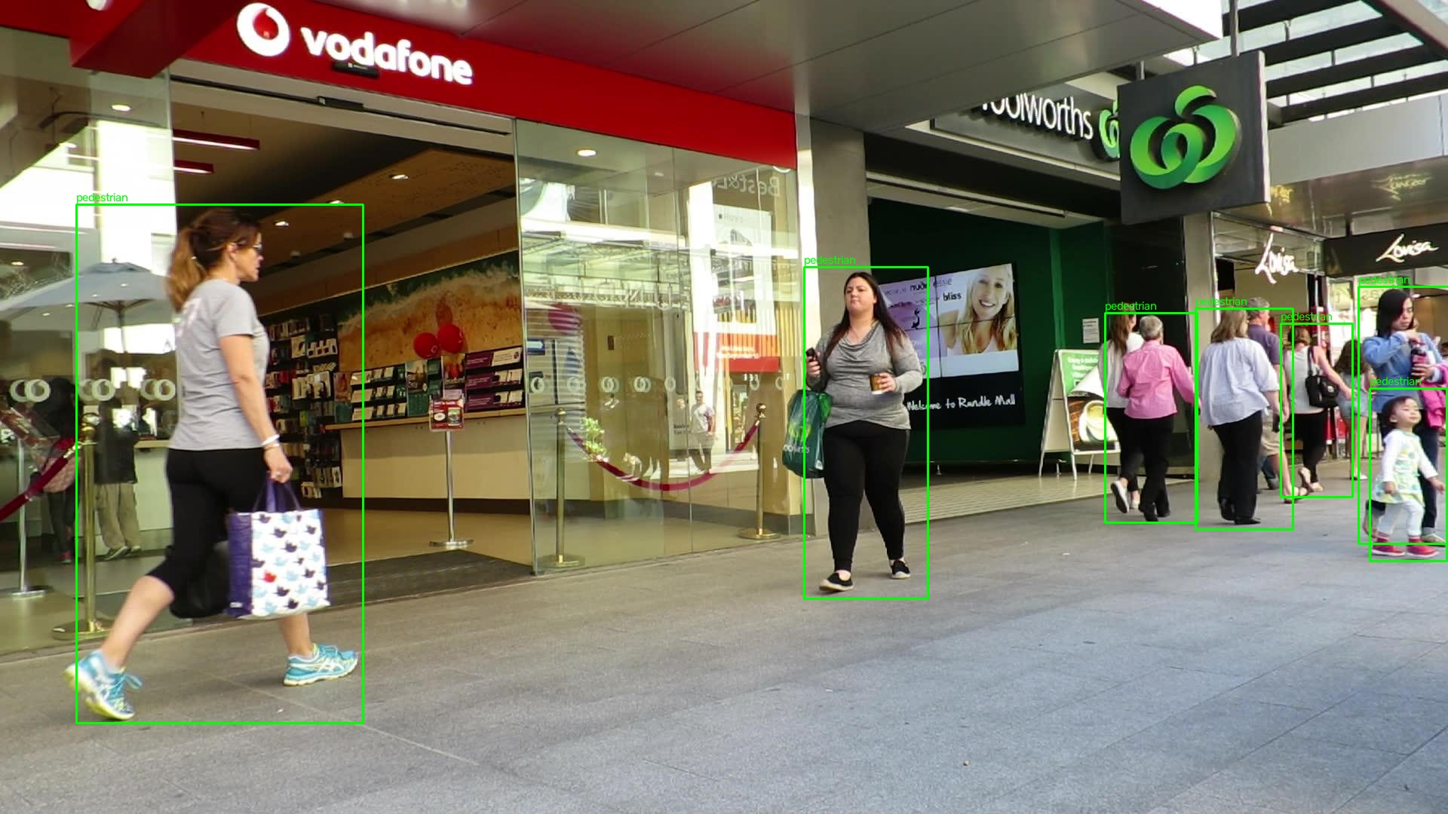
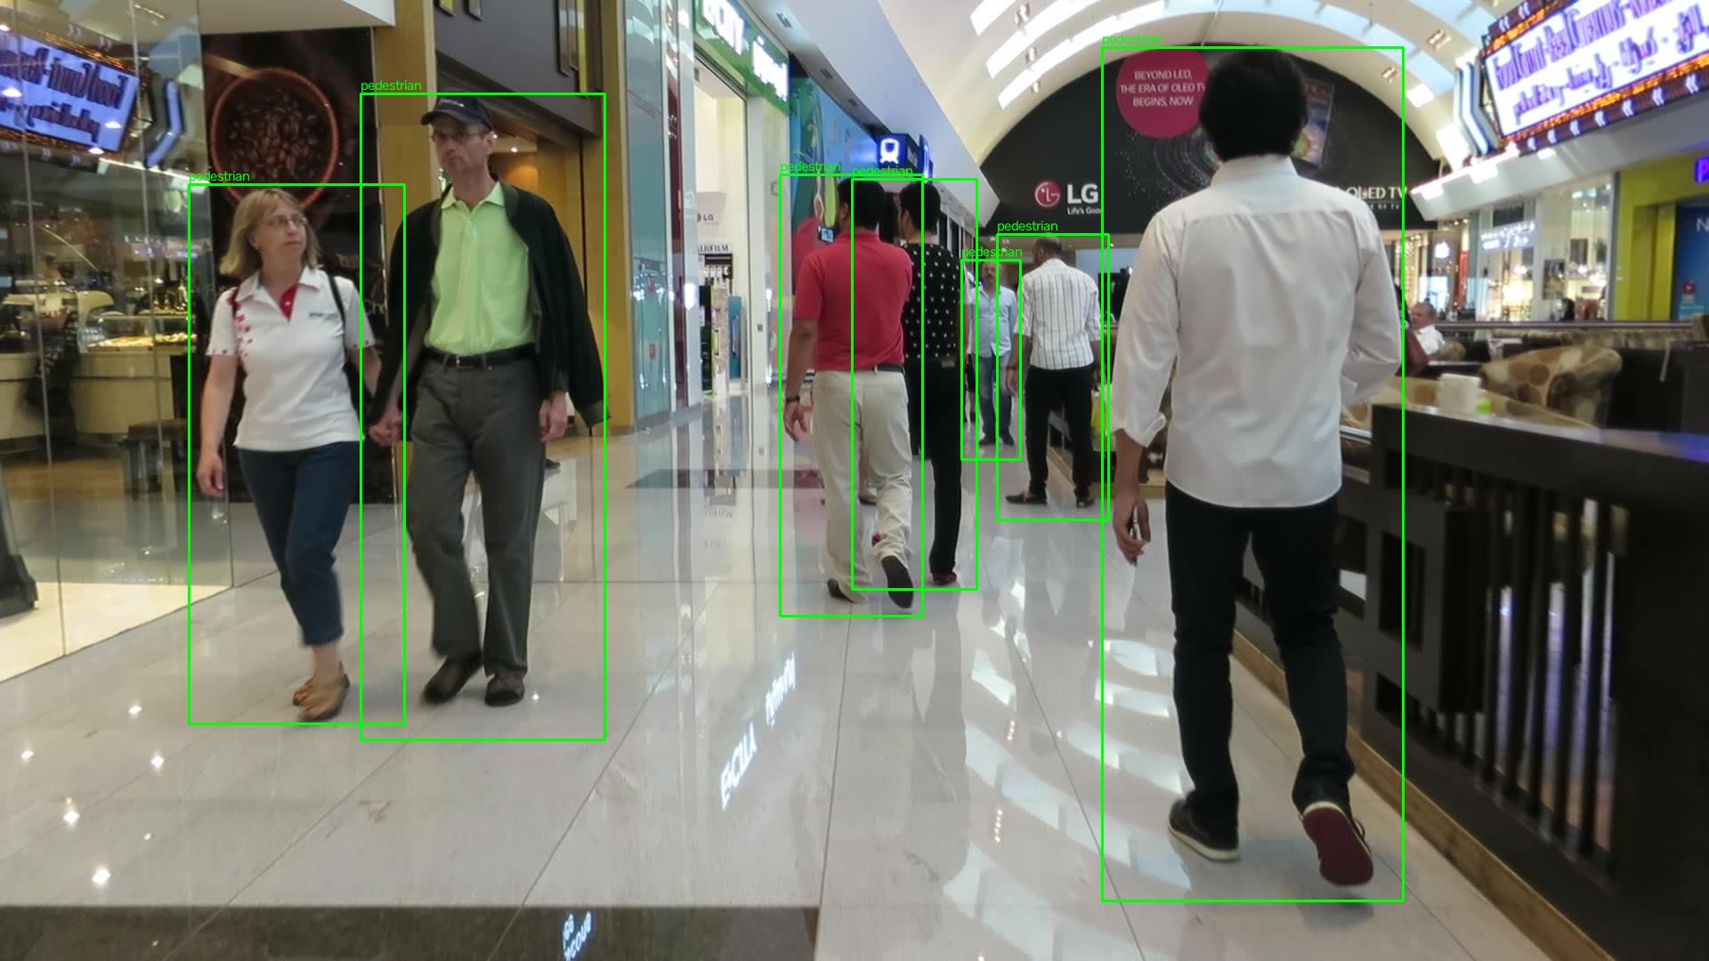
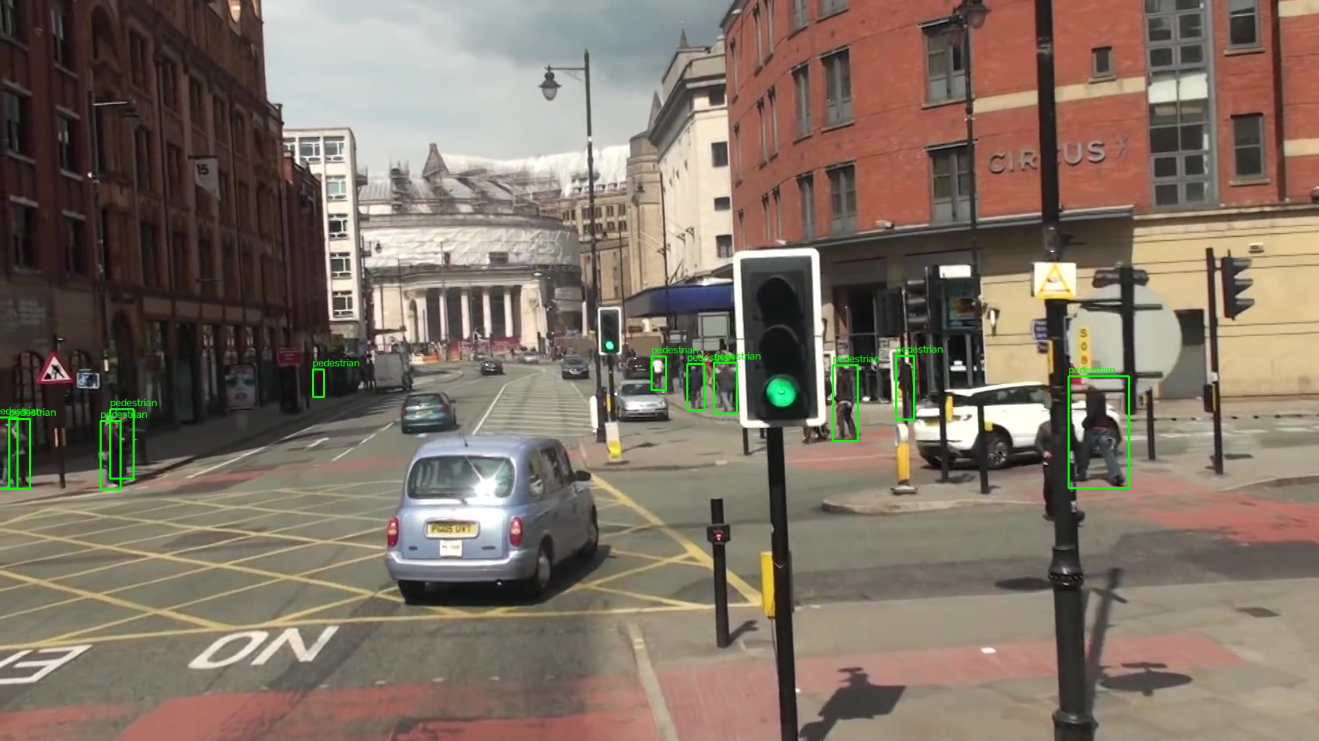
Slide 3: Qualitative Results
Ground-truth bounding boxes on MOT16 validation frames — visualised by verify_labels.py
Green boxes = ground-truth pedestrian annotations | Used to train YOLOv8n
MOT16-02 (Venice plaza) — dense crowd
MOT16-09 (Rundle Mall) — mall walkway
MOT16-11 (Dubai Mall) — indoor scene
MOT16-13 (UK street) — outdoor + vehicles
CO5430 – Group G07 | University of Peradeniya | August 2026

Slide 5
Slide 4: Failure Cases & Observations
Known limitations observed during data analysis and expected during tracking
1. Zero Car Annotations
2. Occlusion Failures
• MOT16 is predominantly a pedestrian dataset
• Car class (MOT16 id=3) exists but very few instances in our 7 sequences
• After applying visibility >= 0.3 filter: 0 car labels survived
• Impact: trained model detects pedestrians only — car tracking not functional at M3
• Fix for M4: add supplementary data (e.g., UA-DETRAC vehicle dataset)
• Pedestrians overlapping each other cause merged bounding boxes
• SORT: when a person is occluded > max_age frames, new ID assigned on reappearance
• High-density scenes (MOT16-02 Venice, MOT16-11 mall) especially problematic
• Impact: ID switches inflate the ID switch metric in MOTA
• Fix for M4: DeepSORT adds appearance re-ID to match same person after occlusion
3. Small Distant Objects
4. Temporal Split Gap
• Pedestrians far from camera appear as ~10x10 px bounding boxes at 640px
• YOLOv8n (nano) has reduced capacity — may miss small targets
• Applied visibility filter >= 0.3, but distant pedestrians still included
• Impact: false negatives on small targets, reducing recall
• Fix: use YOLOv8s/m (larger model), or higher input resolution (1280px)
• Last 20% of frames = validation → scene content shifts (time-of-day, crowd size)
• This is correct practice (avoids leakage) but may lower reported metrics
• val metrics reflect performance on footage 'later in time' than training data
• Expected: slight metric drop vs. random split — accepted trade-off
CO5430 – Group G07 | University of Peradeniya | August 2026

Slide 6
Slide 5: Planned Improvements & Next Steps
M4 (Aug 15 – Aug 25) → DeepSORT / ByteTrack | M5 (Aug 18) → Evaluation
M3
M4
M5
M6
M7
M8
Aug 14–19
→
Aug 15–25
→
Aug 18
→
Aug 25
→
Sep 1
→
Sep 7
YOLOv8 + SORT Baseline Video
DeepSORT / ByteTrack upgrade
MOTA / IDF1 Evaluation
Experiment Freeze
Draft Report & Figures
Final Submit & Demo
M4: Replace SORT with DeepSORT
M5: Quantitative Evaluation Plan
▸ Add deep appearance feature extractor (Re-ID CNN)
▸ Cosine distance metric replaces pure IoU for matching
▸ Tracks re-identified after occlusion using visual similarity
▸ Expected: fewer ID switches, better MOTA & IDF1
▸ Alternative: ByteTrack — use low-confidence detections in second matching pass
▸ Will run same sequences and compare SORT vs DeepSORT metrics in table
▸ Tool: py-motmetrics library against MOT16 ground truth
▸ Primary metrics: MOTA, IDF1, MOTP
▸ MOTA = 1 - (FP + FN + ID_switches) / num_gt
▸ IDF1 = proportion of correctly identified detections over avg detections
▸ Will produce table: SORT vs DeepSORT vs ByteTrack
▸ Stretch goal: separate pedestrian vs car tracking accuracy
▸ Report will include qualitative failure frame analysis
CO5430 – Group G07 | University of Peradeniya | August 2026

Slide 7
Slide 6: Repository Status & Summary
GitHub: cepdnaclk/e23-co5430-vehicle-pedestrian-tracking
Git Commit History
M3 Deliverables Status
ae1e6f4
M3: YOLOv8+SORT tracking pipeline
Aug 14
[OK] sort_tracker.py
SORT (Kalman+Hungarian)
[OK] run_tracker.py
Full tracking pipeline
95d54b5
Updated progress report (M2 slides)
Jul 26
[OK] dataset_colab.yaml
Colab training config
[OK] Colab cells
8-cell training notebook
[WIP] best.pt
Trained model weights
b29aabc
Initial preprocessing scripts
Jul 26
[WIP] MOT16-02_tracked.mp4
Output tracking video
0fc9527
M2: MOT16 → YOLO preprocessing pipeline
Jul 26
Key Files in Repo
📄 data/preprocessing/preprocess.py
📄 data/preprocessing/verify_labels.py
📄 src/tracking/sort_tracker.py
📄 src/tracking/run_tracker.py
📄 data/yolo_dataset/dataset_colab.yaml
📄 ROADMAP.md
0d79b5e
Add project roadmap
Jul
9845b39
First commit
Jul
CO5430 – Group G07 | University of Peradeniya | August 2026

