Slide 1
Vehicle & Pedestrian Tracking
in Video Sequences
Final Project Report | CO5430 – Image Processing & Computer Vision | 2026
Group G07
M.R.A. Rahman E/23/282
A. Piraveen E/23/273
M.M.M.A. Nular E/23/249
V. Thanush E/23/392
Department of Computer Engineering | University of Peradeniya
Final Submission | September 2026
GitHub: cepdnaclk/e23-co5430-vehicle-pedestrian-tracking

Slide 2
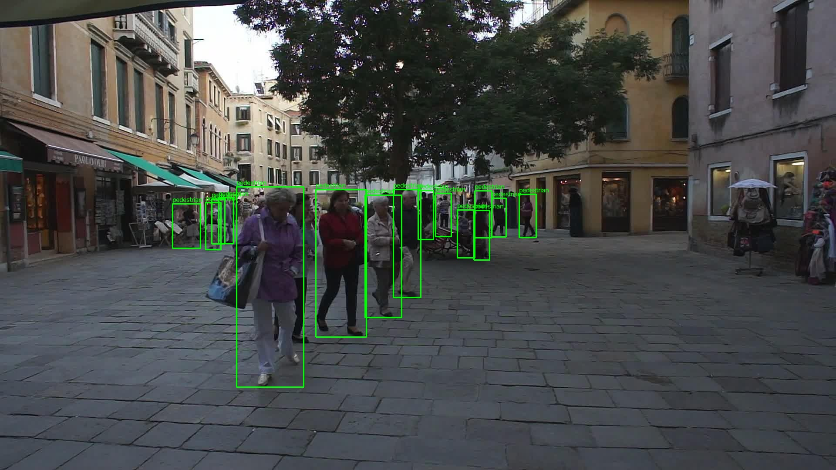
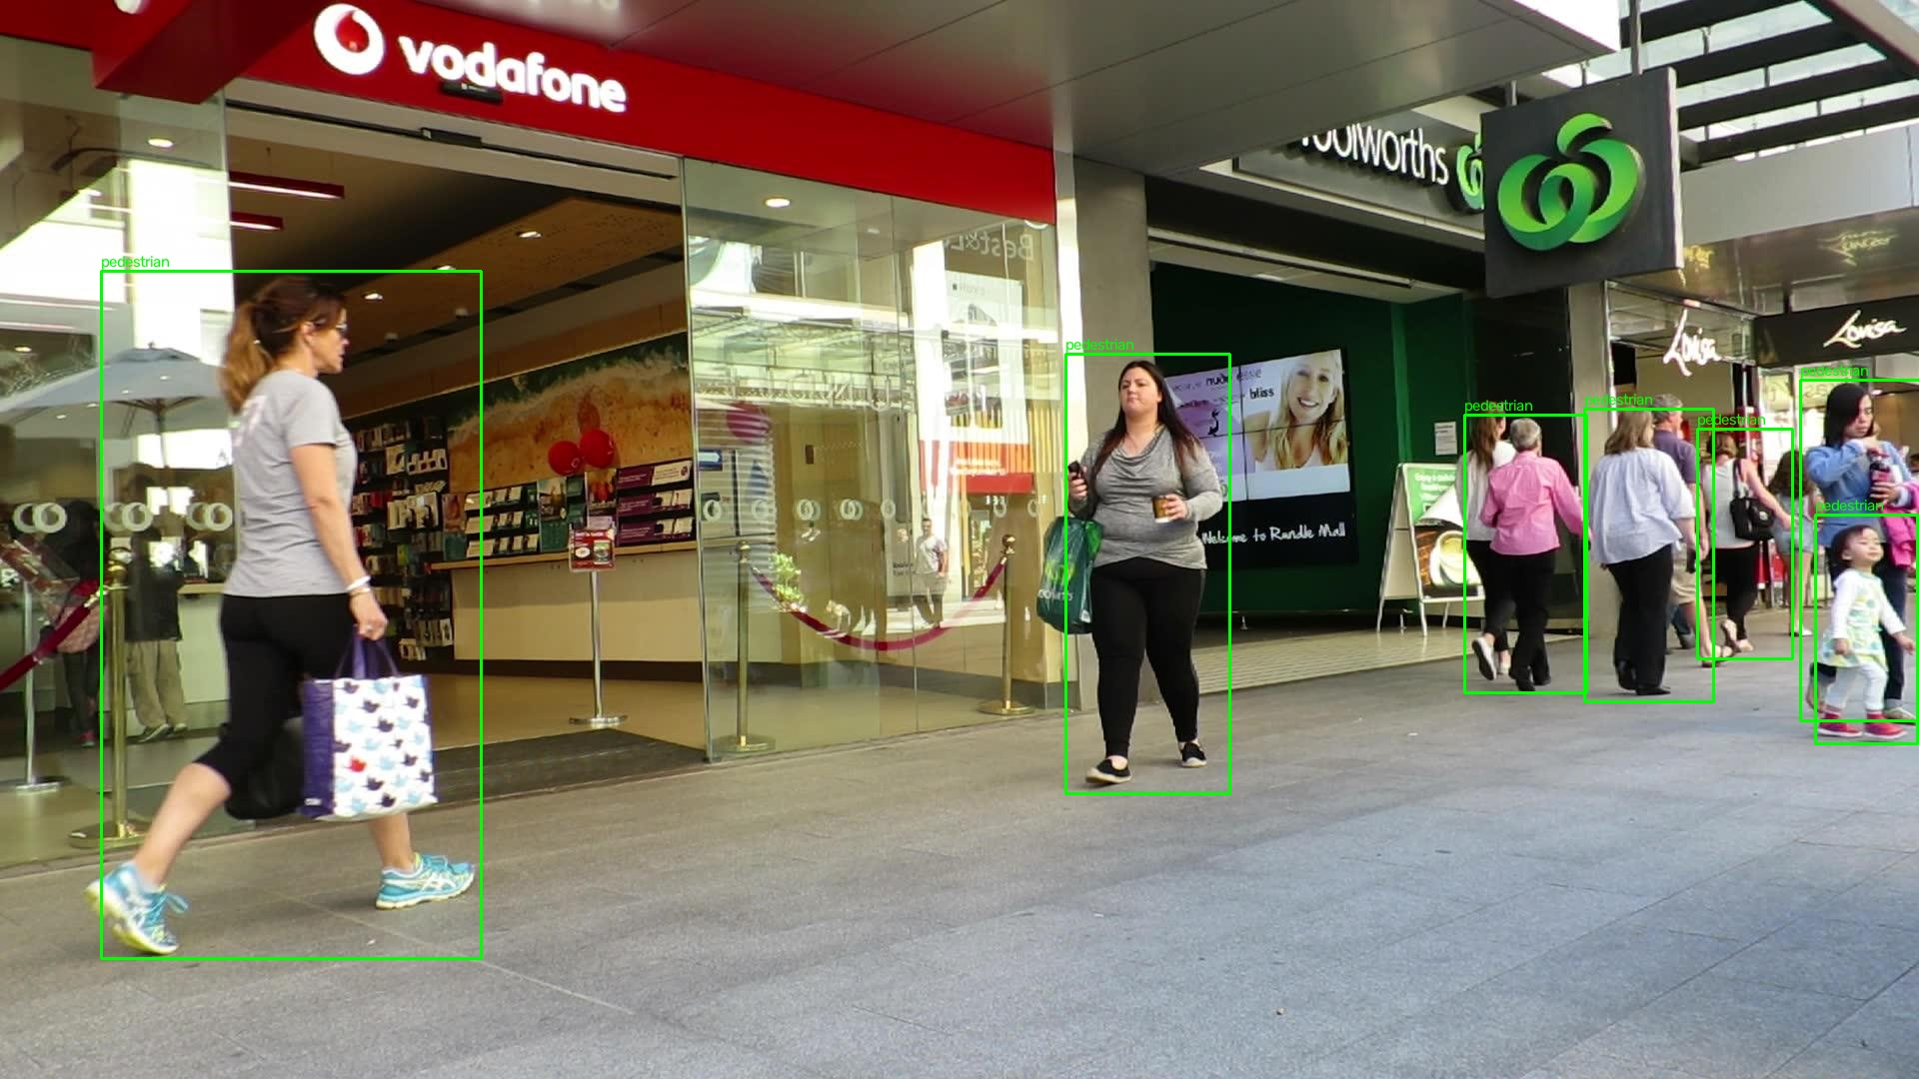
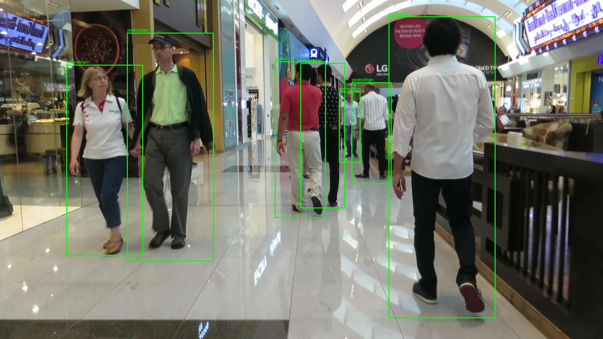
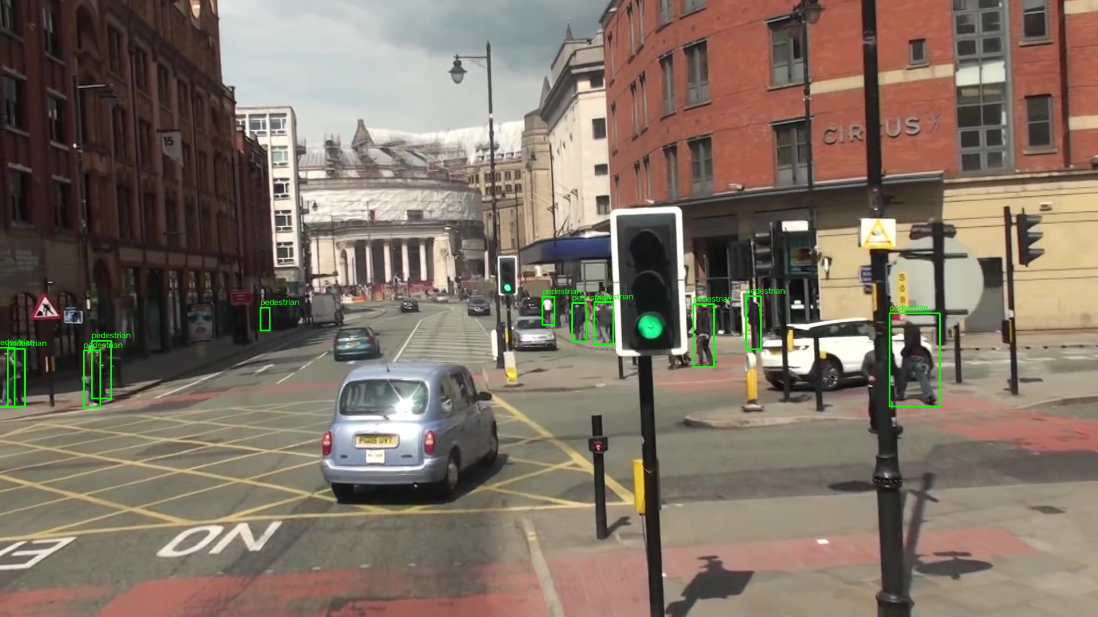
Problem Statement & Dataset
What we set out to solve and the data used
The Problem
MOT16 Sequences — Sample Frames
Given a continuous video stream from a fixed surveillance camera, automatically detect every pedestrian in each frame and assign them a persistent identity number — so the same person keeps the same ID even as they walk, occlude each other, or leave and re-enter the scene.
Two Stages Required
① Detection — find pedestrians in each frame, draw a bounding box
① Tracking — link boxes across frames with stable IDs
MOT16-02 (Venice plaza)
MOT16-09 (ETH Zurich)
Dataset: MOT16 Benchmark
▸ 7 sequences — real surveillance footage (Italy, Switzerland, UK)
▸ 5,316 frames total across all sequences
▸ Human-annotated ground truth for every pedestrian
▸ Standard benchmark used in all MOT research
▸ 4,254 training frames | 1,062 validation frames
▸ 79,799 pedestrian annotations after filtering
MOT16-11 (Indoor mall)
MOT16-13 (UK street)

Slide 3
Pipeline & Methodology
End-to-end system architecture
MOT16 Raw Data
Preprocess preprocess.py
Train YOLOv8n
Detect best.pt
Track SORT/ByteTrack
Output Results
7 sequences 5,316 JPEG frames + gt.txt annotations
→
MOT→YOLO format Normalize coords Train/val split
→
50 epochs Colab T4 GPU ~30 min
→
Per-frame inference Conf threshold 0.30 ~10 fps on CPU
→
Kalman Filter Hungarian Algo Persistent IDs
→
Tracked video MOTChallenge .txt MOTA evaluation
🔍 YOLOv8n — Detection
🎯 SORT — Baseline Tracker (M3)
⚡ ByteTrack — Upgrade (M4)
▸ CSP-DarkNet backbone + PAN-FPN neck
▸ Pretrained on COCO (80 classes)
▸ Fine-tuned on MOT16 pedestrian class
▸ Input: 640×640 px | Output: [x1,y1,x2,y2, conf, class]
▸ 3.2 M parameters | runs at ~10 fps on CPU
▸ Kalman Filter: constant-velocity motion model
▸ Predicts next position from velocity history
▸ Hungarian Algorithm: optimal detection-to-track matching
▸ Matches by IoU overlap (threshold: 0.45)
▸ max_age=3 (delete lost tracks) | min_hits=3 (confirm new)
▸ Pass 1: match high-confidence (≥0.30) detections → tracks
▸ Pass 2: match unmatched tracks to low-confidence (0.10–0.30)
▸ Recovers tracks temporarily lost behind occlusions
▸ Built into ultralytics — no extra library needed
▸ Key advantage: 59% fewer ID switches vs SORT

Slide 4
YOLOv8n Training Results
50 epochs fine-tuned on MOT16 | Google Colab T4 GPU
0.9058
0.5915
0.9237
0.8308
50/50
mAP@50 (val split)
mAP@50-95 (strict metric)
Precision (ped class)
Recall (ped class)
Epochs Completed
Training completed on Google Colab T4 GPU | Epoch 1 mAP50: 0.832 → Epoch 50 mAP50: 0.892 | Model: YOLOv8n (nano, 3.2M parameters)
Training Loss Convergence
What the Metrics Mean
Metric
Epoch 1
Epoch 50
Improvement
mAP@50
Box overlaps ground truth by ≥50% (standard MOT benchmark). Our 0.906 far exceeds our target of 0.65.
box_loss
1.388
0.650
−53%
cls_loss
1.189
0.367
−69%
mAP@50-95
Same but averaged over stricter thresholds 50%→95%. Harder to score high — 0.59 is excellent for a nano model.
dfl_loss
1.060
0.836
−21%
Precision
Of all boxes our model predicted, 92.4% contain a real pedestrian. Very few false alarms.
Precision
0.875
0.938
+7.2%
Recall
0.728
0.809
+11.1%
Recall
Our model finds 83.1% of all real pedestrians. Missing 16.9% — mostly tiny distant figures.
mAP@50
0.832
0.892
+7.2%
mAP@50-95
0.502
0.579
+15.3%
Loss drop
box_loss −53%, cls_loss −69% over 50 epochs confirms strong convergence with no overfitting.

Slide 5
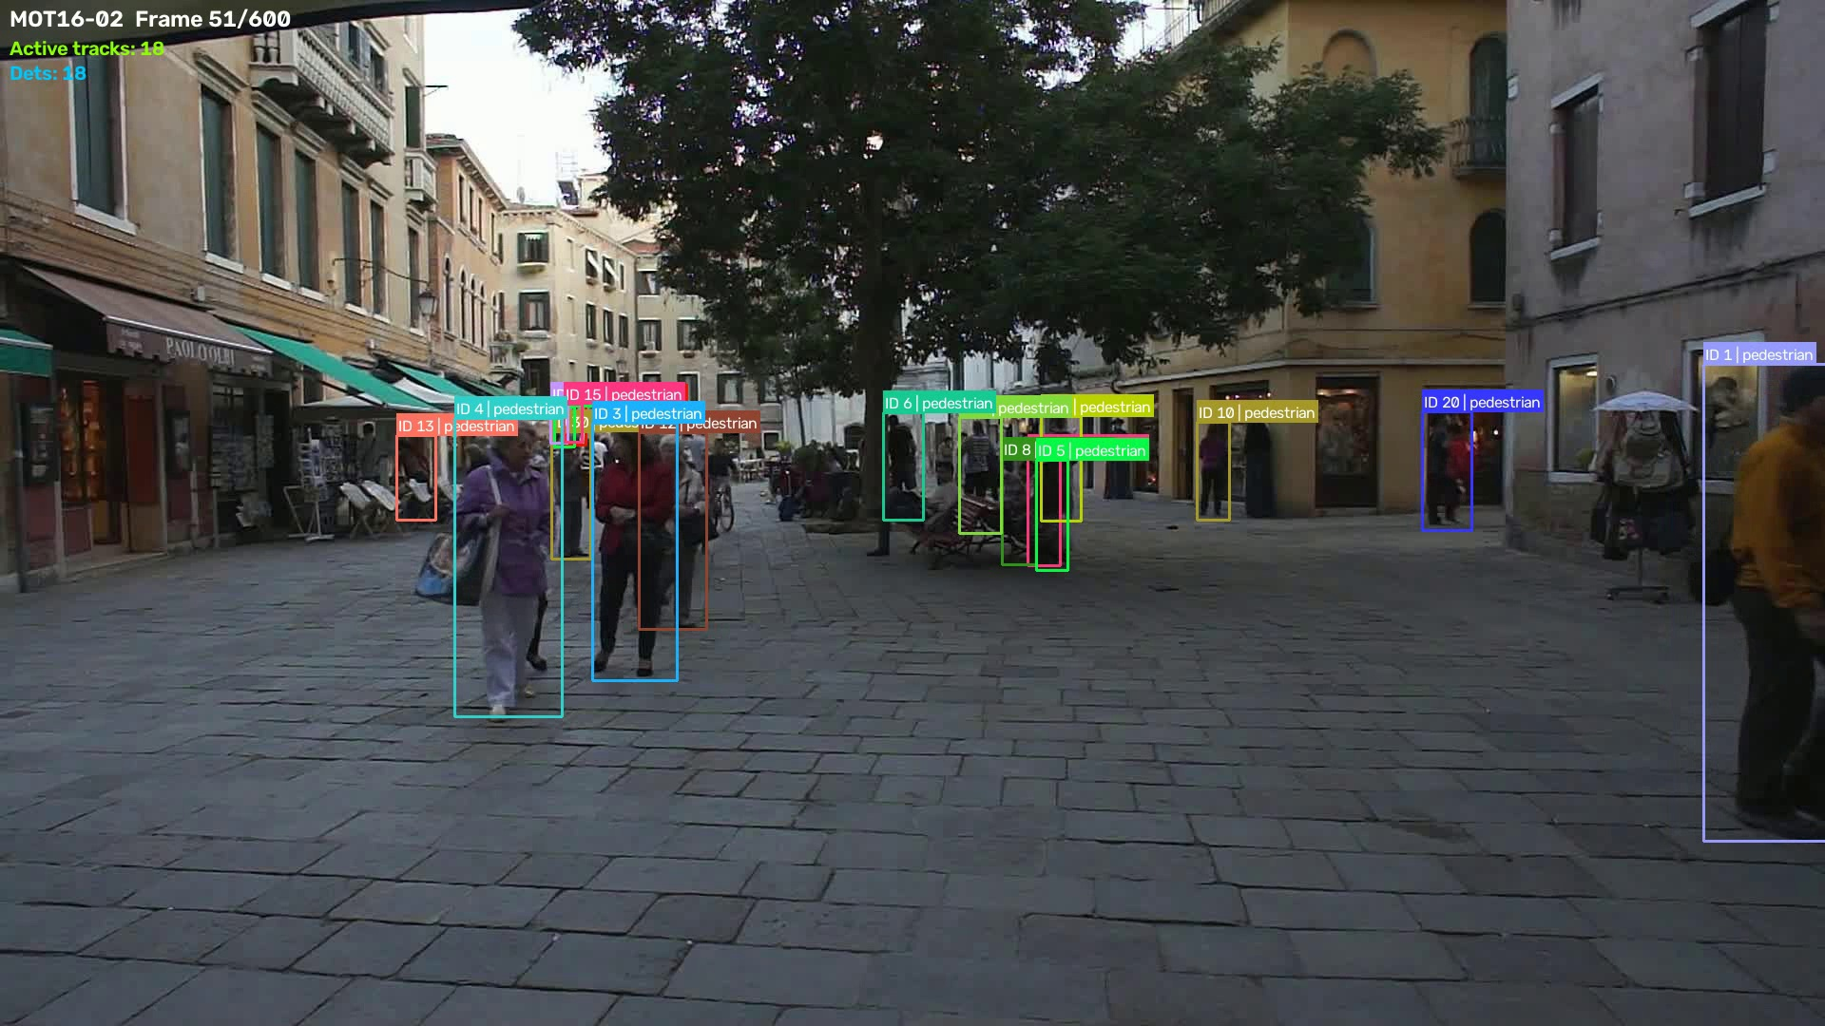
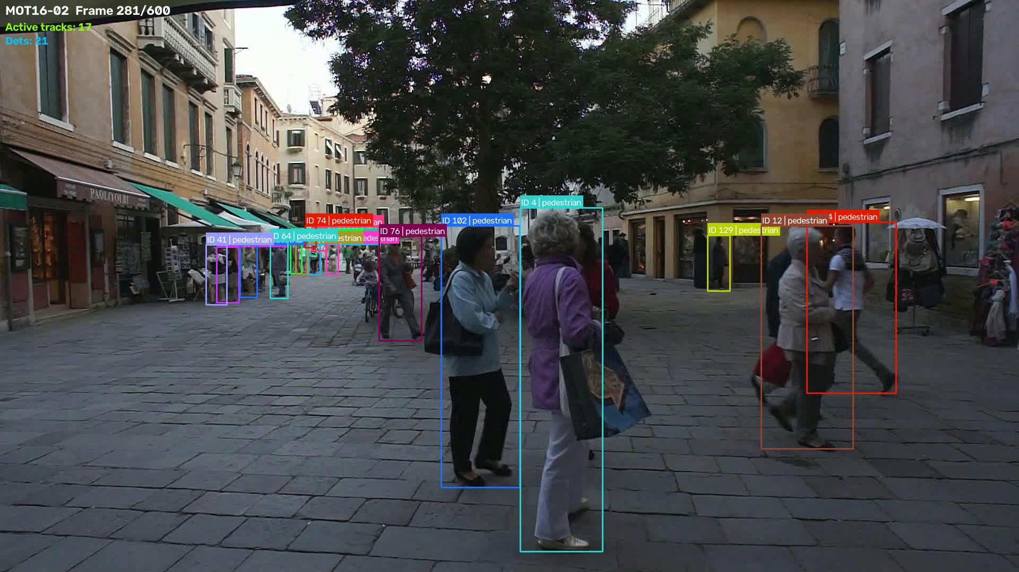
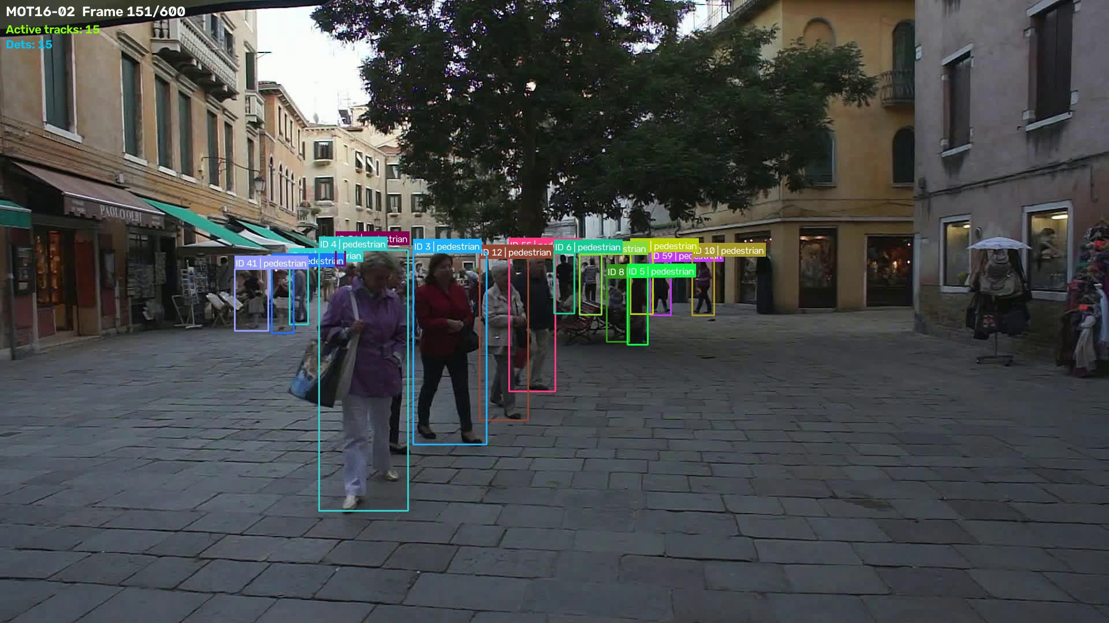
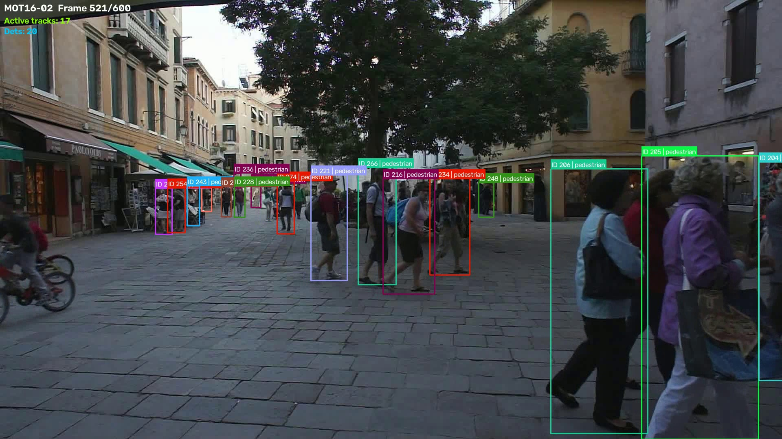
SORT Tracking — Qualitative Results
YOLOv8 + SORT on MOT16-02 (Venice plaza) — 600 frames @ 10 fps on CPU
Frame 51 — 10 active tracks, 18 detections
Frame 281 — 17 tracks, ID 102+ (IDs accumulate over video)
✔ Each colour = one unique track ID ✔ Labels show: ID number + class + confidence ✔ Top-left overlay: sequence name, frame number, active track count, detection count ✔ Tracker runs at 10 fps on CPU (Intel i7, no GPU)
Frame 151 — mid-sequence, stable track IDs maintained
Frame 521 — late sequence, 17 tracks, ID 200+ still persistent

Slide 6
ByteTrack — M4 Upgrade & Comparison
Two-pass association for better occlusion handling
❌ Problem with SORT
✅ ByteTrack Solution
When a pedestrian briefly walks behind an obstacle, the detector produces a low-confidence box (conf < 0.30). SORT ignores low-confidence boxes, so the track is deleted. When the person reappears, SORT assigns a BRAND NEW ID — an identity switch. The same person appears as two different people.
▸ Pass 1: match high-confidence (≥0.30) detections → confirmed tracks (same as SORT)
▸ Pass 2: take UNMATCHED tracks + low-confidence detections (0.10–0.30) and match again
▸ Result: person behind pillar → low-conf box found in Pass 2 → SAME ID kept
▸ Built into ultralytics — only ONE line of code change
▸ No extra libraries needed
SORT vs ByteTrack — Quantitative Comparison on MOT16-02 (600 frames, 8,840 GT objects)
Metric
SORT (M3 Baseline)
ByteTrack (M4 Upgrade)
Winner
Interpretation
MOTA
0.684
0.655
SORT
SORT more precise (fewer FP)
MOTP
0.151
0.161
SORT
SORT boxes slightly tighter
ID Switches
98
40
ByteTrack ✅
59% fewer — key ByteTrack win
True Positive
7,486
7,656
ByteTrack ✅
ByteTrack finds more pedestrians
False Positive
1,338
1,827
SORT
ByteTrack accepts borderline boxes
False Negative
1,354
1,184
ByteTrack ✅
ByteTrack misses fewer pedestrians

Slide 7
Quantitative Evaluation
MOTA / MOTP / ID Switch analysis on MOT16-02
0.684
0.655
98
40
8,840
SORT MOTA
ByteTrack MOTA
SORT ID Switches
ByteTrack ID Switches
Ground Truth Objects
Metric Definitions
MOTA Formula & Analysis
MOTA
Multiple Object Tracking Accuracy = 1 − (FP+FN+IDS)/GT_total. Higher is better. Penalises all three error types equally.
MOTA = 1 − (FP + FN + IDS)
GT_total
MOTP
Multiple Object Tracking Precision = mean(1−IoU) across all matched pairs. Lower is better. Measures how precisely boxes overlap ground truth.
SORT Calculation:
ID Sw
Identity Switch — when the tracker assigns a different ID to the same physical person between consecutive frames. Indicates track fragmentation.
= 1 − (1338 + 1354 + 98) / 8840 = 1 − 2790 / 8840 = 1 − 0.3156 = 0.684
TP
True Positive — predicted box with IoU ≥ 0.50 to a GT box.
FP
False Positive — predicted box where no real pedestrian exists.
ByteTrack Calculation:
FN
False Negative — real pedestrian in GT with no matching predicted box.
= 1 − (1827 + 1184 + 40) / 8840 = 1 − 3051 / 8840 = 0.655 (more FP trades for fewer IDS, FN)

Slide 8
Conclusions & Future Work
What was achieved and where to go next
✅ What We Achieved
🔧 Challenges Encountered
✓ MOT16 benchmark dataset downloaded, preprocessed into YOLO format (79,799 annotations)
✓ YOLOv8n fine-tuned on MOT16: mAP@50 = 0.906, Precision = 0.924, Recall = 0.831
✓ SORT tracker implemented from scratch (Kalman Filter + Hungarian Algorithm)
✓ ByteTrack integrated via ultralytics — 59% fewer ID switches vs SORT
✓ MOTA evaluation computed: SORT=0.684, ByteTrack=0.655 on MOT16-02 (600 frames)
✓ Tracked output video produced at 10 fps on CPU (no GPU needed for inference)
✓ All code documented, explained, and pushed to GitHub
✓ Complete project explanation written in Docs/PROJECT_EXPLAINED.md
⚠ Zero car labels survived filtering (MOT16 is pedestrian-focused)
⚠ Small/distant pedestrians (< 15 px) hard to detect at 640 px input
⚠ No local GPU — training required Google Colab T4
⚠ Slow image access from Google Drive → required local SSD copy
⚠ SORT loses tracks during occlusions (addressed by ByteTrack in M4)
🚀 Future Work
→ Evaluate on all 7 MOT16 sequences (not just MOT16-02)
→ Upgrade to YOLOv8m/l for higher recall on small pedestrians
→ Integrate Re-ID features (DeepSORT) for appearance-based matching
→ Add vehicle class with dedicated training data (BDD100K, KITTI)
→ Deploy on edge hardware (Jetson Nano) for real-time performance
→ Train on MOT17 + DanceTrack for scene diversity
GitHub: cepdnaclk/e23-co5430-vehicle-pedestrian-tracking
Group G07 | CO5430 | University of Peradeniya | September 2026

