Slide 1
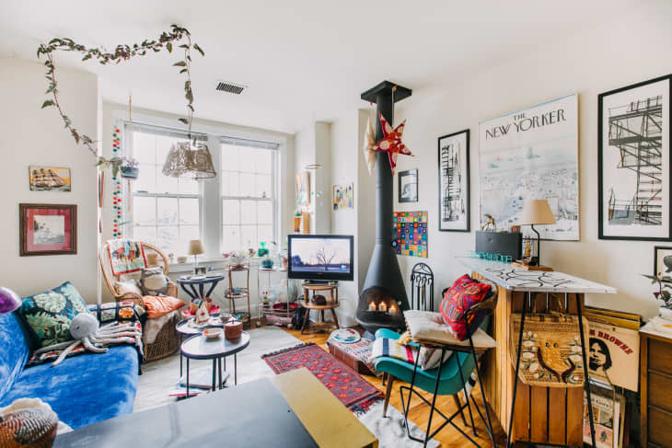

Slide 2
Tabletop

Slide 3
Wall

Slide 4
Pillows and blankets

Slide 5
Stacked objects

