Slide 1
cSurvey
!
😔 sorry...slides have a lot of text and few images…

Slide 2

A brief history
Start develop it on 2009 due to problems maintaining a large survey (Stella-Basino complex, now not so complex).
First release, using Therion as calculation engine, on 2010
First downloadable version, on cSurvey website, on 2011
2 people has directly worked on it: - Cendron Federico, main developer (me) - Petr Koveshnikov, develop 3D model generator
and some give very important help: - Massimiliano Re, github setup and maintenance - Marco Corvi, many useful tips - Danilo Magnani, early adopter and advance user and many others...
Note: cSurvey have known users mainly in Italy, Brazil and Russia.

Slide 3

Why cSurvey?
Is free and open source
Is user friendly UI (some do not agree…)
You could manage from data to design in the same environment
Use Therion for calculate centerline and some other functions so all calculation relay on well know and supported system
Has an easy to understand approach to data management and drawing maintenance
Use, in drawings, cave symbols, pens and brushes same way of well know vector graphics softwares
Note: Therion code is not integrated. cSurvey use Therion an external batch processor so you have to install Therion separately.

Slide 4
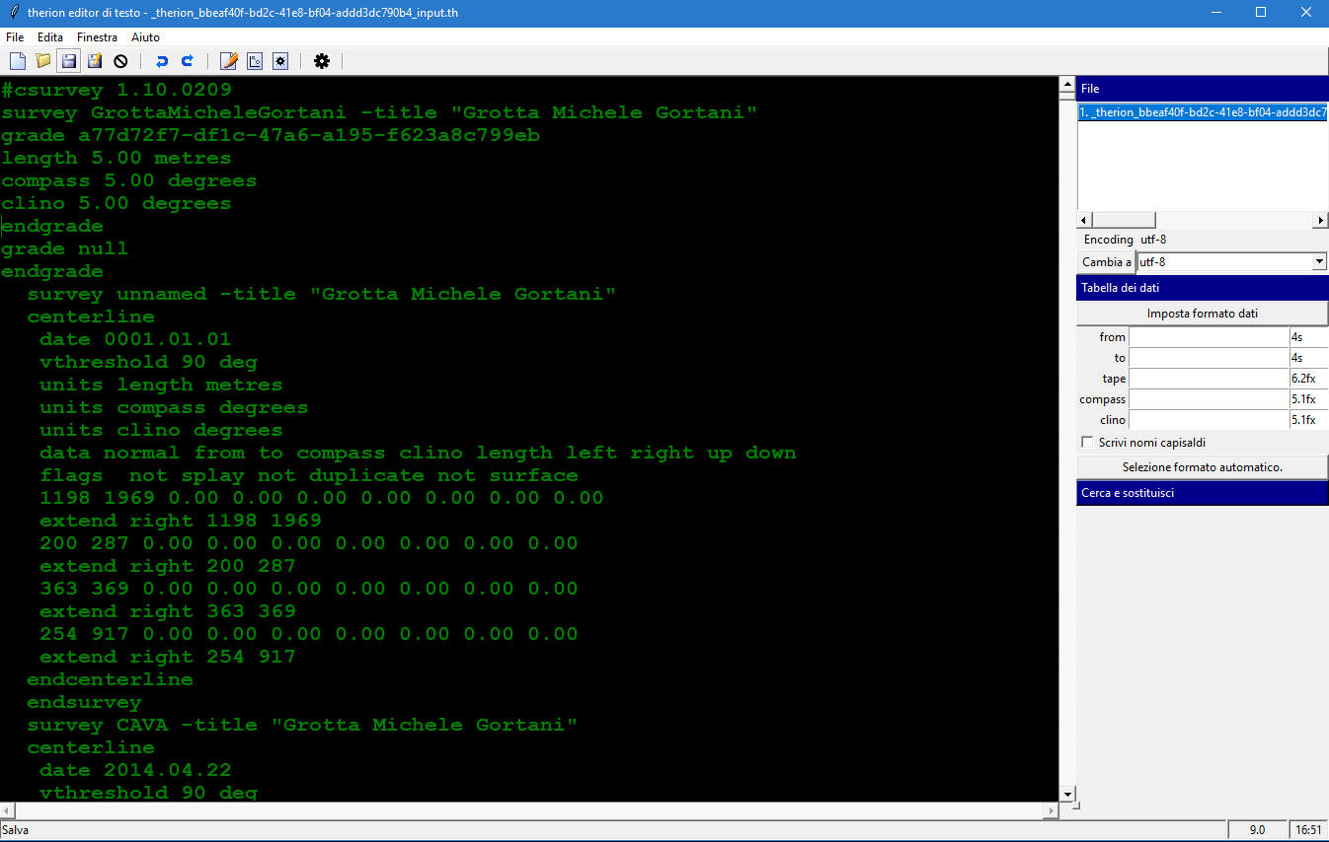
Note: many concept you can find in cSurvey have a counterpart in Therion. Even if you don’t like cSurvey you could use this workshop to understand also Therion logic.
and Therion?
Worst ui
Therion has a better (almost perfect) scalar logic allowing you to work to small drawings or small data set and assembling it in a ‘large as you want’ big survey when needed.
All calculation is done in print preview/export generation (details in the next slide).

Slide 5
cSurvey vs Therion
cSurvey and Therion use different approach to same problem: keep centerline and drawing binded togheter.
cSurvey change drawings when centerline change, in real time. Therion do it only on calculation. Of course, second approach in better but is hard to understand.
...other?
CaveRender Pro (http://www.caverender.de/CaveRenderPro/CaveRenderPro.htm) Compass + Inkscape (https://fountainware.com/compass/) CaveWhere (https://cavewhere.com)
Note: as far as I know CaveRender Pro is the most advanced and most like to cSurvey software.

Slide 6
Note: many ask me about computer configuration to use cSurvey. Of course there is no real answer. cSurvey use a lot of temp file so a fast hard disk (SSD, NVME) will help you even if you computer is not so new.
cSurvey requirements
Windows 7 SP1 or next Microsoft .Net Framework 4 (4.8) (only for Windows 7 or 8) Therion
cSurvey can not run, now, on Windows XP or Window Vista due to missing support to lastest .Net Framework version.
Note: next cSurvey version, 2, now under development, need .Net Framework 4.8 and will work only on 64-bit system.

Slide 7
Note: 🤓 if Therion is installed after the first cSurvey startup you need to run manually the automatic configuration.
Is a setup needed?
No.
cSurvey can run without any setup even from USB drive. So you can also have more cSurvey version in your pc.
But you have to setup Therion before using cSurvey and, in old Windows (7, 8) you have to install Microsoft Framework 4 to run it.

Slide 8
cSurvey ‘limit’
big survey: - for data only survey: <150km (more using linked surveys...) - for drawn survey at 1:250/1:200: <30km
very slow computer
plan or profile in separate output: you could arrange a lot of plan print/export profiles but could not merge plan and profile together in the same table
station’s names: have to be unique in an entire survey
lack in documentation (help needed!)

Slide 9
Is cSurvey in active development?
Yes.
But, is a spare time developed project. So there’s not any kind of ‘assistance’. There’s an online forum used mainly by Italian users but not only so, you can use it to ask something sharing “questions and answers” with other cSurvey users.
Keep in mind that using cSurvey is on your risk without any warranty same way as using TopoDroid (visit Google Play Store to check it) but also for DistoX that is not an industrial product.
Note: if you browse cSurvey forum you will note that I answer a lot of questions even if there are some other ‘administrators’ and many other users. So, if you ask something, be patient...

Slide 10
Note: keep in mind that cSurvey relay on Therion so, sometime (not so rarely) bug are also in Therion.
Is bugged?
Yes.
But the answer is the same for all software.
For cSurvey keep in mind this usefull tips: - save frequently your work - change frequently your work filename (as example, adding a ‘revision number, like ‘mycave1_1.csz, mycave1_2.csz…) so you can go back even after complex changes. or - use, to store your surveys, a revisioned folder (Windows have a native function for this, but also cloud backup software like OneDrive, Google Drive or DropBox). - when cSurvey raise an unhandled exception can send me a log (stack trace) with some information about the exception. So enable this function (cSurvey will ask you to do this) allowing me to raise program stability. Of course, you could notify me the exception using the forum for a better response.

Slide 11
Note: this a very frequent question...
May run on Linux?
No.
Or better, even if cSurvey is written in .Net language it use a lot of functions not supported by the .Net Linux project ‘Mono’. You can run cSurvey v1 using Wine but with a lot of stability issue not related to cSurvey.

Slide 12
Data managment
cSurvey’s data managment key concepts
!
🤓 only some tips...we see all details during this workshop

Slide 13
Shots
Shots are the backbone of a survey.
In cSurvey you can add one set of LRUD data to a shot referring to [from] station or to [to] station. So, if you need to input LRUD data for first or last station, depending on how the work session was set up, you have to enter a 'special' shot with [from]=[to].
cSurvey can recognize also another special shot: equate. An equate define the same spatial point but with 2 (or more) station's name. To define an equate input a shot with [from] and [to] with different names but without any other information (without distance, azimuth and inclination).

Slide 14
Stations
Stations, for cSurvey, are data derived from shots.
You can not directly add a station.
Stations database is updated on every calculation or manually. When a station is added to station’s database cSurvey keep it even if you delete all shots referring to it.
To remove the unused stations use ‘Remove orphans’ function.
Stations have is own data, separated from shots.

Slide 15
Sessions
Shots can (must) be assigned to survey sessions.
A survey session is useful to assign a date, a team, measures unit and more to group of shots (typically a real survey’s session).
Note: you can define a sessions with standard data, cartesian data (X,Y,Z) or diving data (untested).

Slide 16
Caves and branches
cSurvey arrange data by caves and branches.
Each survey can be a cave complex (many caves togheter) or, of course, a single cave. Each cave can be divided in a lot of branches. Branches can be real branches or something you need to split a draw (for example: pit start, pit base).
Caves and branches are also usefull for translations.
Note: use caves and branches to filter data and drawings objects working on small set instead of an entire survey.

Slide 17
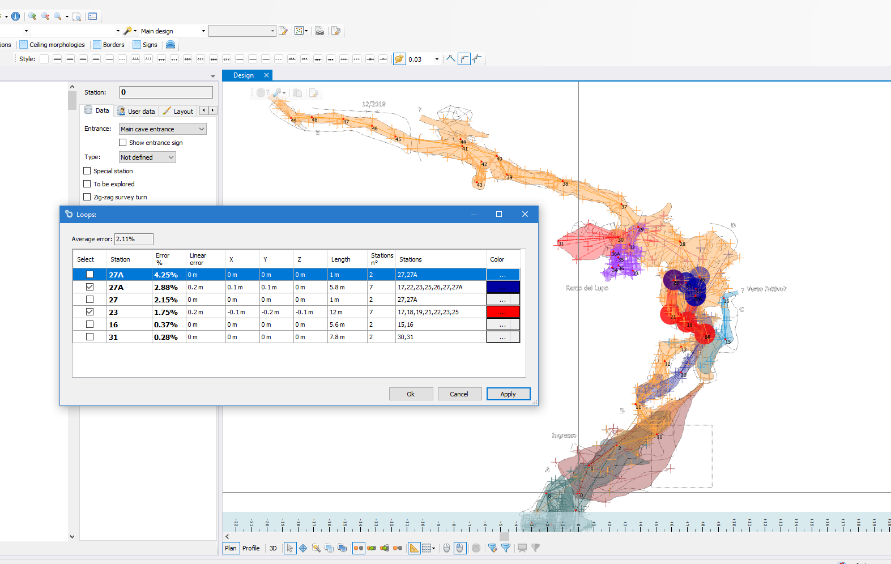
Centerline loops
cSurvey, as Therion, can not leave loops opened.
Loops calculations relay all on Therion.
cSurvey report you average error and error detailed by single loop. You can also hightlight single or more loop.
Keep in mind that fixing 2 or more stations coordinates and allowing cSurvey to use all of them create something like a loop.
Also multiple shots with same stations give you a feedback like a loop (and work with average data).
Note: cSurvey use Therion default settings for loops. At now this behaviour can not be changed.

Slide 18
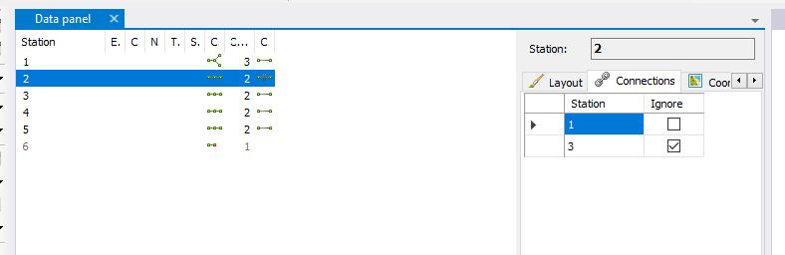
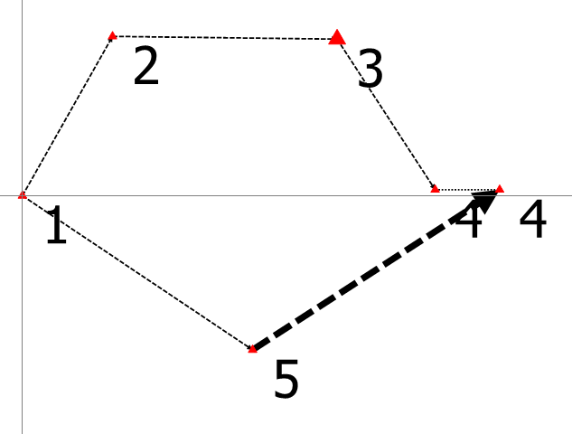
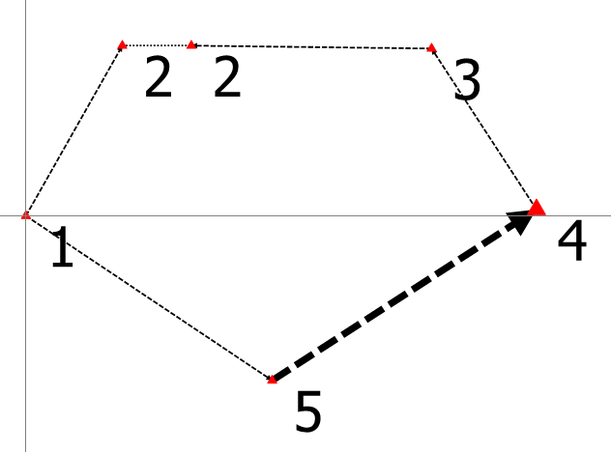
more on centerline loops
You can define where loops breaks, in profile, using ‘ignore’.
Here centerline with 1 as origin and a loop with default settings.
Here same centerline with 1 as origin and a loop drawed ignoring connection 2 → 3.
Note: avoid ignoring both A → B and also B → A. This will break centerline and raise an error (unconnected stations).

Slide 19
Geographic functions
You can fix one or more stations with geographic coordinate and use it to calculate centerline. Of course, if you enable this functions you can read calculated coordinate also for stations without geographic’s fix.
Note: cSurvey allow you to add to a survey also surface elevation data (in Arc ASCII Grid format), orthophoto (in jpg, tiff or png format) and WMS supporting WGS84/UTM CS.

Slide 20
Splay (shots)
cSurvey has its own splay shots management.
In plan you can decide to see all or only splay shots laying near an horizontal plan.
In profile you can decide to see all or only splay shots near vertical planes defined by centerline shot’s azimuth.
In cross-sections you can do the same as in profile but splay’s projection default plane azimuth is 90° rotated compared to centerline shot’s azimuth.
This may help you to draw cave borders using only usefull data.
Note: In some case you can have some duplicated splay point cause cSurvey show you points referred to a shot and, even, to his neighbors.
So, pay attention!

Slide 21
Note: 🤬 cSurvey in not a CAD software but a specialized vector graphics software.
Drawing managment
A brief summary of cSurvey drawing key features
!
🤓 only some tips...we see all details during this workshop

Slide 22
Is cSurvey drawing levels constrained?
Yes.
The logic of the levels is basically the same as that of other vector graphics software but cSurvey drawing is strongly levels constrained so objects type define also in which level object must be. You could change objects order inside a level but you cannot move an object in another level (without changing is type).

Slide 23
What to draw first?
For me: cave borders.
When you have defined the shape of the cave (in plan or in profile) you could start adding all other details.
Remeber that cSurvey (as Therion) will cut, for you, every objects out of cave borders laying in levels under borders level, will not cut object laying in levels above borders level (of course you could customize this). So, don't worry about drawing details perfectly inside borders.

Slide 24
What is ‘warping’?
Warping is the ability of cSurvey to keep drawing binded to centerline even after change in survey data like ring closure, adding geographic position ecc…
Note: ‘warping’ works well but cannot do any king of ‘magic’. Complex centerline changes could lead to wrong worping. So pay attention.

Slide 25
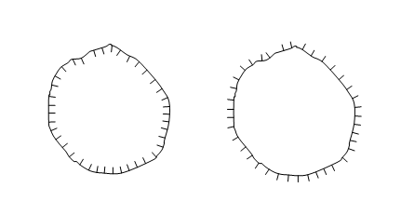
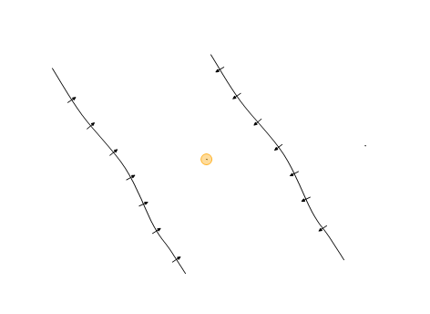
Some line and area have a ‘direction’!
Pay attention to some kind of lines (better: of pens) and areas (better: of brushes) cause these have a ‘direction’.
For example: a pit or a slope. Same sequence of points but different directions change the meaning of the symbol.

Slide 26
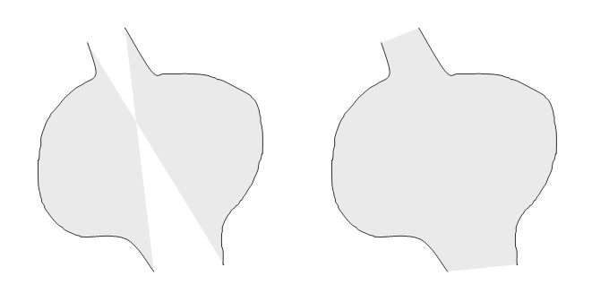
Also cave borders have direction
To take advantage from cave's borders clipping borders have to define a correctly closed area.
We will see how to do this and how to draw a pillar or something 'solid' inside a previously drawn cave area.
No
Yes
Note: clipping is customizable. You can set clipping behaviour for a single object as: clip inside borders, clip outside borders or don’t clip.

Slide 27
Scale
Default cSurvey settings are designed for a 1:250 scaled draw.
Of course you can change a lot of settings to arrange your survey to a different scale or you can define multiple settings, automatically choosed by the program, if you need to create more print/export profiles with different scale.
You can also show or hide objects, or entire object’s categories, by scale.

Slide 28
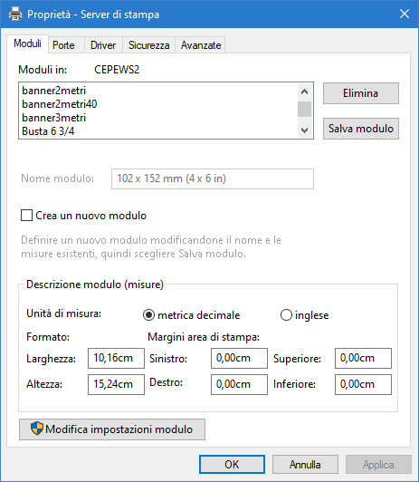
Exporting to PDF
cSurvey can not create, directly, a PDF file but you can easly install free (and, in some case, even open source) PDF Printer.
Microsoft PDF Printer, bundled with Windows 10, is buggy (but work) and, in some case, lines width or some other details are wrong rendered. It have also a limited range of pages size.
I use PDF Creator. PDF generated by PDF Creator are good but installation have to be done carefully due to some junk software setup often suggested during its setup.
Custom page size, event for PDF Printer, can be arranged directly in Windows inside ‘Printer server properties’.
Note: cSurvey can export drawing also in SVG (vector) or JPG, TIF and PNG (raster) file format. At now you can not print/export surface data (surface profile a part).
Note: 😔 sorry...I have available only italian version of Windows to take a screenshot.

Slide 29
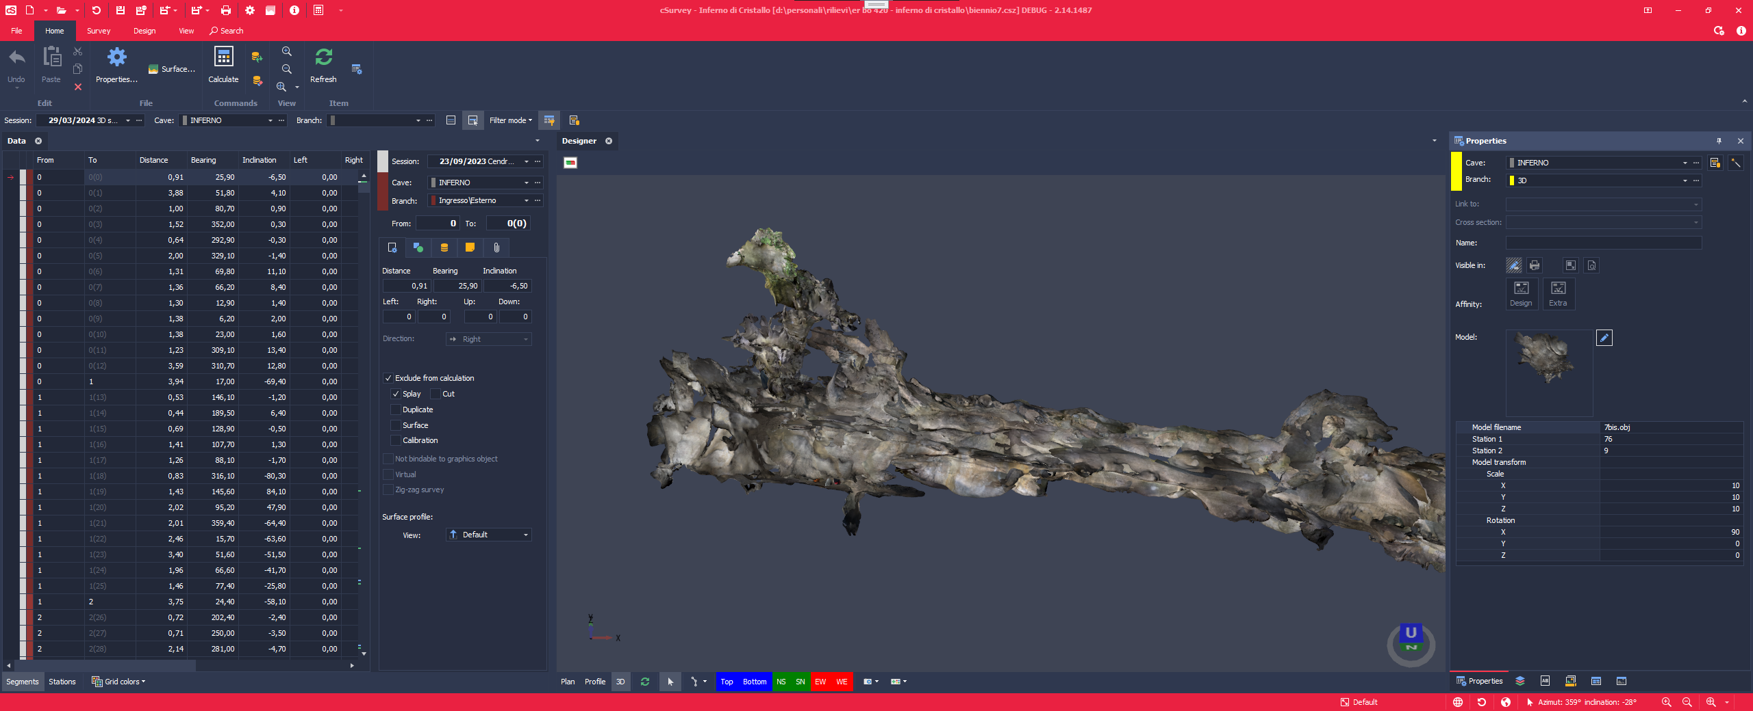
...and what’s next?
more tools and graphical functions.
better 3D integration

Slide 30
Let's start

