Slide 1
Cuteformal Antennas
Rapid Prototyping Cute Antennas
Christin Lundgren
Crowd Supply Teardown
June 25, 2023

Slide 2
ISM Frequency Band
Industrial, scientific & medical applications
Unlicensed
Multiple frequency bands worldwide
Includes 2.4 – 2.5 GHz (WiFi, Bluetooth, others)
Also RFID, garage door openers, radio astronomy, medical devices

Slide 3
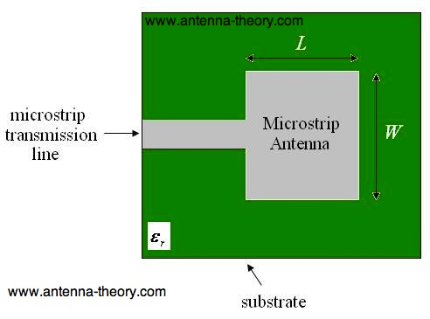
Where to Start?
Application → frequency
Frequency → geometry
Begin with a standard antenna
Microstrip antenna a.k.a. patch antenna

Slide 4
Where to Start?
Patch size: W = L = λ/2
c = f λ
c
c = 3e8; f = 2.45 GHz; λ = 122 mm
W = L = 61 mm
BUT WAIT!

Slide 5
Where to Start?
What about the dielectric constant of the material??
This affects the wavelength in the material
Dielectric constant of chipboard = 2.1
Effective dielectric constant = 1.8 ← use this number
Lreal = L/√(1.8), Wreal = W/√(1.8)
https://www.pasternack.com/t-calculator-microstrip.aspx
https://www.pasternack.com/t-calculator-microstrip-ant.aspx
Rectangular antenna @ 2.45 GHz: 50 mm wide, 42 mm long

Slide 6
Workflow
Choose frequency; get patch antenna size for a starting point
Design and cut out antenna
Test
Iterate
Frequency too high → make antenna bigger
Frequency too low → make antenna smaller

Slide 7
Test Equipment
LibreVNA
Open hardware vector network analyzer
https://github.com/jankae/LibreVNA

Slide 8
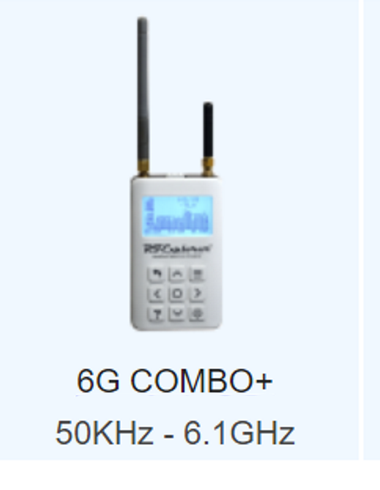
Test Equipment
RF Explorer
Handheld spectrum analyzer with WiFi analysis
http://rfexplorer.com/

Slide 9
General RF & Antenna Resources
https://www.microwaves101.com/
https://www.antenna-theory.com/

Slide 10
Contact
Email: cephLpod@gmail.com
Twitter @crochetronic
GitHub: https://github.com/cephLpod

