Slide 1
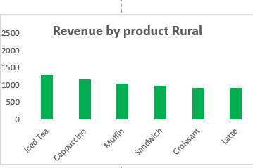
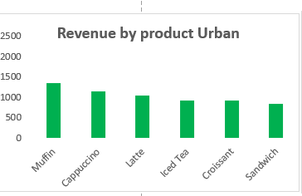
Which menu items are performing the best across different locations?
Which top-selling menu product generate the most revenue?
Muffins generates the highest revenue overall but thrives in Urban areas as airport and Uptown.
Iced tea has the best overall appeal to Suburbs and downtown
Latte and Iced Tea are strong performers, especially in urban locations.
In general Sandwiches have the lowest overall revenue

Slide 2
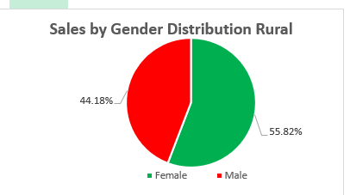
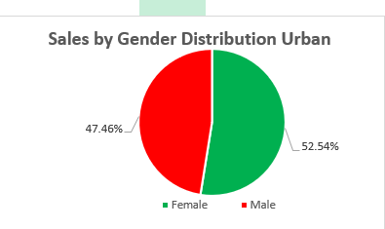
What is the customer profile that tends to spend the most (age, gender, or preferred product)?
Female customers are the overall highest revenue on all sectors.
By all age groups and Locations, Female customers have had the highest overall count on revenue

Slide 3
How can the café improve its stock management to avoid running out of popular items while also reducing overstock?
Overstocked Items : Positive metrics like Coffee Beans
Understocked items: Negative metrics like Milk
Ideal stock is at the 0 margin like Juice Concentrate

Slide 4
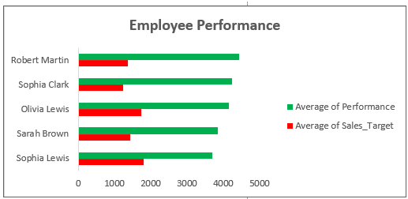
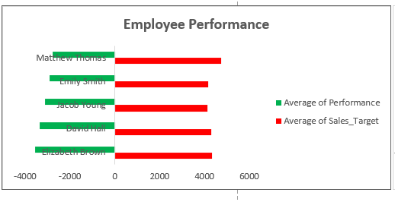
Are there any locations or employee performance issues that require attention?
Table A(left) on the right shows that the average target for the top 5 Employee performance is very low and the expectations need to be raised
Table B(right) shows the underperforming employees.

