Slide 1
CAFÉ HARMONY PRESENTATION
Team Lyra

Slide 2
Problem
Menu performance by location.
Customer spending profiles.
Stock management inefficiencies.
Employee performance gaps.
Revenue produced from locations

Slide 3
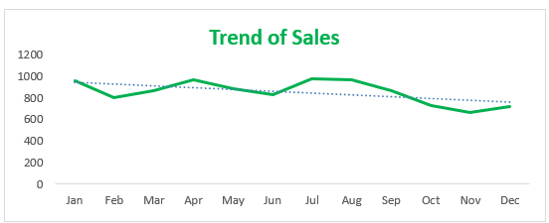

Slide 4
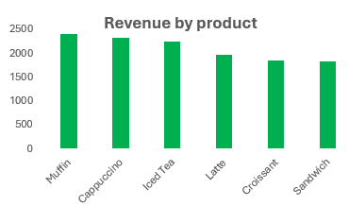
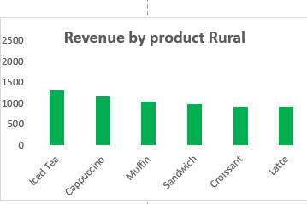
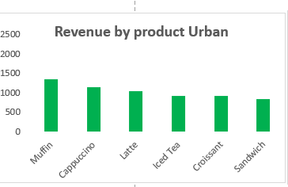
Which menu items are performing the best across different locations?
Which top-selling menu product generate the most revenue?
Muffins generates the highest revenue overall but thrives in Urban areas as airport and Uptown.
Iced tea has the best overall appeal to Suburbs and downtown
Latte and Iced Tea are strong performers, especially in urban locations.
In general Sandwiches have the lowest overall revenue

Slide 5
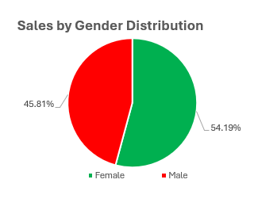
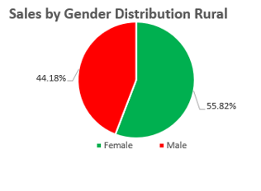
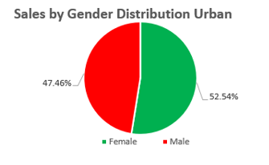
What is the customer profile that tends to spend the most (age, gender, or preferred product)?
Female customers are the overall highest revenue on all sectors.
By all age groups and Locations, Female customers have had the highest overall count on revenue

Slide 6
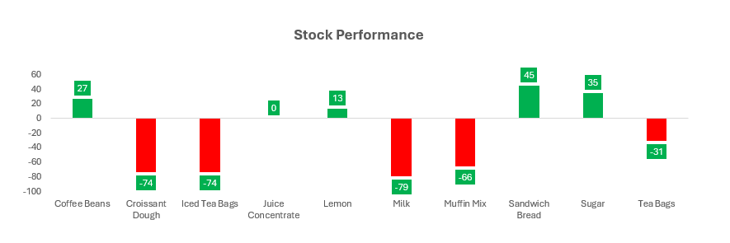
How can the café improve its stock management to avoid running out of popular items while also reducing overstock?
Overstocked Items : Positive metrics like Coffee Beans
Understocked items: Negative metrics like Milk
Ideal stock is at the 0 margin like Juice Concentrate

Slide 7
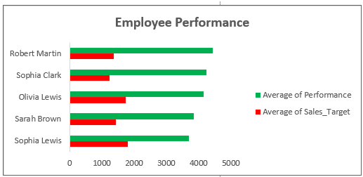
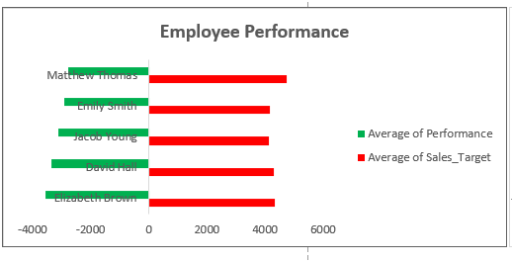
Are there any locations or employee performance issues that require attention?
Table A(left) on the right shows that the average target for the top 5 Employee performance is very low and the expectations need to be raised
Table B(right) shows the underperforming employees.

Slide 8
Business Recommendations
1. Optimize Menu & Inventory
Double Down on Top Sellers:
Expand muffin flavors/options in Urban locations (airports, Uptown).
Promote Iced Tea/Latte combos in Suburbs/Downtown via signage or discounts.
Reduce Sandwich Waste: Test smaller batches or revamp recipes to boost appeal.

Slide 9
2. Targeted Marketing
Leverage Female Customer Loyalty:
Launch loyalty programs or promotions (e.g., "Buy 5 muffins, get 1 free").
Partner with women-centric events/communities in high-revenue areas.

Slide 10
3. Improve Stock Efficiency
Adjust Orders:
Reduce coffee bean purchases and reallocate budget to milk (address shortages).
Use Juice Concentrate’s "0 margin" model as a benchmark for other items.
Tech Solution: Implement dynamic inventory tracking (e.g., real-time alerts for low stock).

Slide 11
4. Employee Performance
Raise Targets: Set higher but achievable goals for top performers (Table A).
Training/Support: Address underperformers (Table B) with coaching or role adjustments.

Slide 12
5. Location-Specific Strategies
Urban Focus: Capitalize on muffin/capuchino demand with grab-and-go options.
Suburban/Downtown: Highlight Iced Tea as a "local favorite" in marketing.

