Slide 1

Dashboarding Using Streamlit

Slide 2
Introduction
Streamlit is an open source app framework in Python. It is used to create web apps for ML and data science projects. However, One must use an IDE and be more accustomed to the command line.
Its compatible with python libraries like Pandas, NumPy, Matplotlib, Scikit-learn, Pytorch, Seaborn, Keras, Plotly etc.
As a result, we are exempt from working with any front-end frameworks or writing HTML, CSS, or JavaScript code.
From a code flow perspective, it appears that you're transmitting data synchronously with the frontend. But in reality, whenever the changes are made to the script it automatically re-executes the code and updates the new value in the frontend (happening asynchronously).

Slide 3
Steps to be followed
Open your Anaconda prompt, pip install streamlit. Once installed successfully.
Open a jupyter Notebook, write a simple hello function as below:
import streamlit as st
def say_hello():
st.write(f"hello {nameText}")
nameText = st.text_input('name', value='joe’)
button = st.button("say hello", on_click=say_hello)

Slide 4
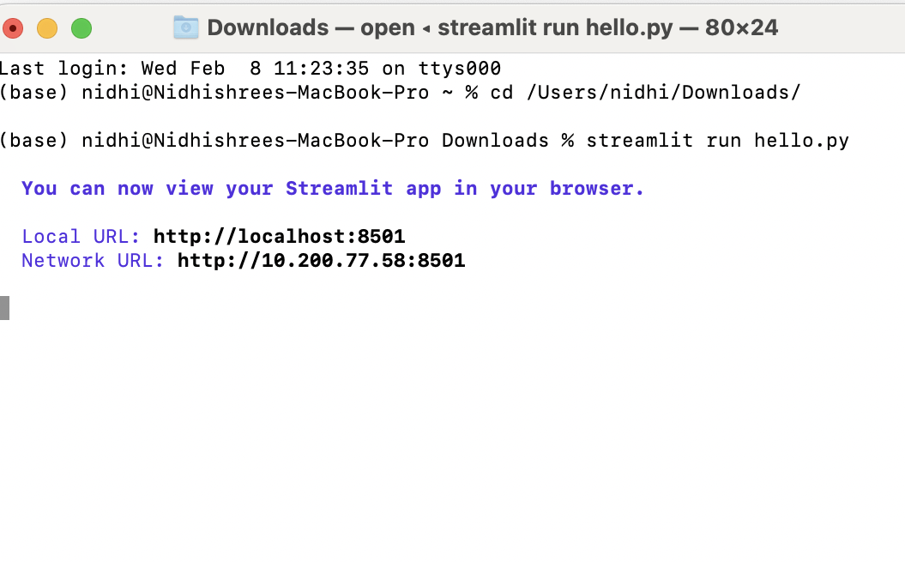
Contin..
download this notebook as .py
Now, to execute this code
open terminal, cd copy the path of your directory where you saved the file.
For Example: cd /Users/nidhi/Downloads/
streamlit run hello.py.

Slide 5
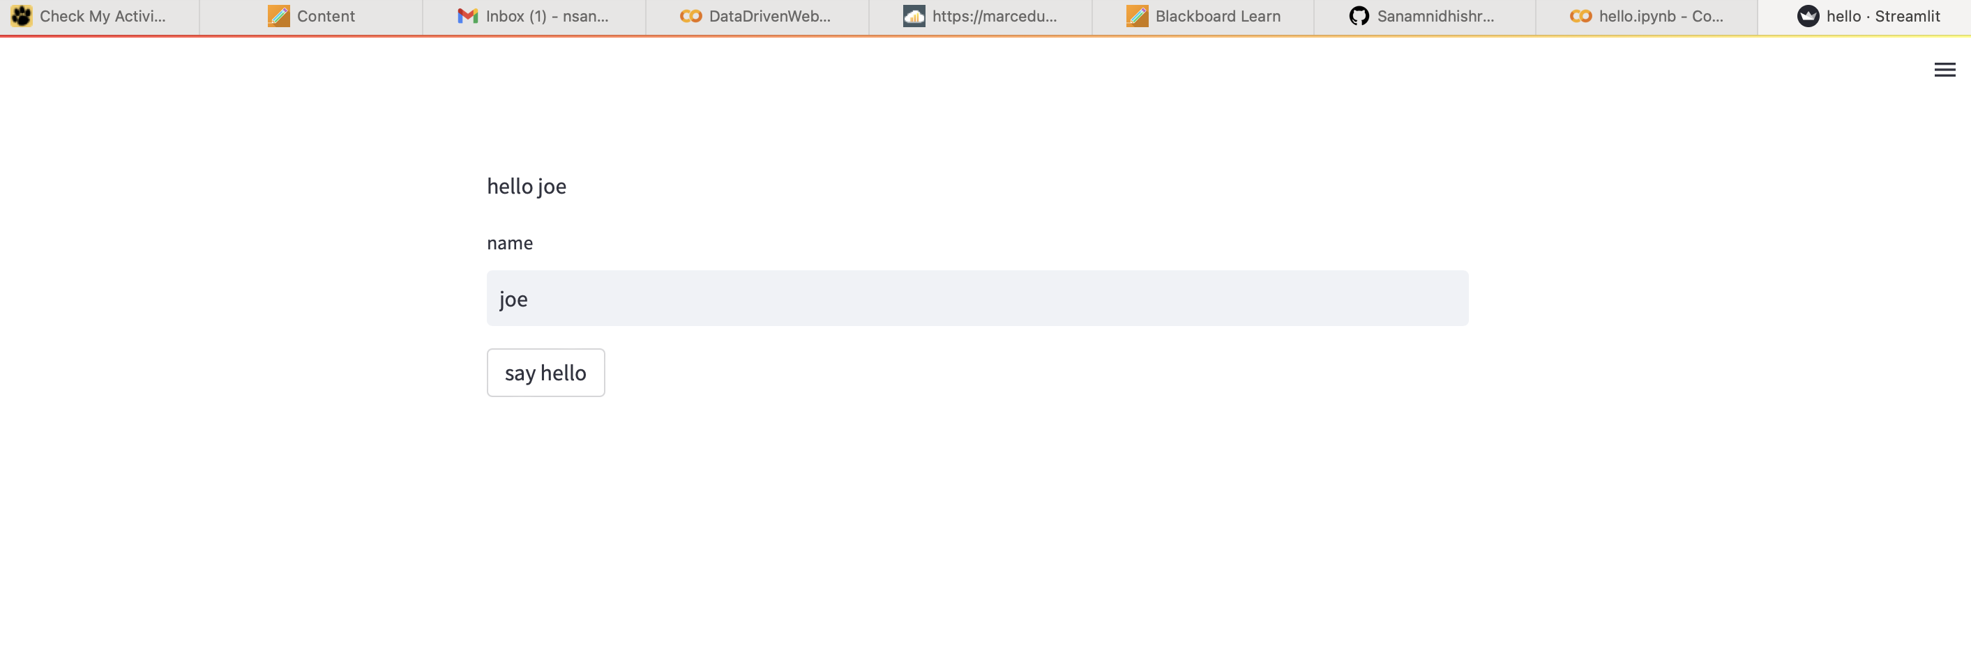
Contin..
The application is opened in a new tab of your default browser.
In case you want to close the application, type ctrl+c in the terminal and close the browser.

Slide 6
Basic Commands
st.write() : This functions is used to add anything to web app. For example, strings, charts, data frames etc.
st.title() : This allows us to add title of the web app.
st.header() : This is used to set header of a section.
st.markdown() : This is used to set markdown of a section.
st.subheader() : this is used to set sub-header of a section.
st.caption() : this is used to write a caption.
st.image() : This is used to display an image.
st.audio() : this is used to display an audio.
st.video() : this is used to display a video.

Slide 7
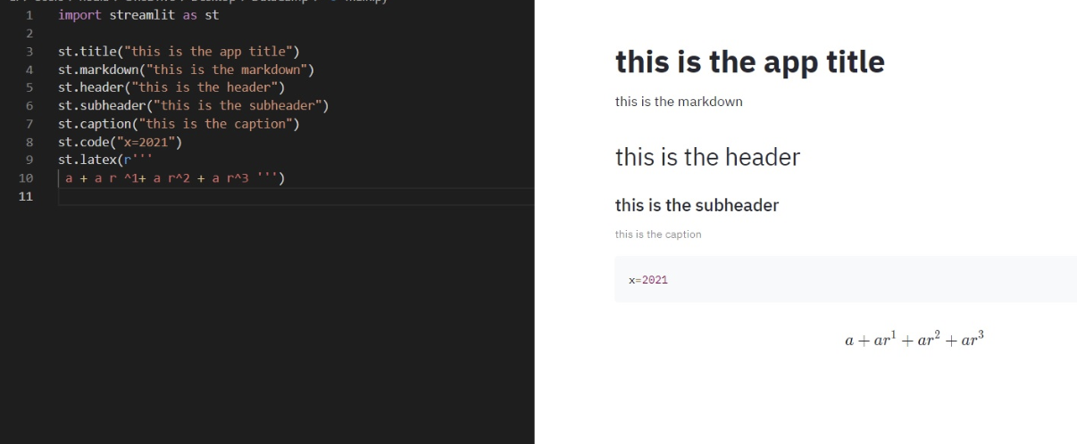
Contin..

Slide 8
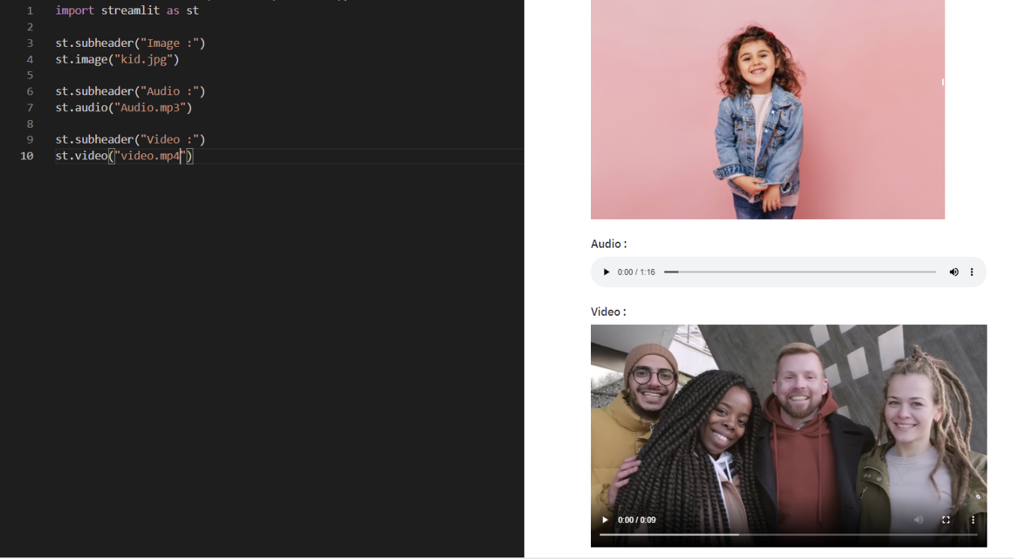
Contin..

Slide 9
Input Widgets
st.checkbox() : this function returns a Boolean value when the box is checked. That is it returns True value else false value.
st.button() : This will display a button widget.
st.radio() : This will display a radio button widget.
st.selectbox() : this will display a select widget.
st.multiselect() : this will display a multi select widget.
st.select_slider() : this will display a select slider widget.
st.slider() : This will display a slider widget.
st.number_input() : this will display a numeric input widget.
st.text_input() : This will display a text input widget.
st.date_input() : This will display a date input widget to choose a date.
st.time_input() : This will display a time input widget to choose a time.
st.text_area() : This is used to display a text input widget with more than a line text.
st.file_uploader() : This is used to display a file uploader widget.
st.color_picker() : This is used to display color picker widget to choose a color.

Slide 10
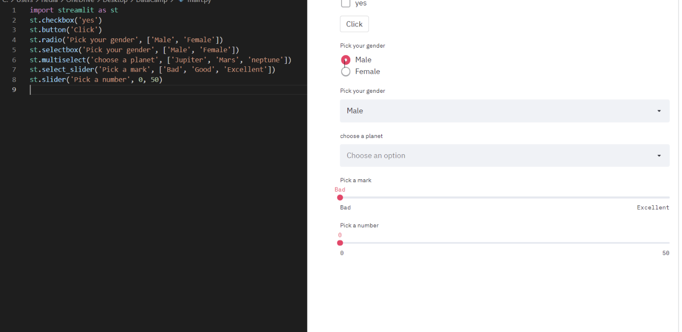
Contin..

Slide 11
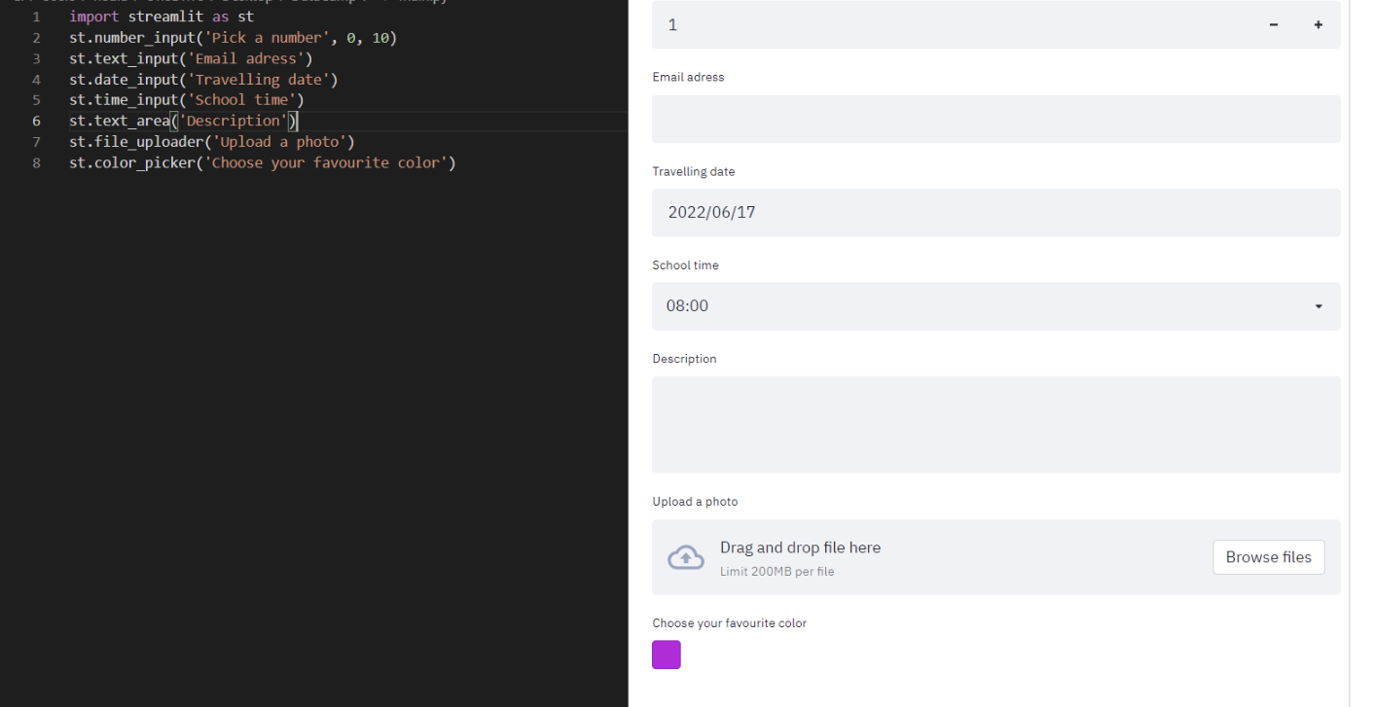
Contin..

Slide 12
Use-Cases
Let us see some use-cases of streamlit which are mostly used in the Data science field.
Pro’s and Con’s:
Pro’s:
you can easily produce a visually appealing interactive dashboard application with a slight changes to your existing python code.
You can edit your source code directly, and every time you save the file, the application will update to reflect your changes in the browser.
Con’s:
It has a speed issues if the python code is large.
Every time your application's code is modified or a user interacts with it, the full Python script is re-run in the browser.

Slide 13

References:
https://docs.streamlit.io
https://www.datacamp.com/tutorial/streamlit

