Slide 1

Social
enterprises
Non-profits
Open Social Innovation
Ecosystem DAO
For-profits
One shared rulebook for social enterprises, non-profits, for-profit organizations and the Karnataka Government
- By Pradeep Shampur, Cephas Consultancy Services Private Limited
Karnataka Government
One DAO, four kinds of members
ECOSYSTEM DAO • OPEN SOCIAL INNOVATION

Slide 2
Problem Statement
What problem are we solving?
Social enterprises, non-profits and for-profit organizations share goals, but coordinate through manual trust, siloed funds and self-reported impact.
Who is affected?
Small social enterprises and non-profits
Funders and CSR teams
The communities they serve
Why is it important?
Money and effort are lost to duplicated due diligence and delay, so less reaches the people the work is meant for.
Current challenges
Partners re-verify each other for every collaboration
Funds and data sit in separate systems
Impact claims are hard for funders to verify
Why now?
Digital identity, smart contracts and AI now make shared, transparent governance practical for small organizations.
How big?
₹40,794 crore of CSR spending by 29,546 companies in FY2024-25, up 17% year on year
An estimated 2 million social enterprises in India (rough estimate)
Sources: Bharat CSR Performance Report 2026 (Fulcrum); British Council, The state of social enterprise in India (2016)
ECOSYSTEM DAO • OPEN SOCIAL INNOVATION
02

Slide 3
Social Impact & SDG Alignment
Primary beneficiaries: Small social enterprises and non-profits, and the communities they serve.
UN SDG alignment: SDG 17 Partnerships for the Goals, SDG 8 Decent Work and Economic Growth, SDG 10 Reduced Inequalities.
Expected outcomes: Less time lost to duplicated paperwork, faster milestone-based funding, and impact that funders can verify.
Impact metrics: Tracked on a public dashboard and reported against the targets below.
Metric | Year 1 | Year 3
Member organizations onboarded | 50 | 500
Funding routed through the shared treasury | ₹2 crore | ₹25 crore
Verified impact reports published | 30 | 600
Days from approval to release of funds | 15 days | 7 days
ECOSYSTEM DAO • OPEN SOCIAL INNOVATION
03

Slide 4
Target Beneficiaries
Persona 1: Founder of a small social enterprise (illustrative)
Demographics: Leads a small team, often outside major cities.
Needs: Reliable funding, credible partners and less paperwork.
Motivations: Grow community impact and be taken seriously by funders.
Challenges: Heavy reporting, slow payments, and difficulty proving results.
Persona 2: CSR manager at a for-profit company (illustrative)
Demographics: Manages a CSR budget and answers to leadership and regulators.
Needs: Vetted partners and evidence of outcomes.
Motivations: Meet ESG goals and show credible results.
Challenges: Time-consuming due diligence and uncertain impact.
User journey: Discover → Join and verify → Propose or vote → Funds released on milestones → Impact verified and published
ECOSYSTEM DAO • OPEN SOCIAL INNOVATION
04

Slide 5
Solution Overview
Solution overview
A DAO that gives social enterprises, non-profits, for-profit organizations and the Karnataka Government one shared rulebook for decisions, funding and impact reporting.
How it works
1. Organizations join and verify their identity.
2. Members propose grants, partnerships and rules.
3. Members vote under rules written into smart contracts.
4. Funds are released from the shared treasury as milestones are verified.
Key features
Balanced voting power across member types
Transparent multi-signature treasury
Milestone-based funding
Open impact registry with independent verification
AI assistant for proposal summaries and grant matching
Benefits
Less duplicated due diligence
Faster, fairer funding
Outcomes funders can trust
Framework
Fragmented trust, funds and impact data
→
One member-run DAO with shared rules and treasury
→
Faster, transparent, verifiable collaboration
ECOSYSTEM DAO • OPEN SOCIAL INNOVATION
05

Slide 6
Innovation & Differentiation
What makes it unique?
One DAO designed for social enterprises, non-profits, for-profits and government together, with balanced voting power
Funding that follows verified milestones, not promises
Human decisions, assisted by AI that members control
Existing alternative | Limitation today | Our solution
Grant portals and NGO directories | List organizations but do not govern money or verify outcomes | Members vote on funding; releases follow verified milestones
Associations and federations | Decisions sit with a small committee, with limited visibility | Open rules, a transparent treasury and every vote recorded
Typical crypto DAOs | Built for token holders, a poor fit for NGOs and companies together | Built for mixed profit and non-profit members, with a legal wrapper and impact checks
ECOSYSTEM DAO • OPEN SOCIAL INNOVATION
06

Slide 7
Technology Architecture
Tech stack (proposed): Ethereum-compatible smart contracts, a multi-signature treasury wallet, a responsive web app and open APIs.
AI/ML usage: Assistant for proposal summaries, grant matching and anomaly flags. Humans make every decision.
Cloud infrastructure: Standard cloud hosting with backups and monitoring.
Security: Audited contracts, multi-signature approvals and role-based access.
Privacy: Personal data stays off-chain; only proofs and attestations go on-chain.
Accessibility: Mobile-first, multilingual and simple voting screens.
Ethical considerations: Transparent decision logs, member control over AI, regular bias and risk review.
Architecture flow
User
→
Application
→
APIs
→
AI layer
→
Database
→
Dashboard
ECOSYSTEM DAO • OPEN SOCIAL INNOVATION
07

Slide 8
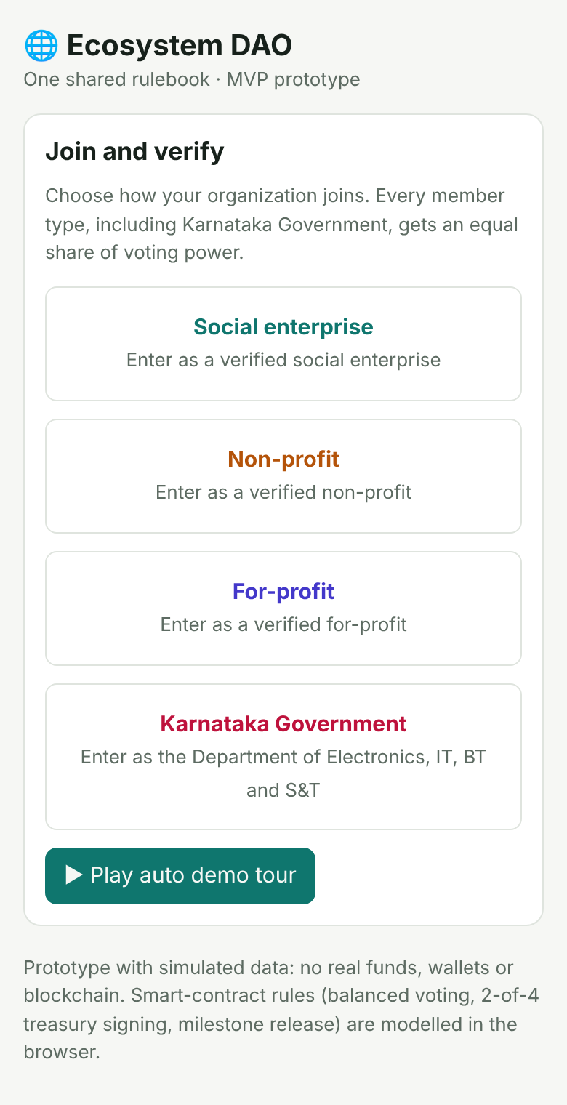
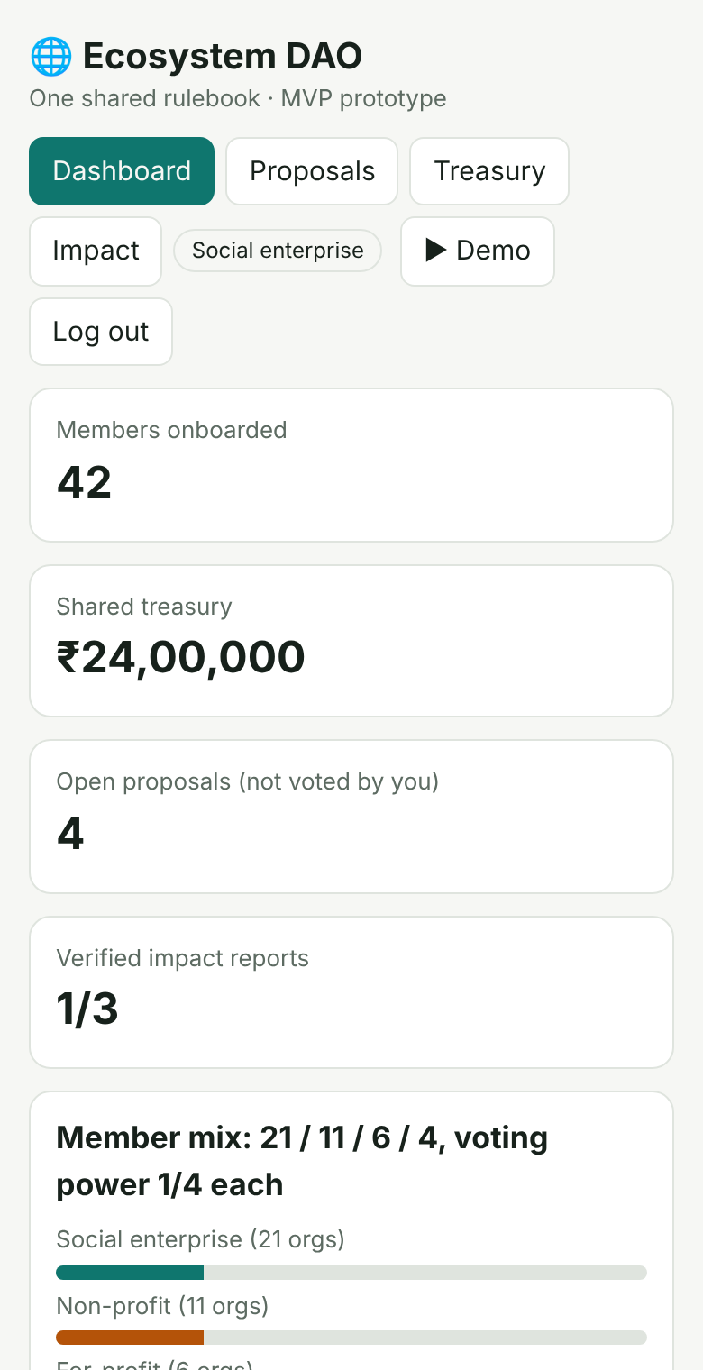
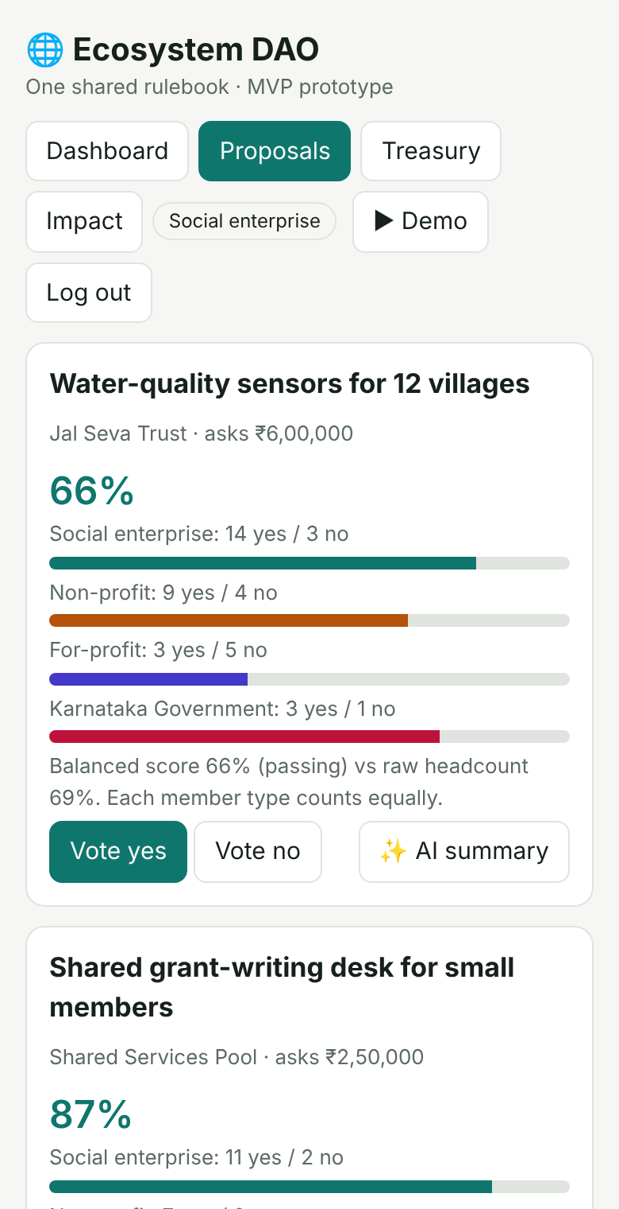
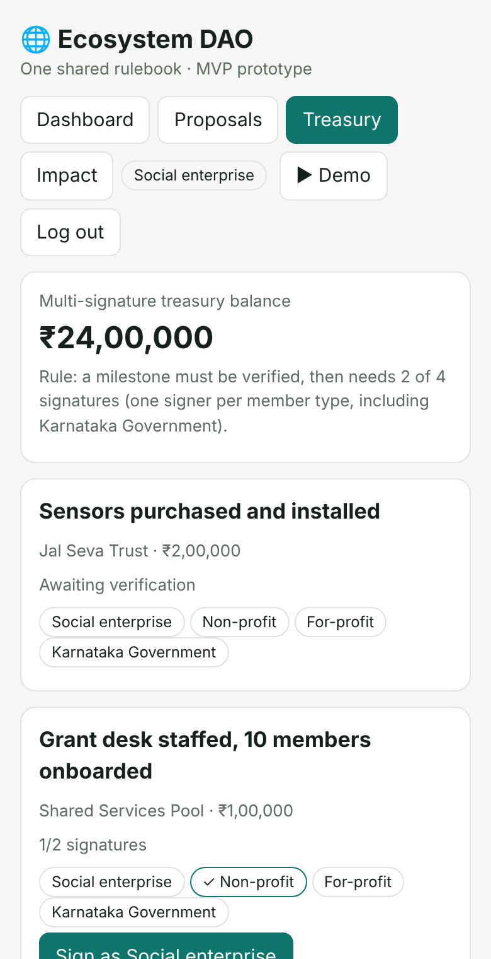
MVP / Prototype Screens
User flow: Login → Main dashboard → Proposals and voting → Treasury view → Impact reporting
Login
Main dashboard
Proposals and voting
Treasury and impact reporting
Demo explanation: The prototype is a working web app: join as a member type, vote with equal weight per member type, verify milestones, and release funds on 2-of-4 signatures. The 5-minute demo video walks through this full flow with narration.
ECOSYSTEM DAO • OPEN SOCIAL INNOVATION
08

Slide 9
Market Validation
Validation plan
Surveys of social enterprises, non-profits and CSR teams
Customer discovery with prospective founding members
Pilot feedback after the first funding round
Validation activity | Target for the pilot
Survey responses | 100+ responses from social enterprises, non-profits and CSR teams
Pilot users | 15 founding member organizations across all four member types
Waitlist | 50 organizations on the waitlist before pilot launch
ECOSYSTEM DAO • OPEN SOCIAL INNOVATION
09

Slide 10
Scalability
Geographic expansion: Start with one city cluster, then add state and national chapters as sub-DAOs.
Digital scalability: The same smart contracts and web app serve every chapter and sector.
Partnerships: Incubators, universities, CSR networks and industry bodies bring members and funders. We also plan to approach government bodies such as the Karnataka Department of Electronics, IT, BT and S&T.
Automation opportunities: Automated fund releases, onboarding checks and AI-assisted summaries reduce manual work.
Roadmap
City pilot
→
State chapters
→
National network
→
Global federation
ECOSYSTEM DAO • OPEN SOCIAL INNOVATION
10

Slide 11
Business & Sustainability Model
Revenue | Costs
Tiered membership contributions from organizations | Platform development, security audits and upgrades
Opt-in share of for-profit surplus and CSR programme fees | Legal, compliance and accounting
Fees for shared services and impact verification | Community operations and member support
Sustainability plan
A reserve share of every inflow stays in the treasury
Fees are reinvested in shared services under member vote
Grants fund the pilot only, not ongoing running costs
ECOSYSTEM DAO • OPEN SOCIAL INNOVATION
11

Slide 12
Risks & Mitigation
Members review risks every quarter, and safeguards can be changed by vote.
Risk | Impact | Mitigation
Operational | Slow onboarding and uneven participation | Delegated voting, simple tools and onboarding help for small members
Adoption | Organizations hesitate to trust a new model | Pilot with a founding cohort, publish results openly
Technology | Contract flaws or lost keys could put funds at risk | Independent audits, multi-signature treasury, staged rollout and spending limits
Regulatory | Unclear legal status of DAOs | Legal wrapper such as a Section 8 company, trust or LLP, with counsel review
ECOSYSTEM DAO • OPEN SOCIAL INNOVATION
12

Slide 13
Implementation Roadmap
90 Days
MVP completion
Pilot program with a founding cohort
180 Days
User acquisition
Partner onboarding with incubators, CSR teams and funders
365 Days
Scale to new sectors and regions
Revenue generation from membership and shared services
ECOSYSTEM DAO • OPEN SOCIAL INNOVATION
13

Slide 14
Team Structure
Founders: Pradeep Shampur, Managing Director, Cephas Consultancy Services Private Limited.
Technical team: Technical lead and two developers, to be recruited in the first 90 days.
Business team: Partnerships lead and a community manager, to be recruited in the first 90 days.
Advisors/mentors: Advisors in governance, legal structuring (Section 8 company, trust or LLP) and CSR, to be invited.
Proposed structure
Managing Director
→
Technical lead
→
Developers
Managing Director
→
Partnerships lead
→
Community and growth
ECOSYSTEM DAO • OPEN SOCIAL INNOVATION
14

Slide 15
Financial Requirements
Funding requirement: ₹60 lakh over 12 months
Category | What it covers | Amount
Product development | Prototype, smart-contract audit and web app | ₹30 lakh
Marketing | Member outreach, events and community building | ₹12 lakh
Operations | Legal wrapper, compliance, accounting and support | ₹18 lakh
Total |  | ₹60 lakh
ECOSYSTEM DAO • OPEN SOCIAL INNOVATION
15

Slide 16
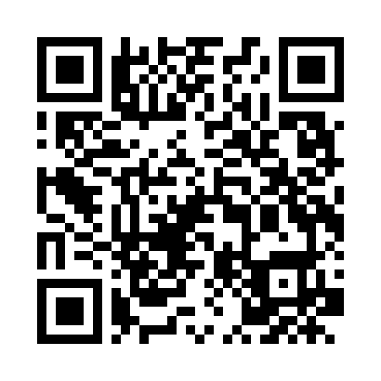
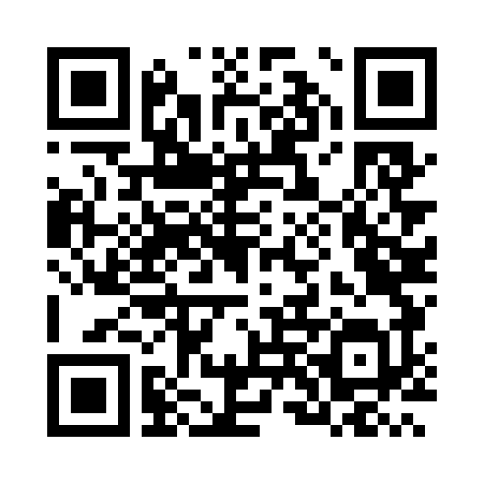
Ask & Next Steps
What support do we need?
Mentorship: governance design and social-sector adoption
Funding: complete the prototype and seed the pilot treasury
Pilot customers: founding members across all four member types
Pilot partners: incubators, universities and CSR networks; government bodies such as the Karnataka Department of Electronics, IT, BT and S&T to be approached
Technology support: smart-contract audits and cloud credits
Strategic partnerships: funders and institutions for national reach
Closing statement
“Ideas Can Create Big Impact When Technology, Purpose, and People Come Together.”
Queries & feedback: Pradeep Shampur, Managing Director, Cephas Consultancy Services Private Limited · consult@cephasconsult.biz · +91-97421 57392
Demo access: No login needed. Open the link, choose any member type on the first screen, then explore the Proposals, Impact and Treasury tabs, or tap ▶ Demo for a guided tour.
Scan For Demo
cephasconsult.github.io/ecosystem-dao-mvp
ECOSYSTEM DAO • OPEN SOCIAL INNOVATION
16

