Slide 1
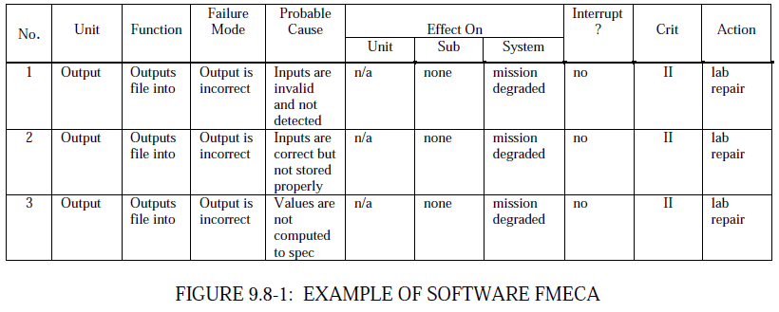
Fault Modeling
FMECA – spreadsheet-driven fault modeling
Enumerate fault scenarios, effects, and criticality
Use the table to drive analysis and testing
From Mil Relibility Guide:

Slide 2
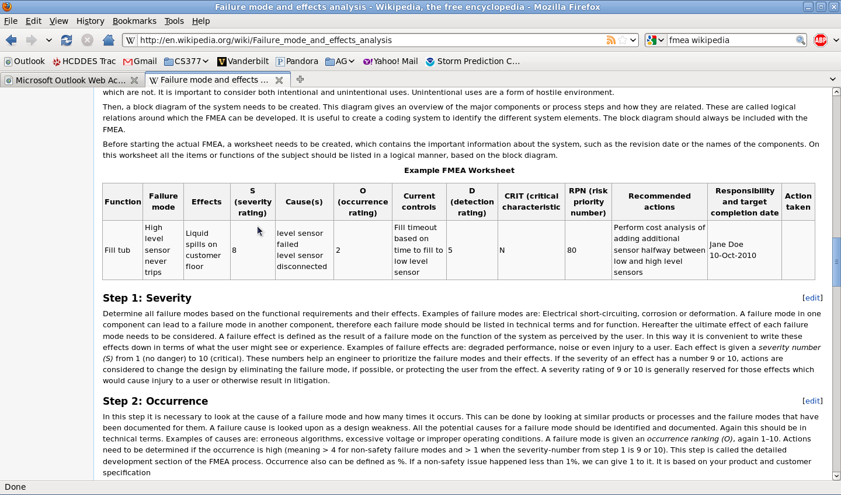
Fault Modeling
Wikipedia example (FMEA, with risk priority numbers -- 1-10 each)
severity
occurrence
detection
RPN = S x O x D
Help prioritize the faults and direct development efforts.

Slide 3
Questions
Is the spreadsheet a good modeling format? It helps with systematic coverage and categorization of all faults we can think of.
Modeling use cases – what questions must be answered by the models?
To what level have we detailed the causes/effects of each fault?
To what degree have we mitigated each fault?
Do we know fault severity, occurrence, and detectability?
How does the FMECA worksheet information correlate with what we have in the ESMoL model? What information do we need to add to ESMoL?
Use cases – can we use statistical model checking with fault scenarios to analyze confidence for the design?

Slide 4
Questions
What about test coverage?
What information needs to go into test descriptions?
Modeling: Is it simpler/useful to simply refer to external test specs?

