Slide 1


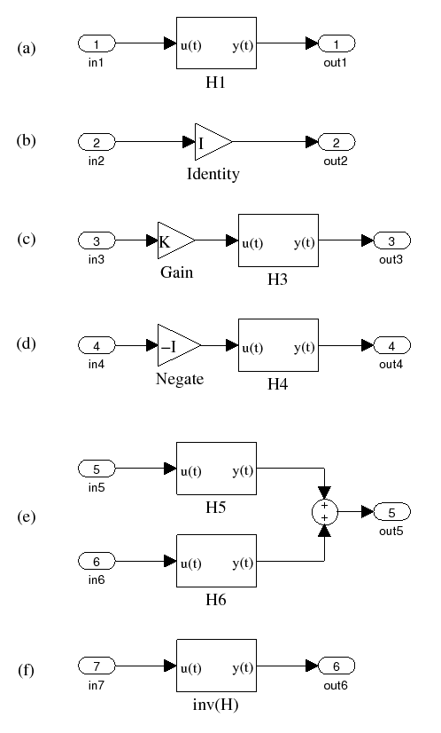
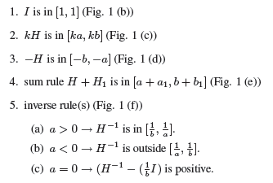
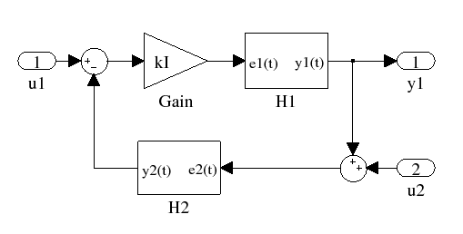
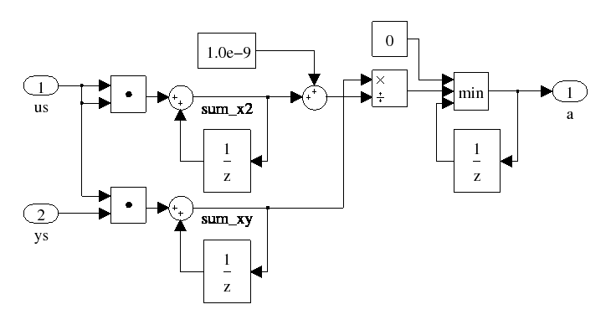
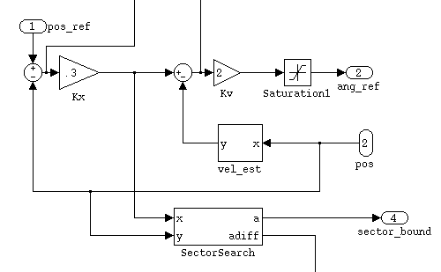

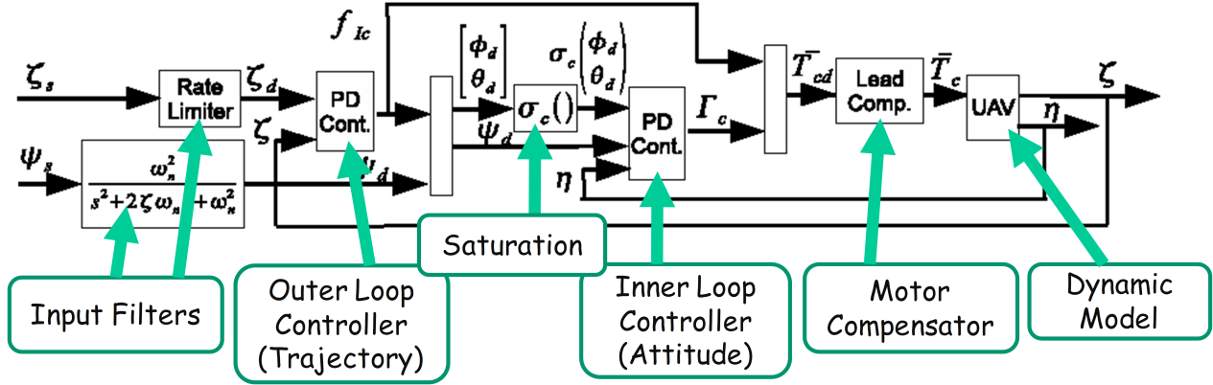
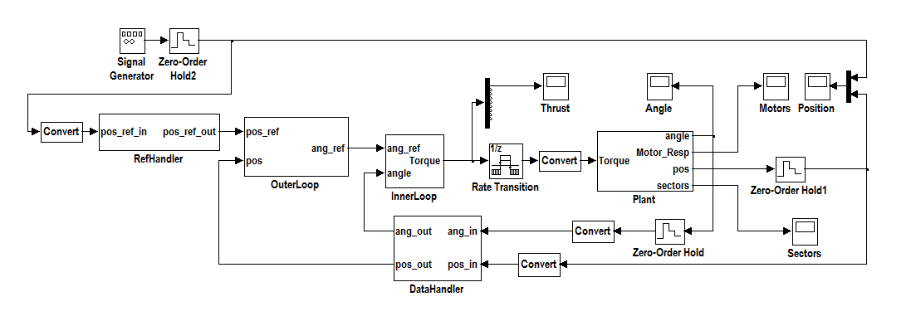
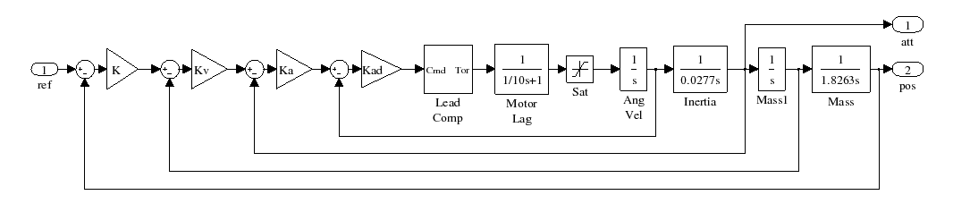
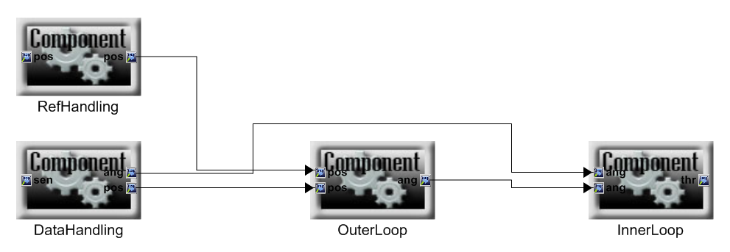
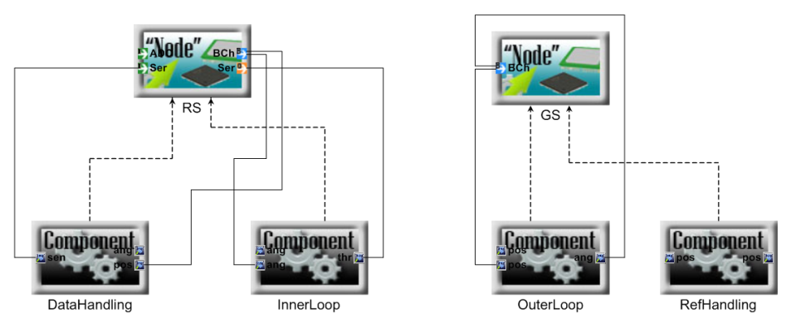
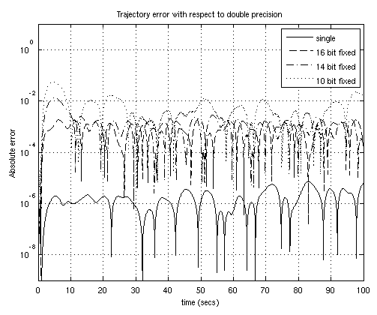
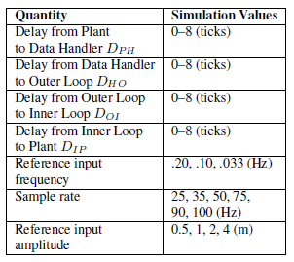
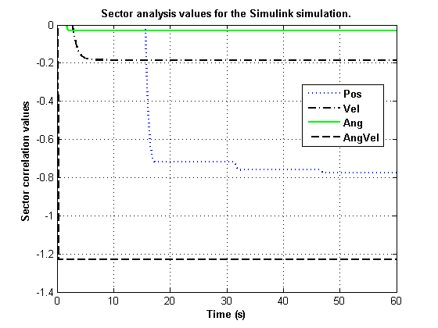
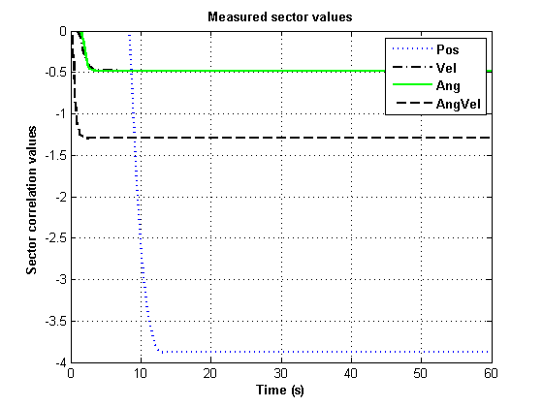
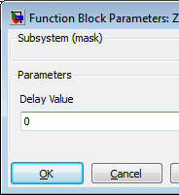
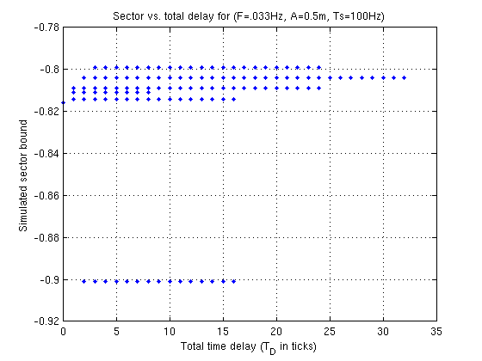
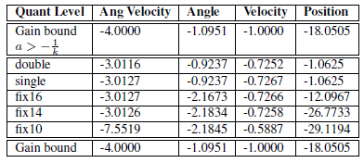
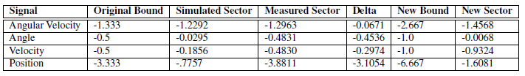
Online Stability Validation Using Sector Analysis
ISIS, Vanderbilt University
Compositional Control Design and Analysis
Passivity
Sector Analysis
 | Power balance equation
 | Energy balance equation
 | Dissipation condition
 | Passivity condition
Conic systems are a superset of passive systems ([0,b]). Stability is easy to determine using gain conditions.
Sector analysis follows simple compositional rules.
 | Input signal
 | Output signal
 | Stored energy
 | Dissipated energy
 | Energy produced by the component so far (output) in interval T.
 | Energy received by the component so far (input) in interval T.
 | Correlation between input and output sample values in interval T. This measures dissipation.
 | Real-valued sector lower bound.
 | Real-valued sector upper bound.
Passive systems exhibit robustness to time delays and quantization errors, preserving stability.
Parallel and feedback interconnections of passive systems are passive.
Joseph Porter, Graham Hemingway, Nicholas Kottenstette, Gabor Karsai, Janos Sztipanovits
Feedback Gain Conditions
Online Analysis
Quadrotor helicopters –
discrete-time controller is not quite passive[9]:
Hold operation introduces small amounts of energy (quantified by sector bound a).
Fast dynamics aggravate the problem.
Sufficient gain condition for L2 stability:
Analyzer
Connecting the analyzer
Limitations
Sector condition is only sufficient.
Sector analyzer approximates.
Analysis requires high precision and worst-case inputs.
Analysis must starting at the beginning of time with reasonable initial conditions.
Evaluation is criteria are design-specific – use carefully.
Simplified Quadrotor Example
Architecture
Model-Based Distributed Control
Software Implementation Using ESMoL
Simulink
TrueTime
Control Loops
ESMoL Logical Architecture (Dataflow)
Evaluation of Analyzer
Delay Effects via Brute Force
HIL Evaluation of Platform Effects
ESMoL Deployment Spec
Quantization noise modeled by discrete-time Gaussian disturbance with variance
Comparison of measured bound with gain bound for different quantization levels.
Quantization sensitivity looks good, but delay sensitivity is inconclusive.
For delay sensitivity, the outliers at -0.9 roughly correspond to
sensor and actuator delays.
Quantization effects via sensor noise injection

