Slide 1
Online Stability Validation Using Sector Analysis
Joseph Porter, Graham Hemingway,
Nicholas Kottenstette, Gabor Karsai,
Janos Sztipanovits
ISIS, Vanderbilt University

Slide 2
Basic Problem
Transitioning safety-critical control system designs from Simulink (continuous time) to software (discrete time, distributed implementations)
How do we maintain guarantees for safety, stability, performance, etc…?
Ideally, we would like to focus on correct-by-construction techniques for our design domains (i.e. control and real-time systems design).

Slide 3

Passivity
Passive systems theory builds on the idea that physical passive systems are compositional with respect to stability [10].
Passive systems exhibit robustness to time delays and quantization errors, preserving stability [3,4,8].
Parallel and feedback interconnections of passive systems are passive.
u(t) | Input signals
y(t) | Output signals
S(t) | Stored energy
D(t) | Dissipated energy
 | Power balance equation
 | Energy balance equation
 | Dissipation condition
 | Passivity condition

Slide 4

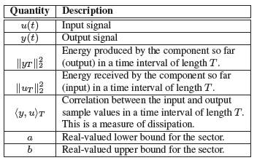
Conic Systems and Sector Analysis
Zames’ generic framework for both continuous-time and discrete-time analysis [21]
Analyze nonlinear control designs for gain and stability
System gain is max( |a|, b )
Interior conic systems (or components) have a bounded output/input ratio for all time
Conic systems are a superset of passive systems (a>=0)
Framework is also compositional (next slide)
y(t)
b
u(t)
a

Slide 5
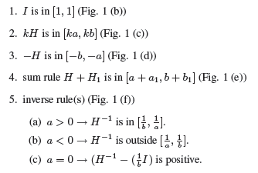
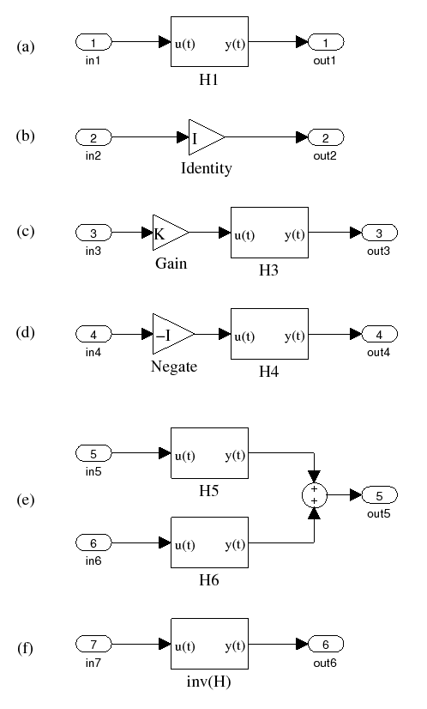
Conic Systems and Sector Analysis

Slide 6
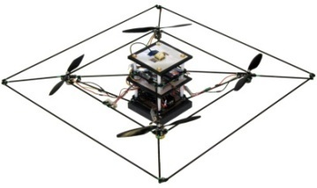
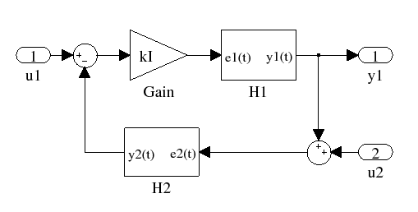

Conic Systems and Sector Analysis: Feedback
Quadrotor helicopters – discrete-time controller is not quite passive[9]:
Hold operation introduces small amounts of energy (quantified by sector bound a).
Fast dynamics aggravate the problem.
Sufficient condition for L₂ stability

Slide 7
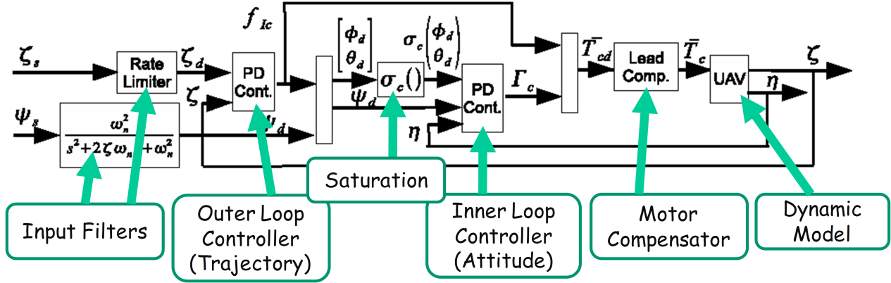
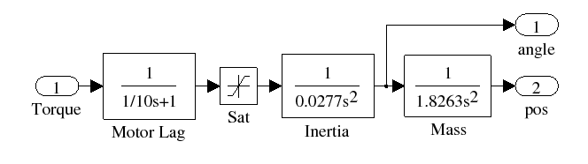
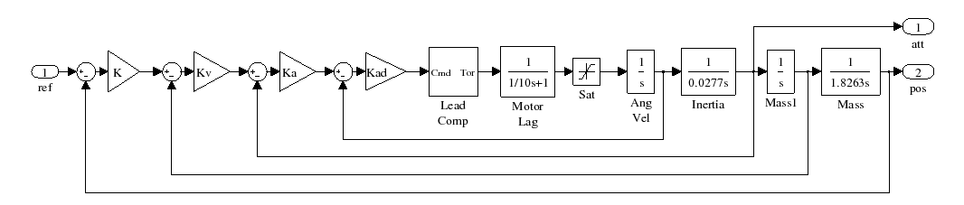
Sample Application: Quadrotor Helicopter (Simplified)
Architecture
Simplification for analysis.
Simplified Plant
Dynamics
Control Loops

Slide 8
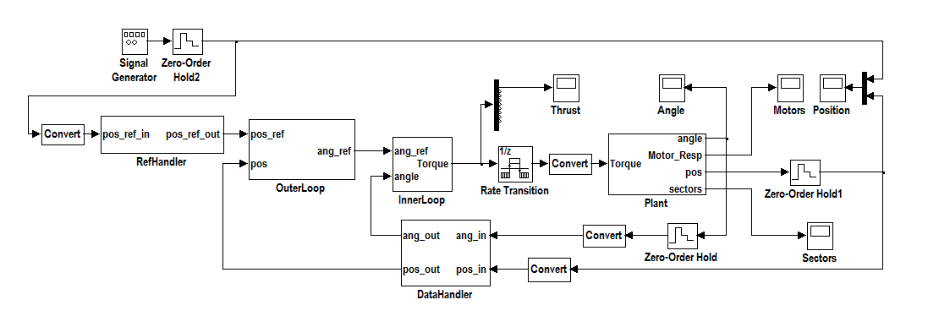
Quad Integrator Model
Each controller component implements two loops, with a velocity estimator.
Reference input scaling.
Sensor data scaling/data distribution component.

Slide 9
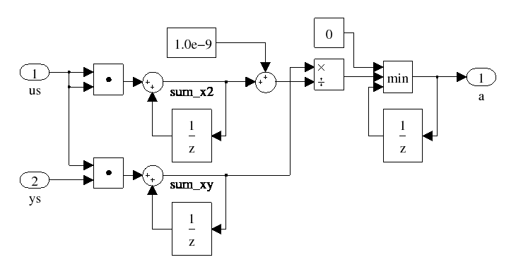
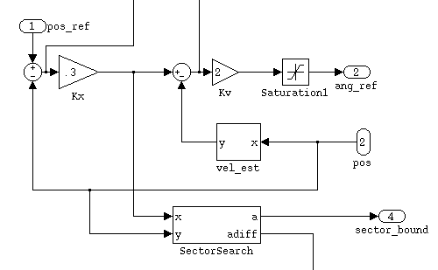
Online Sector Analysis
Simulink Version
Integration Example
Limitations
Sector condition is only sufficient.
Sector analyzer approximates.
Analysis requires high precision and worst-case inputs.
Analysis must starting at the beginning of time with reasonable initial conditions.
Evaluation is criteria are design-specific – use carefully.

Slide 10
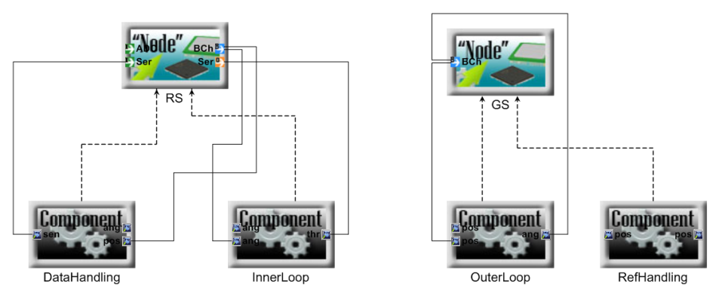
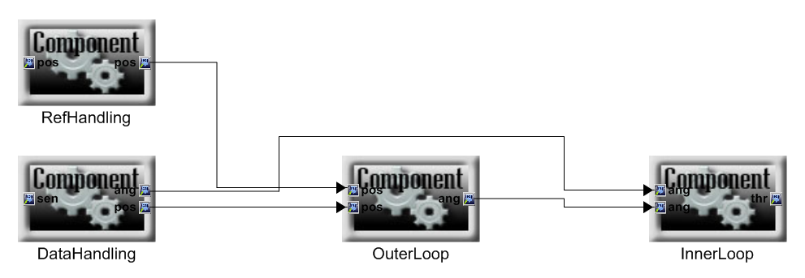
Model-Based Design: ESMoL
TrueTime
Simulation
Simulink Design
ESMoL Logical Architecture
ESMoL Deployment Specification

Slide 11
Model-Based Design: ESMoL
Simulink Design
Mathworks’ xPC Target
ESMoL Logical Architecture
ESMoL Deployment Specification

Slide 12
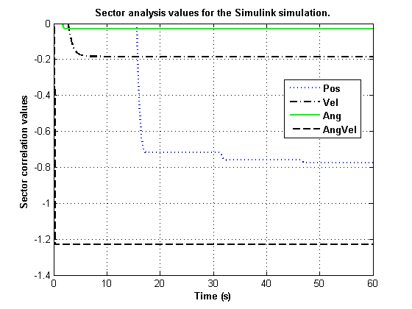
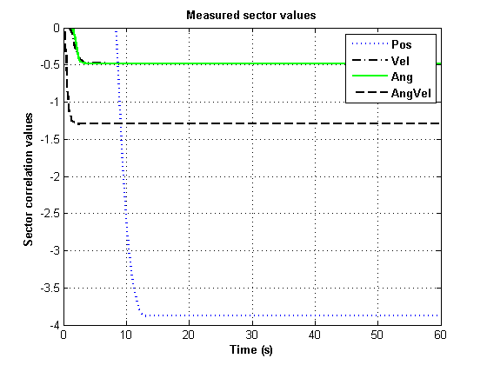
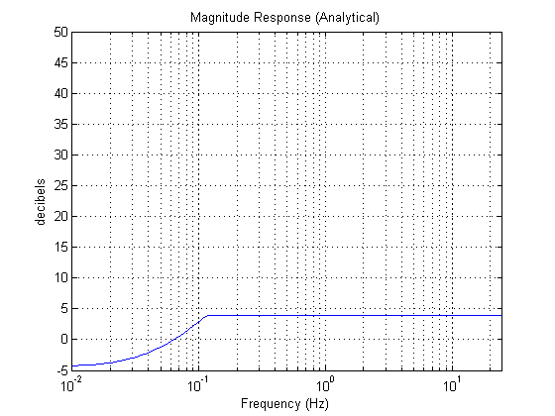
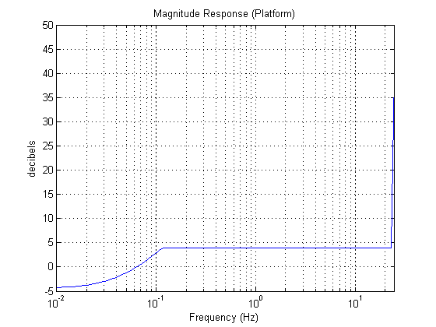
Validating a Hardware-In-the-Loop Quadrotor Controller

Slide 13
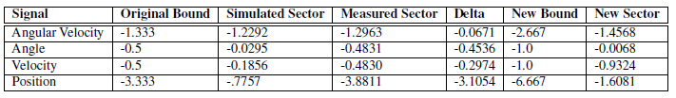
Validating a Hardware-In-the-Loop Quadrotor Controller

Slide 14
Evaluation: Quantization Error Sensitivity by Noise Injection
Quantization noise modeled by discrete-time Gaussian disturbance with variance

Slide 15
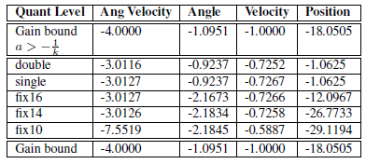
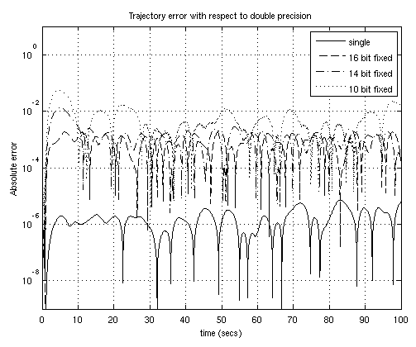
Evaluation: Quantization Error Sensitivity
We simulated the effects for different quantization models (single, fix16, fix14, fix10) using the noise model.
Quantization noise modeled by discrete-time Gaussian disturbance with variance

Slide 16
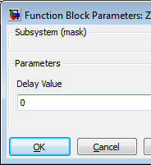
Evaluation: Network Delay Simulation by Brute Force
Synchronous delay model (with zero delay possible).
Over 400,000 data sets.

Slide 17
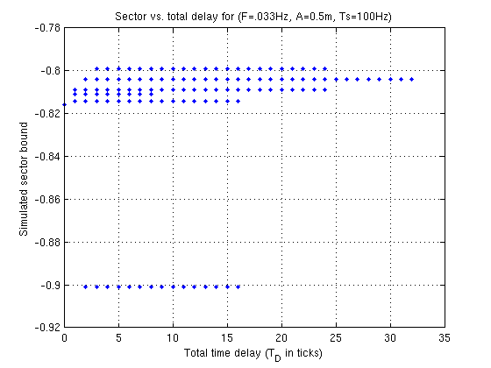
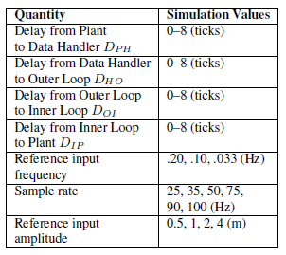
Evaluation: Network Delays
Synchronous delay model (with zero delay possible).
Over 400,000 data sets.
Data gap corresponds to an odd distribution of delays:
D_{PH} > 0 and D_{HO} = 0 and
D_{OI} = 0 and D_{IP} > 0

Slide 18
Related Work
Similarities to work in online verification [2,19]
Online statistical techniques for timing and safety
Sammapun et al [14] – RT-MaC uses stochastic models to check timeliness and reliability for confidence intervals
Zuliani et al[22] – statistical model checking for Simulink models
Other promising techniques
Anta/Tabuada[1] - self-triggered control determines sampling triggers online from bounds derived from stability criteria
Skaf and Boyd [15,16] – offline techniques using constraint models to determine maximum quantization while preserving control objectives

Slide 19
Future Work
Efficiency and accuracy requirements – is a fixed-point implementation possible?
More comparisons between parameterized simulations and hardware deployment (also against TrueTime).
Compare with models that have known delay sensitivity.
More distant future…
Switched/hybrid systems – is this technique too conservative?
Integration into tools
Automatic generation into test models
Use as a condition check in statistical verification models [22]

Slide 20
Questions?

Slide 21
References
[1] A. Anta and P. Tabuada. To sample or not to sample: Self-triggered control for nonlinear systems. IEEE Trans. on Aut. Control, PP(99):1 –1, 2010.
[2] H. Barringer, A. Goldberg, K. Havelund, and K. Sen. Rule-based runtime verification. In Verification, Model Checking, and Abstract Interpretation, volume LNCS 2937, pages 277–306. Springer Berlin / Heidelberg, 2004.
[3] N. Chopra, P. Berestesky, and M. Spong. Bilateral teleoperation over unreliable communication networks. IEEE Transactions on Control Systems Tech., 16(2):304–313, Mar 2008.
[4] A. Fettweis. Wave digital filters: theory and practice. Proc. of the IEEE, 74(2):270 – 327, 1986.
[8] N. Kottenstette and P. J. Antsaklis. Stable digital control networks for continuous passive plants subject to delays and data dropouts. In CDC ’07: Proc. of the 46th IEEE Conf. on Decision and Control, pages 4433 – 4440, 2007.
[9] N. Kottenstette and J. Porter. Digital passive attitude and altitude control schemes for quadrotor aircraft. In ICCA ’09: 7th IEEE Intl. Conf. on Control and Automation, Christchurch, New Zealand, 2009.
[10] M. D. la Sen. Some conceptual links between dynamic physical systems and operator theory issues concerning energy balances and stability. Informatica, 16(3):395–406, 2005.
[14] U. Sammapun, I. Lee, and O. Sokolsky. RT-MaC: runtime monitoring and checking of quantitative and probabilistic properties. In 11th IEEE Intl. Conf. on Emb. and Real-Time Comp. Systems and App., pages 147 – 153, Aug 2005.

Slide 22
References
[15] J. Skaf and S. Boyd. Filter design with low complexity coefficients. IEEE Trans. on Signal Proc., 56(7):3162–3169, Jul 2008.
[16] J. Skaf and S. Boyd. Controller Coefficient Truncation Using Lyapunov Performance Certificate. Intl. Journal of Robust and Nonlinear Control, Mar 2010.
[19] W. Visser, K. Havelund, G. Brat, S. Park, and F. Lerda. Model checking programs. Automated Software Engineering Journal, 10(2), April 2003.
[21] G. Zames. On the input-output stability of time-varying nonlinear feedback systems part one: Conditions derived using concepts of loop gain, conicity, and positivity. IEEE Transactions on Automatic Control, 11(2):228–238, Apr 1966.
[22] P. Zuliani, A. Platzer, and E. M. Clarke. Bayesian statistical model checking with application to stateflow/simulink verification. In HSCC 2010: 13th Intl. Conf. on Hybrid Systems: Computation and Control, pages 12–16, Stockholm, Sweden, Apr 2010.

