Slide 1
High Confidence Design for Distributed Embedded Systems AFOSR MURI
Graduate Student
Collaboration Meeting

Slide 2
MURI Challenges and Goals
Building networked control systems (UAVs)
Scalability of analysis and design tools
Techniques to provide robustness to network uncertainty
Proving that you built the right stuff, and built it correctly
Certification via DO-178B
Safety requirements and levels
Traceability from code
Avoiding re-verification of the whole design

Slide 3
Decoupling Methods
Decoupling Controller Properties from Platform Uncertainties
Boyd’s approach
Fettweiss wave digital filters. Sensitivity approach.
Passive network control systems.
Decoupling Function from Timing: Time-Triggered Architecture
Time-triggered architecture
What requirements does it impose on the platform?
How does it work in a design flow?
Loose Time-triggered architecture? - less platform restrictions
Compositional Scheduling – even less platform restrictions (more conservative)
Decoupling Component Behavior from Interaction
Simulation in Ptolemy
Actors capture component (block) behavior
Directors coordinate actors
A director can be an actor (hierarchy)
Verification
BIP

Slide 4
VU Work in Progress
Toolchain
ESMoL Language
Schedulability analysis
PF-Specific Simulation
PF-Specific Code Generation
FRODO Virtual Machine
Hardware-in-the-Loop Simulation
Expanded Semantics
Deadlock analysis
Control Design
Quadrotor control
Passivity theory
Quantization effects
Network uncertainties
Laboratory
Hardware in the loop simulator
Remote access

Slide 5

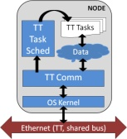

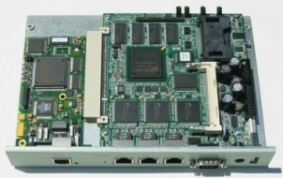


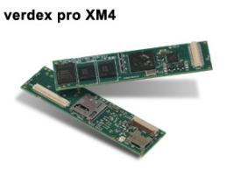
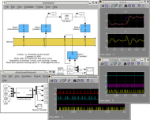

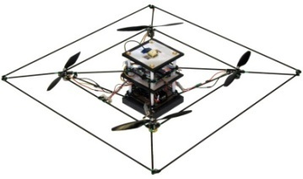
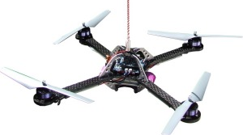

Toolchain
Time-Triggered
Virtual Machine
Constraint-Based Scheduling
Soekris Linux Platform
ESMoL/GME
Platform-Specific Code
Gumstix/Robostix
Time-Triggered Resimulation
Plant Simulation
STARMAC
Hummingbird
LMI Passivity Analysis
PaNeCS/GME

Slide 6
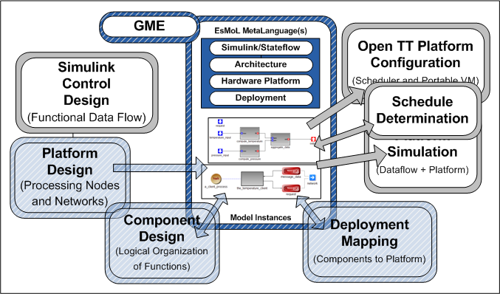
Toolchain
Problems Integrating Tools:
Semantic variations
Developer variations

Slide 7
Toolchain
Problems Integrating Tools:
Semantic variations
Developer variations
Solution?: MetaAdapter Architecture
Nothing too novel – compilers use intermediate languages
Formalizes the way interpreters are written by hand
Rockwell-Collins formal methods group uses Lustre as an IL
Front-End
Design
Language(s)
“Flat” Intermediate Language
Target
Language(s)
Target
Language(s)
Target
Language(s)
Target
Language(s)

Slide 8
Toolchain
Problems Integrating Tools:
Semantic variations
Developer variations
Solution?: MetaAdapter Architecture
Nothing too novel – compilers use intermediate languages
Formalizes the way interpreters are written by hand
Rockwell-Collins formal methods group uses Lustre as an IL
Translation Details go Here
Traverse and generate
(simple)
Front-End
Design
Language(s)
“Flat” Intermediate Language
Target
Language(s)
Target
Language(s)
Target
Language(s)
Target
Language(s)
Information feeds back to the designer

Slide 9
Interesting Problems
Quantization
Composition by passivity
Modeling & Analysis
Putting into the workflow
Mixed MoCs in the VM
Time-triggered + RM + Event-Driven?
What makes sense in HC designs?
How do we implement it?
How do we model it?
Scheduling
Integration of Tools
Verification
What to verify?
Where does it fit in a workflow?
Semantic translation
Details, details…

Slide 10
Passivity and Quadrotors
Passive Control Tutorial
What is passivity?
Why is it useful?
How are we using it?
What are the limitations?
Application to Quadrotor Dynamics
Dynamic models
Are quadrotors passive?
Control design for quadrotors
Proving stability

Slide 11
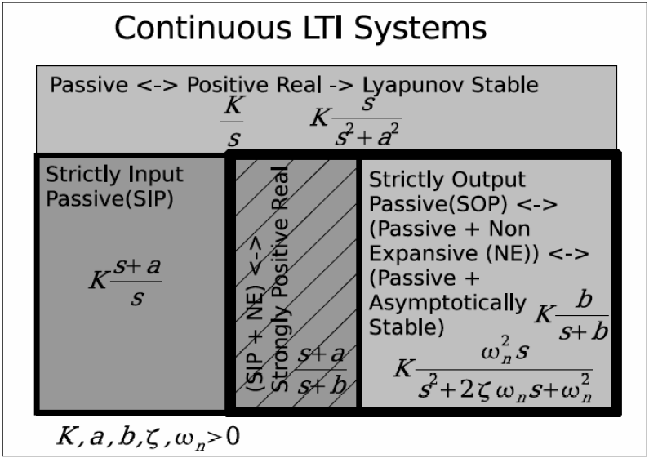
What is passivity?
Interface property of a dynamic system
Constraint on rate of change of energy in a system.
More formally, the system satisfies:

Slide 12
Why is it useful?
Interface property of a dynamic system
Constraint on rate of change of energy in a system.
This implies Lyapunov stability
(set P_{in} to 0 to check)
More formally, the system satisfies:
from Kottenstette (Diss)

Slide 13
Why is it useful?
Interface property of a dynamic system
Implies Lyapunov stability
Compositionality reduces the analysis burden
Feedback connections are passive
Parallel connections are passive
Rough scalability numbers:
Take 10 linear SISO components in a system with three states each
Case | SDP Problem Size | SDP Solver Iters | Approx Runtime
Global Stability Problem | 30x30 | 20 | 4.9 seconds
Decoupled Stability Problems | (3x3 each) x10 | 10 x 8 | 10 x 0.1 seconds

Slide 14
How are we using it?
Passive Architectures
Model structures
Preserving passivity
Helping passivity
Design blocks
Simulink blocks for building and analyzing passive designs
Implementation
Network structures
Wave variables
Power junctions
Quantization effects
Wave variables
Work in progress

Slide 15
How are we using it?
Multiple Plants,
Single Controller
No assumptions about network delays

Slide 16
How are we using it?
Multiple Plants,
Single Controller
No assumptions about network delays
Plants
Controller

Slide 17
How are we using it?
Multiple Plants,
Single Controller
No assumptions about network delays
}
Wave Transform
Plants
Controller
Power Junction

Slide 18
What are the limitations?
Performance
Passivity addresses robustness with respect to stability
Performance robustness is still not well-characterized (platform effects are a big factor)
Theory still in development
What can we do with it, and how?

Slide 19
Quadrotor Dynamics
Quadrotor Control Architecture
Input Filters
Outer Loop
Controller
(Trajectory)
Inner Loop Controller
(Attitude)
Motor Compensator
Quadrotor

Slide 20
Quadrotor Dynamics
Quadrotor Control Architecture
Input Filters
Outer Loop
Controller
(Trajectory)
Inner Loop Controller
(Attitude)
Motor Compensator
Quadrotor

Slide 21
Quadrotor: Simulink Model
Dynamics
Sensors (GPS +
Accelerometer)
Inner Loop
(Attitude Control)
Outer Loop
(Position Control)
Open up the model and look

Slide 22
Are quadrotors passive?
Not so much…
…but if we can make the interface passive, then we can use passive techniques.

