Slide 1
The ESMoL Modeling Language and Tools for Synthesizing and Simulating Real-Time Embedded Systems
Problems to Solve
Application Domain:
Safety Critical Embedded Systems
Goals:
Easily capture system architecture and hardware in models.
Work from existing engineering designs and tools.
Componentize functional models.
Model deployment of software components on the hardware.
Integrated support for verification and certification.
Approach:
Domain-Specific Modeling Languages (ESMoL)
Model-Integrated Computing (MIC)
Hardware-in-the-Loop Simulation
Joseph Porter, Zsolt Lattmann, Graham Hemingway,
Nagabhushan Mahadevan, Sandeep Neema, Harmon Nine, Nicholas Kottenstette, Péter Völgyesi,
Gábor Karsai, and János Sztipanovits
Institute for Software Integrated Systems (ISIS)
Vanderbilt University
Nashville, TN 37235, USA

Slide 2
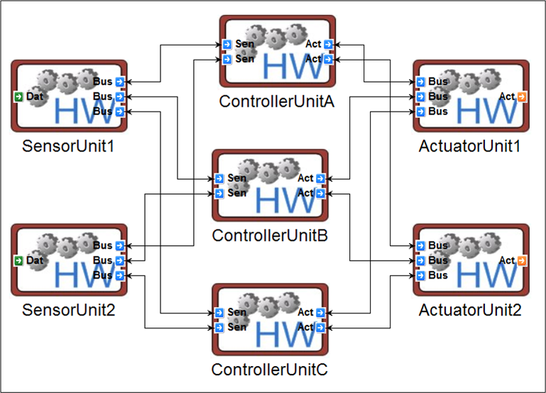
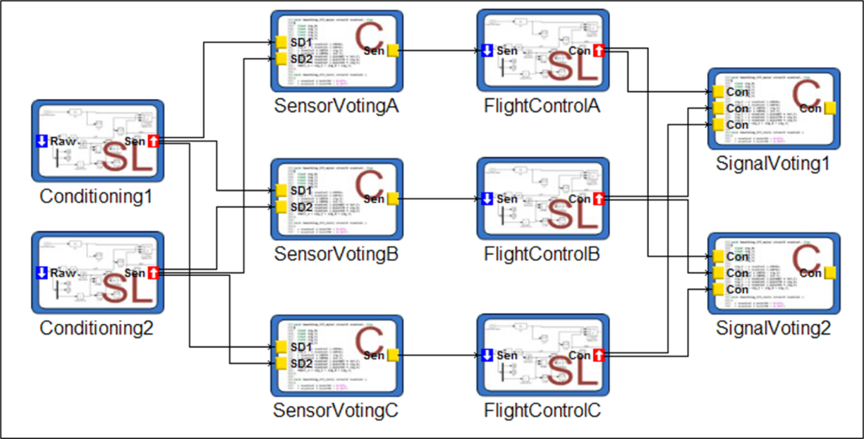
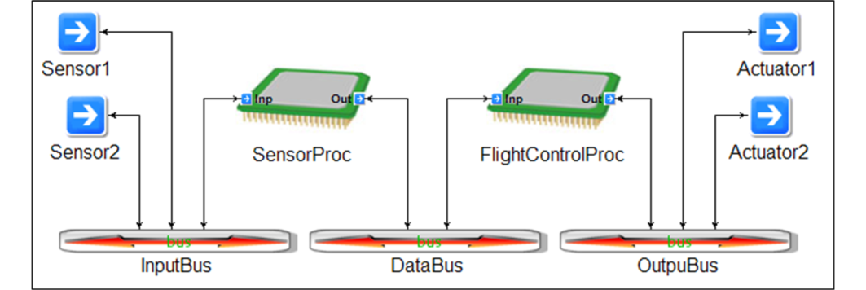
ESMoL: Embedded Systems Modeling Language
Hardware language models hierarchically describe platform topology.
Software Architecture Models capture component instances and their relationships.

Slide 3
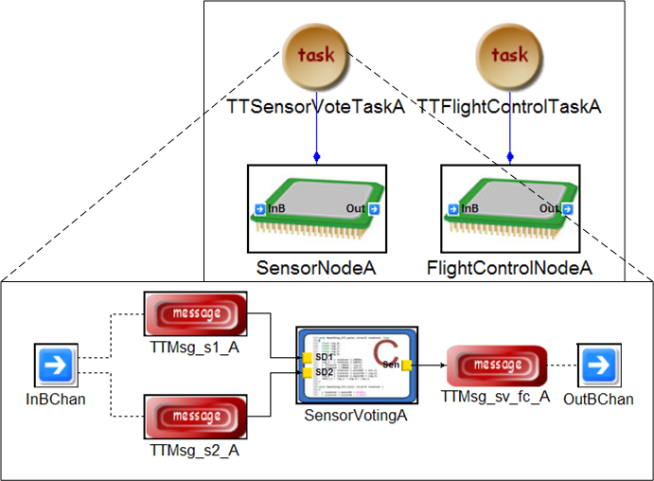
ESMoL: Deployment (where the action occurs)
Tasks execute on a single node, and all task components run at the same rate.
References to components and bus channels define the mapping from architecture to hardware.
Platform-specific code (e.g. for communication) and configuration are also generated from deployment models.

Slide 4
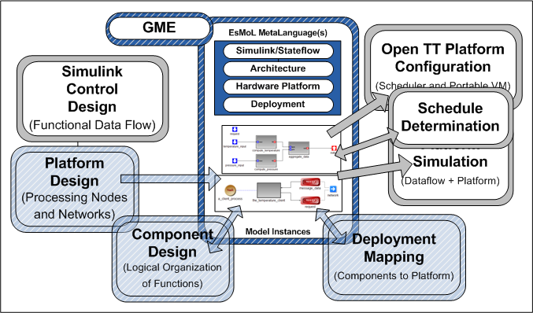
Integrating Tools (In Progress)

Slide 5
Demonstration: STARMAC Quadrotor

Slide 6
Simplified Model for Demo

Slide 7
xPC Target Hardware-in-the-Loop Simulation
Two sides run at the same rate, but delayed.

Slide 8
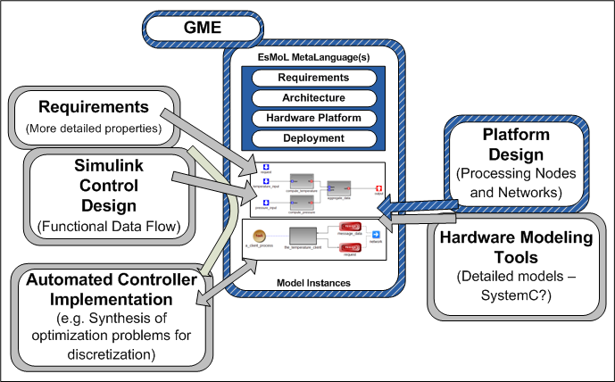
Wishlist: The future…
Traceability, design space exploration/optimization...
Synthesis of tests and verification conditions.
Expansion of platform models and capabilities.
Expanded semantics… event-triggered flows for fault handling.
Generation of optimization problems for control properties and hybrid verification models.
What else?

