Slide 1




Towards a Model-based Toolchain for the High-Confidence Design of Embedded Systems
Creating software tools for certified distributed embedded control systems by bringing together
Dynamics/control system modeling
Software component design
Meaningful simulation
Code generation
Model/code verification
Execution on platforms with guarantees
Model-based test generation
Janos Sztipanovits, Gabor Karsai, Sandeep Neema, Harmon Nine,
Joseph Porter, Ryan Thibodeaux, Peter Volgyesi, and Peter Humke

Slide 2

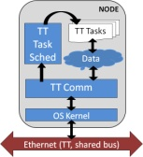

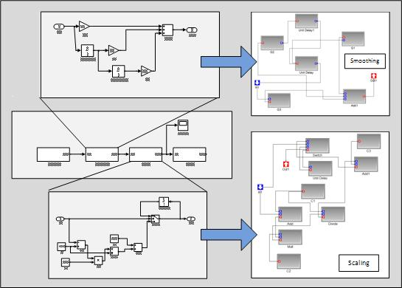
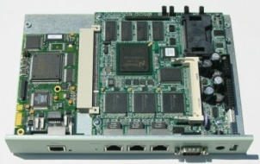
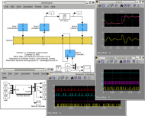

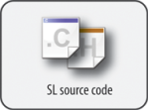
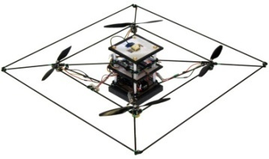

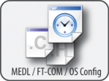
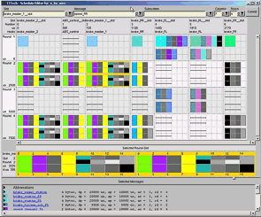

Control System Design and Software Component Modeling
Time-Triggered
Virtual Machine
Simulink models are translated to ECSL-DP models
Constraint-Based Scheduling
Soekris Linux Platform
Time-Triggered Resimulation
STARMAC
Source Code Analysis
Plant Simulation
LMI Performance Certificates
Imported Simulink models are assigned to software components and mapped to hardware.
TTTech TTP Tools
LMI models relate performance parameters (jitter, network delay) to control objectives.

Slide 3
Schedule Generation and (Re)Simulation
Time-Triggered
Virtual Machine
Constraint-Based Scheduling
Constraint solver produces schedule (if feasible).
Soekris Linux Platform
Time-Triggered Resimulation
TrueTime Simulink extension simulates original model and time-triggered network.
Finite domain integer constraint models represent network, tasks, messages, and timing (latency).
STARMAC
Source Code Analysis
Plant Simulation
LMI Performance Certificates
Mathworks xPC target used to simulate the controlled plant. Local controller is built and tested in actual hardware.
TTTech TTP Tools
*Special thanks to Peter Humke of ISIS for developing the TrueTime infrastructure.

Slide 4
Generation of Code and Configuration
Time-Triggered
Virtual Machine
Source code (C or Java) generated by a model transformation to an abstract model for imperative code.
Constraint-Based Scheduling
Soekris Linux Platform
Time-Triggered Resimulation
Automated source analysis verifies properties of the generated code
(e.g. Java Pathfinder).
STARMAC
Source Code Analysis
Plant Simulation
Configuration/schedule for TTTech time-triggered platform is also generated from the models.
LMI Performance Certificates
TTTech TTP Tools

Slide 5
Deployment and Testing
Time-Triggered
Virtual Machine
LMI Performance Certificates
Schedule and source are deployed to a portable VM running on an inexpensive ethernet-based cluster.
Constraint-Based Scheduling
Soekris Linux Platform
Time-Triggered Resimulation
Assured code generation
for the Starmac
quadrotor helicopter
is the overall goal.
STARMAC
Source Code Analysis
Plant Simulation
TTTech TTP hardware target is used for testing.
TTTech TTP Tools

