Slide 1



New Developments in Model-Integrated Development of High-Confidence Software
Graham Hemingway, Joseph Porter,
Nicholas Kottenstette, Harmon Nine, Chris vanBuskirk,
Gabor Karsai, and Janos Sztipanovits
Institute for Software Integrated Systems
Vanderbilt University

Slide 2
Problems and Complications
Problems to Address in
High-Confidence Design
Layered, Conflicting Design Concerns
Behavioral uncertainty of control designs on distributed platforms
Fault management and design validation
Certification
Plant Dynamics
Models
Controller Models
Controller design
Software
Architecture
Models
Software Component Code
Software design
System
Architecture Models
Resource
Management
Models
System Platform Design

Slide 3
Problems and Potential Solutions
Problems to Address in
High-Confidence Design
Solution Approaches
Constructive methods
Platforms with deterministic execution semantics
Platform modeling and simulation
Fault modeling
Statistical model checking
Requirements traceability
Models as documentation
Behavioral uncertainty of control designs on distributed platforms
Fault management and design validation
Certification

Slide 4
Addressing Uncertainty: Compositional Methods
Compositional methods rely on component behavior conditions, interconnection rules, and associative interface properties to guarantee correct behavior, reducing verification burdens.
CONTROL
DESIGN
SOFTWARE
IMPLEMENTATION
DESIGN
SOFTWARE
ANALYSIS
GENERATION
& EXECUTION
SYNCHRONOUS EXECUTION/
TIME-TRIGGERED
ARCHITECTURE
PASSIVE CONTROL
TECHNIQUES
FOR STABILITY
COMPOSITIONAL
SOFTWARE ANALYSIS
(Timing, Deadlock)
Constructive design assumptions must be maintained throughout the implementation process.
Notes:
Constructive = synthesis from requirements and composition rules

Slide 5
Addressing Uncertainty: Deterministic Execution
Time-Triggered Architecture is a robust model of execution for high-confidence embedded systems.
Static execution schedule for both tasks and communications
Good fault detection and recovery characteristics
Strong time synchronization between nodes - on message transmission
Requires accurate on-line schedule execution
Bus
Node A Schedule
(@ 5ms) - Receive msg
(@ 10ms) - Task A
(@ 15ms) - Send msg
Node A

Slide 6
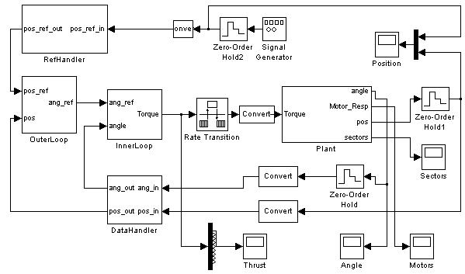

Addressing Uncertainty: Platform Modeling
Deployment of a software model onto an actual hardware platform can introduce unexpected issues =
Platform Effects
Time-related differences
Numerical differences
Platform flaws
Environmental effects
Error conditions
And more...
+

Slide 7
Current Approaches
What are the common current approaches for simulating and analyzing platform effects for embedded systems?
Hacking Simulink model
Co-simulation
Actual deployment and testing on prototype hardware
Custom-built simulation environment
SystemC / AADL

Slide 8
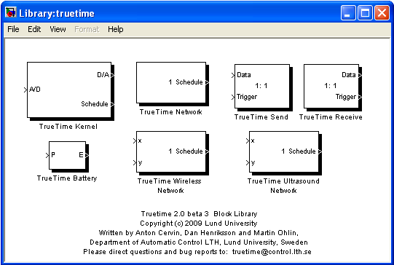
TrueTime toolkit for Simulink
Set of Simulink blocks for simulating task scheduling and execution and network communication.
Task-level execution
Diverse & detailed network models
C++/M-code/SL-block integration
Highly flexible on-line scheduler + API
Standard Simulink visualization of schedule execution

Slide 9

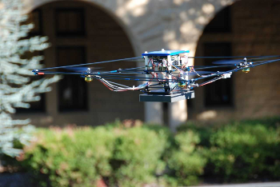
Example - Quad-Integrator Controller
Simplified controller from an actuator-limited quad-rotor helicopter - of course, built in Matlab/Simulink.
InnerLoop
OuterLoop
Plant
DataHandling

Slide 10
ESMoL Modeling Process
Several steps are required to synthesize a TTA-based TrueTime model using the ESMoL toolchain.
Import controller design from Simulink
Define components and message types
Generate component functional code
Create deployment hardware configuration
Deploy components and messages
Calculate time-triggered schedule
Synthesize the TrueTime model
Notes:
Side note: support for hardware-in-the-loop simulation, TT runtime layer(FRODO)
All steps take place inside of the GME modeling tool
7th step is the contribution

Slide 11
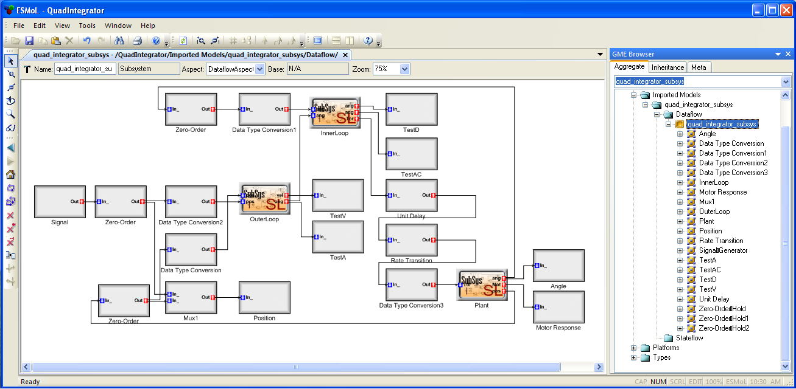
Step 1 - Import Controller from Simulink
Automated import tool reads Simulink model and creates equivalent model in ESMoL language. Multiple models of computation are supported:
Sub-Languages
Dataflow
Stateflow
Petri-nets
Notes:
Initial focus on Matlab/Simulink, now expanding sub-language support to non-TTA based approaches
See GME on right

Slide 12
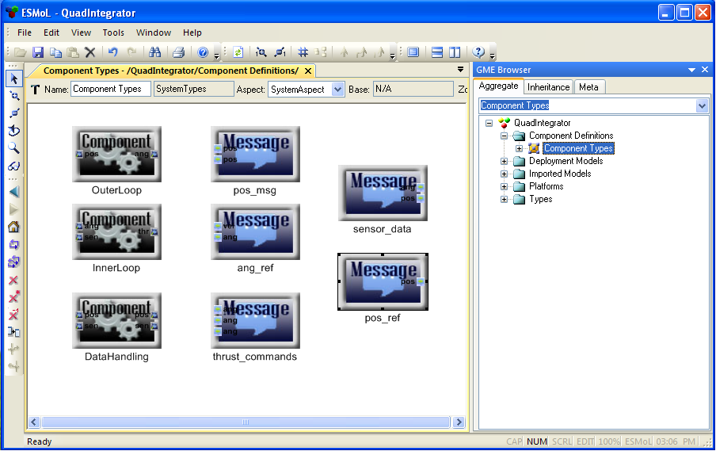
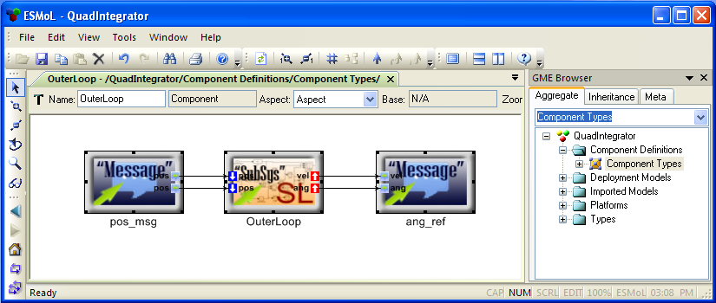
Step 2 - Define Comp. & Message Types
Component types are created from references to imported models. Message types define inputs and outputs to component types.
Referenced SL Block
Input Msg
Output Msg

Slide 13
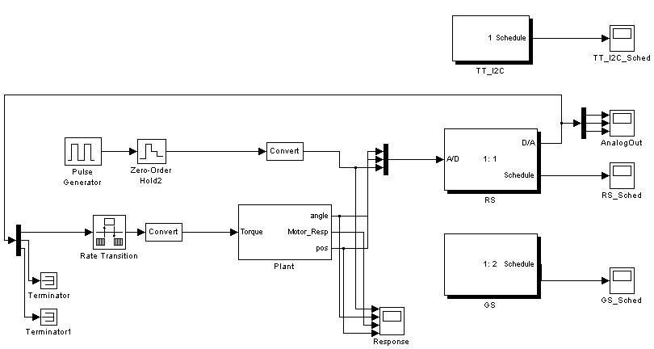
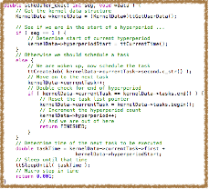
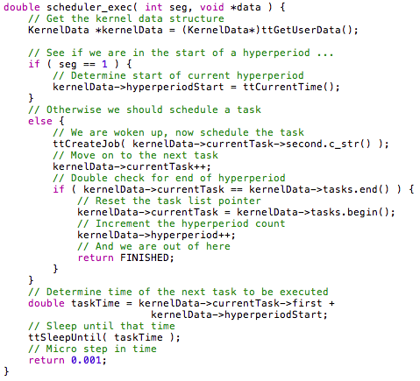
Step 3 - Generate Functional Code
C-code is automatically synthesized from component definitions and is linked into final execution environment.
Exactly the same code is used in all environments
Only two entry functions per component:
Initialization function
Execution function
TrueTime
C-code
ESMoL Component
Deployment

Slide 14
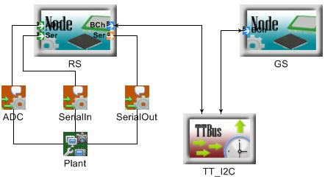
Step 4 - Define Hardware Configuration
A complete hardware platform definition is added into the ESMoL model.
Nodes
Each block contains internal configuration information
In example:
Robostix Node (RS)
Gumstix Node (GS)
TT I²C Bus
Quad-integrator plant reference
Plant
Comms Bus

Slide 15
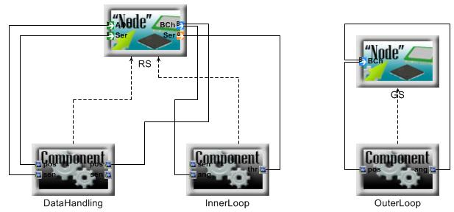
Step 5 - Deploy Components & Messages
Instances of software components are “deployed” onto hardware nodes. Component in/out messages are mapped to node communication ports.
Notes:
Stress instances of components. May have multiple instances of same component type.
Port mapping must translate to valid communications network.

Slide 16

Step 6 - Calculate Execution Schedule
An off-line constraint-based solver creates the static schedule for task execution and all communication
Each component & bus contains scheduling information
Specify WCET & frequency for each task and message
Determines length of global hyperperiod
Determines when to start execution in hyperperiod
ESMoL Model
Execution
Schedule
Problem
Details
Constraint-based Scheduler

Slide 17
Step 7 - Synthesize TrueTime Model
The synthesis of a complete TrueTime model has two distinct aspects: the Simulink model and the code implementing time-triggered behavior.
Simulink Model
Synthesis of new Simulink model
Time-triggered online scheduler
Task execution loop
TTA Code

Slide 18
Mapping ESMoL to TrueTime
There is a mapping from ESMoL model software & hardware elements to TrueTime blocks and code:
ESMoL Node
TT Kernel
ESMoL Bus
TT Network
ESMoL Plant
Simulink Block
ESMoL Component
C-Code

Slide 19
TrueTime - New Model Synthesis
Based on the defined hardware configuration, a new Simulink model using TrueTime blocks and original plant block is created.
DataHandling
InnerLoop
OuterLoop

Slide 20
TrueTime - The TTA Glue Layer
A “glue-code” layer must live between the new Simulink model and the functional code. This is where the TTA behavior exists. We also use this glue layer code as a virtual machine on the actual hardware.
TrueTime Simulink Model
Time-Triggered Glue Layer
Comp A
Comp B
Comp C

Slide 21
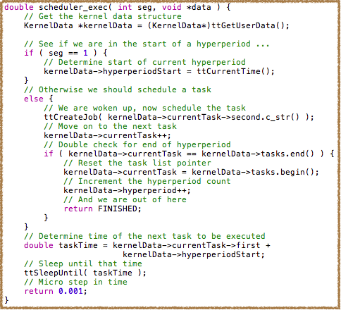
TrueTime - Time Triggered Scheduler
The default TrueTime scheduler is augmented using a custom-built reusable time-triggered scheduler.
Maintains pointer to next task
Consumes some simulation time each invocation
Resets each hyperperiod
Allows for modeling faults
WCET overrun
Task collision
etc...
Uses TrueTime schedule for actual task execution

Slide 22
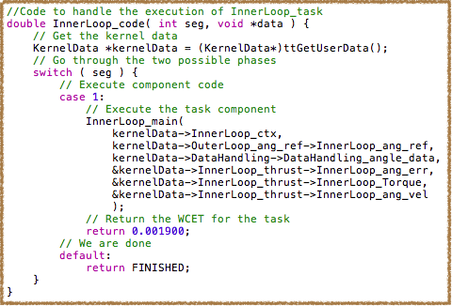
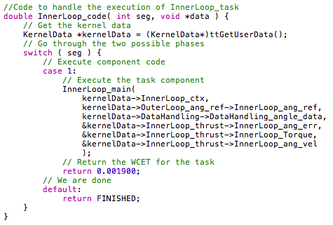
TrueTime - Task Execution Loop
Each task or communication (send/receive) is invoked by the TrueTime scheduler, at the request of the on-line TTA scheduler.
Stores persistent data in KernelData structure, maintained by TrueTime
Calls generated functional code
Consumes task-specific amount of simulation time
Does allow for modeling of faults

Slide 23
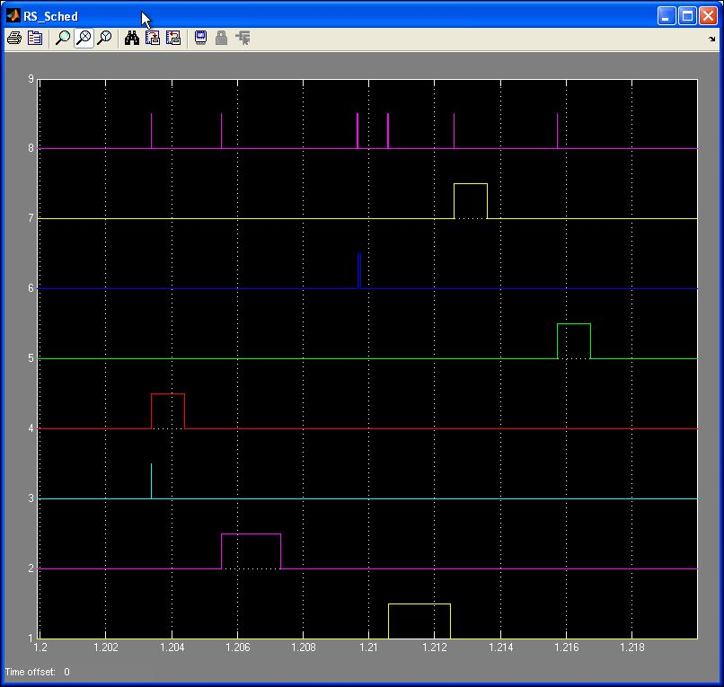
Results - Execution Schedule
Schedule execution is visualized using standard Simulink scopes. One scope is created per task and network.
Custom TT Scheduler
Inner Loop Task
Data Handler Task
Actuator Output
Bus Comms. #1
Sensor Input
Bus Comms. # 2
Outer Loop Task

Slide 24
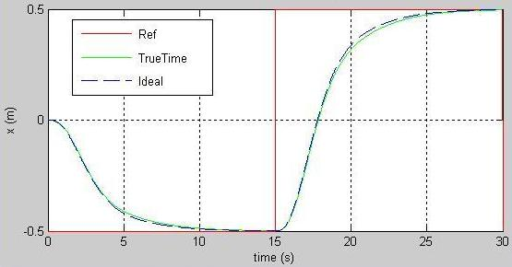
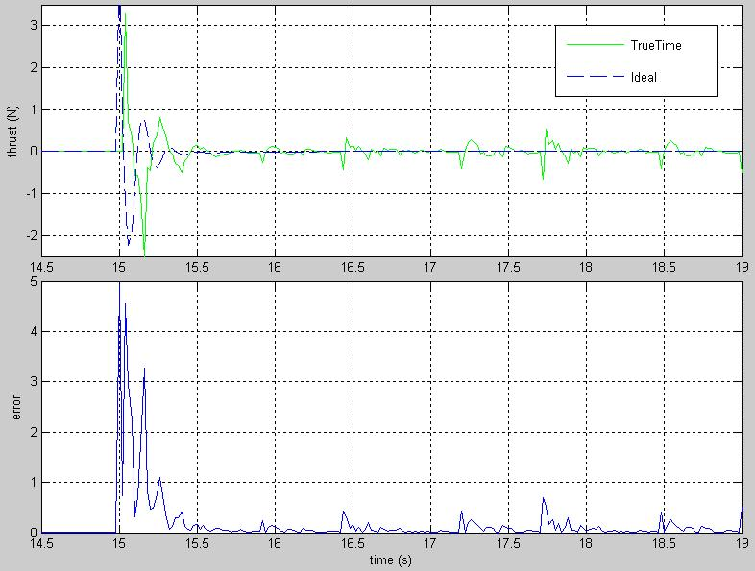
Results - Tracking
Tracking performance is close to ideal…
…but platform effects are successfully simulated

Slide 25
Faults: Validation (WIP)
We extended the Simulink Quadrotor model with a random (Poisson-distributed in time and duration ) sensor fault. During the fault, all of the sensor outputs are zero.
Statistical model checking sees the system as a black box, so we used an LTL error condition on the measured trajectory. “For 500 seconds of the trace, it will never be true that the error of either x, y, or z will exceed the specified bound for more than 50 seconds.”
How did we do? Well, it shouldn’t crash more than 10% of the time under these fault conditions…
¬ F[500] G[50] ( ex > 400 | ey > 400 | ez > 100 )

Slide 26
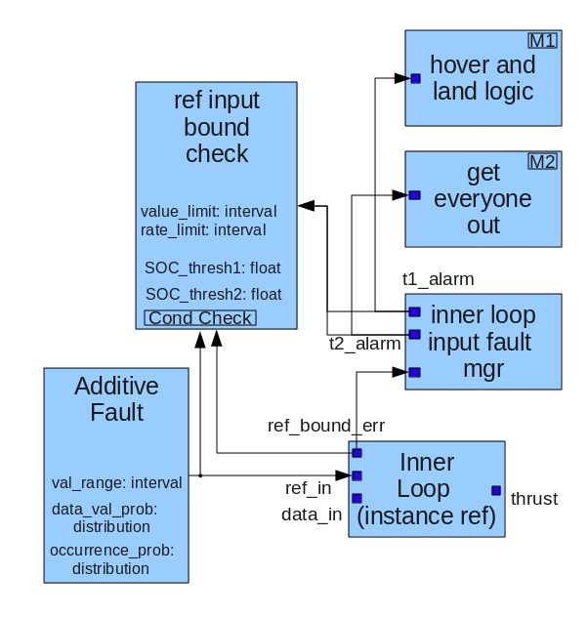
Certification: Requirements, Tests, etc…
ESMoL language extensions to model possible faults, including relationships to test scenarios and requirements.
Generate a Simulink simulation of any fault that we can model
Generate code for fault injection in the controllers
Capture relationships between fault detection code, executing components, runtime environment, and mitigation
Test case generation – input data, expected output data, correctness conditions
Regression tests for bugs – associate with bug reports and software versions
Scripts for running tests, comparing outputs with expected results, evaluating correctness conditions, and collecting statistical results.
Mock-up of modeling concepts

Slide 27
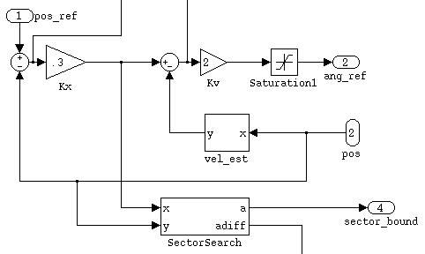

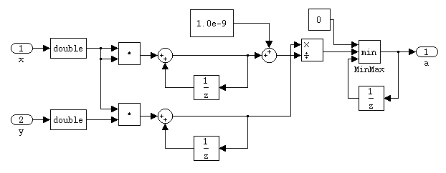
Stability: Validation (WIP)
Fast quadrotor dynamics introduce a small amount of active behavior. Sector search relates control gain to an interval behavior bound abstraction.
Example: Quadrotor position tracking uses a passive PD controller, and we validate the position gain using sector search around the gain loop
( Kx < -1/a ).
Sector search works in simulation as well as in software, so we can adjust gains for platform effects and iterate the design evaluation process.

Slide 28
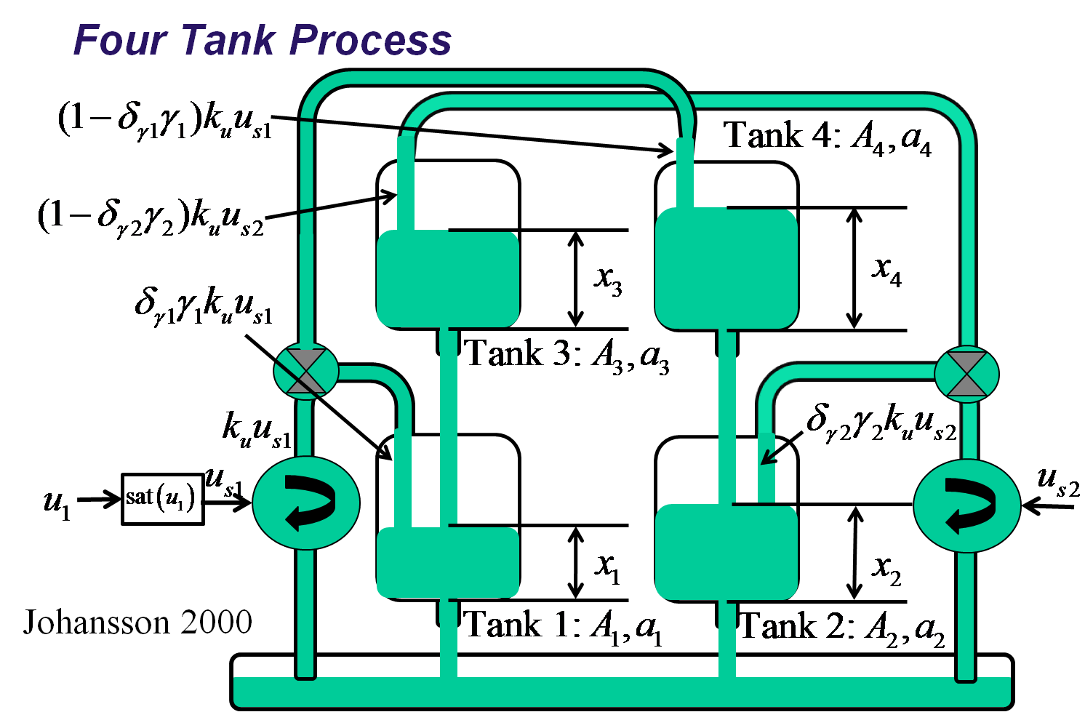
Control Design Highlights
We are also investigating tools to automate the design of low-complexity controllers for nonlinear systems.
Specifically, we are looking at Interconnection Damping Assignment-Passivity Based Control (IDA-PBC)
We are addressing issues related to actuator saturation and discrete-time implementations.
Applied the prototype tools to coupled tank control system models.
Control Law
Integrator Anti-Windup Compensator

Slide 29
Control Design: IDA-PBC
Bilinear transform approximation worked well for discrete-time integrators.

Slide 30
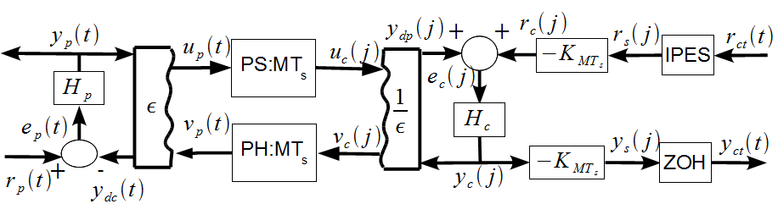
Control Design: Delay-Insensitive Control of Conic Systems
Framework can not only be applied to passive systems, but also to interior conic dissipative systems inside the sector [a,b], in which a < 0 (a passive system is inside the sector [0, ∞]).
We applied these results to direct position control of two haptic paddles used in a telemanipulation example.
Result includes a novel manner to couple the two paddles using an orthogonal matrix in order to retain a strictly passive control structure.

Slide 31
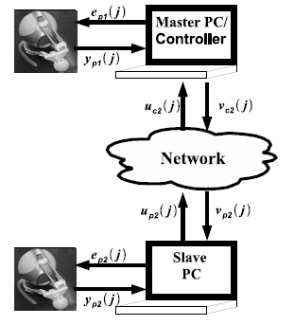
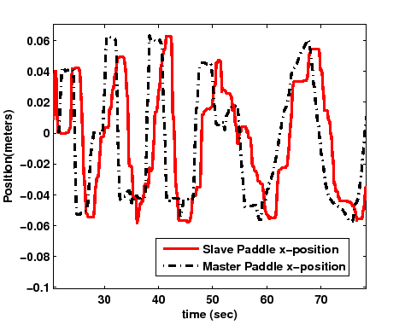
Control Design:Haptic Paddles

Slide 32
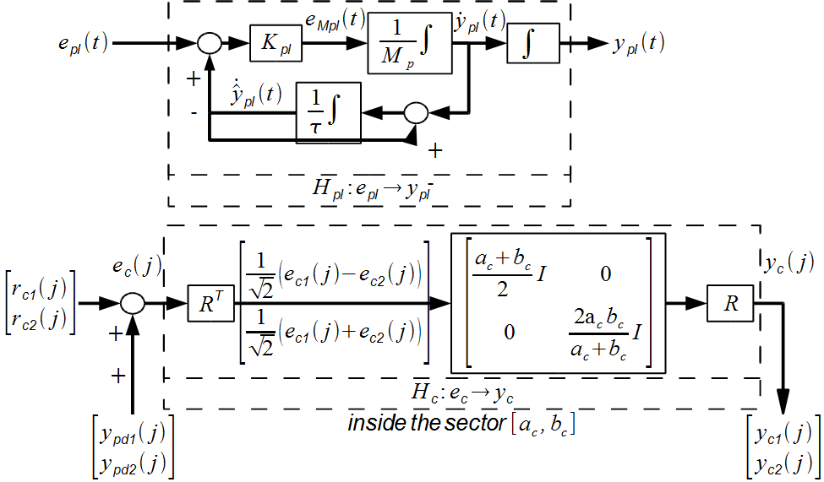
Control Design: Delay-Insensitive Control of Conic Systems

Slide 33
References
F. Balarin, et. al. Metropolis: An integrated electronic system design environment. Computer, 36(4):45–52, April 2003.
A. Basu. Component-based Modeling of Heterogeneous Real Time Systems in BIP. PhD thesis, VERIMAG, 2008.
A. Basu. BIP2 User Manual. VERIMAG, 2009.
A. Basu, M. Bozga, and J. Sifakis. Modeling heterogeneous real-time components in BIP. In SEFM, volume 6, pages 3–12, 2006.
P. Caspi, et. al. From Simulink to SCADE/Lustre to TTA: A layered approach for distributed embedded applications. In Proceedings of the 2003 ACM SIGPLAN Conference on Languages, Compilers, and Tools for Embedded Systems, pages 153–162. ACM New York, NY, USA, 2003.
A. Cervin, M. Ohlin, and D. Henriksson. Simulation of net- worked control systems using TrueTime. In Proc. 3rd Inter- national Workshop on Networked Control Systems: Tolerant to Faults, 2007.
P. V. den Bosch and E. V. de Waal. A case study of multi- disciplinary modeling using Matlab/Simulink and TrueTime. In Proceedings of INCOSE Symposium, 2005.
J. Eker and A. Cervin. A Matlab toolbox for real-time and control systems co-design. In Proceedings of the 6th International Conference on Real-Time Computing Systems and Applications, pages 320–327, 1999.
E. Farcas, C. Farcas, W. Pree, and J. Templ. Transparent distribution of real-time components based on logical execution time. In Proceedings of the 2005 ACM SIGPLAN/SIGBED Conference on Languages, Compilers, and Tools for Em- bedded Systems, pages 31–39. ACM New York, NY, USA, 2005.
T. Grotker. System design with SystemC. Kluwer Academic Publishers Norwell, MA, USA, 2002.
D. Henriksson, A. Cervin, and K. Arzen. TrueTime: Real-time control system simulation with Matlab/Simulink. In Proceedings of the Nordic MATLAB Conference, Copenhagen, Denmark, 2003.
T. Henzinger, B. Horowitz, and C. Kirsch. Giotto: A time-triggered language for embedded programming. Lecture Notes in Computer Science, 2211: 166-184, 2001.
P. Zuliani, A. Platzer, E. M. Clarke. Bayesian Statistical Model Checking with Application to Stateflow/Simulink Verification. HSCC 2010 (Hybrid Systems: Computation and Control), Apr. 12-16, 2010, Stockholm, Sweden.

Slide 34
References (Continued)
W. Herzner, et. al. Model-based development of distributed embedded real-time systems with the DECOS tool-chain. In Proceedings of the 2007 SAE AeroTech Congress & Exhibition. Citeseer, 2007.
J. Hudak and P. Feiler. Developing AADL models for control systems: A practitioner’s guide. Tech. Rpt. CMU/SEI-2007-TR-014, Software Engineering Institute (SEI), 2007.
H. Kopetz. Real-time systems: Design principles for distributed embedded applications. Springer, 1997.
H. Kopetz and G. Bauer. The time-triggered architecture. Proceedings of the IEEE Special Issue on Modeling and Design of Embedded Software, 91(1):112–126, October 2003.
H. Kopetz and G. Gru ̈nsteidl. TTP - A time-triggered protocol for fault-tolerant real-time systems. Computer, 27(1):14–23, 1993.
N. Kottenstette and J. Porter. Digital passive attitude and altitude control schemes for quadrotor aircraft. Technical report, Vanderbilt University, 2008.
Kottenstette, N., J. Porter, G. Karsai, and J. Sztipanovits, "Discrete-Time IDA-Passivity Based Control of Coupled Tank Processes Subject To Actuator Saturation", 3rd International Symposium on Resilient Control Systems, Idaho Falls, ID, IEEE, 08/2010
J. Porter, G. Karsai, and J. Sztipanovits. Towards a time-triggered schedule calculation tool to support model-based embedded software design. In EMSOFT ’09: Proceedings of the 7th ACM International Conference on Embedded Soft- ware, pages 167–176, New York, NY, USA, 2009. ACM.
J. Porter, G. Karsai, P. Volgyesi, H. Nine, P. Humke, G. Hemingway, R. Thibodeaux, and J. Sztipanovits. To- wards model-based integration of tools and techniques for embedded control system design, verification, and imple- mentation. In Workshops and Symposia at MoDELS 2008, volume 5421 of LNCS, pages 20–34, 2008.
J. Porter, P. Volgyesi, N. Kottenstette, H. Nine, G. Karsai, and J. Sztipanovits. An experimental model-based rapid prototyping environment for high-confidence embedded software. In Proceedings of the 2009 IEEE/IFIP International Symposium on Rapid System Prototyping, pages 3–10. IEEE Computer Society, 2009.
K. Schild and J. Wu ̈rtz. Scheduling of time-triggered real- time systems. Constraints, 5(4):335–357, Oct. 2000.
C. Schulte, M. Lagerkvist, and G. Tack. Gecode: Generic Constraint Development Environment. http://www.gecode.org/.
R. Thibodeaux. The specification and implementation of a model of computation. MS thesis, Vanderbilt Univ., 2008.

