Slide 1
A Passivity-Based Framework for Networked Control of Cyber Physical Systems
Lockheed Martin Review Meeting
Nashville, TN
Tuesday, August 20 2009
Nicholas Kottenstette ( nkottens@isis.vanderbilt.edu ), Gabor Karsai,
Joseph Porter and Janos Sztipanovits
ISIS, Vanderbilt University

Slide 2
Pressure Insensitive MFC
http://www.isis.vanderbilt.edu/nicholas_kottenstette_home
Dual-core (ARM/C54xDSP) (Communications/Control) low-power, low-cost, relatively-small-size, Communication-API/Control-API, general-sensor-arch., general-actuator-arch.
7,136,767: … calibration of mass flow controller
( http://www.patentstorm.us/patents/7136767.html )
7,120,542: Flow monitoring system
7,007,707/ 6,766,260: Mass flow ratio system and method
7,004,191: … mass flow controller with embedded web server
6,948,508: … self-calibration of mass flow controller
6,932,098: … pressure fluctuation insensitive mass flow control
6,868,862: … mass flow controller w/plurality of closed loop control code sets
6,868,723: Thermal anemometry mass flow measurement …
6,810,308: … mass flow controller with network access to diagnostics

Slide 3

Passive Systems

Slide 4
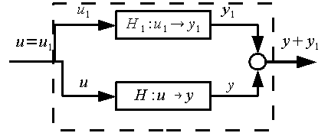



Passive Systems Properties
Digital Passive Attitude and Altitude Control Schemes for Quadrotor Aircraft (Kottenstette, Porter: to appear ICCA’09)

Slide 5
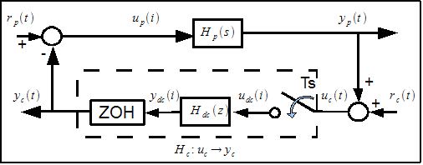
A Fundamental Problem
Can you interconnection a continuous-time systems to a digital controllers and guarantee continuous-time stability?
Simple example

Slide 6
Simple Example
Passivity Theorem

Slide 7
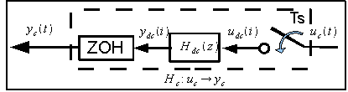
Res. Controller Has Infinite L^{m}₂ - Gain

Slide 8

Not all is lost, can handle many inputs.

Slide 9
Implications
Can not synthesize digital controllers in this framework which satisfy L^{m}₂-stability under all input conditions (clear path to add some restrictions however).
High-gain digital (PID) controllers -> High correlated noise sensitivity.
Low-gain digital controllers such as those which suppress resonances (notch filters) should still perform reasonably well.

Slide 10
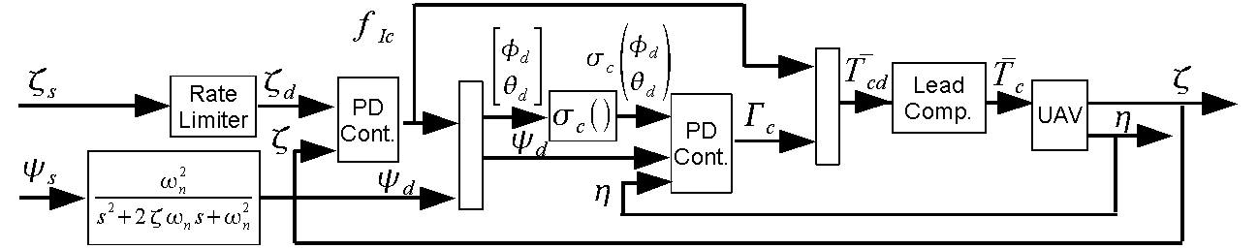
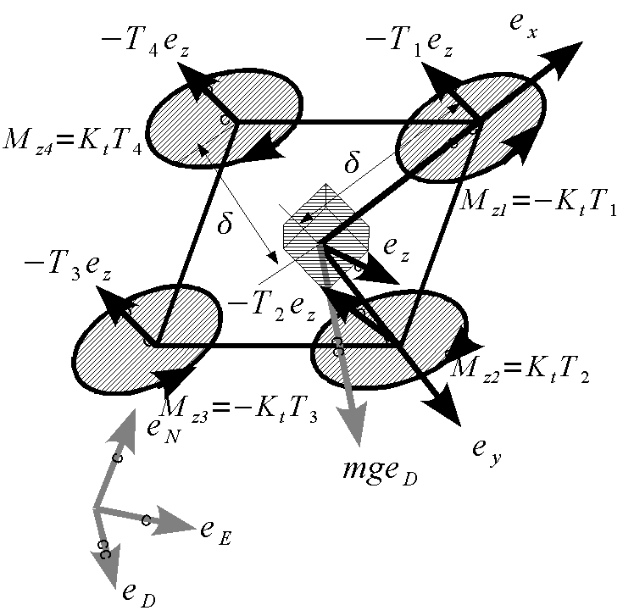
Yet, they still work quite well

Slide 11
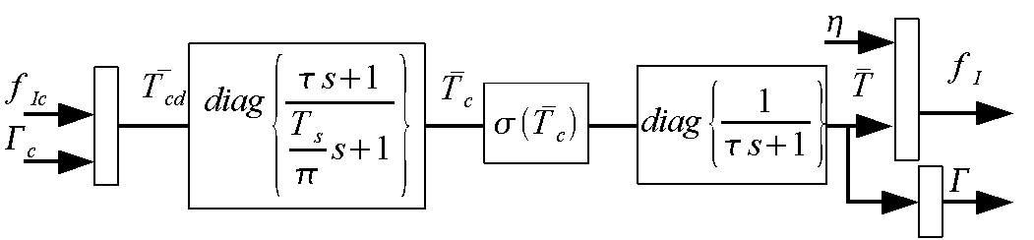
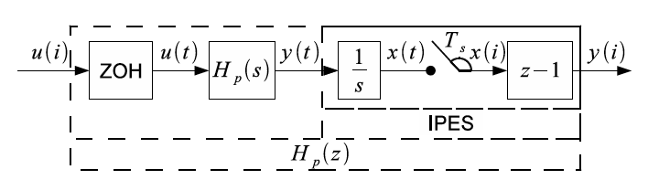
Lead-Compensator, Thrust Compensation

Slide 12
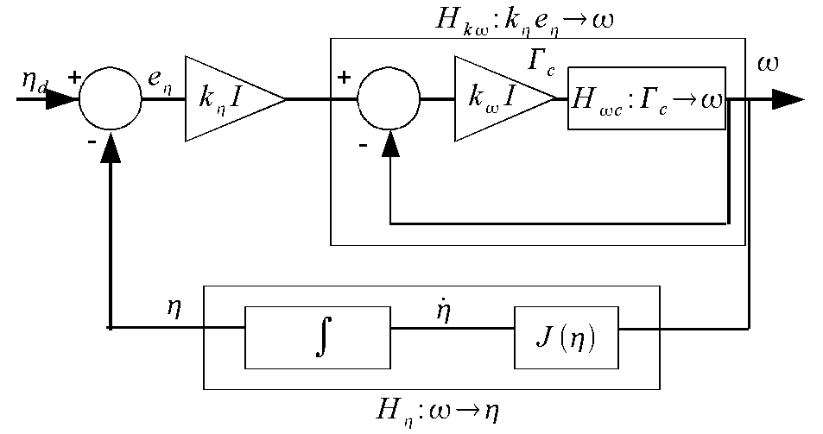
Attitude PD-Controller

Slide 13
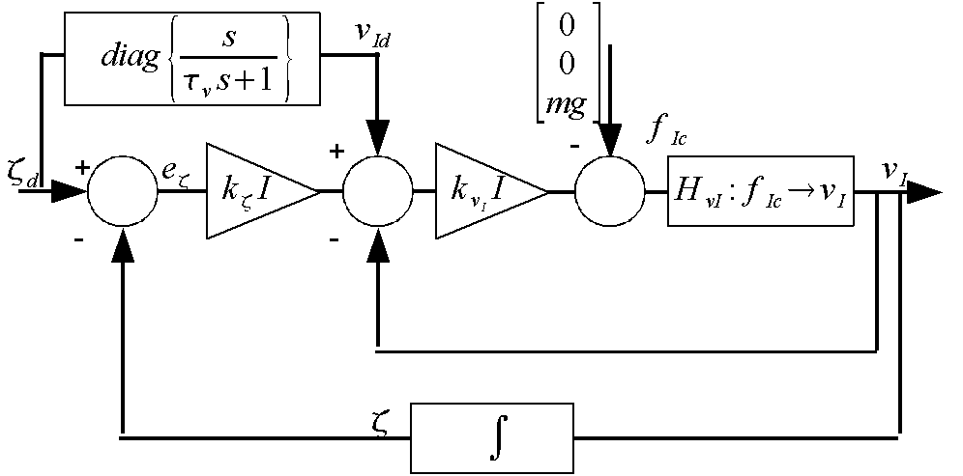
Inertial PD-Controller

Slide 14
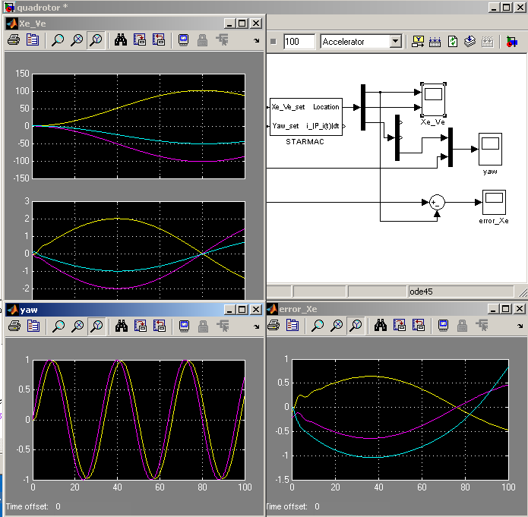
Advanced Quad-Rotor System Model
Used Extensively
OpenC2WT
Integrated seamlessly with autonomous target trackers

Slide 15
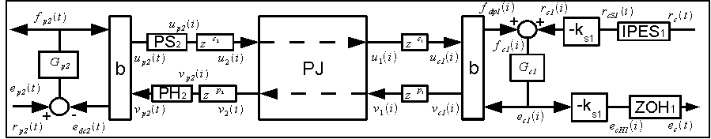
L^{m}₂-Stable Digital Control Network
Design of Networked Control Systems Using Passivity
(Kottenstette, Hall, Koutsoukos, Sztipanovits, Antsaklis, under review TPDS)

Slide 16
IPESH-Transform

Slide 17
Bilinear Transform w/ Wave Variables

Slide 18
PS-PH “inside” [-1,1]

Slide 19
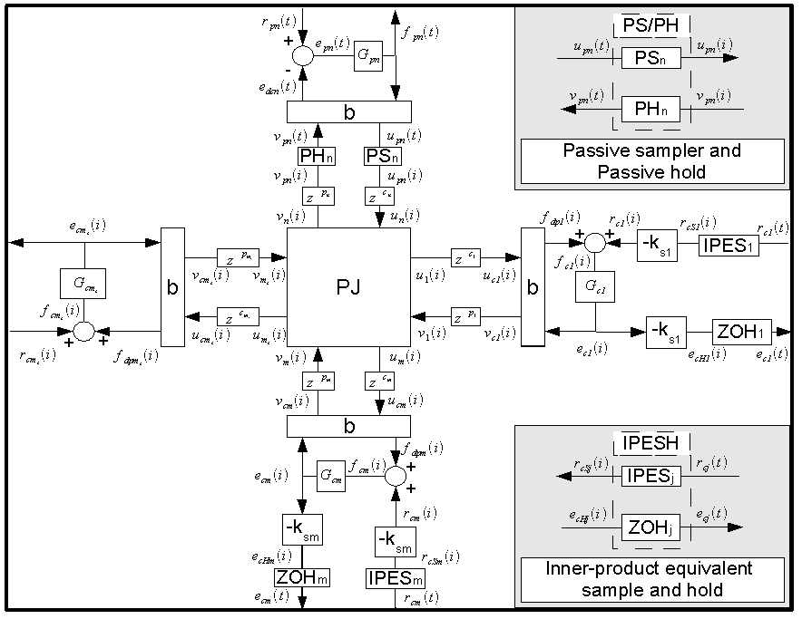
Stable Digital Control Networks

Slide 20
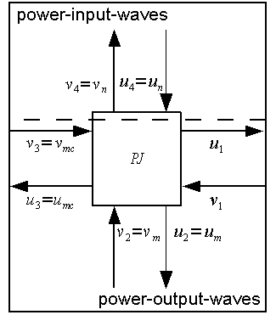
Resilient-power-junction-network

Slide 21
Resilient-power-junction-network

Slide 22
Case Study

Slide 23
Nominal Response

Slide 24
Single Controller Integrator Failure

Slide 25
DOS Attack on Single Controller

Slide 26
(undetected) Destabilizing controller introduced

Slide 27
Destabilizing controller detected and isolated

Slide 28
Conclusions
Demonstrated how to interconnect redundant controllers in a resilient manner
Tolerates both passive-faults and denial-of-service attacks w/o needing detection
Highly unstable controllers will destabilize network w/o detection
However, if detection occurs, isolation can be implemented in a transparent manner
Detecting de-stabilizing controllers in the presence of different networking delays among controllers if fundamental research question.

Slide 29
How to Make a Conic Sys. Passive

Slide 30
How to Make a Conic Sys. Passive

Slide 31
How to Make a Conic Sys. Passive

Slide 32
Additional Reading
Kottenstette, N., and N. Chopra, "Lm2-stable digital-control networks for multiple continuous passive plants", 1st IFAC Workshop on Estimation and Control of Networked Systems (NecSys'09), Venice, Italy, International Federation of Automatic Control, 09/2009. http://www.isis.vanderbilt.edu/node/4101
Kottenstette, N., and N. Chopra, "Lm2-stable digital-control networks for multiple continuous passive plants", Technical Report, Nashville, TN, Institute for Software Integrated Systems, Vanderbilt University, pp. 1-14, 04/2009. http://www.isis.vanderbilt.edu/node/4079
Kottenstette, N., J. Hall, X. Koutsoukos, P. J. Antsaklis, and J. Sztipanovits, "Digital Control of Multiple Discrete Passive Plants Over Networks", Technical Report, Nashville, TN, Institute for Software Integrated Systems, Vanderbilt University, pp. 1-14, 03/2009. (accepted with revisions IJSCC) http://www.isis.vanderbilt.edu/node/4050

Slide 33
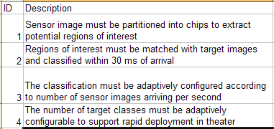
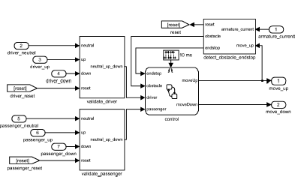
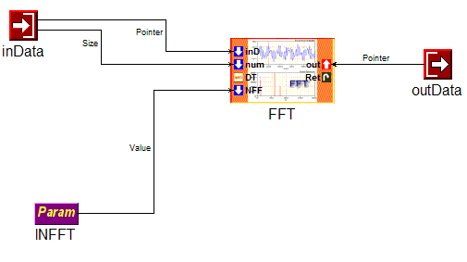
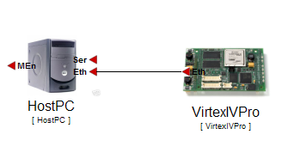
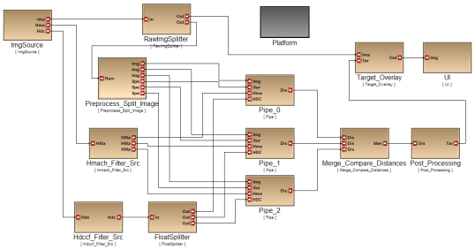
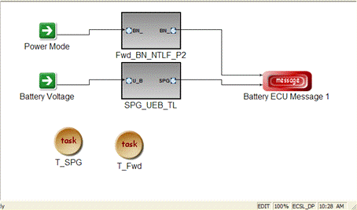
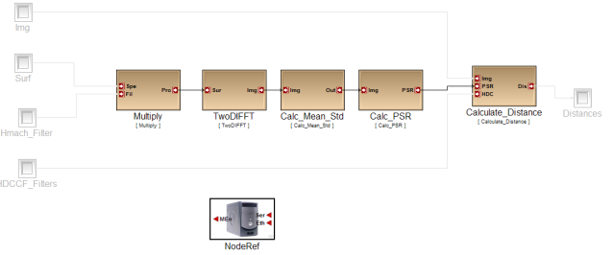
Overall Design Flow
Requirement Specification
RA
Control Design
FD
HwA
Functional
Mod/Sim
Software Architecture
HW Arch. Design
HW Pwr/
Perf Est
SwA
Component Design
System Arch. Design
Arch Mod/Sim
SY
CD
Code Gen. Verif.
Latency/RT
Analysis
Alloc./Sched.
Analysis
DPL
SW Deployment

Slide 34

Focus of the toolchain
Plant Models and Requirements
Code and SW Component Design
System-Level
Design
Model-Based Design
Analysis
Meta-Model
ESMoL
-> Analysis
Function (Controller) Modeling
Component
Platforms
System and
Hardware Platforms
MDL
Meta-Model
MDL-> ESMoL
ESMOL
Meta-Model
ESMoL-> SFC
SFC Meta-Model
The toolchain turns the functional controller design into a software implementation: a collection of integrated components executed by a robust component platform that runs on a system/hardware platform.

Slide 35
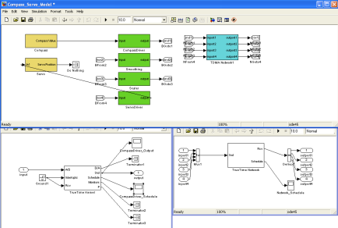
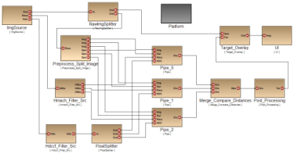

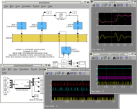
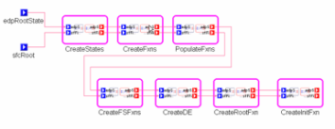


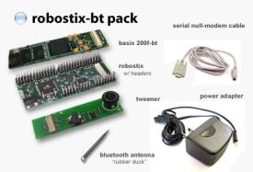
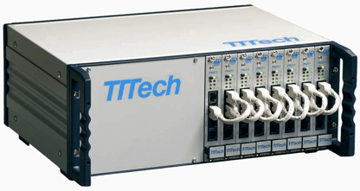
Toolchain overview
Model-based Design
Componentization
Architecture modeling
Deployment modeling
Functional Design
Simulink/Stateflow
Model-based Code Generation
Schedule Generation
Analysis
Platform effects
Verification
Schedule
SW Platform

Slide 36
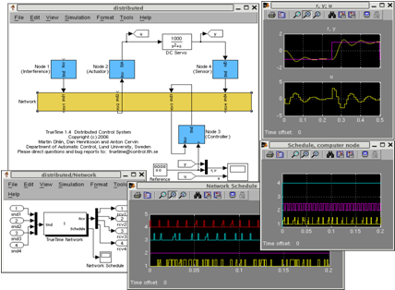
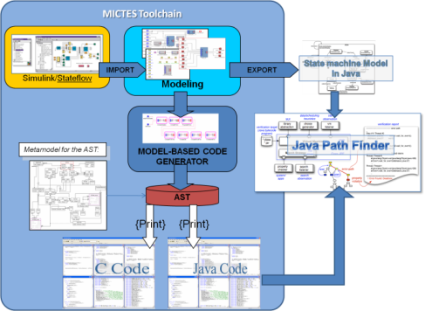
Analysis and verification
Platform effects analysis
TrueTime model for platform
Generator to build Simulink model for functional model + platform model
Continuous time, high-precision Simulink simulation allows studying subtle platform effects
Verification (Leverage NASA MICTES Project - JPF)
Functional model state reachability verification
Functional code verification
Objective: To give feedback for the designer

Slide 37
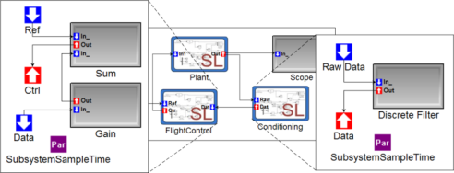
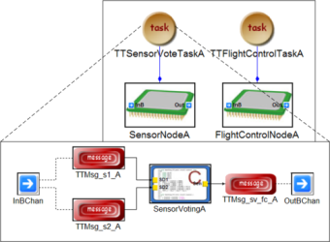
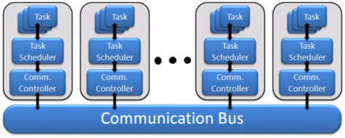
Foundation: Semantics for ESMoL
ESMoL: Embedded System Modeling Language
Components: (Imported from Simulink)
Synchronous dataflow network + Statecharts
Run at a fixed rate - periodic execution:
x(k+1) = f(x(k),u(k)) – State update
y(k+1) = g(x(k),u(k)) – Output Update
Responsible for (periodic) I/O interactions
Component architecture:
Components are statically scheduled according to their rates
Communication is facilitated by time-triggered messages (also statically scheduled)
Hardware platform:
Each node runs a cyclic, static, timed-triggered schedule
Nodes communicate via time-triggered messages
Deployment model:
Time-triggered tasks hosting components, interfacing via messages, mapped to processor nodes

Slide 38
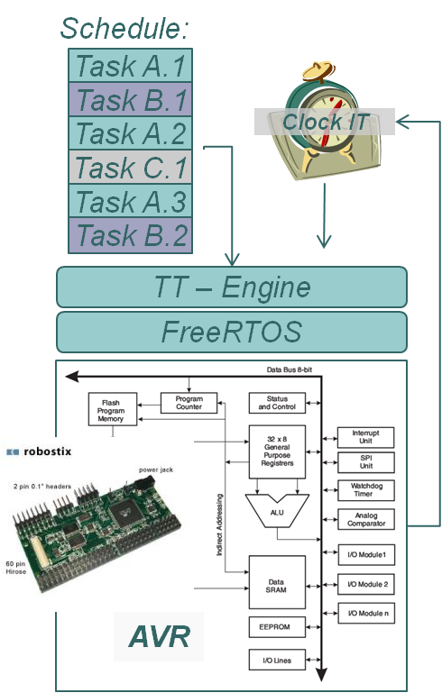
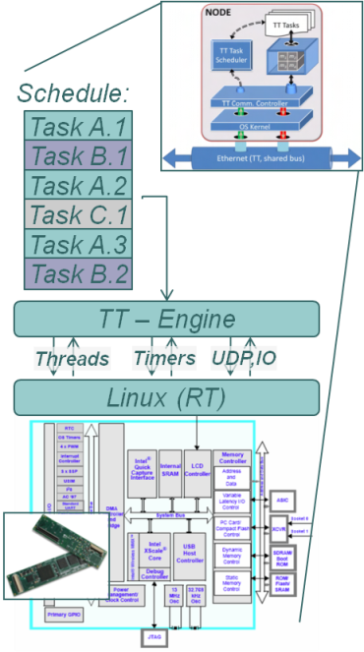
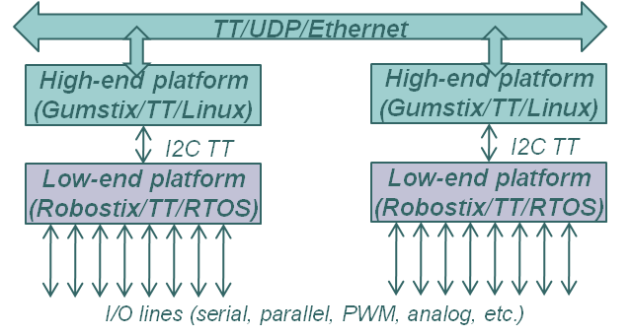
Execution: Time-triggered Platform
Execution model:
Timer/clock-interrupt driven periodic execution of tasks according to a static schedule
Tasks do not preempt, except in case of overruns
If a task overruns its WCET, it is cancelled and the next task is started
Tasks are scheduled with sufficient slack to allow for I/O interrupts
IT-driven I/O communicates with component/tasks via shared buffers

Slide 39
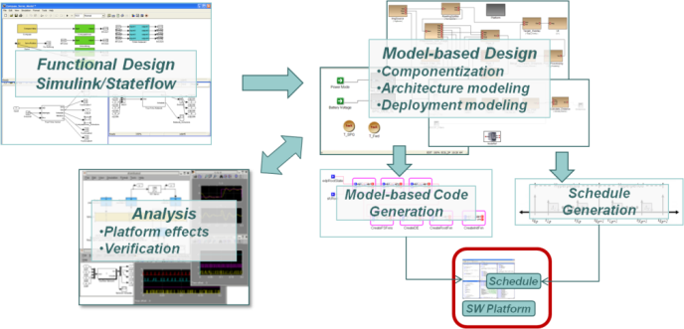
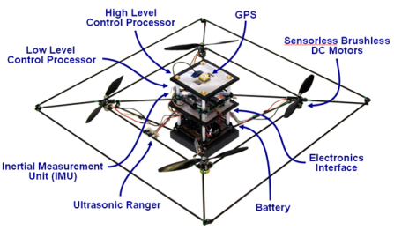

A Platform for Experimentation
Model-based Toolchain
TT/UDP/Ethernet
High-end platform
(Gumstix/TT/Linux)
High-end platform
(Gumstix/TT/Linux)
I2C TT
Platform
I2C TT
Low-end platform
(Robostix/TT/RTOS)
Low-end platform
(Robostix/TT/RTOS)
I/O lines (serial, parallel, PWM, analog, etc.)
Next steps:
Supporting other Models of Computation
Integration of heterogeneous MoC-s
Fault management
Real-time Simulation Platform ‘Virtual plant’

