Slide 1
An Experimental Model-Based Rapid Prototyping Environment for High-Confidence Embedded Software
Joseph Porter, Peter Volgyesi,
Nicholas Kottenstette, Harmon Nine,
Gabor Karsai, Janos Sztipanovits
Vanderbilt University/ISIS
Supported by: Multi-University Research Initiative on
High-Confidence Design for Distributed Embedded Systems
US AFOSR, FA9550-06-0312

Slide 2
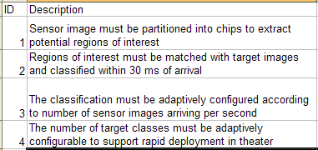
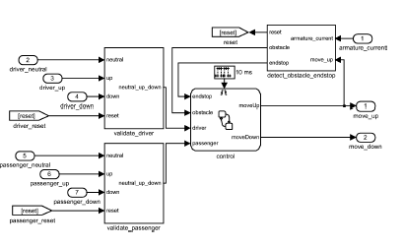
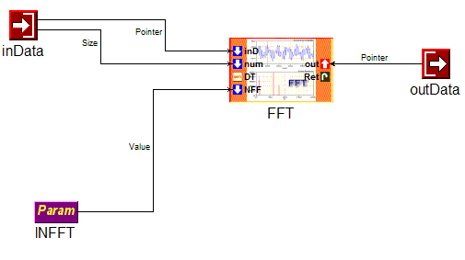
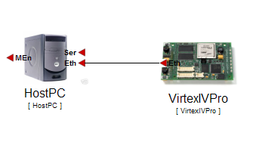
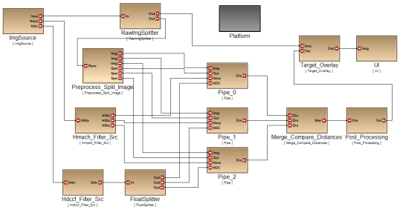
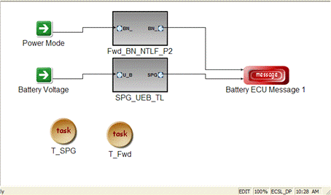
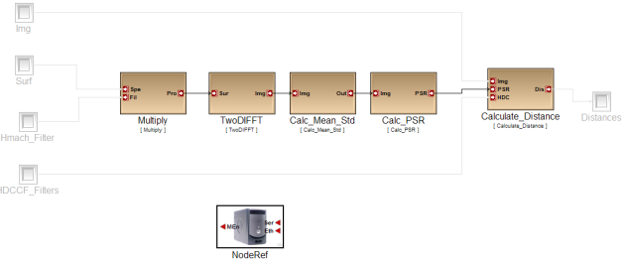
Overall Design Flow
Requirement Specification
RA
Control Design
FD
HwA
Functional
Mod/Sim
Software Architecture
HW Arch. Design
HW Pwr/
Perf Est
SwA
Component Design
System Arch. Design
Arch Mod/Sim
SY
CD
Code Gen. Verif.
Latency/RT
Analysis
Alloc./Sched.
Analysis
DPL
SW Deployment

Slide 3
Challenges for a toolchain
Software Architecture Modeling
Timing and schedulability analysis
Deployment models
Integrated verification

Slide 4

Focus of the toolchain
Plant Models and Requirements
Code and SW Component Design
System-Level
Design
Model-Based Design
Analysis
Meta-Model
ESMoL
-> Analysis
Function (Controller) Modeling
Component
Platforms
System and
Hardware Platforms
MDL
Meta-Model
MDL-> ESMoL
ESMOL
Meta-Model
ESMoL-> SFC
SFC Meta-Model
The toolchain turns the functional controller design into a software implementation: a collection of integrated components executed by a robust component platform that runs on a system/hardware platform.

Slide 5
Toolchain requirements
Using the results of the functional controller design stage
Import functional design models into the toolchain
Building software component/s from the functional models for a component platform on top of a hardware platform
Modeling the components that “wrap” the functional models, modeling the component architecture
Modeling the hardware platform
Mapping the software components onto the hardware platform

Slide 6
Toolchain requirements
Code generation
Functional code + Integration code (functional code/platform bridge)
Scheduling
Design-time, static schedule computation
Analysis and verification
Platform effects: generating simulation models from the functional models and platform models
Functional model & code verification
Execution
Robust execution on a component platform

Slide 7
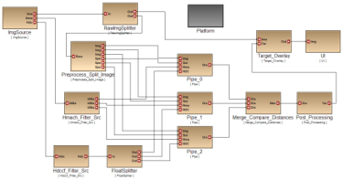

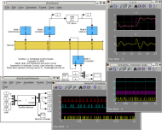
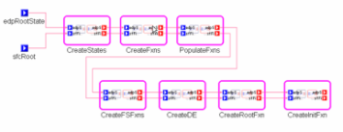


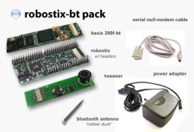
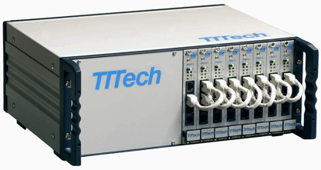
Toolchain overview
Model-based Design
Componentization
Architecture modeling
Deployment modeling
Functional Design
Simulink/Stateflow
Model-based Code Generation
Schedule Generation
Analysis
Platform effects
Verification
Schedule
SW Platform

Slide 8
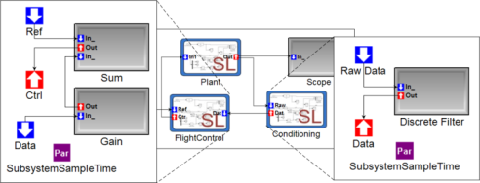
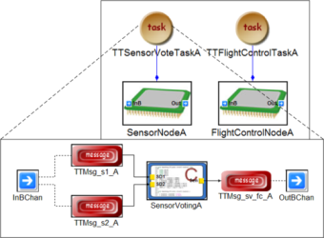
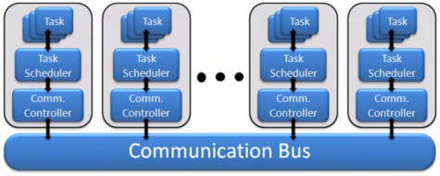
Foundation: Semantics for ESMoL
ESMoL: Embedded System Modeling Language
Components:
Synchronous dataflow network + Statecharts
Run at a fixed rate - periodic execution:
x(k+1) = f(x(k),u(k)) – State update
y(k+1) = g(x(k),u(k)) – Output Update
Responsible for (periodic) I/O interactions
Component architecture:
Components are scheduled according to their rates
Communication is facilitated by time-triggered messages
Hardware platform:
Each node runs a cyclic, static, timed-triggered schedule
Nodes communicate via time-triggered messages

Slide 9
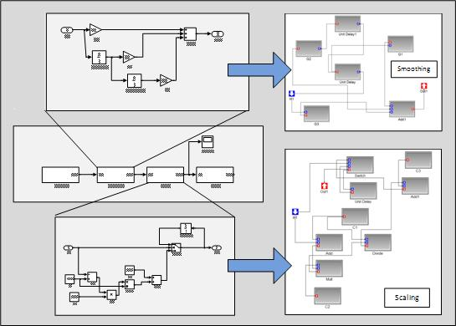
Functional design models into implementation models
Simulink models translated into ESMoL functional models
Syntactical translation
Only discrete-time, fixed, single-rate subsystems and Stateflow blocks
Produces an XML representation of the Simulink/Stateflow model (suitable for other, XML-based tools)

Slide 10

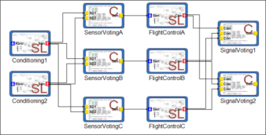
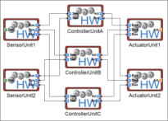
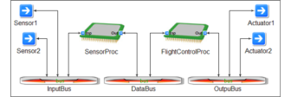

Design models in ESMoL
Component models: imported Simulink subsystems
Software architecture models: dataflow diagram depicting signal flows and components
Hardware architecture models: processor nodes, communication buses, sensors and actuators
Deployment models: (TT) tasks hosting components, interfacing via messages, mapped to processor nodes

Slide 11
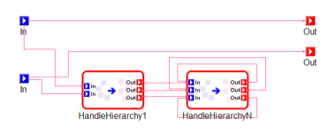
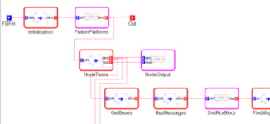
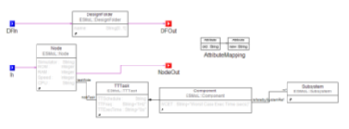
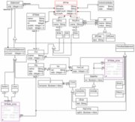
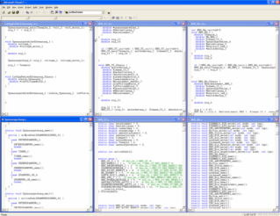
Code Generation
Functional code generator
Preprocessing: type inference on the models
Translation: based on graph transformations (uses the GReAT toolsuite)
Retargetable code emitter: restricted/safe subset of C or Java [fixed-size arrays, no dynamic memory allocation]
3 generators: Simulink, Stateflow, Embedded Matlab
Integration code generator
Produces platform-specific integration code that ‘glues’ functional code to platform API-s.
Transformation Program with Rewriting Rules
Metamodel of Executable Code
Restricted C (or Java) Code

Slide 12
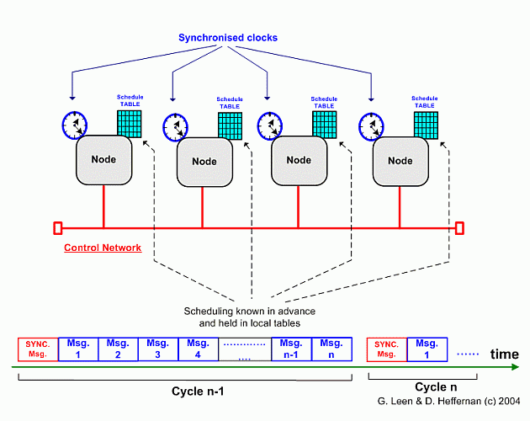
Schedule Generation
Time-triggered schedule generation:
Components are periodically executed tasks:
Read/Execute-Update/Write
Tasks are statically scheduled, do not preempt
Communication is periodically executed
Read buffer/Transmit → Receive/Write buffer
Messages are statically scheduled, do not preempt
Assumptions: fixed and known
Task rates and WCET
Message transfer times and dependencies
Solution: The scheduling problem is translated into finite-domain constraint programming problem – the valuation of variables gives the schedule.
Constraint-Based Scheduling
Based on:
Off-Line Scheduling of a Real-Time System
Klaus Schild, Jörg Würtz Proceedings of the 1998 ACM Symposium on Applied Computing, SAC98:29-38, Atlanta, Georgia, ACM

Slide 13
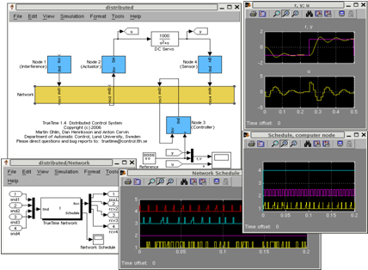
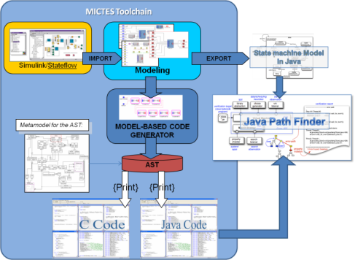
Analysis and verification
Platform effects analysis
TrueTime model for platform
Generator to build Simulink model for functional model + platform model
Continuous time, high-precision Simulink simulation allows studying subtle platform effects
Verification (Leverage NASA MICTES Project - JPF)
Functional model state reachability verification
Functional code verification
Objective: To give feedback for the designer

Slide 14
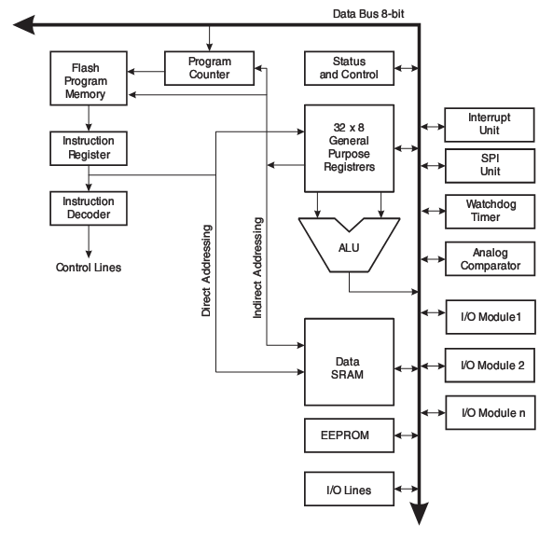
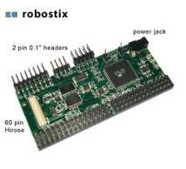
Execution: Time-triggered Platform
Low-end platform:
AVR microcontroller with I/O devices
Timer/clock-interrupt driven execution of tasks according to static schedule
Tasks do not preempt, except in case of overruns
If a task overruns its WCET, it is cancelled and the next task is started
Tasks are scheduled with sufficient slack to allow for I/O interrupts
IT-driven I/O communicates with component/tasks via shared buffers
Schedule:
Task A.1
Task B.1
Task A.2
Clock IT
Task C.1
Task A.3
Task B.2
TT – Engine
FreeRTOS
AVR

Slide 15
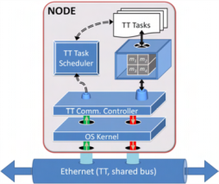
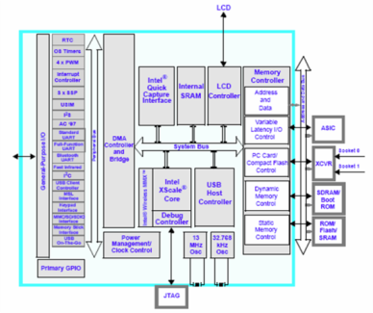
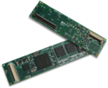
Execution: Time-triggered Platform
High-end platform:
OS (Linux), with limited timing accuracy (threads and nanosleep services)
Time-triggered execution model for components
Time-triggered messaging
Using UDP on isolated Ethernet
Using char IO on I2C (to AVR)
Schedule:
Task A.1
Task B.1
Task A.2
Task C.1
Task A.3
Task B.2
TT – Engine
Threads
Timers
UDP,IO
TT/UDP/Ethernet
Linux (RT)
High-end platform
(Gumstix/TT/Linux)
High-end platform
(Gumstix/TT/Linux)
I2C TT
I2C TT
Low-end platform
(Robostix/TT/RTOS)
Low-end platform
(Robostix/TT/RTOS)
I/O lines (serial, parallel, PWM, analog, etc.)

Slide 16
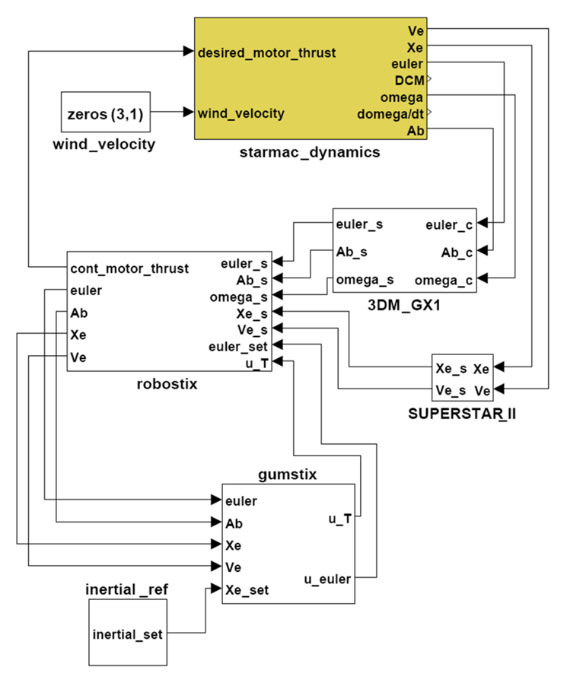
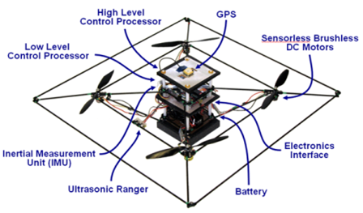
Example: Simulink Model
Quadrotor design and controller:
Courtesy of C. Tomlin UC Berkeley

Slide 17
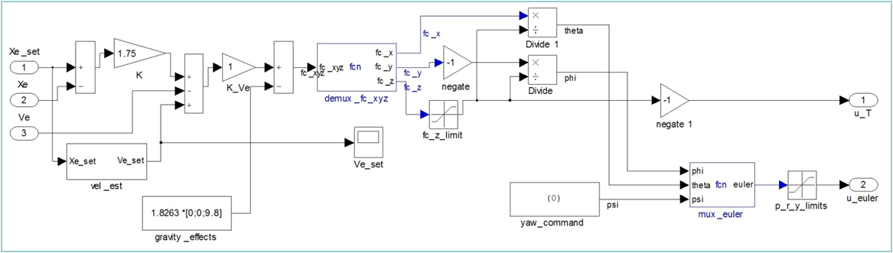
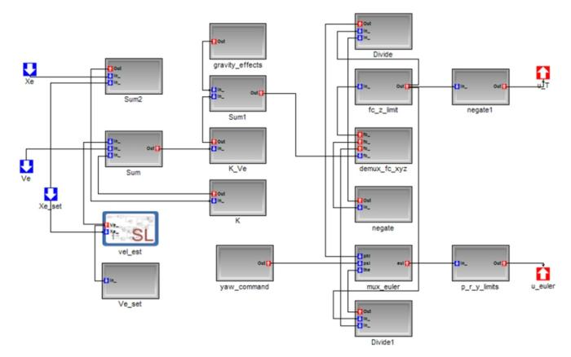
Example: Inertial Controller
Design in Simulink:
Design in ESMoL:

Slide 18
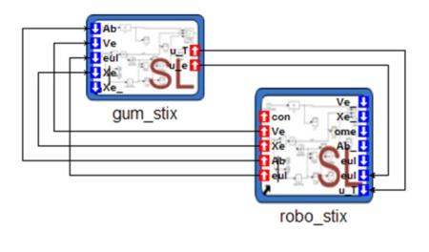
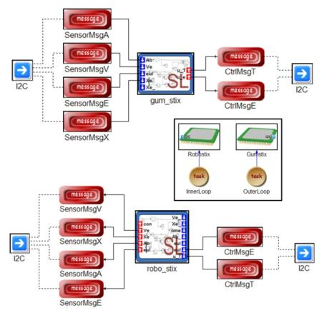
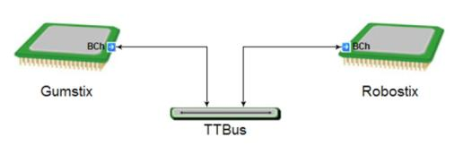
Example: Software Components, Hardware, Deployment
Software Components:
Deployment:
Hardware platform:

Slide 19
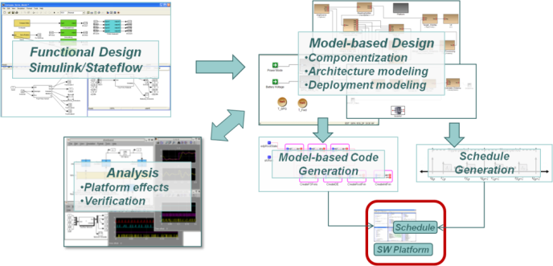
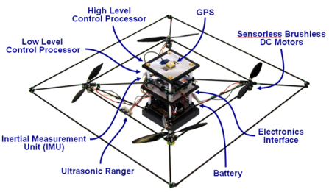
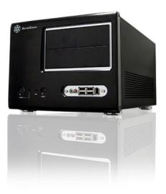
A Platform for Experimentation
Model-based Toolchain
TT/UDP/Ethernet
High-end platform
(Gumstix/TT/Linux)
High-end platform
(Gumstix/TT/Linux)
I2C TT
Platform
I2C TT
Low-end platform
(Robostix/TT/RTOS)
Low-end platform
(Robostix/TT/RTOS)
I/O lines (serial, parallel, PWM, analog, etc.)
Real-time Simulation Platform ‘Virtual plant’

Slide 20
Towards A Development Paradigm
All Simulated
Real Platform
Simulated Plant
Real System
Simulated Application
Simulated Application
Real Application
Real Application
Sim/API Adapter
Sim/Sim if
API
API
API
Simulated Platform
Real Platform
Real Platform
Real Platform
Sensor
Signal i/f
Actuator Signal i/f
Sensor
Signal i/f
Actuator Signal i/f
Sim/Sim if
Sensors
Actuators
Simulated Plant +
Environment
Simulated Plant +
Environment
Simulated Plant +
Environment
Physical System
Environment

Slide 21
Status and next steps
‘Closing the loop’ …
Tests and experiments
Supporting other Models of Computation
Event-driven, asynchronous
Integration of heterogeneous MoC-s
Problem/domain-specific ‘bridges’
Fault management
Integrated toolchain: from virtual prototyping to physical implementation

Slide 22
BACKUP SLIDES

Slide 23
Prototype toolchain elements
Simulink/Stateflow
Single rate subsystems
Synchronous Dataflow semantics
Event-triggered charts
Matlab/Simulink/Stateflow
Functional Design
Scheduler
Constraint-based generation of task and bus message schedules for a time-triggered platform
ESMoL Modeling Tool (GME)
Software Architecture
Componentization
CSP-based Scheduler
Resource allocation
(Scheduling)
Allocation and Deployment
ESMoL
Simulink/Stateflow import
Additional aspects for components, architecture, and deployment
Code generation for
Dataflow (Simulink/SDF) models
Statechart (Stateflow) models
Platform interface code
Time-Triggered Platform
Platform
Multiple processors connected via a time-shared bus
Tasks are cyclic, time-triggered
Message receive/send happens before/after task release/finish
Execution
Platform

Slide 24
Design rationale for prototype toolchain (1)
The connection towards Simulink/Stateflow
Simulink/Stateflow is the industry standard
SDF and (restricted) Statechart semantics is well-defined and widely used
Could be substituted in later stages of the project
The ESMoL language
Software components and architectures and deployment had to be captured in models and integrated with the functional models.
Not all features of Simulink/Stateflow are supported – only a ‘safe’ subset.
Dataflow (Simulink/SDF) model: scheduling based on the time-triggered paradigm (t_k is determined by an off-line scheduler)
receive(t_k) → execute() → send(t_k+1)
Extensible towards other models of computation

Slide 25
Embedded System Modeling Language
Components
Deployment
Dataflow
Platform
Stateflow

Slide 26
Design rationale for prototype toolchain (2)
Code generation
Dataflow/SDF code generation:
Explicit type inference (if Simulink model is not fully typed)
Graph transformation into an intermediate code format (C-like, Abstract Syntax Graph)
Printing C code (or Java, or …)?
Stateflow code generation:
Follows Stateflow semantics (state transitions)
Graph transformation into an intermediate code format (C-like, Abstract Syntax Graph)
Printing C code (or Java, or …)?
Both code generators are extensible/backend can be replaced

Slide 27
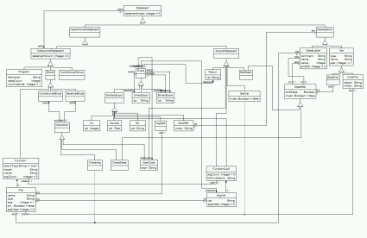
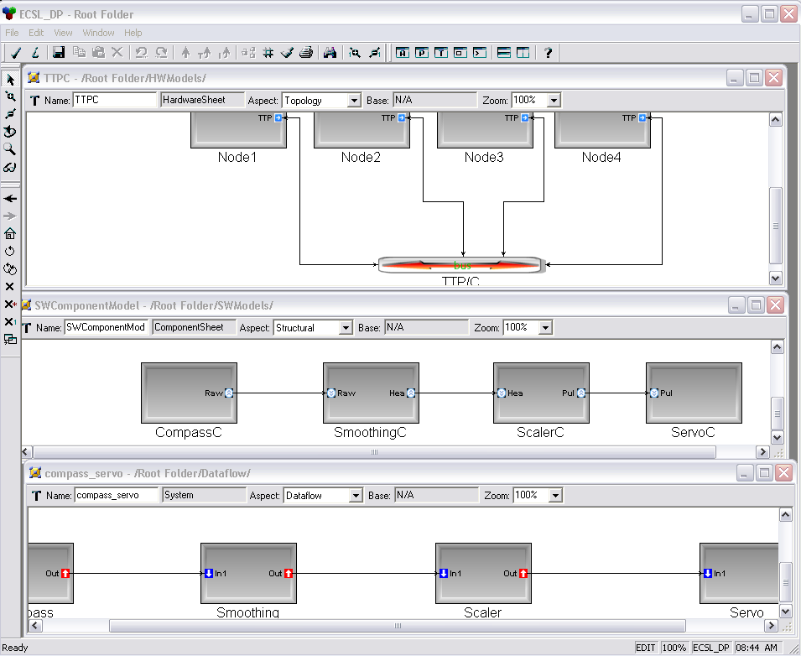
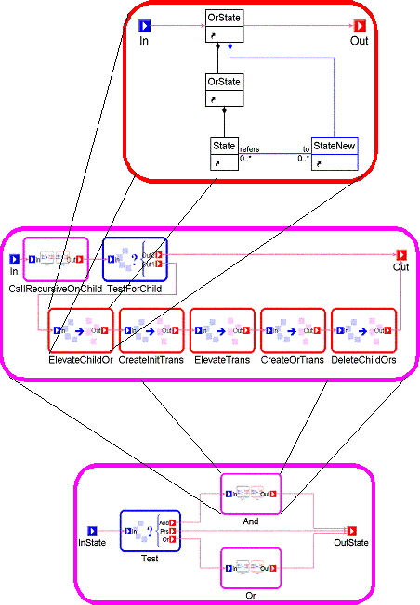
Code generation Dataflow(Simulink) and Statechart(Stateflow)
SFC Metamodel
ESMoL Model
Graph
Transformation
Abstract Syntax Graph
of executable code
The code generator is formally specified as a programmed graph transformation system. This allows reasoning about the correctness of the transformation itself.
Print
The result of the transformation is an abstract syntax graph that allows ‘printing’ the executable code in various languages.
Support for verification:
The code generation could insert verification conditions (derived from the models )into the generated ASG.
C source code

Slide 28
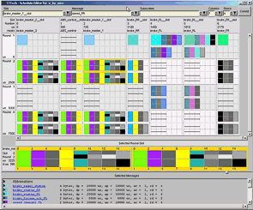
Design rationale for prototype toolchain (3)
Scheduler
Explicit, design-time generation of cyclic time-triggered schedules for tasks and messages
Constraint-based scheduling approach
The Platform
Robust, timed execution of tasks on a network of processors
Time-triggered approach:
- Nodes schedulers are time-synchronized
- Tasks are run cyclically released at
specific points in time
- Messages are transferred at
specific points in time
Tasks:
Receive(t_k) → execute() → Send (t_k+1)
Task: single rate, multiple components
Components == Simulink subsystems
Messages == input and output dataflows (signals) of subsystems

Slide 29
Scheduling
ESMoL Model
Constraint Solver Engine
(GECode)
The model is translated into a scheduling problem:
Input: set of tasks with desired rates, set of messages with desired source/destination tasks and rates
Output: task release times (in a cyclic schedule)
Formulation: Constraint Satisfaction Problem (equalities and inequalities) over integers .
Task
Schedule
Message
Schedule
Support for certification:
Off-line scheduling of time-critical tasks and messages ensures correct temporal behavior.

Slide 30
Realization
Simulation-based verification
Modeling/Simulation Environment
(Simulink/Stateflow)
Model Editing Environment
(ESMoL)
Mdl2Mga
Dataflow
Stateflow
System
Simulink Code Gen
Stateflow Code Gen
Scheduler Conf Gen
Platform
Symbolic verification (TBD)
C code
C code
TT Schedule
Conf

Slide 31
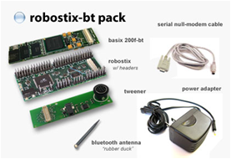
Platforms
TTTech
Gumstix/Robostix
MPC 555 micros
TTP/C comm
TTTech Software tools
Fault-tolerance
Linux + AVR micro
TT Virtual Machine on Linux/UDP + FreeRTOS
No fault tolerance (yet)

Slide 32
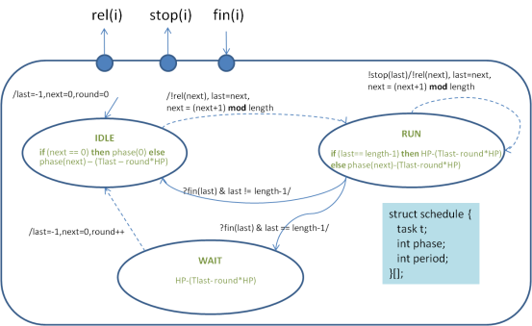
TT Virtual Machine
Step 1:
DEVS model of the TT scheduler
Step 2:
Prototype on POSIX interface
- Embedded Linux hosts
- Isolated Ethernet network (UDP)
- High-precision timers
TT Tasks
TT Sched
DEVS: (Discrete-Event Systems)
Finite-State Machines with
- Continuous time model for timed transitions
- Communication/triggering via discrete events
Abstract model, has C++ simulator implementation
TT Comm
Kernel
Ethernet (TT, shared bus)

Slide 33
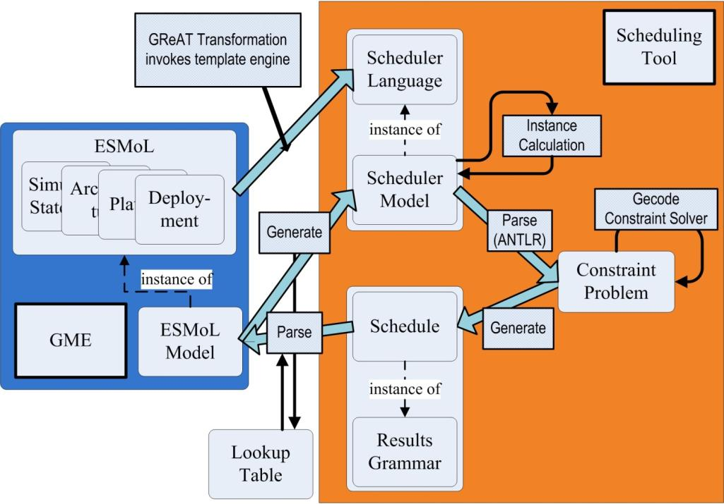
Integrated scheduling

