Slide 1
A Passivity-Based Framework for Resilient Cyber Physical Systems
ISRCS 2009
Idaho Falls, Idaho
Tuesday, August 11, 2009 8:15 AM
Nicholas Kottenstette ( nkottens@isis.vanderbilt.edu ), Gabor Karsai,
and Janos Sztipanovits
ISIS, Vanderbilt University
Thanks: Air Force (FA9550-06-1-0312), NSF (NSF-CCF-0820088)

Slide 2

Passive Systems

Slide 3
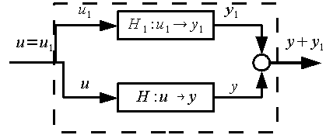



Passive Systems Properties
Digital Passive Attitude and Altitude Control Schemes for Quadrotor Aircraft (Kottenstette, Porter: to appear ICCA’09)

Slide 4
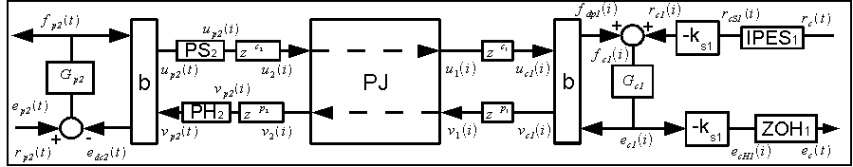
L^{m}₂-Stable Digital Control Network
Design of Networked Control Systems Using Passivity
(Kottenstette, Hall, Koutsoukos, Sztipanovits, Antsaklis, under review TPDS)

Slide 5
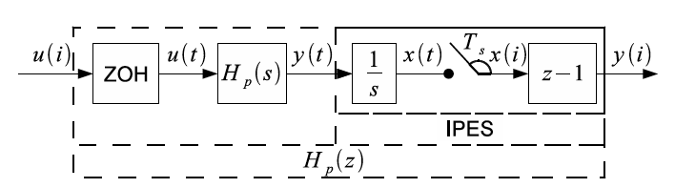
IPESH-Transform

Slide 6
Bilinear Transform w/ Wave Variables

Slide 7
PS-PH “inside” [-1,1]

Slide 8
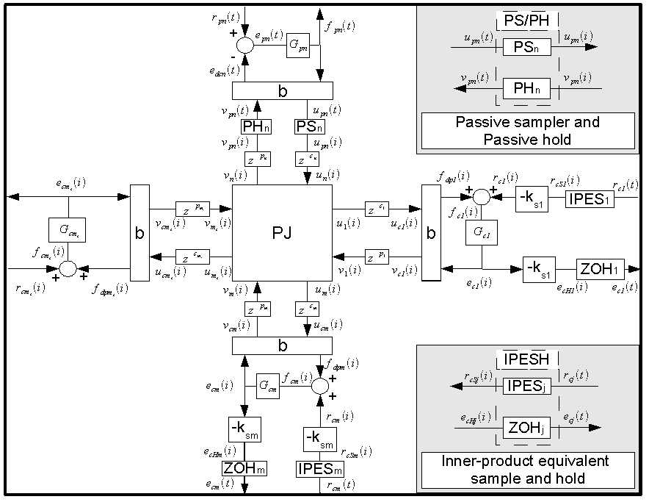
Stable Digital Control Networks

Slide 9
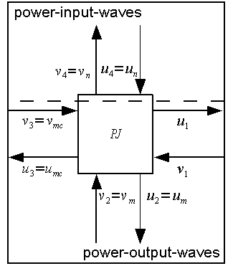
Resilient-power-junction-network

Slide 10
Resilient-power-junction-network

Slide 11
Case Study

Slide 12
Nominal Response

Slide 13
Single Controller Integrator Failure

Slide 14
DOS Attack on Single Controller

Slide 15
(undetected) Destabilizing controller introduced

Slide 16
Destabilizing controller detected and isolated

Slide 17
Conclusions
Demonstrated how to interconnect redundant controllers in a resilient manner
Tolerates both passive-faults and denial-of-service attacks w/o needing detection
Highly unstable controllers will destabilize network w/o detection
However, if detection occurs, isolation can be implemented in a transparent manner
Detecting de-stabilizing controllers in the presence of different networking delays among controllers if fundamental research question.

Slide 18
How to Make a Conic Sys. Passive

Slide 19
How to Make a Conic Sys. Passive

Slide 20
How to Make a Conic Sys. Passive

Slide 21
Additional Reading
Kottenstette, N., and N. Chopra, "Lm2-stable digital-control networks for multiple continuous passive plants", 1st IFAC Workshop on Estimation and Control of Networked Systems (NecSys'09), Venice, Italy, International Federation of Automatic Control, 09/2009. http://www.isis.vanderbilt.edu/node/4101
Kottenstette, N., and N. Chopra, "Lm2-stable digital-control networks for multiple continuous passive plants", Technical Report, Nashville, TN, Institute for Software Integrated Systems, Vanderbilt University, pp. 1-14, 04/2009. http://www.isis.vanderbilt.edu/node/4079
Kottenstette, N., J. Hall, X. Koutsoukos, P. J. Antsaklis, and J. Sztipanovits, "Digital Control of Multiple Discrete Passive Plants Over Networks", Technical Report, Nashville, TN, Institute for Software Integrated Systems, Vanderbilt University, pp. 1-14, 03/2009. (accepted with revisions IJSCC) http://www.isis.vanderbilt.edu/node/4050

