Slide 1
Constructive Non-linear Control Design With Applications to Quad-Rotor and Fixed-Wing Aircraft
Nicholas Kottenstette, Joseph Porter
ISIS-Vanderbilt University
December 2, 2009
Notes:
1

Slide 2
Outline
To make (distributed) control system design and synthesis intuitive and robust via constructive formalisms
Recent Milestones
Fixed-Wing Aircraft Literature Review ‏
Main Idea (back-stepping control)
Quad-rotor Dynamics/ Control/ Simulation
Fixed-Wing Aircraft Dynamics
Airframes Library
Fixed-Wing Control Equations
Velocity Control Subsystem
Body Angular Velocity Control
Angle-of-attack, slide-slip-angle, bank-angle Control
Preliminary Simulations
Future Directions
Notes:
2

Slide 3
Recent Milestones
Journal Papers:
Kottenstette N., Hall J., Koutsoukos X., Antsaklis P., Sztipanovits J., "Digital Control of Multiple Discrete Passive Plants Over Networks", Int. J. of Systems, Control and Communications Special Issue on “Progress in Networked Control Systems”, pp. 1-20 (to appear)
Conference / Workshop Papers:
N. Kottenstette, J. Porter “Digital Passive Attitude and Altitude Control Schemes for Quadrotor Aircraft”, 7th IEEE International Conference on Control & Automation (ICCA’09), Christchurch, New Zealand, December 2009. (invited chair Aircraft Control and Aerodynamic Systems)
Kottenstette, N., Chopra, N., "Lm2-stable digital-control networks for multiple continuous passive plants", NecSys'09, Venice, Italy, September, 2009.
Nicholas Kottenstette, Gabor Karsai, and Janos Sztipanovits, “A Passivity-based Framework for Resilient Cyber-Physical Systems”, 2nd International Symposium on Resilient Control Systems (ISRCS 2009), August 11-13, 2009, Idaho Falls, Idaho.
Technical Report:
Kottenstette, N., H. LeBlanc, E. Eyisi, and X. Koutsoukos, "Multi-Rate Networked Control of Conic Systems", Technical Report, Nashville, TN, Institute for Software Integrated Systems, Vanderbilt University, 09/2009.
Notes:
3

Slide 4
Fixed-Wing Aircraft Literature Review
Key Fixed-Wing Aircraft Control:
J. Farrell, M. Sharma, and M. Polycarpou, “Backstepping-based flight control with adaptive function approximation,” Journal of Guidance, Control, and Dynamics, vol. 28, no. 6, pp. 1089–1102, 2005.
O. Harkegard, “Backstepping and control allocation with applications to flight control,” Ph.D. dissertation, Linkoping University, 2003.
B. L. Stevens and F. L. Lewis, Aircraft Control and Simulation, 2nd ed. John Wiley & Sons, Inc., 2003.
S.L. Morris, D.E. Bossert and W.F. Hallgren, Introduction to Aircraft Flight Mechanics, Performance, Static Stability, Dynamic Stability, and Classical Feedback Control, AIAA Education Series, 2003.
Key Fixed-Wing Aircraft Formation Control:
G. Campa, Y. Gu, B. Seanor, M. Napolitano, L. Pollini, and M. Fravolini, “Design and flight-testing of non-linear formation control laws,” Control Engineering Practice, vol. 15, no. 9, pp. 1077–1092, 2007. [airlib]
Y. Zou, P. Pagilla, and R. Ratliff, “Distributed Formation Flight Control Using Constraint Forces,” JOURNAL OF GUIDANCE, CONTROL, AND DYNAMICS, vol. 32, no. 1, 2009.
Notes:
4

Slide 5
Main Idea (back-stepping control)
J. Farrell, M. Sharma, and M. Polycarpou, “Backstepping-based flight control with adaptive function approximation,” Journal of Guidance, Control, and Dynamics, vol. 28, no. 6, pp. 1089–1102, 2005.
Notes:
5

Slide 6
Recursive Control Strategy
Notes:
6

Slide 7
Ideal Feedback and Feedforward Comp.
Notes:
7

Slide 8
Recursive Control Strategy
Notes:
8

Slide 9
Quad-Rotor Dynamics
Notes:
9

Slide 10
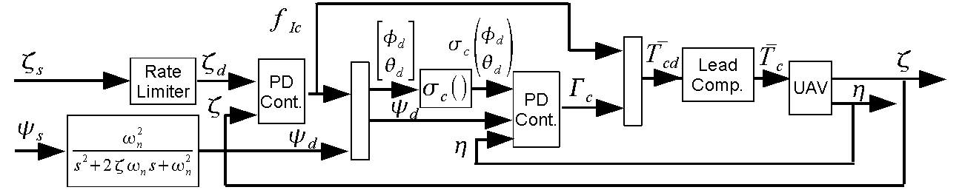
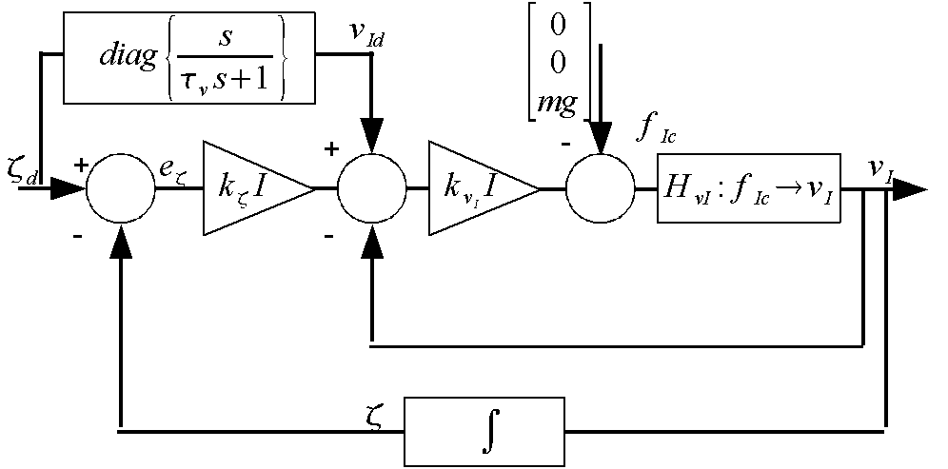
Quad-Rotor Control
Notes:
10

Slide 11
Quad-Rotor Simulation
Notes:
11

Slide 12
Quad-Rotor Simulation
Notes:
12

Slide 13
Fixed-Wing Aircraft Dynamics
Notes:
13

Slide 14
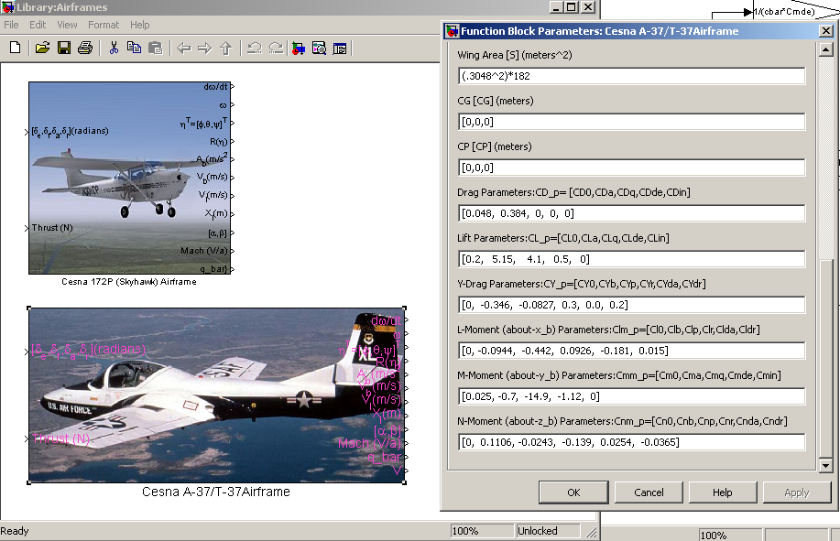
Airframes Library
http://www.ae.illinois.edu/m-selig/apasim/Aircraft-uiuc.html
Notes:
14

Slide 15
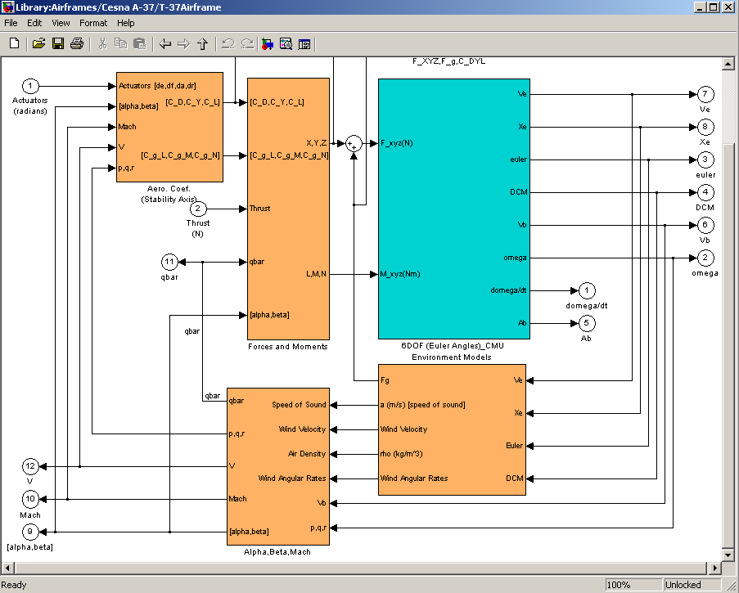
Airframes Library
Notes:
15

Slide 16
Relevant Fixed-Wing Equations for Control
Notes:
16

Slide 17
Relevant Fixed-Wing Equations for Control
Velocity
Controller
Vel-Angle
Controller
Aerodynamic-Angle
Controller
Body-angular
Velocity Controller
Notes:
17

Slide 18
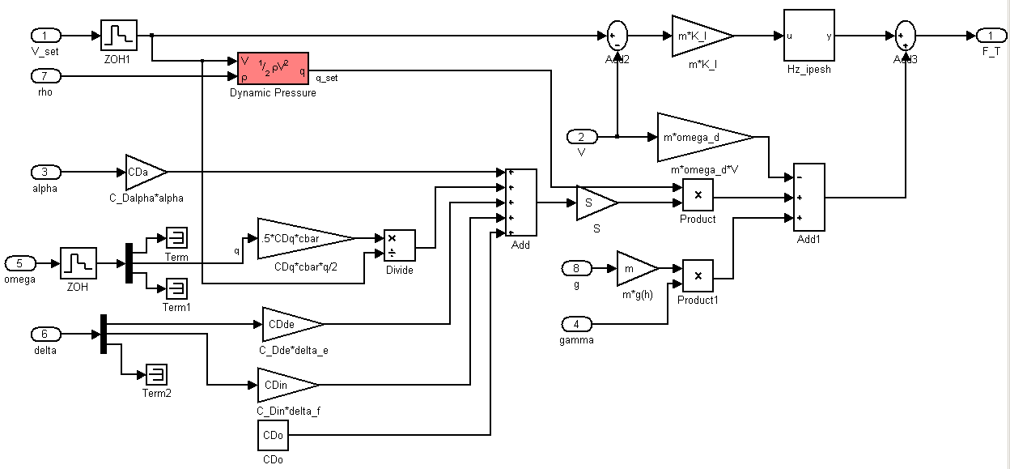
Velocity Control Subsystem
Notes:
18

Slide 19
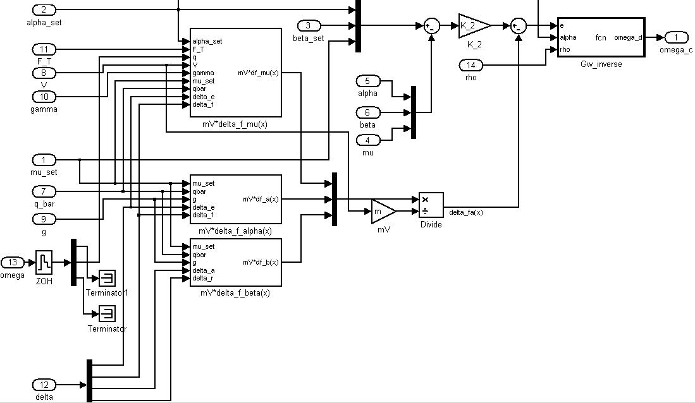
Angle-of-attack, slide-slip-angle, bank-angle Control
Notes:
19

Slide 20
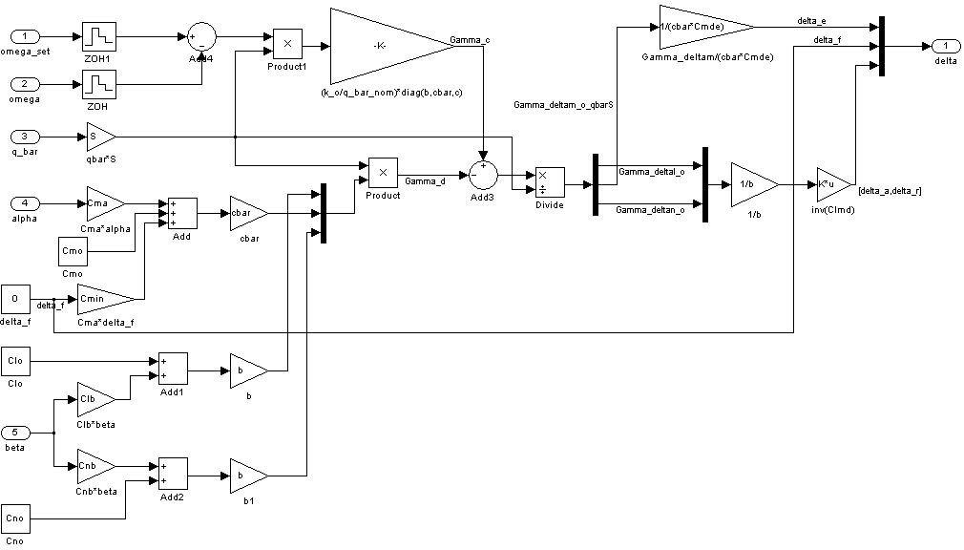
Body Angular Velocity Control
Notes:
20

Slide 21
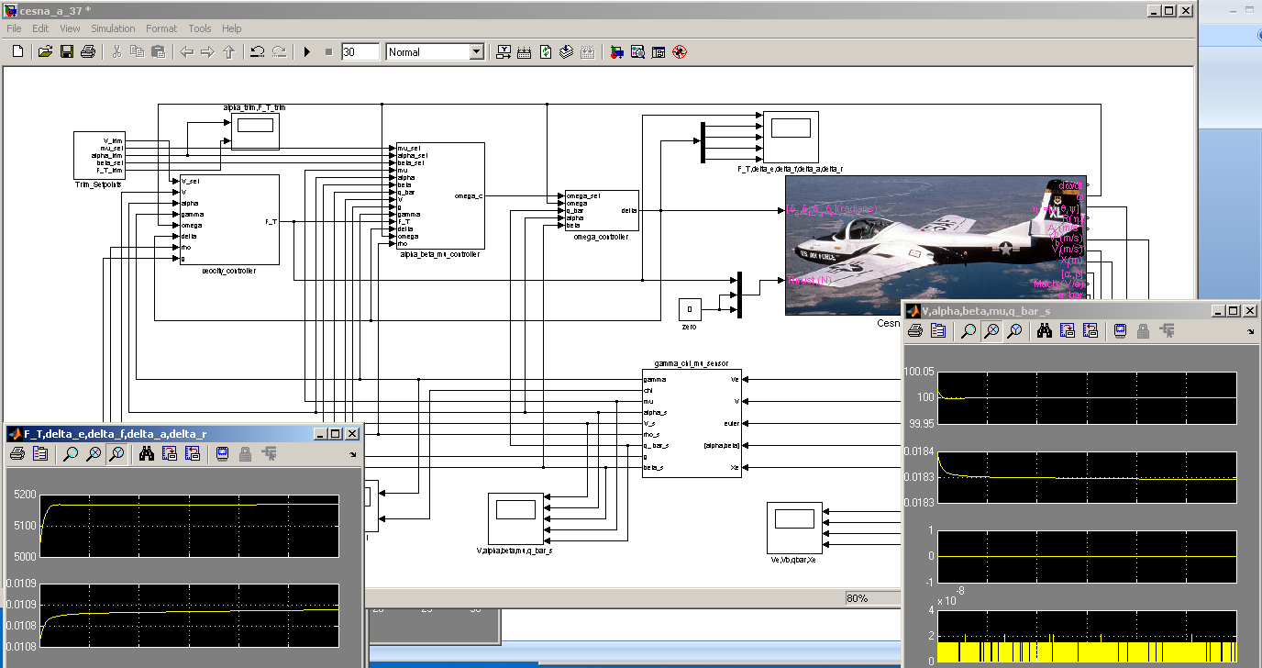
Preliminary Simulations
Notes:
21

Slide 22
Future Directions
Short Term:
Finish Flight-Path Heading Angle and Velocity Heading Angle Controller Design
Evaluate Controller Performance When Subject to Wind Disturbances
Include 101-[1,4] and 201-[1,4] airframe-configurations described in WL-TR-97-3059
Long Term:
Use Power-Junction Like Structure to Implement Formation Control System
Investigate Adaptive Control Structures
Consider Actuator Rate and Dynamic Limitations
Improve back-stepping control synthesis tools
Notes:
22

