Slide 1
FRAMEWORKS AND TOOLS FOR HIGH-CONFIDENCE OF ADAPTIVE DISTRIBUTED EMBEDDED CONTROL SYSTEMS
Janos Sztipanovits and Gabor Karsai
ISIS-Vanderbilt University
Claire Tomlin, Edward Lee and Shankar Sastry
UC Berkley
Bruce Krogh and Edmund Clarke, CMU
Stephen Boyd, Stanford
Air Force (FA9550-06-1-0312)
July 16, 2009
Notes:
1

Slide 2
Team
Vanderbilt
Sztipanovits (PI), Karsai, Kottenstette, Porter, Hemingway, Thibodeaux
UC Berkeley
Tomlin (PI), Lee, Sastry, Gonzales, Zhou, Leung, Hsia, Ding, Brooks
CMU
Krogh (PI), Clarke, Kapinski, Rahjans, Jain, Lerda, Bhave, Donze
Stanford
Boyd (PI), Skaf, Joshi, Mutapcic, Kim
Notes:
2

Slide 3
Project Overview
Develop a comprehensive approach to the model-based design of high-confidence embedded control systems.
Hybrid Control Systems (aircraft collision avoidance): Tomlin, Krogh, Sastry
Integrated Software Model Checking (bisimulation functions) and new widening operator for verification on numerical programs: Clarke, Krogh
Networked-digital-control of (cascaded) continuous-time conic (passive) systems which are L^{m}₂-stable : Kottenstette
Working prototype of an end-to-end tool-chain for model-based design of networked-control systems: Sztipanovits, Karsai, Kottenstette
Ptolemy-II extended to build code generators based on synchronous dataflow, FSM, …, models of computation which can target micros, microkernels, and RTOS’s: Lee
Convex (optimal, affine, model-predictive,…) control: Boyd
Notes:
3

Slide 4
Outline
Networked-digital-control of (cascaded) continuous-time conic (passive) systems which are L^{m}₂-stable : Kottenstette
Nested controllers for cascades of (passive) conic systems
Quad-rotor control problem
Digital Control of (non-linear) continuous-time systems – Fundamental limitations
use wave-variables, a constructive solution
networked control of passive cont.-time systems
Polyhedral Domains and Widening for Verification of Numerical Programs: Krogh
Working prototype of an end-to-end tool-chain for model-based design of networked-control systems: Sztipanovits, Karsai, Kottenstette
Notes:
4

Slide 5

Conic systems
Digital Passive Attitude and Altitude Control Schemes for Quadrotor Aircraft (Kottenstette, Porter: to appear ICCA’09)
Notes:
5

Slide 6
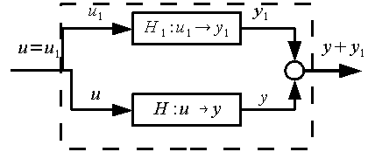



Conic systems - Properties
Notes:
6

Slide 7
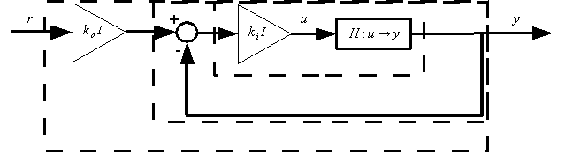
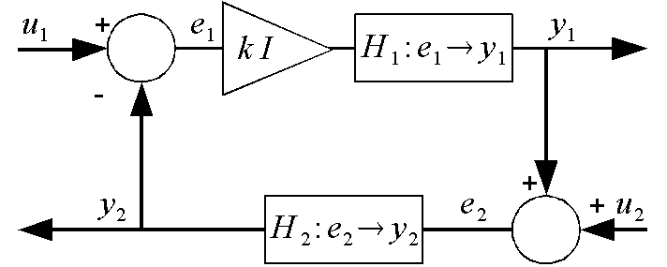
Conic systems – Feed-back Properties
Notes:
7

Slide 8
Conic systems – Feed-back Properties
Notes:
8

Slide 9
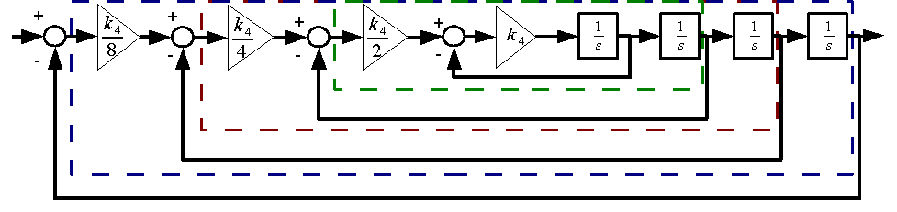
Four Integrators – No Saturation
Notes:
9

Slide 10
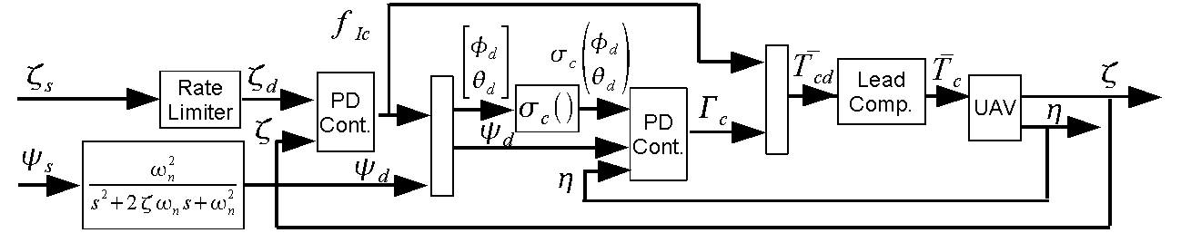
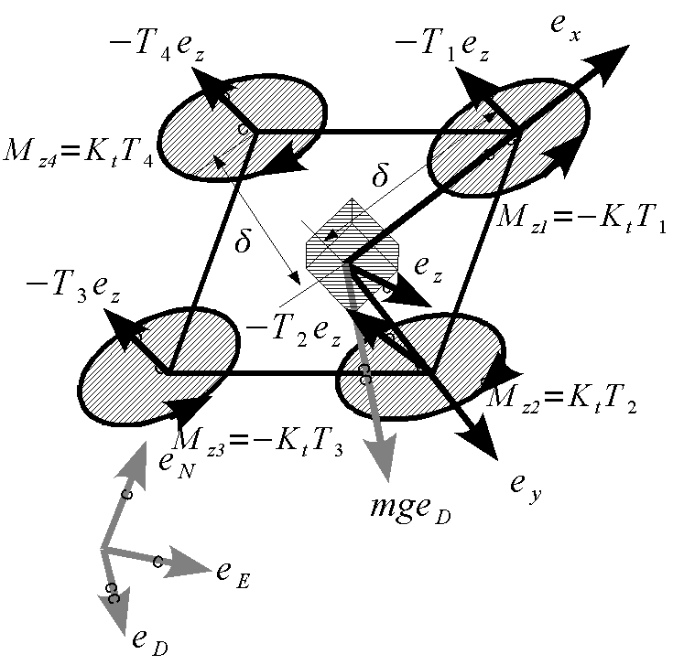
Quad-Rotor Cont. Subj. To Actuator Saturation
Notes:
10

Slide 11
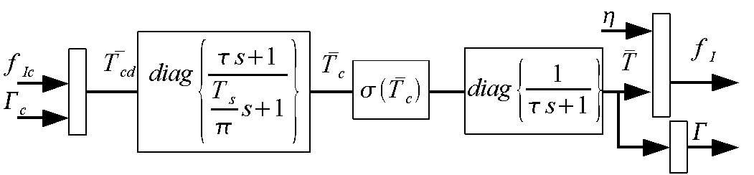
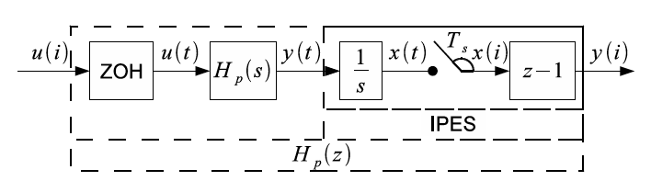
Lead-Compensator, Thrust Computation
Notes:
11

Slide 12
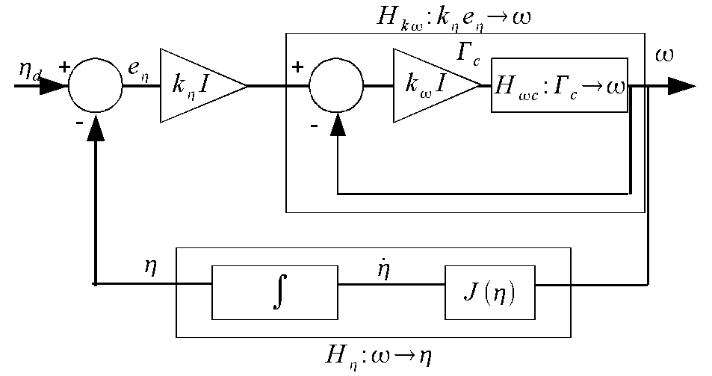
Attitude PD-Controller
Notes:
12

Slide 13
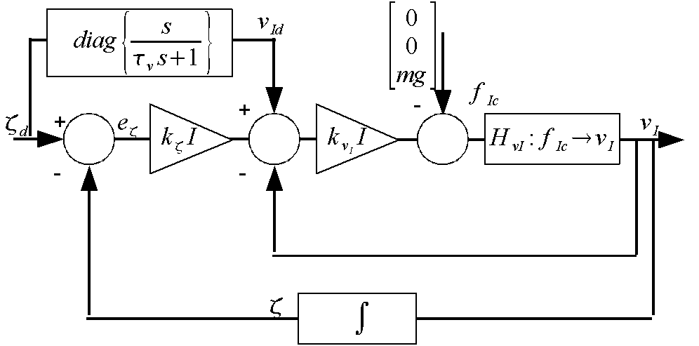
Inertial PD-Controller
Notes:
13

Slide 14
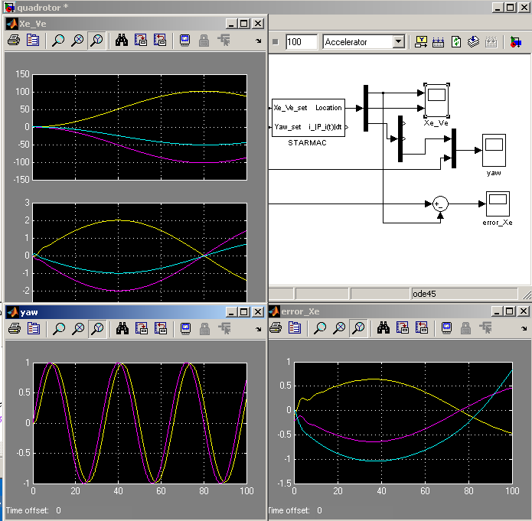
Advanced Quad-Rotor System Model
Used Extensively
OpenC2WT
Integrated seamlessly with autonomous target trackers
Notes:
14

Slide 15
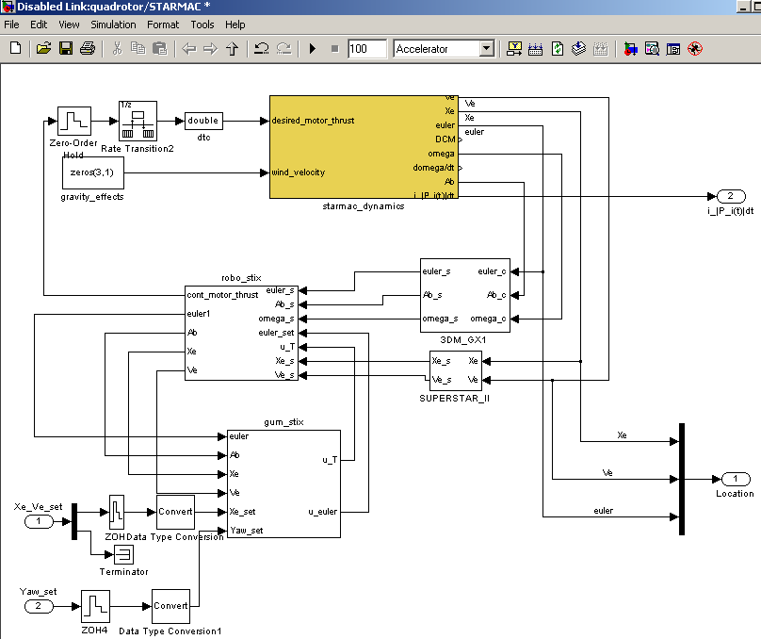
Quad-Rotor System Model
Notes:
15

Slide 16
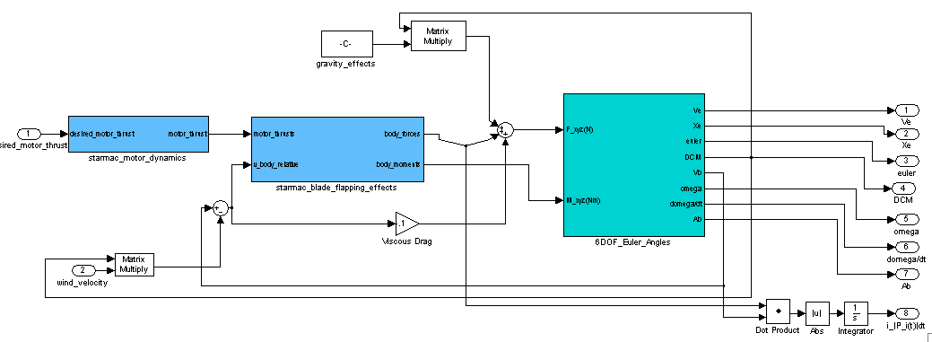
UAV Dynamics
Highly detailed and refined model
UC-Berkley, CMU, Vanderbilt
Notes:
16

Slide 17
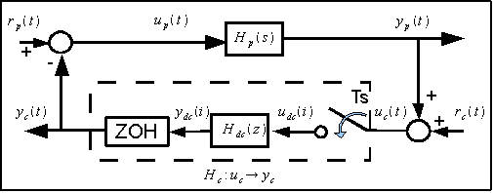
Recall Passivity Theorem
Notes:
17

Slide 18
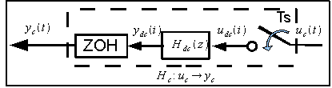
Res. Controller Has Infinite L^{m}₂ - Gain
Notes:
18

Slide 19
Not all is lost, can handle many inputs.
Notes:
19

Slide 20
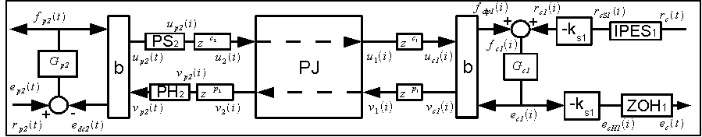
L^{m}₂ – stable networks w/ digital control
Design of Networked Control Systems Using Passivity
(Kottenstette, Hall, Koutsoukos, Sztipanovits, Antsaklis, under review TPDS)
Notes:
20

Slide 21
Bilinear Transform w/ Wave Variables
Notes:
21

Slide 22
PS-PH inside [-1,1]
Notes:
22

Slide 23
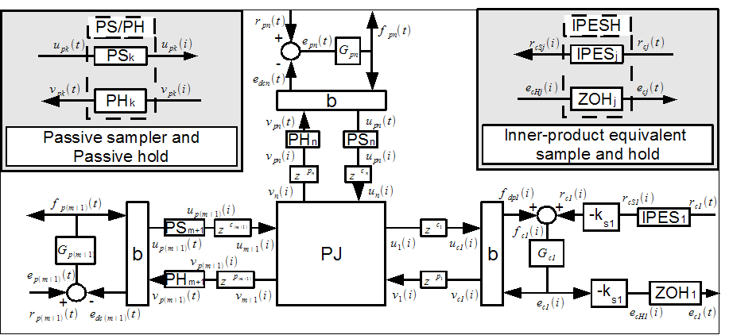
L^{m}₂ – stable digital control networks
Single Digital Controller, Multiple Continuous Plants [1]
(Kottenstette, Chopra: to appear Necsys 2009)
Digital Control of Multiple Discrete Passive Plants Over Networks (Kottenstette, Hall, Koutsoukos, Antsaklis, and Sztipanovits: under review IJSCC)
Notes:
23

Slide 24
L^{m}₂ – stable digital control networks
Both consensus-like networks and (even better) parallel networks can be created which allow:
passive-plants (different dynamics) with similar steady-state gains to be led by a single SISO PID-controller.
used to coordinate multiple robotic arms
Can be used to coordinate aircraft
resilient networks to be created which allow redundant controllers to control a single passive plant.
Notes:
24

Slide 25
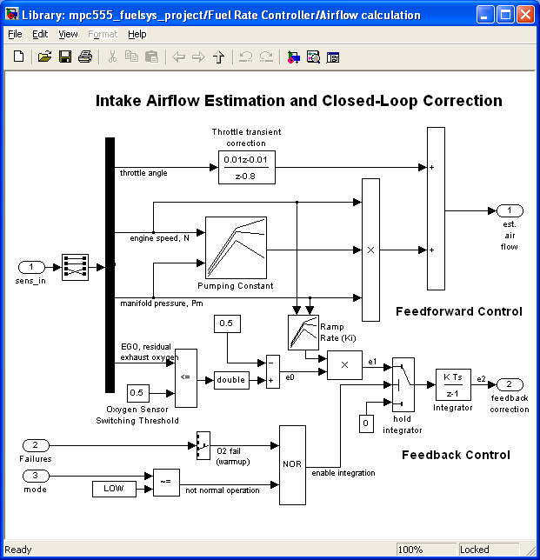
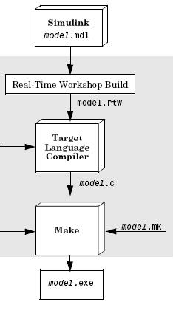
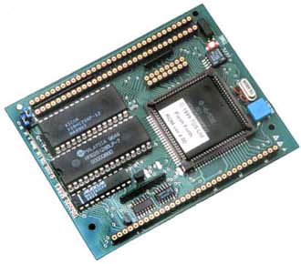
Polyhedral Domains and Widening for Verification of Numerical Programs
design model
model-based development
source code implementation
code generation
Goran Frehse
Verimag
Hitashyam Maka and Bruce H. Krogh
Carnegie Mellon University
target processor
compiler
platform implementation

Slide 26
Verification of numerical programs
design model
Need to verify how
numerical code will
execute on the target
processor
code generation
target processor
compiler
Problem: simulation tools don’t execute numerical code exactly as it will be executed on the target processor (e.g., because of different round off properties due to different word-lengths)

Slide 27
Verification of numerical programs
design model
disassembler
control flow graph
numerical
program
verifier
CFA generator
target processor
error model
code generation
CFA
PHAVer
target processor
compiler
reachability
results
To achieve verification of the target code, the binary is disassembled into a control flow graph – similar to what is done in compilers

Slide 28
Verification of linear numerical programs
CFG is augmented with a model of the numerical error propagation (IEEE 754 standard), leading to a linear hybrid automaton (LHA) model
design model
disassembler
control flow graph
CFA generator
target processor
error model
code generation
CFA
PHAVer
target processor
compiler
reachable sets
error
bounds
A LHA rechability tool which calculates error bounds on critical variables by using polyhedra in order to, for example, over-approximate piecewise affine dynamics

Slide 29
Polyhedral domains
convex polyhedron: conjunction of linear predicates
polyhedron: disjunction of convex polyhedra
Parma Polyhedra Library (PPL): performs exact computations with non-convex polyhedra
PHAVer: performs reachability for LHA
exact and robust arithmetic with unlimited precision (PPL)
bit-constrained over-approximations for termination heuristics
on-the-fly over-approximation of piecewise affine dynamics
support for compositional and assume-guarantee reasoning.

Slide 30
Exact Arithmetic in PHAVer
Finite resources require over approximation
Semi-bounded exact arithmetic
exact computations (rational arith.) that result in finite precision
* Managing the complexity by over-approximation
generate time-elapse polyhedron
* compute conservative over-approximation (bits bounded!)
derivative
initial set
y
109
x
121
y
100
limit the number of bits of coefficients
limit the number of constraints
1
6
x
6
y
6
0
1
x
bounding the number of bits guarantees convergence of reachability computations

Slide 31
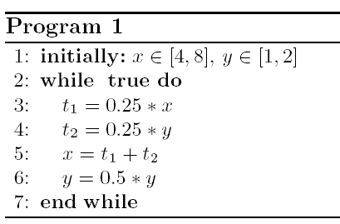
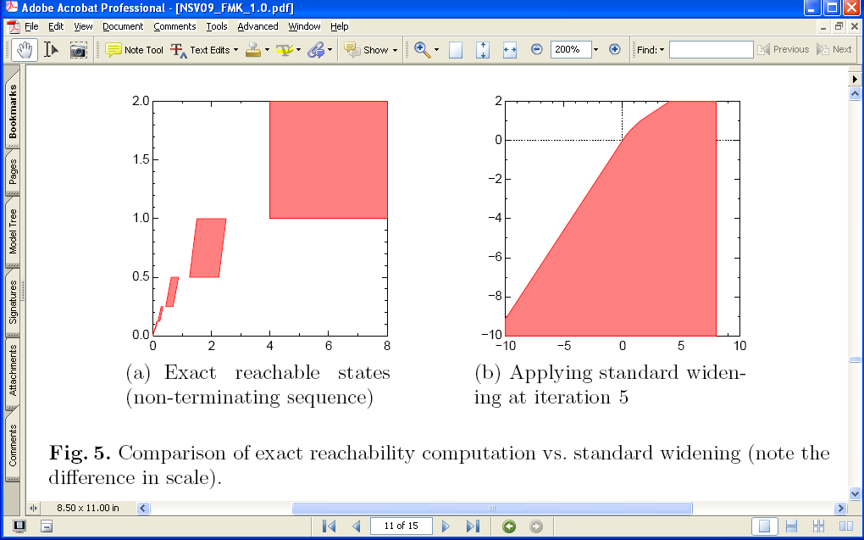
Standard widening: example (Cousot)
exact
(nonterimintating)
std. widening
terminates at iteration 5
large over approximation

Slide 32
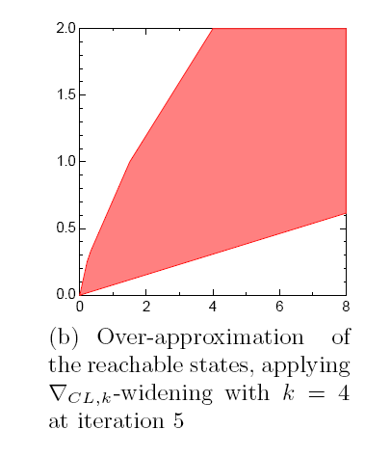
Example 1: Application to Program 1
std. widening
coefficient-limiting
widening

Slide 33
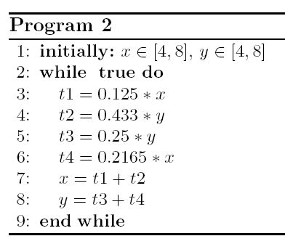
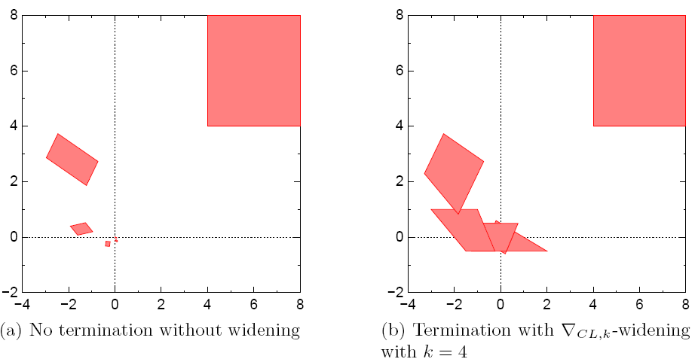
Example 2: Non-convex polyhedra (w/o convex hull)

Slide 34
Summary
new widening operator based on bounding coefficients
error-preserving reductions - transition merging - variable elimination
implementation using PHAVer
next steps
exercise on benchmarks
integration with standard tools
incorporating other sources of errors (e.g., inf, NaN)

Slide 35
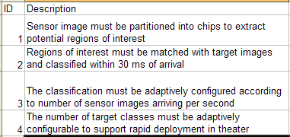
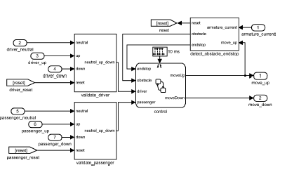
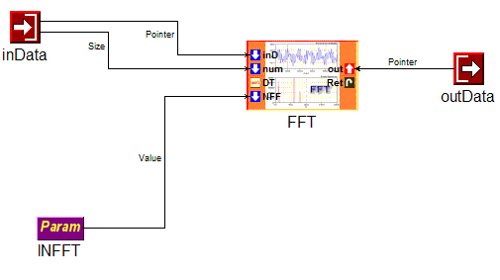
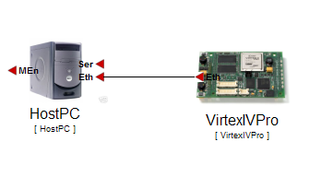
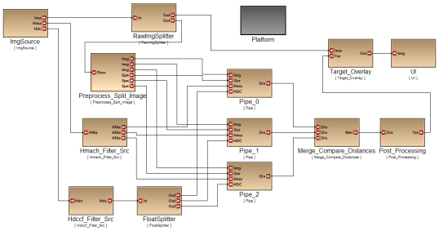
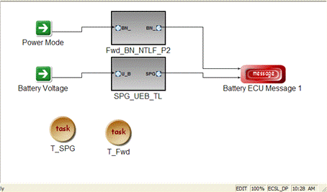
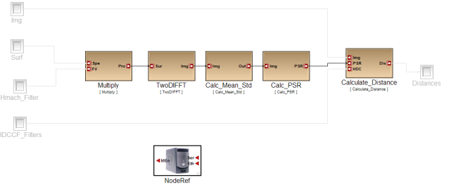
Overall Design Flow
Requirement Specification
RA
Control Design
FD
HwA
Functional
Mod/Sim
Software Architecture
HW Arch. Design
HW Pwr/
Perf Est
SwA
Component Design
System Arch. Design
Arch Mod/Sim
SY
CD
Code Gen. Verif.
Latency/RT
Analysis
Alloc./Sched.
Analysis
DPL
SW Deployment

Slide 36

Focus of the toolchain
Plant Models and Requirements
Code and SW Component Design
System-Level
Design
Model-Based Design
Analysis
Meta-Model
ESMoL
-> Analysis
Function (Controller) Modeling
Component
Platforms
System and
Hardware Platforms
MDL
Meta-Model
MDL-> ESMoL
ESMOL
Meta-Model
ESMoL-> SFC
SFC Meta-Model
The toolchain turns the functional controller design into a software implementation: a collection of integrated components executed by a robust component platform that runs on a system/hardware platform.

Slide 37
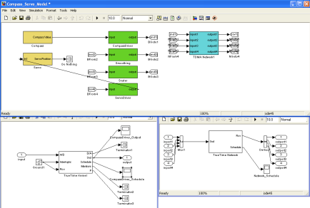
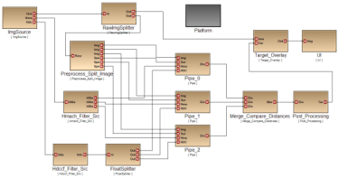

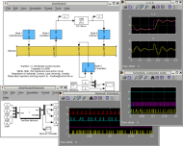
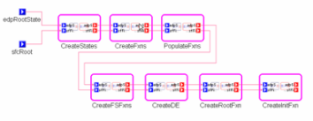


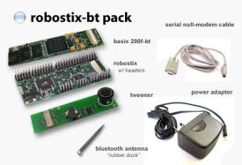
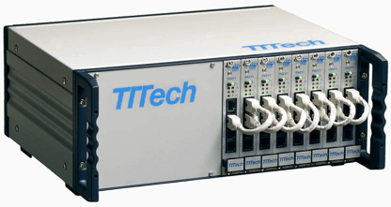
Toolchain overview
Model-based Design
Componentization
Architecture modeling
Deployment modeling
Functional Design
Simulink/Stateflow
Model-based Code Generation
Schedule Generation
Analysis
Platform effects
Verification
Schedule
SW Platform

Slide 38
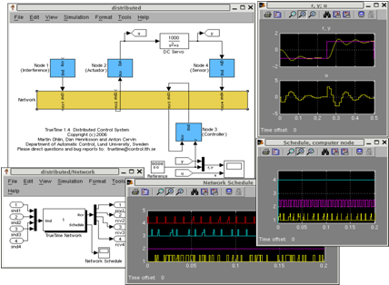
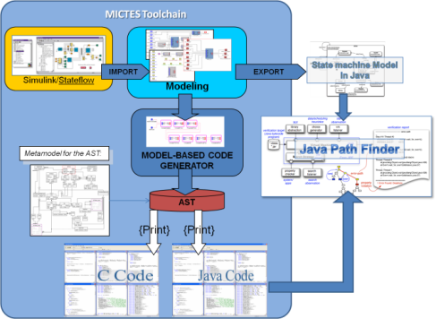
Analysis and verification
Platform effects analysis
TrueTime model for platform
Generator to build Simulink model for functional model + platform model
Continuous time, high-precision Simulink simulation allows studying subtle platform effects
Verification (Leverage NASA MICTES Project - JPF)
Functional model state reachability verification
Functional code verification
Objective: To give feedback for the designer

Slide 39
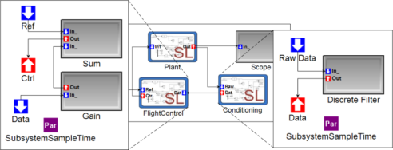
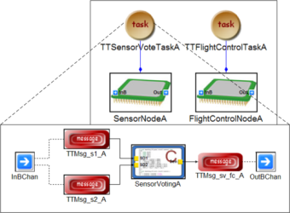
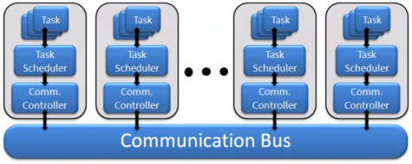
Foundation: Semantics for ESMoL
ESMoL: Embedded System Modeling Language
Components: (Imported from Simulink)
Synchronous dataflow network + Statecharts
Run at a fixed rate - periodic execution:
x(k+1) = f(x(k),u(k)) – State update
y(k+1) = g(x(k),u(k)) – Output Update
Responsible for (periodic) I/O interactions
Component architecture:
Components are statically scheduled according to their rates
Communication is facilitated by time-triggered messages (also statically scheduled)
Hardware platform:
Each node runs a cyclic, static, timed-triggered schedule
Nodes communicate via time-triggered messages
Deployment model:
Time-triggered tasks hosting components, interfacing via messages, mapped to processor nodes

Slide 40
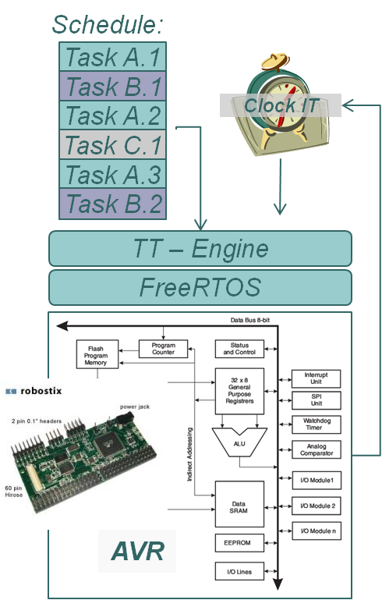
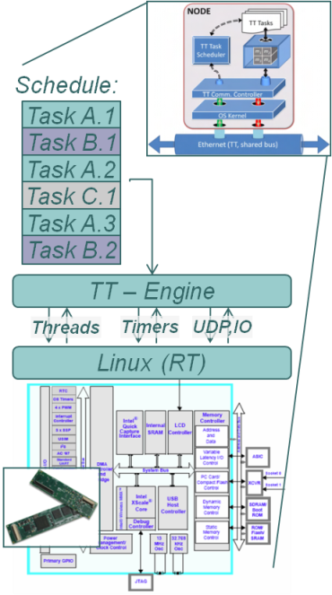
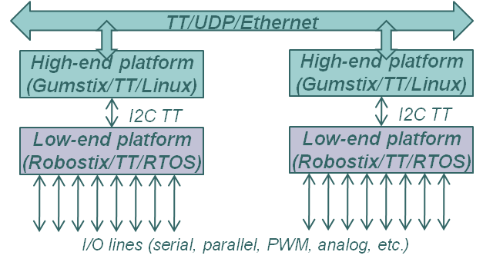
Execution: Time-triggered Platform
Execution model:
Timer/clock-interrupt driven periodic execution of tasks according to a static schedule
Tasks do not preempt, except in case of overruns
If a task overruns its WCET, it is cancelled and the next task is started
Tasks are scheduled with sufficient slack to allow for I/O interrupts
IT-driven I/O communicates with component/tasks via shared buffers

Slide 41
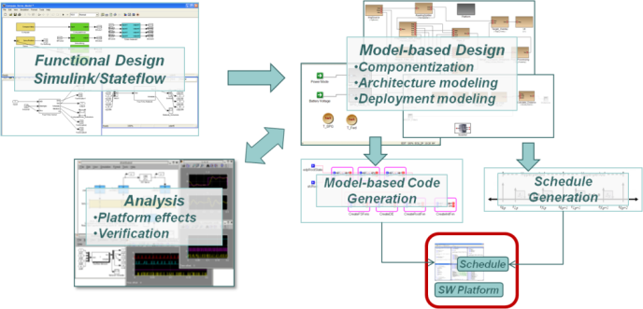
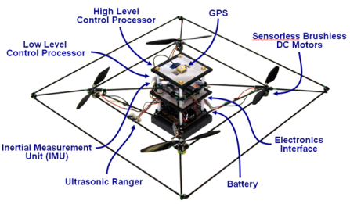
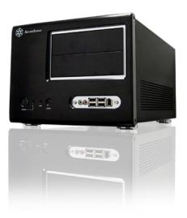
A Platform for Experimentation
Model-based Toolchain
TT/UDP/Ethernet
High-end platform
(Gumstix/TT/Linux)
High-end platform
(Gumstix/TT/Linux)
I2C TT
Platform
I2C TT
Low-end platform
(Robostix/TT/RTOS)
Low-end platform
(Robostix/TT/RTOS)
I/O lines (serial, parallel, PWM, analog, etc.)
Next steps:
Supporting other Models of Computation
Integration of heterogeneous MoC-s
Fault management
Real-time Simulation Platform ‘Virtual plant’

