Slide 1
New Developments in Model-Integrated Development of High-Confidence Software
Joe Porter, Graham Hemingway, Nicholas Kottenstette,
Harmon Nine, Chris vanBuskirk,
Gabor Karsai, and Janos Sztipanovits
Institute for Software Integrated Systems
Vanderbilt University
Nashville, TN 37205

Slide 2
Big Picture: High-Confidence Embedded Software Design
Layered Design Concerns
Our Goals
Certifiable implementations
Plant Dynamics
Models
Controller Models
Model-based Design Flows (GME)
Domain-Specificity (ESMoL)
Support certification processes
Controller design
Integrating verification and validation into tools
Software
Architecture
Models
Software Component Code
Concurrency/Deadlock
Schedulability
Value domain issues
Software design
Exploring compositional techniques
Emphasize correct-by-construction
Passive control design
Verification
Scheduling
System
Architecture Models
Resource
Management
Models
System Platform Design
Notes:
High-confidence designs have to deal with multiple layers of design concerns and multiple correctness objectives. Rather than an all-in-one tool approach that admits the full expressive power of all design languages involved in the process, we’re trying to restrict the design space for each aspect to use correct-by-construction techniques to reduce verification burdens. Our approach is to build up modeling tools incrementally as we can identify new areas where correct-by-construction methods can be applied.

Slide 3
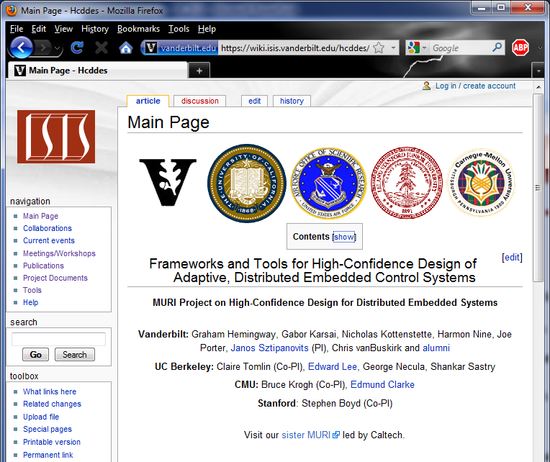
Big Picture: High-Confidence Embedded Software Design
Layered Design Concerns
AFOSR HCDDES MURI Team
Plant Dynamics
Models
Controller Models
Controller design
Software
Architecture
Models
Software Component Code
Software design
System
Architecture Models
Resource
Management
Models
System Platform Design
https://wiki.isis.vanderbilt.edu/
hcddes
Sponsored by the AFOSR MURI
FA9550-06-0312
and by NSF CPS contract
NSF-CCF-0820088
Notes:
We’re starting with the big picture. Beyond our goals we also have a bigger project with many contributors. The AFOSR funded two MURI projects in this area. Our collaborators are Claire Tomlin and Edward Lee at UC Berkeley, Bruce Krogh and Edmund Clarke at Carnegie-Mellon University, and Stephen Boyd at Stanford.

Slide 4
Overview: High-Confidence Embedded Software Design
Workflow
Design aspects
Flow details
Philosophy: Correct-by-construction where possible
Meta project
Quadrotor Design Example
Architecture & Simulink
ESMoL
Flow
Interpreter framework
Scheduler
TrueTime
Work in Progress
Fixed wing aircraft modeling and analysis
Test generation
Statistical model checking
Incremental analysis

Slide 5
Development Workflows for Modeling Tools
CONTROL
DESIGN
SOFTWARE
IMPLEMENTATION
SOFTWARE
ANALYSIS
GENERATION
& EXECUTION
Simulink
Simulation
Software Modeling
Scheduling
Platform/HIL
Simulation
Requirements
Platform Design
Deadlock
Testing
High-confidence development involves many activities in different domains of expertise.
Notes:
Inputs to our tools are Simulink control designs, but we recognize that distributing those functions quickly leads to violation of the semantic execution model in Simulink. Our goal is to use model integrated computing to pull together all of these aspects of the design in a consistent way, and generate code that maintains the properties of the control design when executed on a proper platform. These technologies do not exist in a vacuum. Tools and development processes must work together, recognizing that often simply understanding the design problems is the rate-limiting factor. We’ll describe a design flow that cuts across these modeling and analysis aspects, and which is supported by our modeling tools.

Slide 6
Workflow: Control Design
CONTROL
DESIGN
SOFTWARE
IMPLEMENTATION
SOFTWARE
ANALYSIS
GENERATION
& EXECUTION
1
Software Modeling
Scheduling
Platform/HIL
Simulation
Simulink
Simulation
Platform Design
Deadlock
Testing
Matlab
analysis scripts
Tuning
Control designers create Simulink and Stateflow models to capture and simulate the physical behavior as well as the engineering design. Design verification takes the form of scripts to assess controller performance (e.g. stability, settling time, overshoot) and adjust controller gains.
RequirementsAssessment

Slide 7
Workflow: Import Control Design to ESMoL
CONTROL
DESIGN
SOFTWARE
IMPLEMENTATION
SOFTWARE
ANALYSIS
GENERATION
& EXECUTION
Software Modeling
(Arch/Deployment)
Scheduling
Platform/HIL
Simulation
2
Simulink
Model Files (.mdl)
Deadlock
Testing
ESMoL Modeling Language
Importer
The ESMoL domain-specific modeling language (DSML) includes a sublanguage which fully represents Simulink and Stateflow model structures. The tools include a fully automated model importer.
Requirements
Platform Design
Notes:
At ISIS our business is Domain-Specific Modeling Languages.

Slide 8
Workflow: Software and Hardware Design
CONTROL
DESIGN
SOFTWARE
IMPLEMENTATION
SOFTWARE
ANALYSIS
GENERATION
& EXECUTION
Software Modeling
(Arch/Deployment)
Simulink
Simulation
Scheduling
Platform/HIL
Simulation
Requirements
3
Deadlock
Testing
ESMoL Modeling Language
Software and hardware designers manually enter software designs in GME to describe the software architecture of the Simulink design models, network topology, and deployment of the software components to the hardware.
Platform Design
Notes:
Note that the syntactic binding from Simulink components to ESMoL components is very lightweight, so importing a revised design is straightforward and requires only a small amount of model rework.

Slide 9
Workflow: Software Analysis
CONTROL
DESIGN
SOFTWARE
IMPLEMENTATION
SOFTWARE
ANALYSIS
GENERATION
& EXECUTION
Software Modeling
(Arch/Deployment)
Scheduling
Simulink
Simulation
Platform/HIL
Simulation
Sched Spec
Esched
Tool
Requirements
4
Testing
ESMoL Modeling Language
Release Times
Model
Transformations
BIP
Spec
DFinder
Model interpreters generate scheduling specifications and import results. BIP analysis is under development.
Round-trip analysis is integrated into the tool environment.
Platform Design
Deadlock
Notes:
BIP analysis is under development to support extending our execution semantics to asynchronous communications in a safe and constructive way.

Slide 10
Workflow: Generation & Execution
CONTROL
DESIGN
SOFTWARE
IMPLEMENTATION
SOFTWARE
ANALYSIS
GENERATION
& EXECUTION
Software Modeling
(Arch/Deployment)
A platform-independent time-triggered virtual machine provides a synchronous distributed execution environment.
Simulink
Simulation
Scheduling
Platform/HIL
Simulation
Control Functions
Requirements
5
Deadlock
ESMoL Modeling Language
Task/Msg
Wrappers
SoftwareGenerator
Model interpreters synthesize C code for controller functions and for platform-specific task/messaging wrappers.
FRODO VM
TrueTime provides platform-specific simulation, and the xPC target enables hardware-in-the-loop.
TrueTime (Simulink)
xPC Target (HIL)
Platform Design
Testing

Slide 11
Workflow: Assessment & Refinement (in progress)
CONTROL
DESIGN
SOFTWARE
IMPLEMENTATION
SOFTWARE
ANALYSIS
GENERATION
& EXECUTION
Simulink
Simulation
Software Modeling
Scheduling
Platform/HIL
Simulation
Control designers can use the same tests to assess controller stability and performance, closing the loop on the design flow.
In the TrueTime and HIL execution environments we can measure the effects of platform uncertainty on controller performance.
Control Functions
Platform Design
Deadlock
Task/Msg
Wrappers
FRODO VM
Requirements Assessment
Matlab analysis scripts
6
TrueTime (Simulink)
xPC Target (HIL)
Tuning
Testing
Notes:
Here we close the loop on the design process. Some of us get uncomfortable at the thought of iterating the design, but there are two points we should make here: 1. Often design problems are due to partial understanding, which we don’t discover until later in the integration, verification, and testing phases. Sometimes you have to break the design to address those problems. 2. We want to make the whole process as painless and lightweight as possible, so that we can preserve model artifacts that were not affected by our radical re-design, and quickly rebuild things that were broken. For example, what if we realized late in the game that our control architecture was inadequate, and we needed a more sophisticated control framework instead? We may end up seriously breaking the component structure (including interfaces) to accommodate such a change.

Slide 12
Workflow: Correct-by-construction
Correct-by-construction methods rely on component behavior conditions and interconnection rules to guarantee correct behavior, reducing verification burdens.
CONTROL
DESIGN
SOFTWARE
IMPLEMENTATION
SOFTWARE
ANALYSIS
GENERATION
& EXECUTION
PASSIVE CONTROL
TECHNIQUES
Simulink
Simulation
Software Modeling
Scheduling
Platform/HIL
Simulation
COMPOSITIONAL
ANALYSIS
Platform Design
Deadlock
Testing
Requirements
SYNCHRONOUS EXECUTION/
TIME-TRIGGERED
ARCHITECTURE
Structural conditions guaranteeing correctness must be maintained throughout the implementation generation process.
Notes:
What are we talking about when we say “Correct-by-construction methods”? There are lots of variants out there in different domains.

Slide 13
META Ugly Chart (Ted)
Boeing: Steward
iFAB
Architecture
Modeling
Complexity/
Adaptability
System
Build
Sandeep/Ted
Eby
Harmon/Himanshu
Component
Lib
Verification
Implementation
Graph, Hierarchy,…
C2WT
System
Simulation
Porter
Comp. Properties,
Statistics, etc
OTIF
Tool Integr
Struct, Params,
Exec Comp. Models
Conditions
Bapty/…
Struct, Properties,
Constraints,.
DESERT
Discrete
Des Sp Expl
Smith/Feng
Domain
Analysis Tools
Feng
Struct, Params,
Detailed Comp. Models
Struct, Params,
Comp. Models
Struct, Params,
Mfg Models
Matt
Lattman
MDAO
Parametric Design Space Exploration
Bond Graph
Multi-Dyn
Sim
Wrenn/Porter/Hemingway
Wrenn/Lattman
ESMOL
SW Impl
Manufacturability
GTRI: Ceisel/German
Boeing: Mattakali

Slide 14
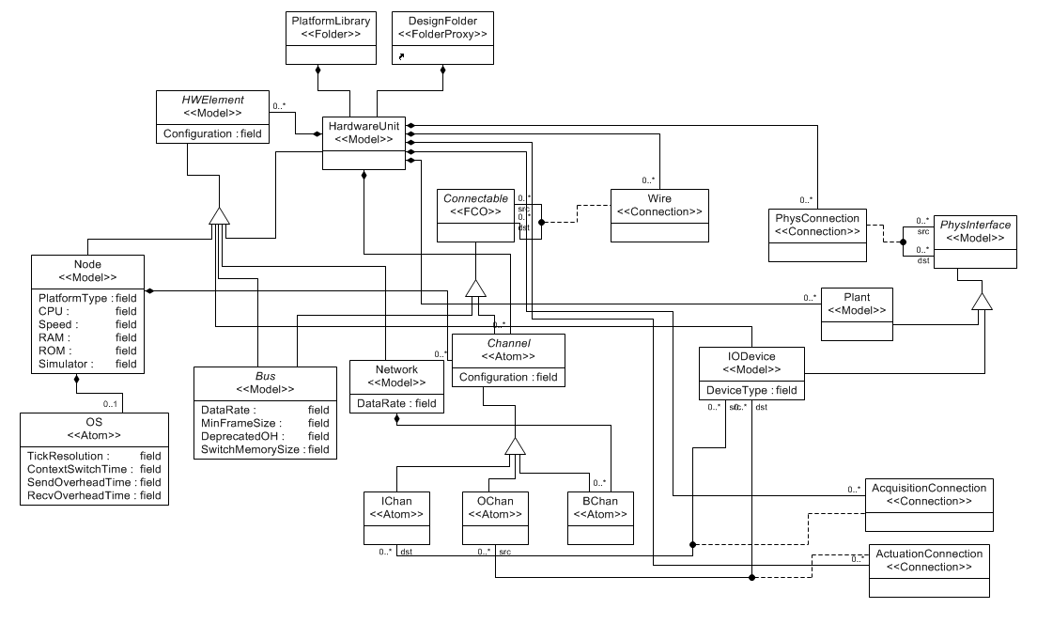
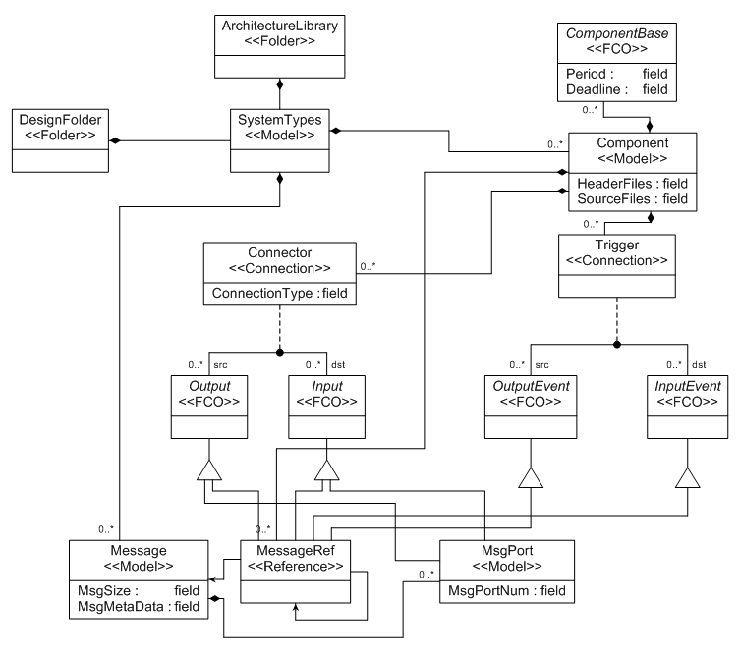
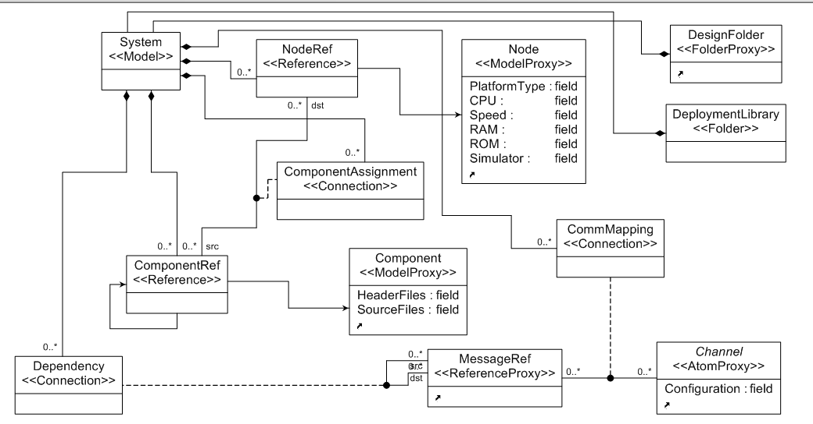
ESMoL Language: Model-Integrated Computing (MIC)
Platform Sublanguage
Architecture Sublanguage
Deployment
Sublanguage
Notes:
The deployment language integrates elements from the architecture sublanguage with elements from the platform sublanguage. Their relationships are precisely defined, and user visualization is also specified.

Slide 15
Quadrotor Design Example
Quadrotor Control Architecture
Trajectory
Generator
Outer Loop
Controller
(Inertial Position)
Inner Loop Controller
(Attitude)
Motor Compensator
Quadrotor
CONTROL
DESIGN

Slide 16
Quadrotor: Simulink
Quadrotor
Inner Loop Controller
(Attitude)
Outer Loop Controller
(Inertial Position) and Trajectory Generator
CONTROL
DESIGN

Slide 17
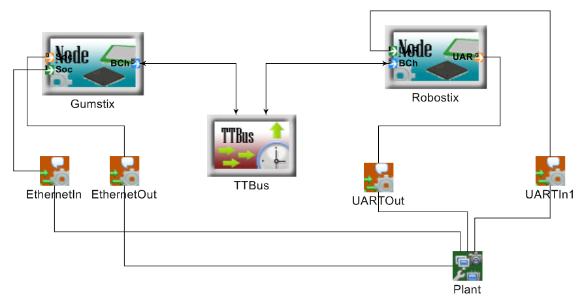
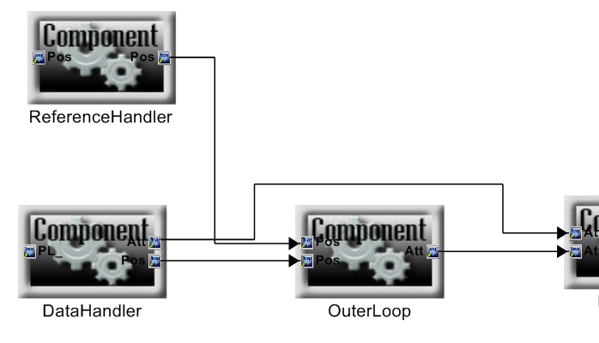
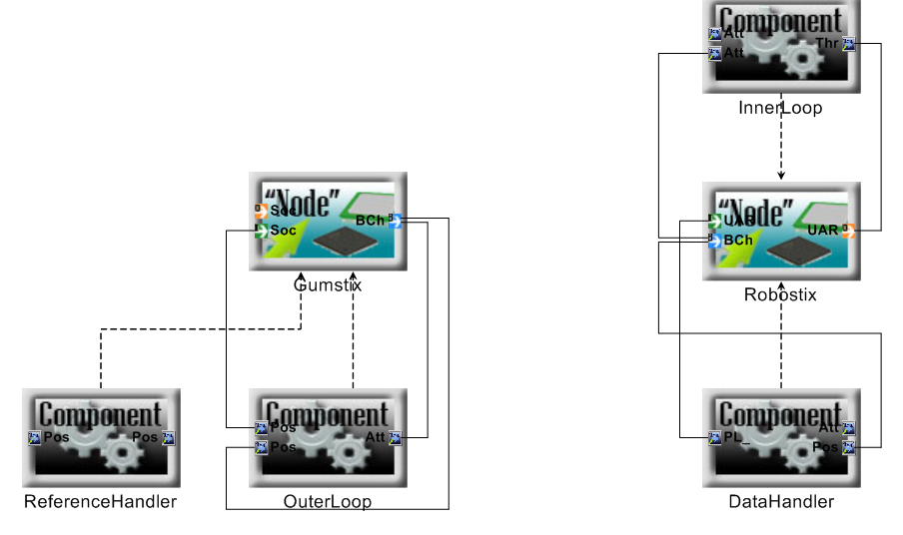
Quadrotor Software Design: GME & ESMoL
Processor
Platform Design
Model
Bus
Block == Component Instance
Port == Message Instance
Peripherals
Node Ports == Comm Channels
Message
Assignment
Software
Deployment
Component Assignment
Logical Architecture
(Dataflow)
SOFTWARE
IMPLEMENTATION

Slide 18
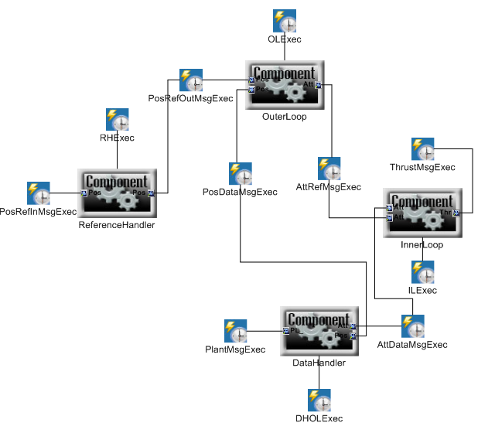
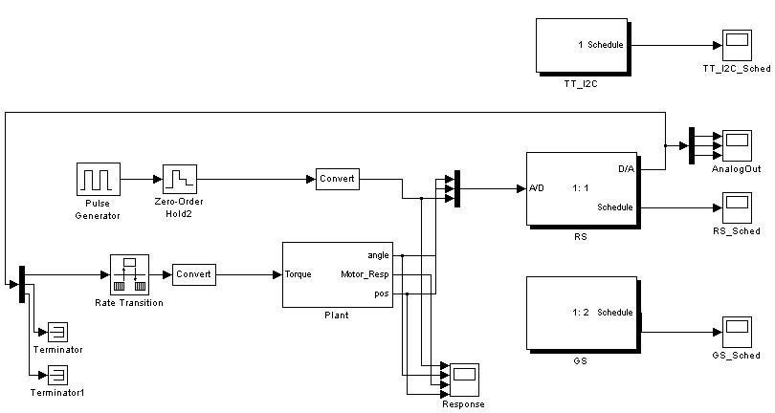
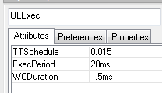
Quadrotor Platform Simulation with TrueTime
SOFTWARE
IMPLEMENTATION
SOFTWARE
ANALYSIS
GENERATION
& EXECUTION
Resolution 5us
Proc RS 4MHz 0s 0s
Comp InnerLoop =50Hz 1ms
Comp DataHandling =50Hz 1ms
Comp ADC =50Hz 1us
Comp SerialIn =50Hz 1ms
Comp SerialOut =50Hz 1ms
Msg DataHandling.sensor_data 8B RS/ADC RS/DataHandling
Msg DataHandling.pos_ref 8B RS/SerialIn RS/DataHandling
Msg InnerLoop.thrust_commands 8B RS/InnerLoop RS/SerialOut
Msg LocalOrder 1B RS/DataHandling RS/InnerLoop
Proc GS 100MHz 0s 0s
Comp OuterLoop =50Hz 1ms
Bus TT_I2C 100kb 1ms
Msg OuterLoop.ang_ref 8B GS/OuterLoop RS/InnerLoop
Msg DataHandling.pos_msg 8B RS/DataHandling GS/OuterLoop
Schedule Spec
Time-Triggered Network
Component Timing Parameters:
TTSchedule – start times
ExecPeriod
WC Duration
Time-Triggered
Nodes
Hyperperiod 20 ms
GS/OuterLoop_0 9.495
RS/SerialIn_0 7.75
RS/ADC_0 8.995
RS/InnerLoop_0 9.495
RS/DataHandling_0 10.495
RS/SerialOut_0 11.865
TT_I2C/OuterLoop.ang_ref_0 9.175
TT_I2C/DataHandling.pos_msg_0 10.815
Calculated Schedule
Generated Task Execution Code
ESMoL Model
File (mga)
Generator
Scheduler Spec (.scs)
Scheduler
TrueTime Simulink Model (mdl)
Task Execution Code (C)
Importer
Scheduler Result (.rslt)

Slide 19
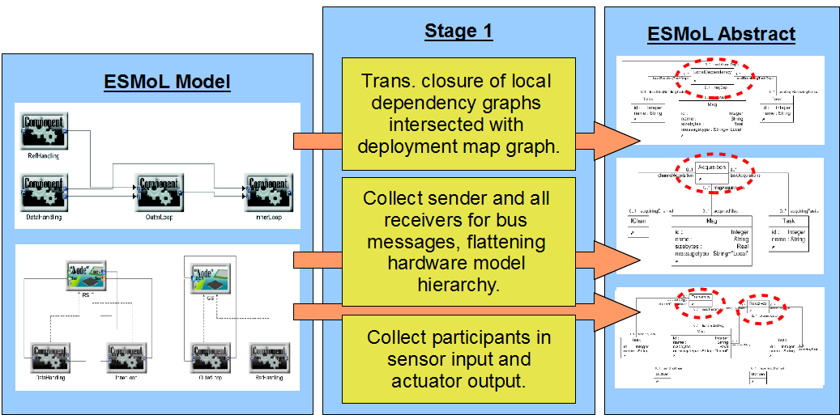
Model Interpreter Framework: Stage 1

Slide 20
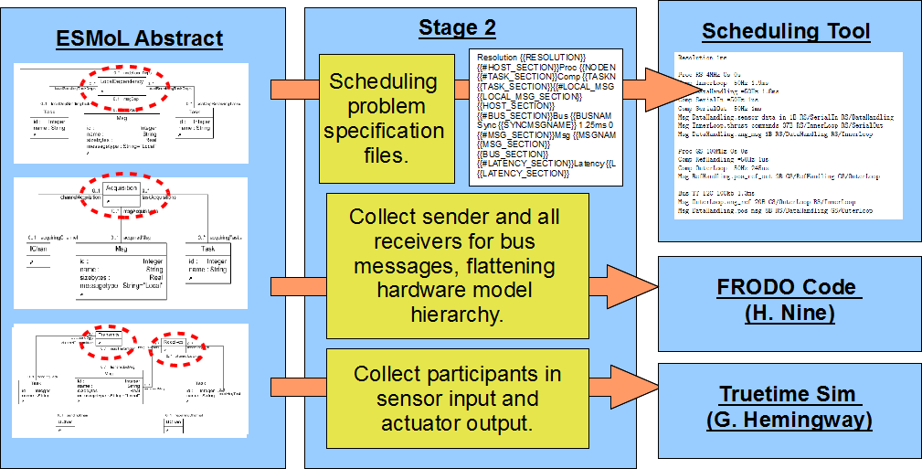
Model Interpreter Framework: Stage 2

Slide 21
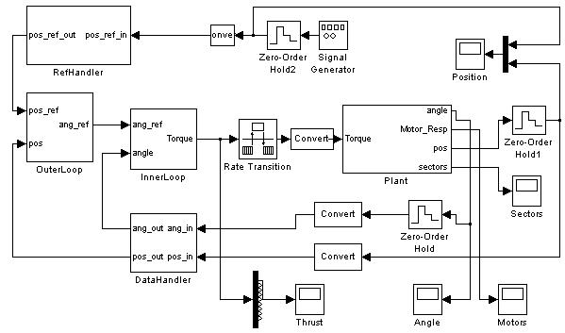

Software + Hardware = Any Problems?
Deployment of a software model onto an actual hardware platform can introduce unexpected issues:
Platform Effects
+
Time-related differences
Numerical differences
Platform flaws
Environmental effects
Error conditions
And more...
Rapid System Prototyping ’10 - Fairfax, VA, June 8-11
Notes:
Cyber-physical system domain
Starting is Simulink for controller design
Real-time sf introduced to hardware

Slide 22
Current Approaches
What are the common current approaches for simulating and analyzing platform effects for embedded systems?
Hacking Simulink model
Co-simulation
Actual deployment and testing on prototype hardware
Custom-built simulation environment
SystemC / AADL
Rapid System Prototyping ’10 - Fairfax, VA, June 8-11
Notes:
Insert some delays in SL model
Co-simulation is very low level
Desire to allow Simulink-based controls engineers

Slide 23
Time Triggered Architecture
TTA is a robust distributed model of execution for high-confidence embedded systems.
Static execution schedule for both tasks and communications
Good fault detection and recovery characteristics
Strong time synchronization between nodes - on message transmission
Requires accurate on-line scheduler execution
Bus
Node A Schedule
(@ 5ms) - Receive msg
(@ 10ms) - Task A
(@ 15ms) - Send msg
Node A
Rapid System Prototyping ’10 - Fairfax, VA, June 8-11
Notes:
Mention nature of high-confidence systems: examples
H. Kopetz in Austria, TTTech, TTP/A and TTP/C, TTP/E
Extend Kopetz’s model to include tasks execution not just comms.

Slide 24
Quadrotor: Schedule Verification and Generation
Scheduling Model Assumptions
Tasks are released on a periodic static schedule. For plants having discrete dynamics (i.e. for DES or hybrid models) the assumption is necessary for consistency of the dynamic state between replicas.
Worst-case execution time (WCET) is known for each task on its processor.
Tasks assigned to the same processor are not preemptive.
Message buses are shared by multiple processors.
Processors (and tasks) may connect to multiple communication buses (though scheduling will be harder).
Message transfer times are known.
A feasible bus schedule does not allow preemption of message transfers.
Messages are broadcast to all nodes on a bus.
On task release input data are already available for use in input buffers. Tasks write output data to output buffers at completion time. The communication framework transfers data and updates these buffers.

Slide 25
Scheduling: Periodic Tasks
Task has instances ordered by the constraint:
Hyperperiod of all tasks
Correction from formula (1)
Release time of instance
Period of task
Period of task

Slide 26
Scheduling: Periodic Tasks
Task has instances ordered by the constraint:
Each instance has exclusive processor access:
Index set of tasks on processor p
All instances of task
Enforce exclusive access to the resource during each interval (using a global constraint).
Notes:
We’re determining phase for each task on each processor.

Slide 27
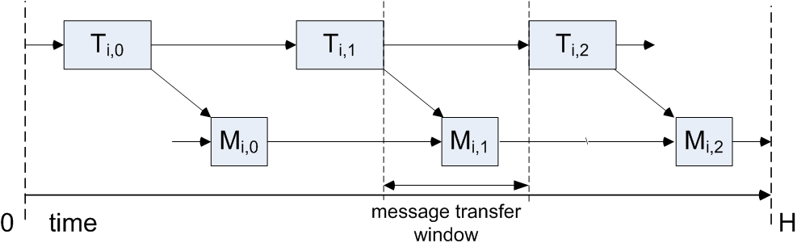
Scheduling: Messages
Message instance ( ) ordering:
End of the sending task
Message send start time
Message transfer time
Start of the receiving task

Slide 28
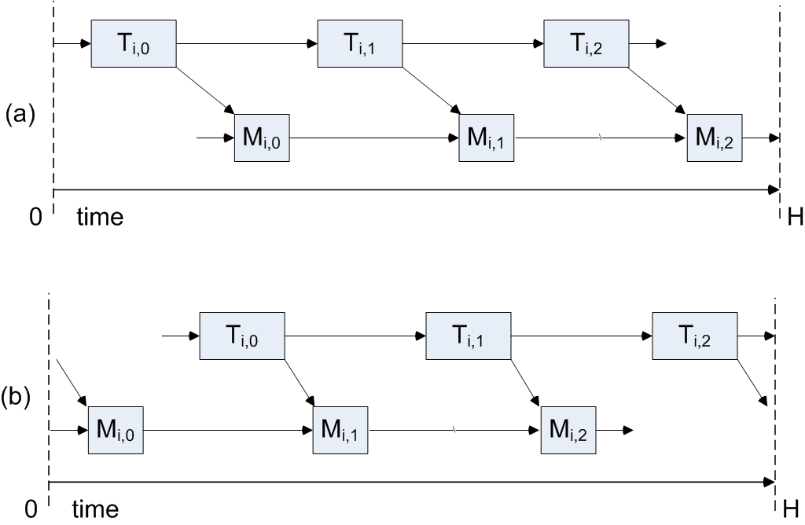
Scheduling: Messages
That case showed
One ordering possibility
Single-rate transfer
Need to handle:
Wrap-around at the ends →
Multi-rate data transfers

Slide 29
Scheduling: Messages
Need to handle:
Wrap-around at the ends →
Multi-rate data transfers
Encodes all of the ordering for a single bus, its messages, and the tasks that send them (no receivers).
To handle multi-rate transfers (with decimation rate ), we have to also insure a minimum distance between instances of the same messages. These constraints replace those shown earlier for messages.
Notes:
Global constraints – Quimper Thesis: Efficient Propagators for Global Constraints. Also the paper on Cumulatives.

Slide 30
Scheduling: Latency
For control systems, we would like to enforce maximum temporal separation between two tasks in different parts of the system.
This is tricky:
Enumeration of all execution dependency paths between them leads to severe problem growth.
Many of the expanded paths would be infeasible?
We want to avoid problem explosions!

Slide 31
Scheduling: Latency
Relax the latency constraints –
Ignore the dependency chains between the specified tasks
Enforce only the temporal distance
Check to see if the dependencies are satisfied in the result (here we could use an IPET-like check).
Now, for the constraints…

Slide 32
Scheduling: Latency
These are less efficient (so far) – for a sending task and a receiving task we create (up to) reified constraints enforcing the maximum time separation, one for each sender/receiver instance pair. Many of these constraints are actually infeasible.
It seems to work better to use equality in the constraint and optimize on the value of .
Each possible arrangement has a control variable .
At least one of the control variables must be true.

Slide 33
Scheduling: Language
Resolution 2us
Proc P1 100MHz 50us 10us
Task T1 =50Hz 8us
Task T2 =100Hz 10us
Proc P2 100MHz 40us 12us
Task T1 =50Hz 10us
Task T2 =100Hz 10us
Proc P3 100MHz 50us 12us
Task T1 =25Hz 10us
Task T2 =50Hz 5us
Bus B12 1Mb 0us
Msg M1 16B P1/T1 P2/T1
Bus B23 1Mb 0us
Msg M2 2B P2/T1 P3/T1
Msg M3 4B P3/T2 P2/T2
Latency 35us P1/T1 P2/T1
% Latency loop
Latency 100us P2/T1 P2/T2
Keep it simple
Capture relevant structure and platform parameters (e.g. rates and overhead)
P1
P2
P3
T1
T2
T1
T2
T1
T2
B12
B23
M1
M2
M3

Slide 34
Scheduling: Limitations
No mode switching
No preemption
No slots
Single set of overhead parameters for each resource
Single resolution and hyperperiod for the whole problem
No parameters for inter-frame gap nor time sync uncertainty
No optimization on the schedule to account for control (or other) performance cost functions

Slide 35
Quadrotor: Schedule Verification and Generation
Schedule Specification
Resolution 5us
Proc RS 4MHz 0s 0s
Comp InnerLoop =50Hz 1ms
Comp DataHandling =50Hz 1ms
Comp ADC =50Hz 1us
Comp SerialIn =50Hz 1ms
Comp SerialOut =50Hz 1ms
Msg DataHandling.sensor_data 8B RS/ADC RS/DataHandling
Msg DataHandling.pos_ref 8B RS/SerialIn RS/DataHandling
Msg InnerLoop.thrust_commands 8B RS/InnerLoop RS/SerialOut
Msg LocalOrder 1B RS/DataHandling RS/InnerLoop
Proc GS 100MHz 0s 0s
Comp OuterLoop =50Hz 1ms
Bus TT_I2C 100kb 1ms
Msg OuterLoop.ang_ref 8B GS/OuterLoop RS/InnerLoop
Msg DataHandling.pos_msg 8B RS/DataHandling GS/OuterLoop
Calculated Schedule
Hyperperiod 20 ms
GS/OuterLoop_0 9.495
RS/SerialIn_0 7.75
RS/ADC_0 8.995
RS/InnerLoop_0 9.495
RS/DataHandling_0 10.495
RS/SerialOut_0 11.865
TT_I2C/OuterLoop.ang_ref_0 9.175
TT_I2C/DataHandling.pos_msg_0 10.815

Slide 36
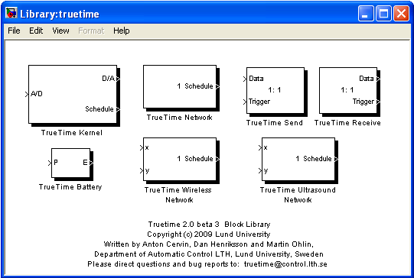
TrueTime toolkit for Simulink
Set of Simulink blocks for simulating task scheduling and execution and network communication.
Task-level execution
Diverse & detailed network models
C++/M-code/SL-block integration
Highly flexible on-line scheduler + API
Standard Simulink visualization of schedule execution
Rapid System Prototyping ’10 - Fairfax, VA, June 8-11
Notes:
Network types: Simple bus, Bus ethernet, Switched ethernet, Flexray, etc., wireless networks also
Built in schedulers: Rate monotonic & Earliest Deadline First, Priority-based

Slide 37
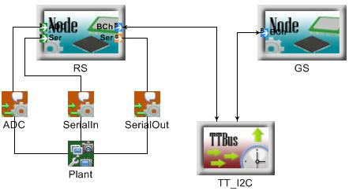
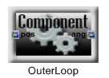
Mapping ESMoL to TrueTime
There is a mapping from ESMoL model software & hardware elements to TrueTime blocks and code:
ESMoL Node
TT Kernel
ESMoL Bus
TT Network
ESMoL Plant
Simulink Block
ESMoL Component
C-Code
Rapid System Prototyping ’10 - Fairfax, VA, June 8-11

Slide 38

TrueTime - New Model Synthesis
Based on the defined hardware configuration, a new Simulink model using TrueTime blocks and original plant block is created.
DataHandling
InnerLoop
OuterLoop
Rapid System Prototyping ’10 - Fairfax, VA, June 8-11
Notes:
Mention that network is off on its own - this is OK. RS/GS communicate via network using TT API - the implementation code - next step

Slide 39
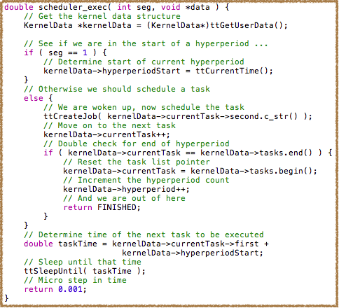
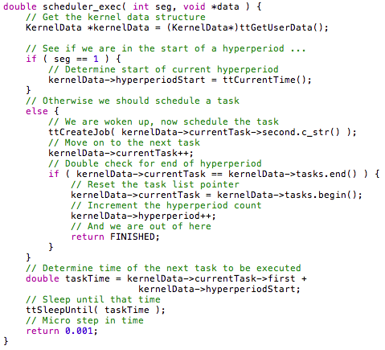
TrueTime - Time Triggered Scheduler
The default TrueTime scheduler is augmented using a custom-built reusable time-triggered scheduler.
Maintains pointer to next task
Consumes some simulation time each invocation
Resets each hyperperiod
Allows for modeling faults
WCET overrun
Task collision
etc...
Uses TrueTime schedule for actual task execution
Rapid System Prototyping ’10 - Fairfax, VA, June 8-11

Slide 40
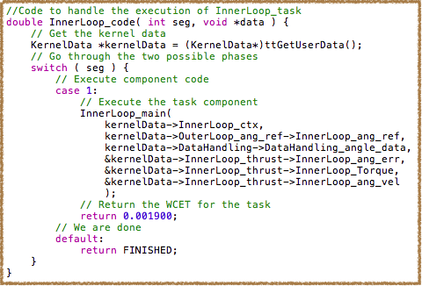
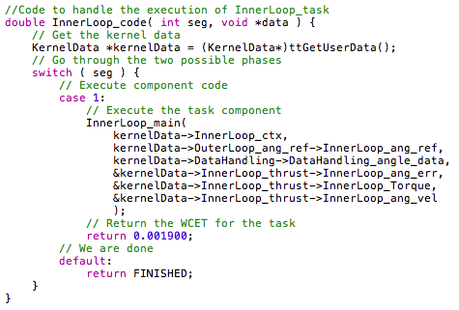
TrueTime - Task Execution Loop
Each task or communication (send/receive) is invoked by the TrueTime scheduler, at the request of the on-line TTA scheduler.
Stores persistent data in KernelData structure, maintained by TrueTime
Calls generated functional code
Consumes task-specific amount of simulation time
Does allow for modeling of faults
Rapid System Prototyping ’10 - Fairfax, VA, June 8-11

Slide 41
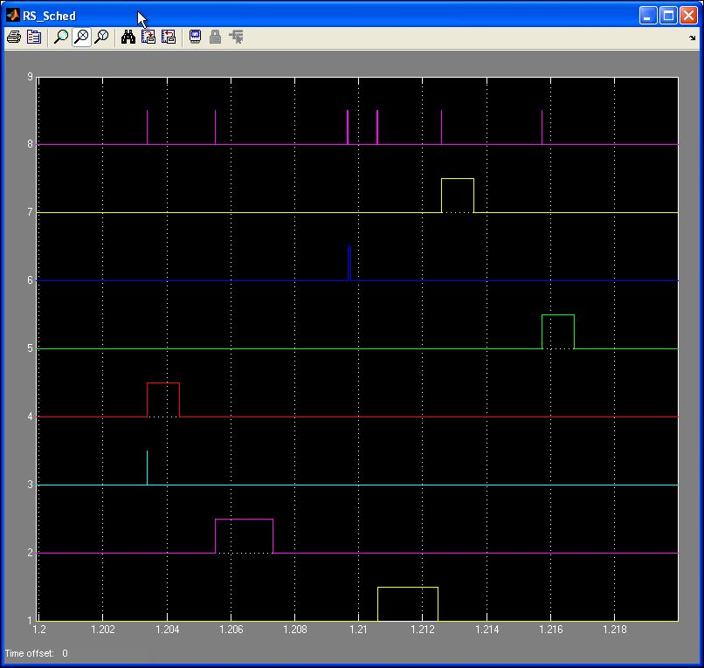
Results - Execution Schedule
Custom TT Scheduler
Inner Loop Task
Data Handler Task
Actuator Output
Bus Comms. #1
Sensor Input
Bus Comms. # 2
Outer Loop Task
Rapid System Prototyping ’10 - Fairfax, VA, June 8-11
Notes:
Execution schedule may introduce unit delays due to ordering, communications, etc. This should be evident in the actual execution behavior.

Slide 42
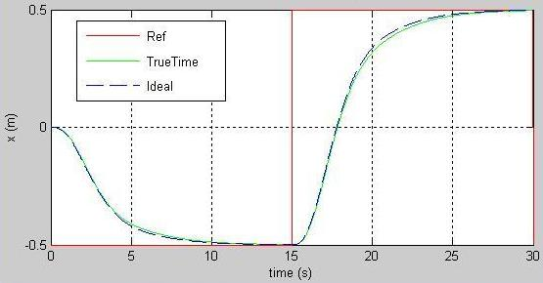
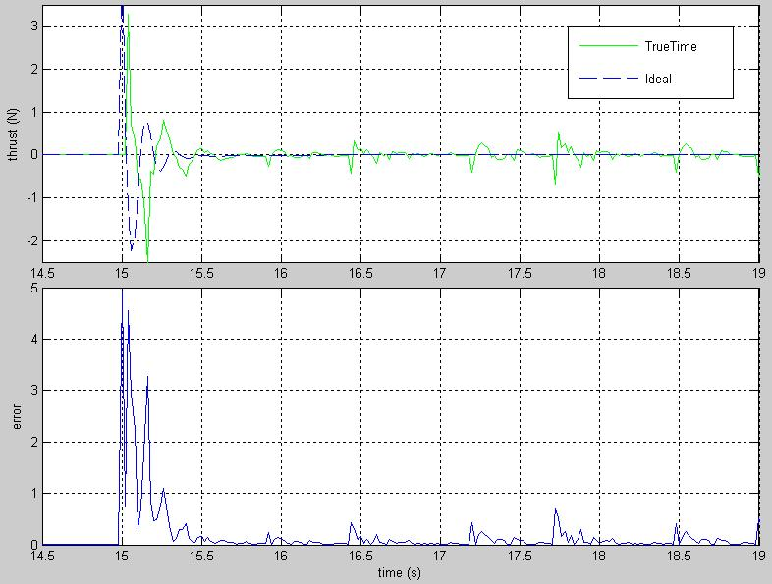
Quadrotor: TrueTime Execution
Tracking performance is close to ideal…
…but platform effects are successfully simulated
GENERATION
& EXECUTION

Slide 43
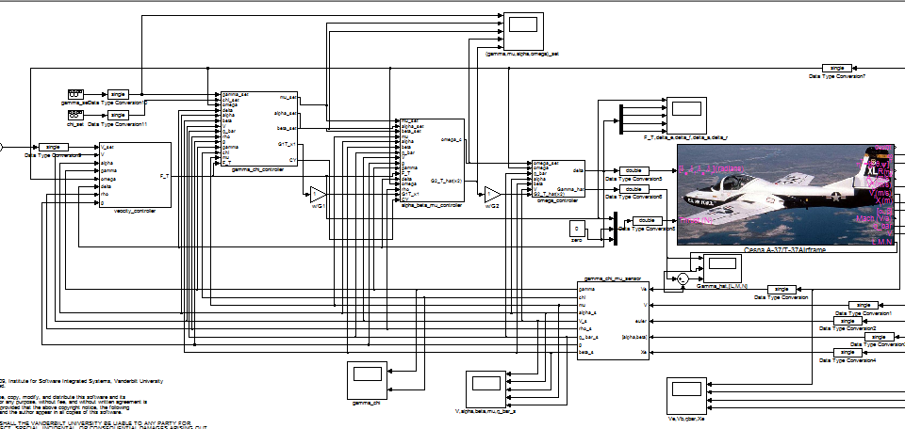
Work In Progress: Fixed Wing Aircraft Example
We wanted to try our hand at a more complex control design…
Cessna
Plant
Gamma Chi Controller
Velocity
Controller
Alpha Beta Mu Controller
Omega
Controller
Questions to be answered:
Design coverage
Online stability assessment for backstepping designs
Sensor
Data Handler
Multicore Experiment: Deploying multiple control loops to the Cell processor.

Slide 44
Work in Progress: Test and Tap
One problem with complex systems is assessing operational data values inside the system (tap the data streams). This is a job for… grad students!
We want to compare simulated data traces to those collected from the platform for various test cases and tap points. Our prototype test generator automates data generation, execution, data collection, and comparison. It’s still fairly limited…
CONTROL
DESIGN
SOFTWARE
ANALYSIS
GENERATION
& EXECUTION

Slide 45
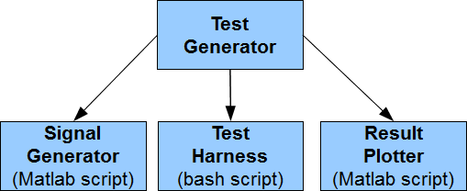
Work in Progress: Test Generator
Signal Generator (Matlab script created by the template engine):
% CreateOuterLoopFreq10Hz.m
t = [0:0.02:50];
PosData = 0 + (10^(25.0/20)) * sin( (2 * pi * 10 * t) + 0 );
PosRef = 0.0 * ones( size(t ) );
% Create a directory based on the test name, and write the input data file into it
dirname = 'OuterLoopFreq10Hz';
mkdir( dirname );
fname = sprintf( '%s/inputs.dat', dirname );
fd = fopen( fname, 'w' );
data = [t PosData PosRef ]';
fwrite( fd, data, 'single' );
fclose(fd);
Example Spec:
test OuterLoopFreq10Hz [0:0.02:50]
exec OuterLoopTest
precision single
sig in PosData sin( 25.0, 10, 0, 0 ), “Position (m)”
sig in PosRef const( 0.0 ), “Position Reference (m)”
sig out AngRef “Angle Reference Output (radians)”
plot t, AngRef, “Angle Reference Data”
plot t, PosData, t, AngRef, “Frequency Comparison 10Hz”
log gainphase.txt “10.0”, “Gain”, calcgain( PosRef, AngRef ), “Phase”, calcphase( PosRef, AngRef), 'OuterLoopFreq10Hz'
Test Harness (bash shell script created by the template engine):
# Run Test OuterLoopFreq10Hz
# Command-line ./RunOuterLoopFreq10Hz.sh <username>@<remote IP address>
matlab -automation -r CreateOuterLoopFreq10Hz
ssh $1 “mkdir OuterLoopFreq10Hz; make clean; make OuterLoopTest”
scp OuterLoopFreq10Hz/inputs.dat $1:/OuterLoopFreq10Hz
ssh $1 “cd OuterLoopFreq10Hz; ../OuterLoopTest inputs.dat outputs.dat >> stats.log 2&>1”
scp $1:OuterLoopFreq10Hz/outputs.dat OuterLoopFreq10Hz/
matlab -automation -r PlotOuterLoopFreq10Hz

Slide 46
Work in Progress: Statistical Model Checking
We extended the Simulink Quadrotor model with a random (Poisson-distributed in time and duration ) sensor fault. When the fault occurs, all of the sensor outputs return zero.
CONTROL
DESIGN
Requirements
Assessment
Statistical model checking sees the system as a black box, so we used an LTL error condition on the measured trajectory. “For 500 seconds of the trace, it will never be true that the error of either x, y, or z will exceed the specified bound for more than 50 seconds.”
How did we do? Well, it shouldn’t crash more than 10% of the time under these fault conditions…
See Zuliani [5]
for details.
¬ F[500] G[50] ( ex > 400 | ey > 400 | ez > 100 )

Slide 47
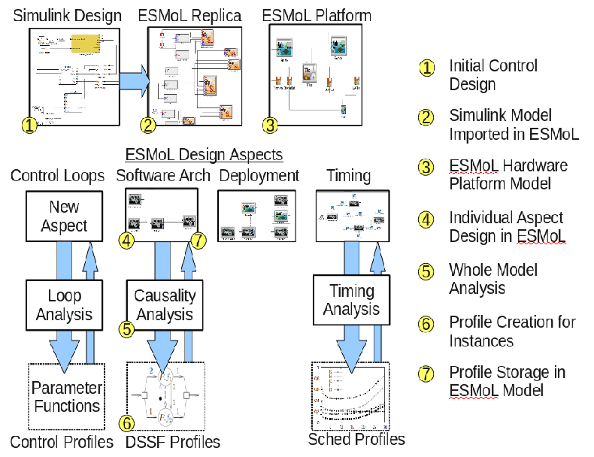
Work in Progress: Incremental Analysis

Slide 48
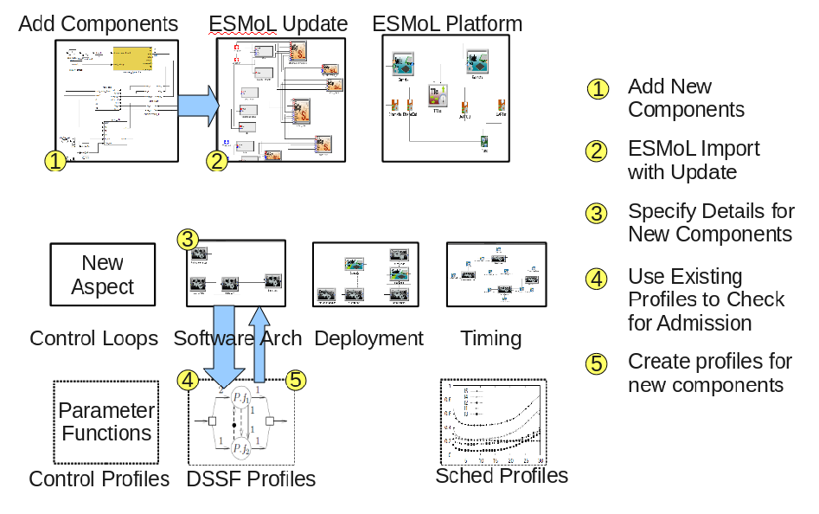
Work in Progress: Incremental Analysis

Slide 49
Questions?
Those interested in trying our tools can visit
https://wiki.isis.vanderbilt.edu/hcddes/index.php/The_ESMoL_Tool

Slide 50
References
[1] N. Kottenstette, J. Porter. Digital Passive Attitude and Altitude Control Schemes for Quadrotor Aircraft. IEEE 7th Intl. Conf. on Control and Automation (ICCA 2009). Christchurch, New Zealand, Dec. 2009.
[2] Porter, J., P. Volgyesi, N. Kottenstette, H. Nine, G. Karsai, and J. Sztipanovits, "An Experimental Model-Based Rapid Prototyping Environment for High-Confidence Embedded Software", Rapid System Prototyping (RSP'09), Paris, France, Jun. 2009.
[3] J. Porter, G. Hemingway, C. vanBusKirk, N. Kottenstette, G. Karsai, J. Sztipanovits. Online Dynamic Stability Verification Using Sector Search. ACM Intl. Conf. on Embedded Software (EMSoft) Grenoble, Oct. 2010.
[4] G. Hemingway, J. Porter, N. Kottenstette, H. Nine, C. vanBuskirk, G. Karsai, and J. Sztipanovits. Automated Synthesis of Time-Triggered Architecture-based TrueTime Models for Platform Effects Simulation and Analysis. Rapid Systems Prototyping (RSP), Jun. 2010.
[5] P. Zuliani, A. Platzer, E. M. Clarke. Bayesian Statistical Model Checking with Application to Stateflow/Simulink Verification. HSCC 2010 (Hybrid Systems: Computation and Control), Apr. 12-16, 2010, Stockholm, Sweden.
[6] LeBlanc, H., E. Eyisi, N. Kottenstette, X. Koutsoukos, and J. Sztipanovits, "A Passivity-Based Approach To Deployment In Multi-Agent Networks", Informatics in Control, Automation and Robotics (ICINCO 2010), Funchal, Madeira - Portugal, Jun. 2010.
[7] R. Thibodeaux. The Specification and Implementation of a Model of Computation. M.S. Thesis. Vanderbilt University, May 2008.
[8] N. Kottenstette, "Constructive Non-Linear Control Design With Applications to Quad-Rotor and Fixed-Wing Aircraft", Tech. Rpt., Inst. for Software Integrated Systems, Vanderbilt Univ., Jan. 2010. Nashville.
[9] S. Bensalem, M. Bozga, T. Nguyen, J. Sifakis: D-Finder: A Tool for Compositional Deadlock Detection and Verification. CAV 2009: 614-619

