Slide 1
High-Confidence Design: ESMoL and Examples
AFOSR HCDDES MURI
Janos Sztipanovits, Gabor Karsai,
Nicholas Kottenstette, Chris VanBuskirk, Harmon Nine,
Graham Hemingway, Joe Porter

Slide 2
Big Picture: High-Confidence Embedded Software Design
Plant Dynamics
Models
Controller Models
Certifiable implementations
Model-based Design Flows (GME)
Domain-Specificity (ESMoL)
Support certification processes
Controller design
Integrating verification and validation into tools
Software
Architecture
Models
Software Component Code
Concurrency/Deadlock
Schedulability
Value domain issues
Software design
Exploring compositional techniques
Emphasize correct-by-construction
Passive control design
Verification (Synchrony/BIP)
Scheduling
System
Architecture Models
Resource
Management
Models
System Platform Design

Slide 3
Modeling Tool Workflows
Design Model Input
ESMoL GME Modeling
Analysis Tools
Generation and Execution
Platform
Deployment
Causal Dependencies
Hardware Mapping
Execution Specs
TT Scheduling
TrueTime
Simulink
Model
Passive Control Model: Simulink
Software Components
FRODO Virtual Machine: TT Execution of C Code
Petri Net Models: BIP
For the continuous/passive control design flow, the time-triggered paradigm provides safe synchronous execution semantics.
Deadlock Analysis
What else?
*TT = Time-Triggered

Slide 4
Work in Progress
Design Model Input
ESMoL GME Modeling
Analysis Tools
Generation and Execution
Platform
TT + Sporadic Task Scheduling
Deployment
Causal Dependencies
Hardware Mapping
Execution Specs
TrueTime
Simulink
Model
Passive Control Model: Simulink
Software Components
BIP Deadlock Analysis
FRODO Virtual Machine:
Expanded Semantics for Sporadic Tasks
Petri Net Models: BIP
We want to use BIP as a formal discrete-event modeling paradigm. The generated BIP models will include synchronous control tasks as well as platform and protocol models.
What else?

Slide 5
Quadrotor Example
Quadrotor Control Architecture
Input Filters
Outer Loop
Controller
(Trajectory)
Inner Loop Controller
(Attitude)
Motor Compensator
Quadrotor

Slide 6
Quadrotor: Simulink
Quadrotor
Inner Loop Controller
(Attitude)
Outer Loop
Controller
(Trajectory)

Slide 7
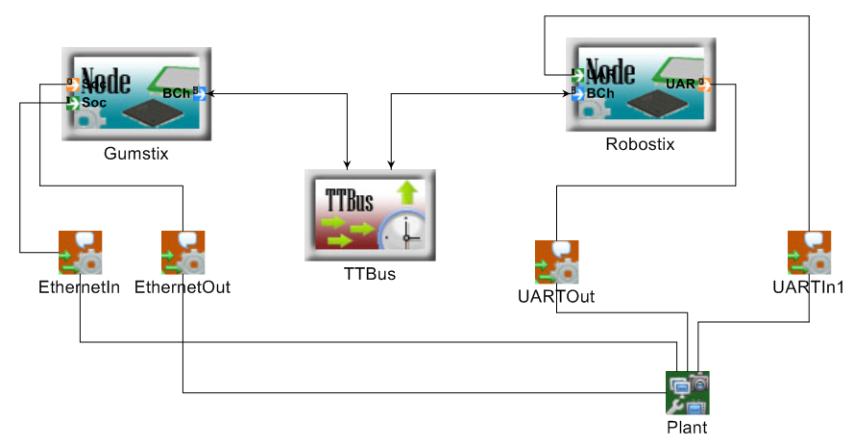
Platform Diagram
Processor
Bus
Peripherals

Slide 8
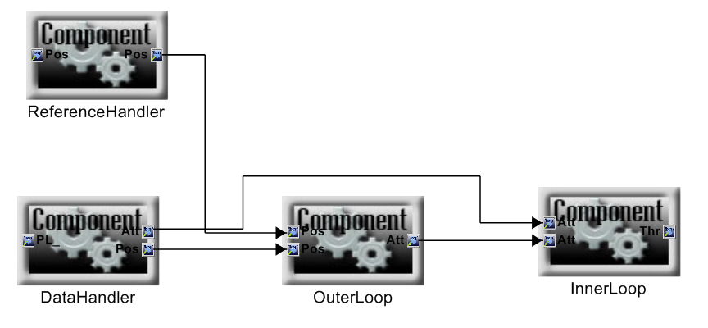
Logical Architecture (Data Flow Dependencies)
Block == Component Instance
Port == Message Instance

Slide 9
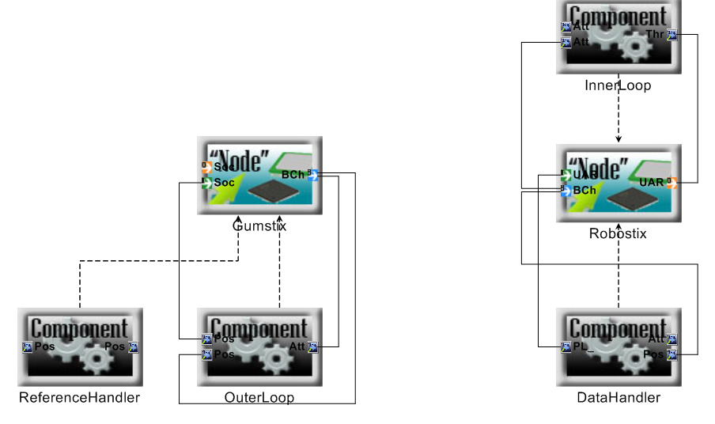
Platform Mapping (Deployment)
Node Ports == Comm Channels
Message
Assignment
Component Assignment

Slide 10
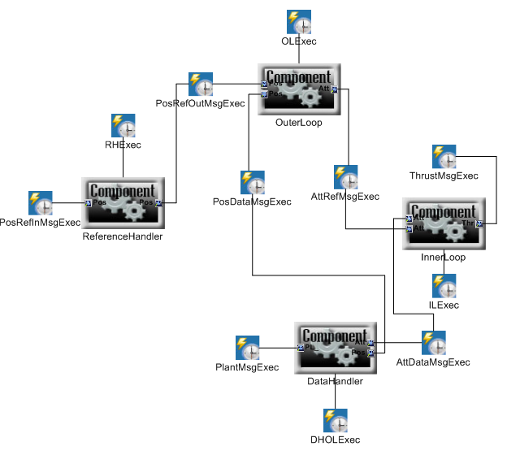
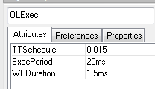
Execution Details
Time-Triggered Execution
Component (Task) Execution
Component Parameters:
TTSchedule – start time
ExecPeriod
WC Duration

Slide 11
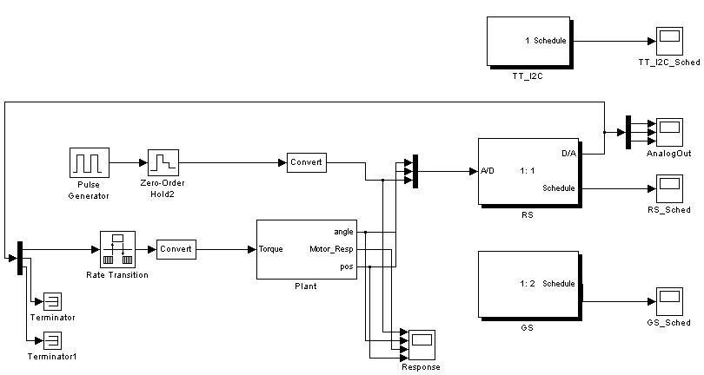
TrueTime Synthesis
Time-Triggered Network
Time-Triggered Nodes

Slide 12
TrueTime Execution
Primary execution loop is an embedded Time-Triggered scheduler

Slide 13
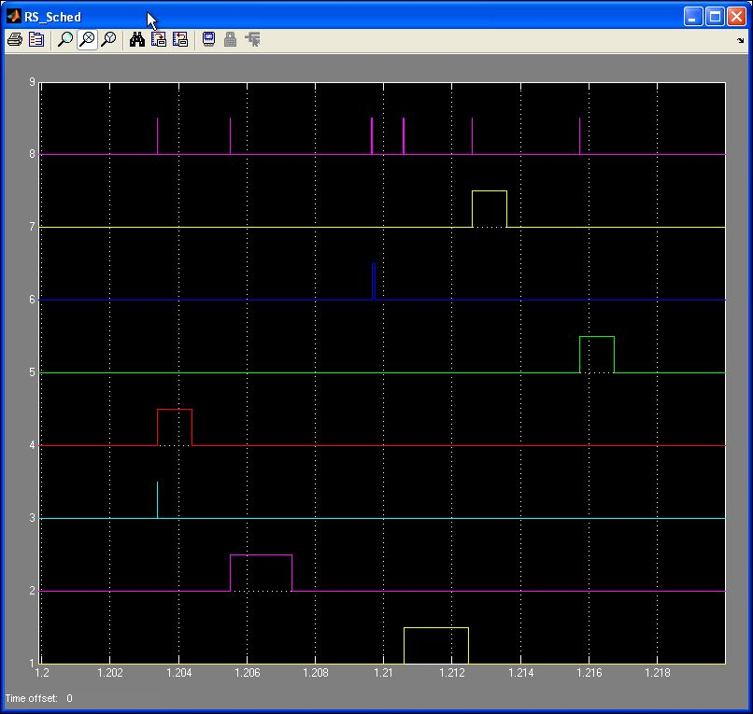
TrueTime Schedule
Time-triggered execution schedule for one Node

Slide 14
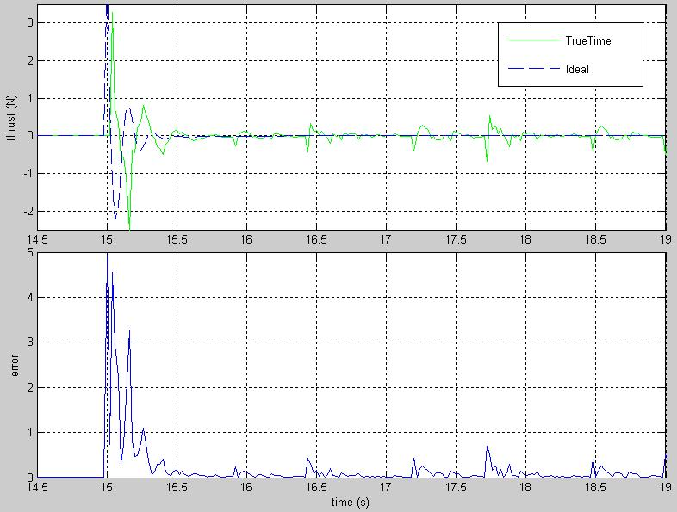
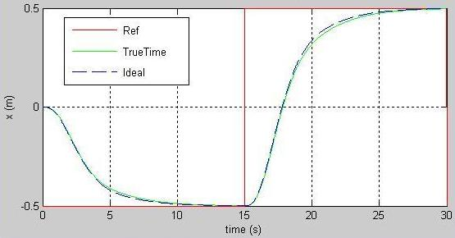
TrueTime Results
Performance is close to ideal
But, platform effects are simulated

Slide 15
Assessment
Simulink – statistical model checking (Zuliani/Clarke) (in progress)
TrueTime
Hardware in the loop
xPC Target
RT workshop embedded coder (in progress)
Target hardware (in progress)

Slide 16
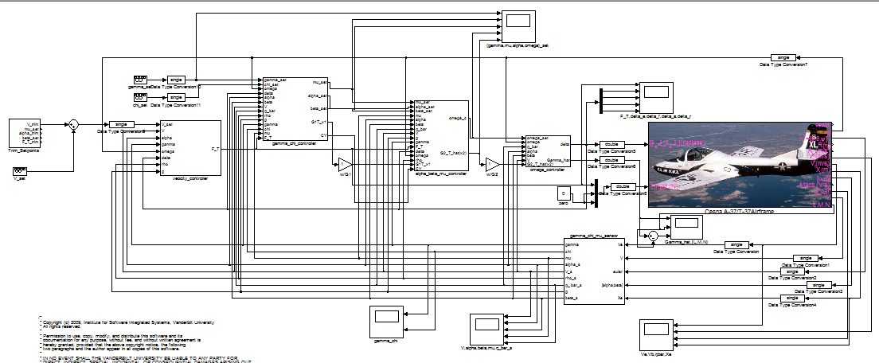
Example 2: Fixed Wing Aircraft
Multicore Experiment: Deploying to the Cell Processor

Slide 17
Questions?

