Slide 1
New Developments in Model-Integrated Development of High-Confidence Software Science of Integration for CPS Kickoff Meeting 11/29/2010
Joe Porter, Graham Hemingway, Nicholas Kottenstette,
Harmon Nine, Chris vanBuskirk,
Gabor Karsai, and Janos Sztipanovits
Institute for Software Integrated Systems
Vanderbilt University
Nashville, TN 37205

Slide 2
Overview: High-Confidence Embedded Software Design
Design working control system with Simulink-based model
Software design using ESMoL
Time-triggered schedule generation
TrueTime platform simulation

Slide 3
Workflow: Control Design
CONTROL
DESIGN
SOFTWARE
IMPLEMENTATION
SOFTWARE
ANALYSIS
GENERATION
& EXECUTION
1
Software Modeling
Scheduling
Platform/HIL
Simulation
Simulink
Simulation
Platform Design
Deadlock
Testing
Matlab
analysis scripts
Tuning
Control designers create Simulink and Stateflow models to capture and simulate the physical behavior as well as the engineering design. Design verification takes the form of scripts to assess controller performance (e.g. stability, settling time, overshoot) and adjust controller gains.
RequirementsAssessment

Slide 4
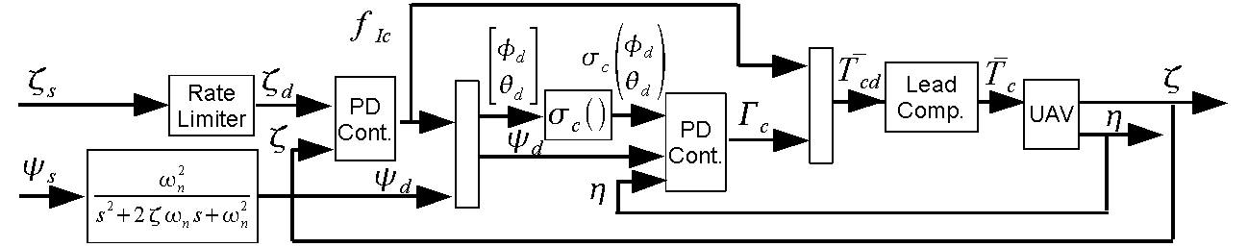
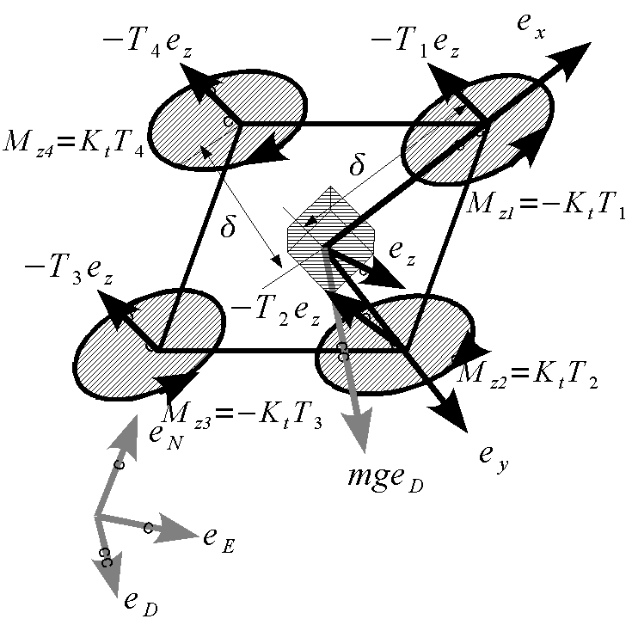
Quad-Rotor Cont. Subj. To Actuator Saturation
N. Kottenstette and J. Porter, “Digital passive attitude and altitude control schemes for quadrotor aircraft,” ICCA09. http://www.isis.vanderbilt.edu/node/4051
Notes:
4

Slide 5

Interior Conic Systems

Slide 6
Properties: Interior Conic Systems
Notes:
6

Slide 7
Non-linear control corollary with Nyquist Like Conditions
Notes:
7

Slide 8
Classic Attitude/Robotic Control Structure
Next we observe that the following structure is also always stable.
Notes:
8

Slide 9
Assumption: Dissipative-Conic
Systems
Notes:
9

Slide 10
Definition: continuous-time conic-dissipative
systems inside the sector [a,b]
Notes:
10

Slide 11
Properties: Dissipative-Conic Systems
Notes:
11

Slide 12
Quad-Rotor Equations of Motion
Notes:
12

Slide 13
Rigid Body Rotational Dynamics Are
Passive
Notes:
13

Slide 14
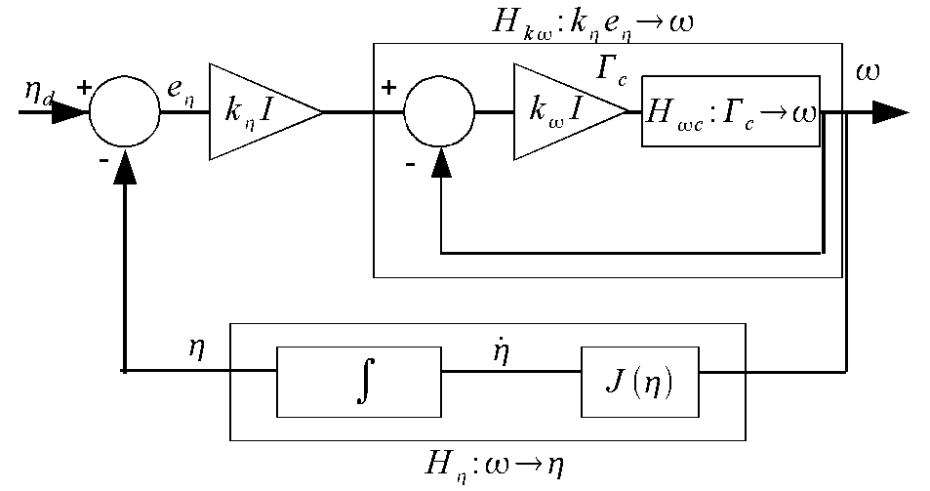
Attitude PD Control Subsystem
Notes:
14

Slide 15
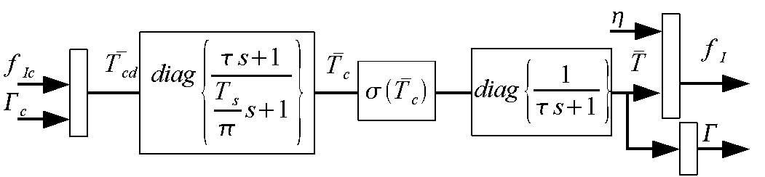
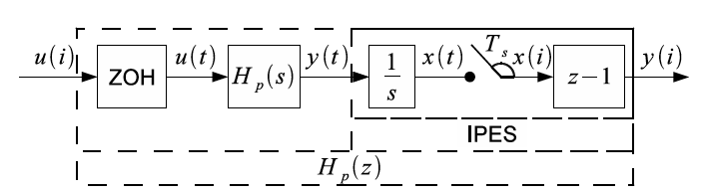
Lead-Compensator, Thrust Mapping
Notes:
15

Slide 16
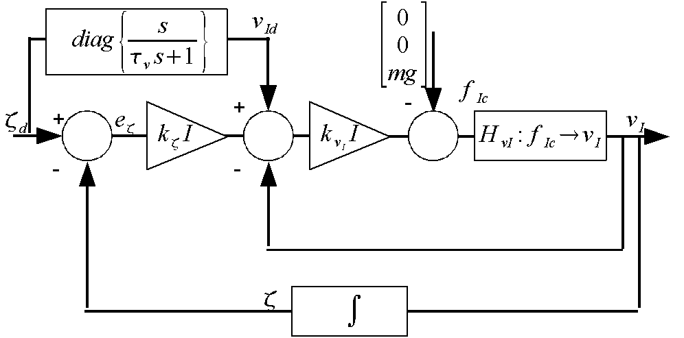
Inertial PD Control Subsystem
Notes:
16

Slide 17
Quadrotor: Simulink
Quadrotor
Inner Loop Controller
(Attitude)
Outer Loop Controller
(Inertial Position) and Trajectory Generator
CONTROL
DESIGN

Slide 18
Workflow: Import Control Design to ESMoL
CONTROL
DESIGN
SOFTWARE
IMPLEMENTATION
SOFTWARE
ANALYSIS
GENERATION
& EXECUTION
Software Modeling
(Arch/Deployment)
Scheduling
Platform/HIL
Simulation
2
Simulink
Model Files (.mdl)
Deadlock
Testing
ESMoL Modeling Language
Importer
The ESMoL domain-specific modeling language (DSML) includes a sublanguage which fully represents Simulink and Stateflow model structures. The tools include a fully automated model importer.
Requirements
Platform Design
Notes:
At ISIS our business is Domain-Specific Modeling Languages.

Slide 19
Workflow: Software and Hardware Design
CONTROL
DESIGN
SOFTWARE
IMPLEMENTATION
SOFTWARE
ANALYSIS
GENERATION
& EXECUTION
Software Modeling
(Arch/Deployment)
Simulink
Simulation
Scheduling
Platform/HIL
Simulation
Requirements
3
Deadlock
Testing
ESMoL Modeling Language
Software and hardware designers manually enter software designs in GME to describe the software architecture of the Simulink design models, network topology, and deployment of the software components to the hardware.
Platform Design
Notes:
Note that the syntactic binding from Simulink components to ESMoL components is very lightweight, so importing a revised design is straightforward and requires only a small amount of model rework.

Slide 20
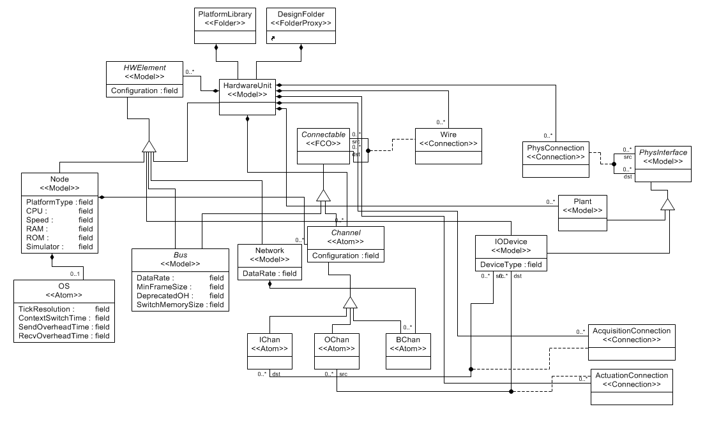
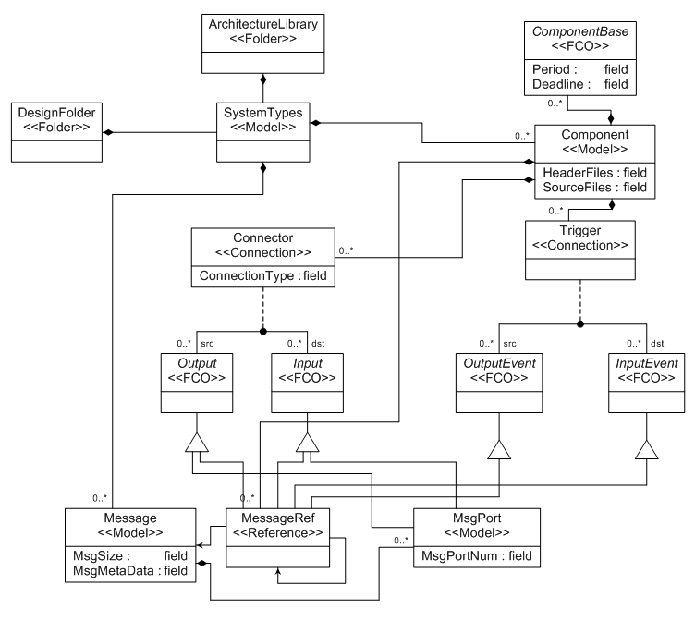
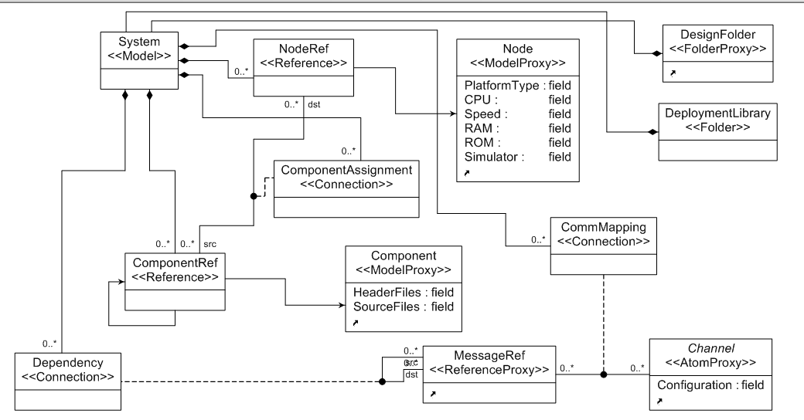
ESMoL Language: Model-Integrated Computing (MIC)
Platform Sublanguage
Architecture Sublanguage
Deployment
Sublanguage
Notes:
The deployment language integrates elements from the architecture sublanguage with elements from the platform sublanguage. Their relationships are precisely defined, and user visualization is also specified.

Slide 21
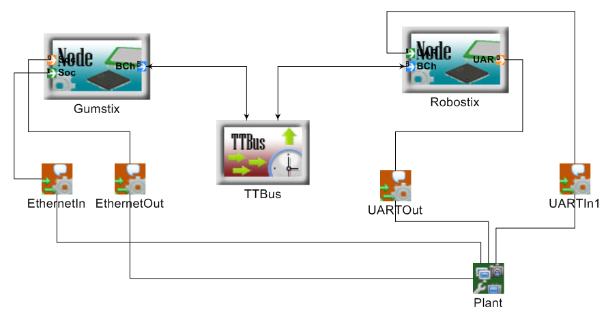
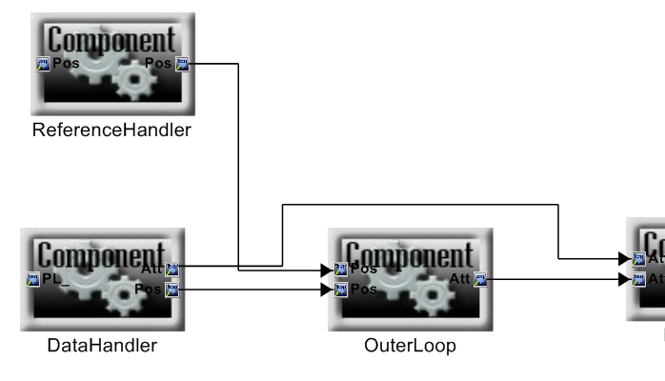
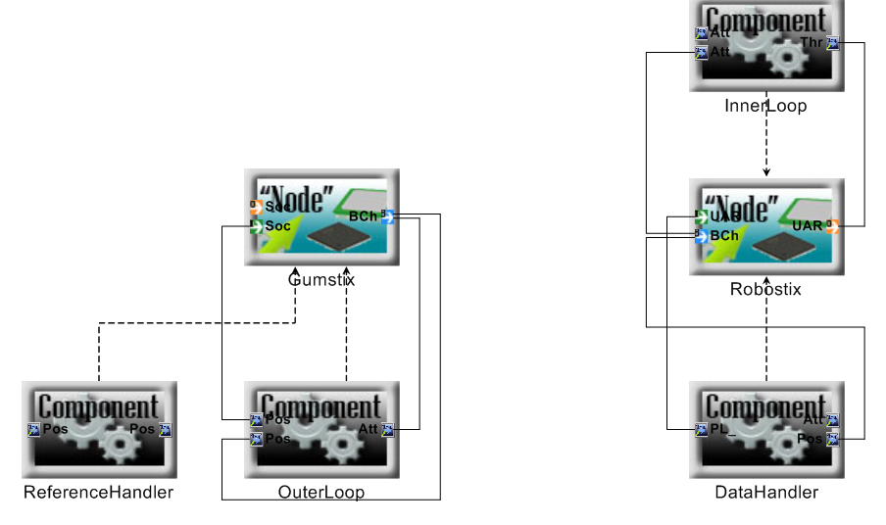
Quadrotor Software Design: GME & ESMoL
Processor
Platform Design
Model
Bus
Block == Component Instance
Port == Message Instance
Peripherals
Node Ports == Comm Channels
Message
Assignment
Software
Deployment
Component Assignment
Logical Architecture
(Dataflow)
SOFTWARE
IMPLEMENTATION

Slide 22
Workflow: Software Analysis
CONTROL
DESIGN
SOFTWARE
IMPLEMENTATION
SOFTWARE
ANALYSIS
GENERATION
& EXECUTION
Software Modeling
(Arch/Deployment)
Scheduling
Simulink
Simulation
Platform/HIL
Simulation
Sched Spec
Esched
Tool
Requirements
4
Testing
ESMoL Modeling Language
Release Times
Model
Transformations
BIP
Spec
DFinder
Model interpreters generate scheduling specifications and import results. BIP analysis is under development.
Round-trip analysis is integrated into the tool environment.
Platform Design
Deadlock
Notes:
BIP analysis is under development to support extending our execution semantics to asynchronous communications in a safe and constructive way.

Slide 23
Quadrotor: Schedule Verification and Generation
Calculated Schedule
Schedule Specification
Resolution 5us
Proc RS 4MHz 0s 0s
Comp InnerLoop =50Hz 1ms
Comp DataHandling =50Hz 1ms
Comp ADC =50Hz 1us
Comp SerialIn =50Hz 1ms
Comp SerialOut =50Hz 1ms
Msg DataHandling.sensor_data 8B RS/ADC RS/DataHandling
Msg DataHandling.pos_ref 8B RS/SerialIn RS/DataHandling
Msg InnerLoop.thrust_commands 8B RS/InnerLoop RS/SerialOut
Msg LocalOrder 1B RS/DataHandling RS/InnerLoop
Proc GS 100MHz 0s 0s
Comp OuterLoop =50Hz 1ms
Bus TT_I2C 100kb 1ms
Msg OuterLoop.ang_ref 8B GS/OuterLoop RS/InnerLoop
Msg DataHandling.pos_msg 8B RS/DataHandling GS/OuterLoop
Hyperperiod 20 ms
TTBusSync 0
Gumstix/EthernetIn_0 3
Gumstix/ReferenceHandler_0 5
Gumstix/OuterLoop_0 11
TTBusSync 0
Robostix/UARTIn1_0 3
Robostix/DataHandler_0 4
Robostix/InnerLoop_0 16
Robostix/UARTOut_0 17
TTBusSync 0
TTBus/DataHandler.Pos_Data_msg_0 7
TTBus/OuterLoop.Att_Ref_msg_0 1

Slide 24
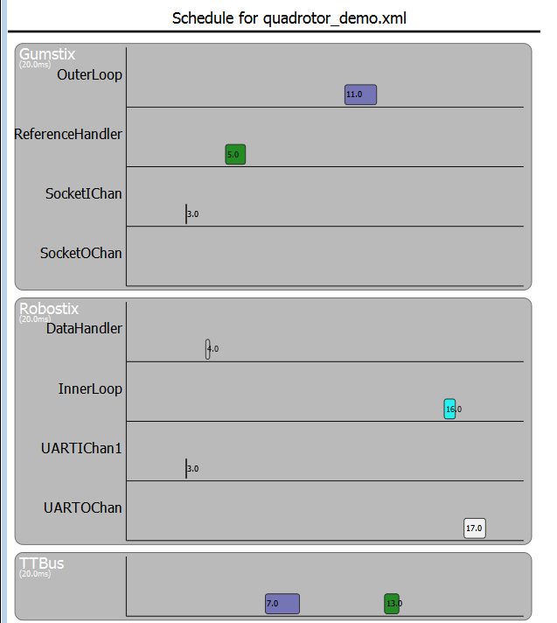
Schedule Visualization
Calculated Schedule
Hyperperiod 20 ms
TTBusSync 0
Gumstix/EthernetIn_0 3
Gumstix/ReferenceHandler_0 5
Gumstix/OuterLoop_0 11
TTBusSync 0
Robostix/UARTIn1_0 3
Robostix/DataHandler_0 4
Robostix/InnerLoop_0 16
Robostix/UARTOut_0 17
TTBusSync 0
TTBus/DataHandler.Pos_Data_msg_0 7
TTBus/OuterLoop.Att_Ref_msg_0 1

Slide 25
Workflow: Generation & Execution
CONTROL
DESIGN
SOFTWARE
IMPLEMENTATION
SOFTWARE
ANALYSIS
GENERATION
& EXECUTION
Software Modeling
(Arch/Deployment)
A platform-independent time-triggered virtual machine provides a synchronous distributed execution environment.
Simulink
Simulation
Scheduling
Platform/HIL
Simulation
Control Functions
Requirements
5
Deadlock
ESMoL Modeling Language
Task/Msg
Wrappers
SoftwareGenerator
Model interpreters synthesize C code for controller functions and for platform-specific task/messaging wrappers.
FRODO VM
TrueTime provides platform-specific simulation, and the xPC target enables hardware-in-the-loop.
TrueTime (Simulink)
xPC Target (HIL)
Platform Design
Testing

Slide 26
Workflow: Assessment & Refinement (in progress)
CONTROL
DESIGN
SOFTWARE
IMPLEMENTATION
SOFTWARE
ANALYSIS
GENERATION
& EXECUTION
Simulink
Simulation
Software Modeling
Scheduling
Platform/HIL
Simulation
Control designers can use the same tests to assess controller stability and performance, closing the loop on the design flow.
In the TrueTime and HIL execution environments we can measure the effects of platform uncertainty on controller performance.
Control Functions
Platform Design
Deadlock
Task/Msg
Wrappers
FRODO VM
Requirements Assessment
Matlab analysis scripts
6
TrueTime (Simulink)
xPC Target (HIL)
Tuning
Testing
Notes:
Here we close the loop on the design process. Some of us get uncomfortable at the thought of iterating the design, but there are two points we should make here: 1. Often design problems are due to partial understanding, which we don’t discover until later in the integration, verification, and testing phases. Sometimes you have to break the design to address those problems. 2. We want to make the whole process as painless and lightweight as possible, so that we can preserve model artifacts that were not affected by our radical re-design, and quickly rebuild things that were broken. For example, what if we realized late in the game that our control architecture was inadequate, and we needed a more sophisticated control framework instead? We may end up seriously breaking the component structure (including interfaces) to accommodate such a change.

Slide 27
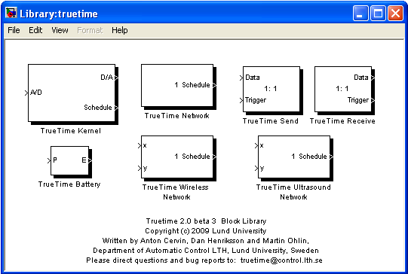
TrueTime toolkit for Simulink
Set of Simulink blocks for simulating task scheduling and execution and network communication.
Task-level execution
Diverse & detailed network models
C++/M-code/SL-block integration
Highly flexible on-line scheduler + API
Standard Simulink visualization of schedule execution
Rapid System Prototyping ’10 - Fairfax, VA, June 8-11
Notes:
Network types: Simple bus, Bus ethernet, Switched ethernet, Flexray, etc., wireless networks also
Built in schedulers: Rate monotonic & Earliest Deadline First, Priority-based

Slide 28
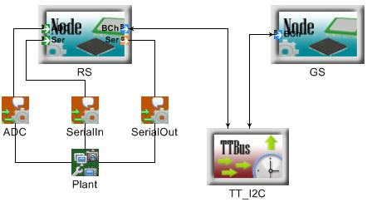
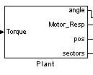
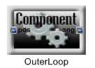
Mapping ESMoL to TrueTime
There is a mapping from ESMoL model software & hardware elements to TrueTime blocks and code:
ESMoL Node
TT Kernel
ESMoL Bus
TT Network
ESMoL Plant
Simulink Block
ESMoL Component
C-Code
Rapid System Prototyping ’10 - Fairfax, VA, June 8-11

Slide 29
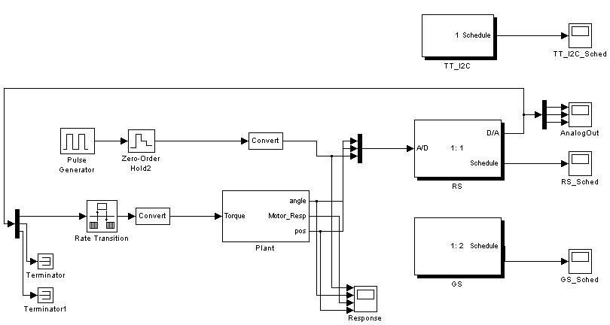

TrueTime - New Model Synthesis
Based on the defined hardware configuration, a new Simulink model using TrueTime blocks and original plant block is created.
DataHandling
InnerLoop
OuterLoop
Rapid System Prototyping ’10 - Fairfax, VA, June 8-11
Notes:
Mention that network is off on its own - this is OK. RS/GS communicate via network using TT API - the implementation code - next step

Slide 30
Questions?
Those interested in trying our tools can visit
https://wiki.isis.vanderbilt.edu/hcddes/index.php/The_ESMoL_Tool

Slide 31
References
[1] N. Kottenstette, J. Porter. Digital Passive Attitude and Altitude Control Schemes for Quadrotor Aircraft. IEEE 7th Intl. Conf. on Control and Automation (ICCA 2009). Christchurch, New Zealand, Dec. 2009.
[2] Porter, J., P. Volgyesi, N. Kottenstette, H. Nine, G. Karsai, and J. Sztipanovits, "An Experimental Model-Based Rapid Prototyping Environment for High-Confidence Embedded Software", Rapid System Prototyping (RSP'09), Paris, France, Jun. 2009.
[3] J. Porter, G. Hemingway, C. vanBusKirk, N. Kottenstette, G. Karsai, J. Sztipanovits. Online Dynamic Stability Verification Using Sector Search. ACM Intl. Conf. on Embedded Software (EMSoft) Grenoble, Oct. 2010.
[4] G. Hemingway, J. Porter, N. Kottenstette, H. Nine, C. vanBuskirk, G. Karsai, and J. Sztipanovits. Automated Synthesis of Time-Triggered Architecture-based TrueTime Models for Platform Effects Simulation and Analysis. Rapid Systems Prototyping (RSP), Jun. 2010.
[5] P. Zuliani, A. Platzer, E. M. Clarke. Bayesian Statistical Model Checking with Application to Stateflow/Simulink Verification. HSCC 2010 (Hybrid Systems: Computation and Control), Apr. 12-16, 2010, Stockholm, Sweden.
[6] LeBlanc, H., E. Eyisi, N. Kottenstette, X. Koutsoukos, and J. Sztipanovits, "A Passivity-Based Approach To Deployment In Multi-Agent Networks", Informatics in Control, Automation and Robotics (ICINCO 2010), Funchal, Madeira - Portugal, Jun. 2010.
[7] R. Thibodeaux. The Specification and Implementation of a Model of Computation. M.S. Thesis. Vanderbilt University, May 2008.
[8] N. Kottenstette, "Constructive Non-Linear Control Design With Applications to Quad-Rotor and Fixed-Wing Aircraft", Tech. Rpt., Inst. for Software Integrated Systems, Vanderbilt Univ., Jan. 2010. Nashville.
[9] S. Bensalem, M. Bozga, T. Nguyen, J. Sifakis: D-Finder: A Tool for Compositional Deadlock Detection and Verification. CAV 2009: 614-619

