Slide 1
Constructive Nonlinear Control Design With Applications to Control of Quad-Rotor Aircraft
Nicholas Kottenstette
ISIS-Vanderbilt University
July 27, 2010
Notes:
1

Slide 2
Outline
Main Idea
Assumption: Dissipative-Conic Systems
Definition: Dissipative-Conic Systems
Properties: Conic Systems
Definition: Lyapunov and Asymptotic Stability
Properties: Conic Systems-II
Theorem: Feed-back Stability For Conic Systems
Example: High-Performance Control System for quad-rotor aircraft.
Notes:
2

Slide 3

Passive Systems

Slide 4
Main Idea
Identify the key elements of a system to be controlled.
Simplify the description of the system while preserving the fundamental physical properties of the system, then
Determine an initial control structure to apply to the system in order to regulate those elements of the system
Identify any non-ideal affects that will adversely affect your control implementation and refine your initial design
Notes:
4

Slide 5
Non-linear control corollary with Nyquist Like Conditions
We first observe that we can make the following sub-system move ‘as fast’ as we desire. More formally:
Notes:
5

Slide 6
Classic Attitude/Robotic Control Structure
Next we observe that the following structure is also always stable.
Notes:
6

Slide 7
A Key Observation for Selecting Gains
Notes:
7

Slide 8
A Key Observation for Selecting Gains
Notes:
8

Slide 9
A Key Observation for Selecting Gains
Notes:
9

Slide 10
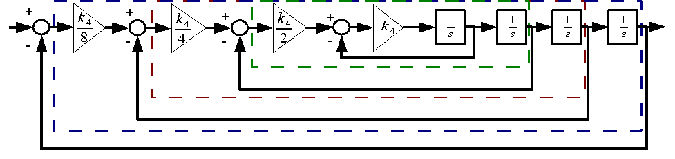
Step Response and Nyquist Diagram
Notes:
10

Slide 11
Assumption: Dissipative-Conic Systems
Notes:
11

Slide 12
Assumption: Dissipative-Conic Systems
Notes:
12

Slide 13
Definition: continuous-time conic-dissipative systems inside the sector [a,b]
Notes:
13

Slide 14
Definition: discrete-time conic-dissipative system inside the sector [a,b]
Notes:
14

Slide 15
Properties: Conic Systems
Notes:
15

Slide 16
Lyapunov Stability – Continuous time
Notes:
16

Slide 17
Lyapunov Stability – Discrete time
Notes:
17

Slide 18
Properties: Conic Systems - II
Notes:
18

Slide 19
Conic Dissipative Systems
G. Zames, “On the input-output stability of time-varying nonlinear feedback systems. i. conditions derived using concepts of loop gain, conicity and positivity,” IEEE TAC 1966.
J. Willems, Feedback systems. The analysis of. London, UK: MIT Press, 1971.
Hill and Moylan “Stability results for nonlinear feedback systems,” Automatica, 1977.
W. M. Haddad and V. S. Chellaboina, Nonlinear Dynamical Systems and Control: A Lyapunov-Based Approach. 2008.
J.C. Willems, “Dissipative dynamical systems”, European Journal on Control V. 13, p. 134-151, 2007

Slide 20
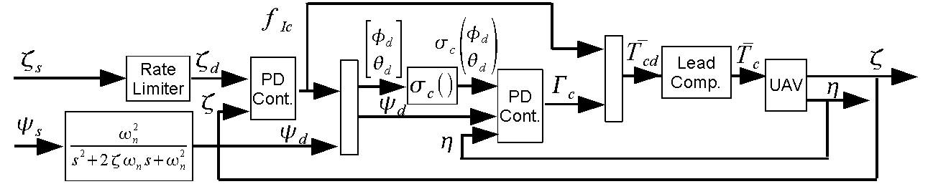
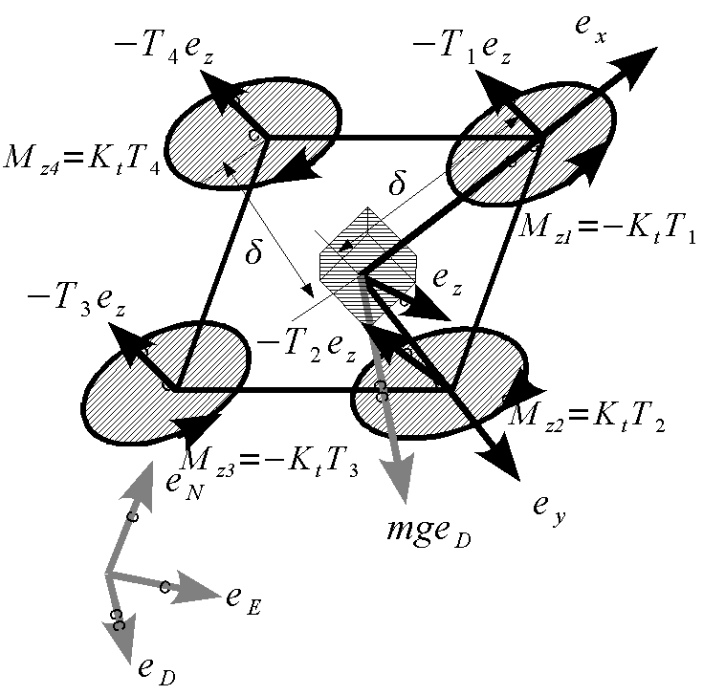
Quad-Rotor Cont. Subj. To Actuator Saturation
N. Kottenstette and J. Porter, “Digital passive attitude and altitude control schemes for quadrotor aircraft,” ICCA09. http://www.isis.vanderbilt.edu/node/4051
Notes:
20

Slide 21
A few more details on the equations of motion
Notes:
21

Slide 22
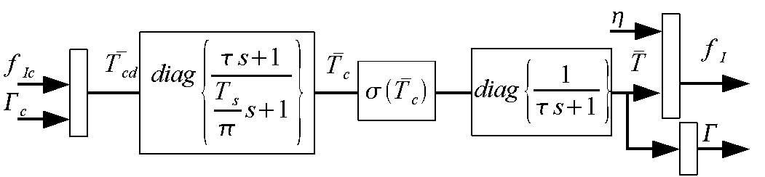
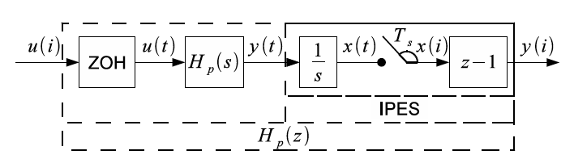
Lead-Compensator, Thrust Computation
Notes:
22

Slide 23
IPESH-Transform
Properties:
The discrete-time filter H_{p}(z) closely matches the magnitude response of the continuous-time filter H_{p}(s) up to the Nyquist Freq.
If H_{p}(s) is inside the sector [a,b], then H_{p}(z) is inside the sector [a,b].

Slide 24
IPESH-Transform
See also:
N. Kottenstette, J. Hall, X. Koutsoukos, P. Antsaklis, and J. Sztipanovits, “Digital control of multiple discrete passive plants over networks,” International Journal of Systems, Control and Communications (IJSCC), Special Issue on Progress in Networked Control (to Appear).
N. Kottenstette, H. LeBlanc, E. Eyisi, X. Koutsoukos, “Multi-Rate Networked Control of Conic Systems,” ISIS-09-108, TR 2009.
N. Kottenstette and P.J. Antsaklis, “Digital Control Networks for Continuous Passive Plants Which Maintain Stability Using Cooperative Schedulers”, ISIS-2007-002, March 2007 http://www.nd.edu/~isis/techreports/isis-2007-002-updated.pdf.

Slide 25
Rigid Body Rotational Dynamics Are Passive

Slide 26
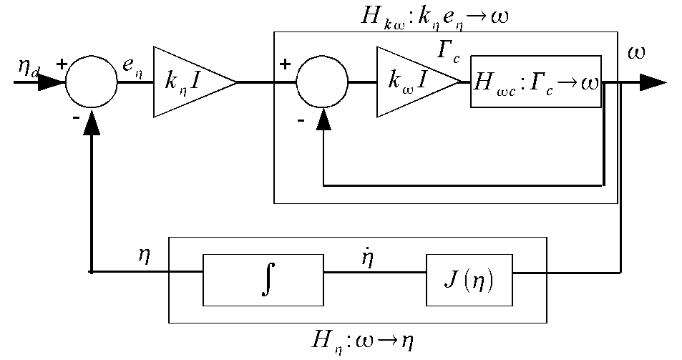
Attitude PD-Controller
Notes:
26

Slide 27
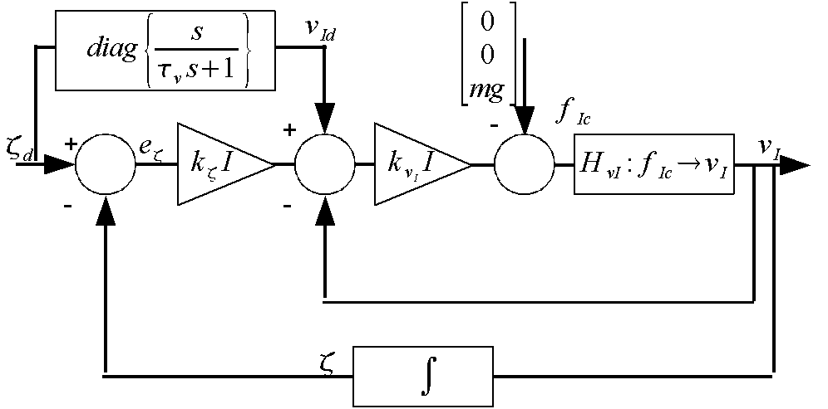
Inertial PD-Controller
Notes:
27

Slide 28
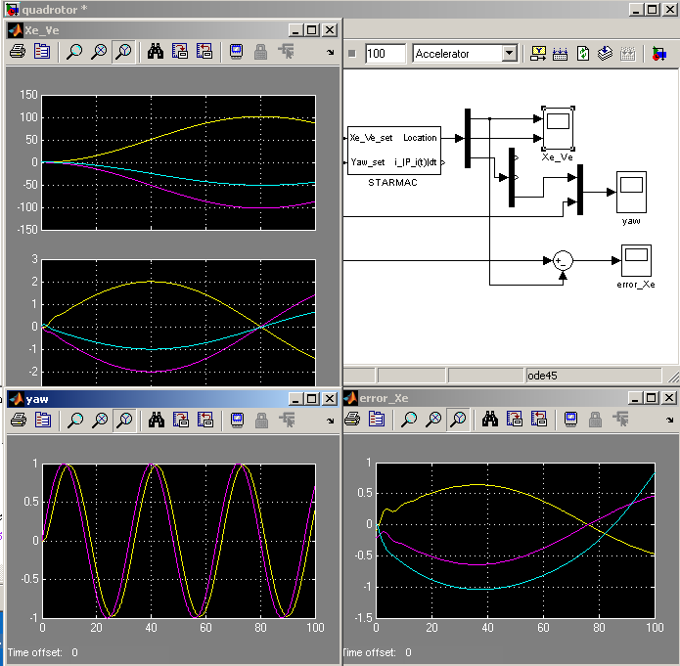
Advanced Quad-Rotor System Model
Used Extensively
OpenC2WT
Integrated seamlessly with autonomous target trackers
Notes:
28

Slide 29
Quad-Rotor Simulation
Notes:
29

Slide 30
Quad-Rotor Simulation
Notes:
30

Slide 31
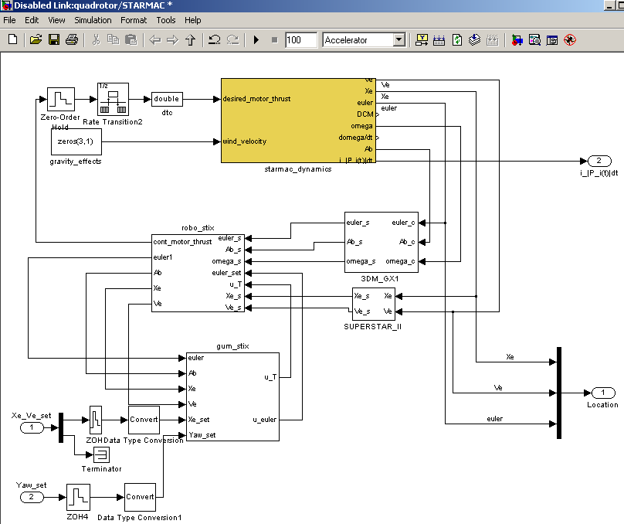
Quad-Rotor System Model
Notes:
31

Slide 32
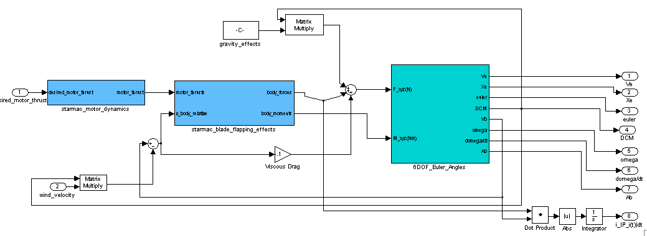
UAV Dynamics
Highly detailed and refined model
UC-Berkley, CMU, Vanderbilt
Notes:
32

Slide 33
Constructive Digital Control for Continuous Time Systems
Confronting the fact that digital control has some implicit limitations when compared to our ‘idealized’ continuous time controllers. We offer an architecture which attempts to orthogonalize discrete time and continuous time components.
Digital controllers typically have infinite gain.
Using wave-variables we can introduce digital controllers while explicitly preserving continuous time stability properties
For fun, a telemanipulation example.

Slide 34
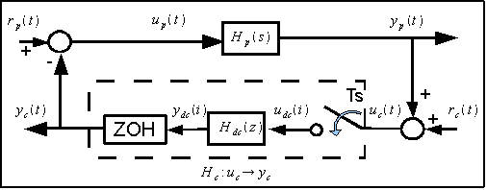
Recall Passivity Theorem
Notes:
34

Slide 35
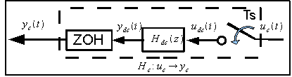
Res. Controller Has Infinite L^{m}₂ - Gain
Notes:
35

Slide 36
Not all is lost, can handle many inputs.
Notes:
36

Slide 37
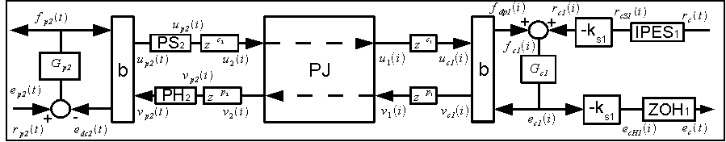
L^{m}₂ – stable networks w/ digital control
Design of Networked Control Systems Using Passivity
(Kottenstette, Hall, Koutsoukos, Sztipanovits, Antsaklis, under review Transactions of Control Systems Technology)
Notes:
37

Slide 38
Bilinear Transform w/ Wave Variables
Notes:
38

Slide 39
PS-PH inside [-1,1]
Notes:
39

Slide 40
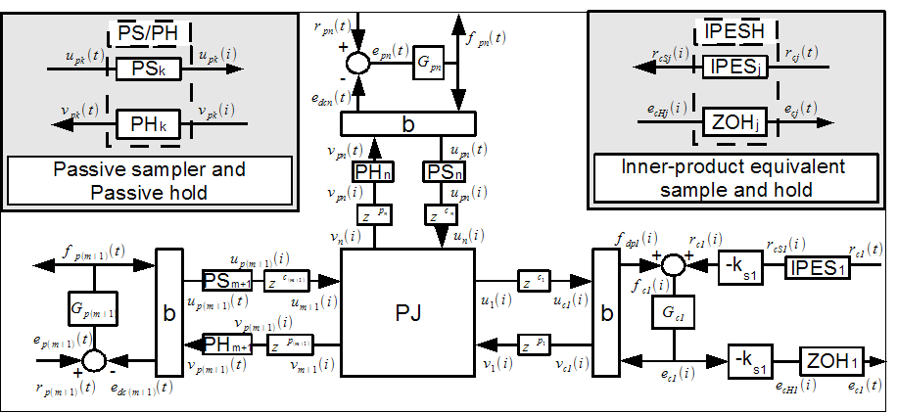
L^{m}₂ – stable digital control networks
Single Digital Controller, Multiple Continuous Plants [1]
(Kottenstette, Chopra: to appear Necsys 2009)
Digital Control of Multiple Discrete Passive Plants Over Networks (Kottenstette, Hall, Koutsoukos, Antsaklis, and Sztipanovits: to appear IJSCC)
Notes:
40

Slide 41
L^{m}₂ – stable digital control networks
Both consensus-like networks and (even better) parallel networks can be created which allow:
passive-plants (different dynamics) with similar steady-state gains to be led by a single SISO PID-controller.
used to coordinate multiple robotic arms
Can be used to coordinate aircraft
resilient networks to be created which allow redundant controllers to control a single passive plant.
Notes:
41

Slide 42
Additional Reading
Kottenstette, N., LeBlanc, H., Eyisi, E., Koutsoukos, X., “Multi-Rate Networked Control of Conic Systems”, ISIS-09-108.
Kottenstette, N. and Chopra, N., “Lm2-stable digital-control networks for multiple continuous passive plants,” NecSys’09.
Hirche, S., Matiakis, T., and Buss, M., “A distributed controller approach for delay-independent stability of networked control systems,” Automatica 2009.
Kottenstette, N., Karsai G. and Sztipanovits J., "A Passivity-Based Framework for Resilient Cyber Physical Systems", ISRCS 2009.
Kottenstette, N. and Antsaklis, P.J., Wireless digital control of continuous passive plants over token ring networks. International Journal of Robust and Nonlinear Control. doi:10.1002/rnc.1395 2008.

