Slide 1
UDM Interpreter Development by Example
CS 388: Model-Integrated Computing

Slide 2
Automation Decisions
What should be automated in the whole software engineering process?
Everything
Nothing
Everything that’s easy to automate!
Useful?

Slide 3
Automation Decisions
What should be automated in the whole software engineering process?
Everything
Nothing
Everything that’s easy to automate!
Useful? Where is the automation needed?

Slide 4
Useful Automation
Where is the automation needed?
Volume
Repetition
Complexity
Details

Slide 5
Useful Automation
Where is the automation needed?
Volume
Data entry tasks
Code generation
Repetition
Complexity
Details

Slide 6
Useful Automation
Where is the automation needed?
Volume
Data entry tasks
Code generation
Repetition
Data entry tasks – often requirements
Large distributed system with similar nodes
Complexity
Details

Slide 7
Useful Automation
Where is the automation needed?
Volume
Data entry tasks
Code generation
Repetition
Data entry tasks – often requirements
Large distributed system with similar nodes
Complexity
Complex relationships that must be managed correctly each time – i.e. walking hierarchy trees or extracting data from graphs
Details
Keeping track of lots of little things that a designer may need only infrequently (like configuration items)

Slide 8
Things to Think About
Which API, BON2 or UDM?

Slide 9
Things to Think About
Which API, BON2 or UDM?
 | BON2 | UDM
Pro | Stable API MS COM (Pro?) Visitor Framework | Portable Standalone XML Backend GReAT
Con | Platform-Dependent GME Dependent | Less mature Extra steps

Slide 10
Traversal: Visitor?
Visitors traverse the model, and invoke callbacks by type…
Limited context during visit –
Immediate node
Adjacent nodes
Lots of interpreters don’t need context
Use manual traversal for more complicated, context-dependent tasks!

Slide 11
Example: Constraint-Based Scheduler
Start with Requirements:
Model time-triggered platforms, tasks, and messages.
Create a valid schedule for time-triggered networks (if model is schedulable).
Output/display schedules in a useful form.
Build a standalone version for non-GME users.
Learn a little bit about UDM and constraint programming ☺

Slide 12
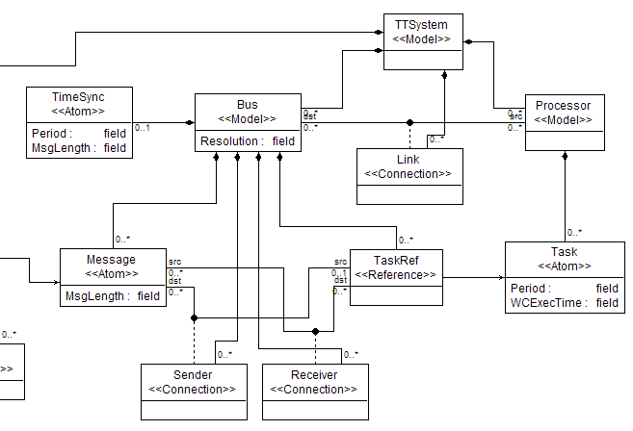
System Description

