Slide 1



COFORCE - COPPER FORECASTING CHILE
Methodology and Design of a Macro-Econometric Input-Output Model for the Chilean Economy
Anke Mönnig, Loreto Bieritz, Anett Großmann
International Input-Output Conference June 25-29, 2018 - Juiz de Fora, Brazil

Slide 2
Content
Motivation
Methodology Overview
Selected Specification of COFORCE
Final demand
Private consumption
Investment
Intermediate transaction and production
Value added
Unit cost and prices
System of National Accounts
Outcome
Steps ahead

Slide 3
Motivation

Slide 4
Motivation
Joint research project „Development of sustainable strategies in the Chilean mining sector through a regionalized national model“
Overall aim: Analysis of socio-economic impact of copper on the Chilean economy
Choice of instrument: macro-econometric input-output model of Chile
national level – completed 2018
regional level – upcoming work in 2018/2019

Slide 5
Methodology Overview

Slide 6
Methodology Overview
 | Characteristics
Type | INFORUM type of model
Focus | Macro / meso economy
Derived assumptions | Bounded rationality of economic actors Imperfect markets Price rigidities Equal importance of supply and use
Implementation of modelling | Econometric estimation of parameters and their elasticity values using OLS
Technology | Variable input coefficient
Basic dataset | IO Tables + National Accounts
Modelling approach | Bottom-up (73 products and industries) Total integration („closed system“; double accounting; intersectoral dependencies)
Solution procedure | Iterative; simultanous solution of total system
Time | Irreversible; path dependency; dynamic (until 2035)

Slide 7
Methodology Overview
Strengths
Allows for the analysis of complex socio-economic structures and interdepencies.
Identification of direct and indirect impacts and interdependencies.
Low sectoral aggregation level by goods and industries
Differentiation of institutional sectors according to SNA
Amplification of model is possible („modularization“)
Update on yearly basis
Well-suited for scenario analysis
Weeknesses
Large and complex system; „black box“
Quality of historical dataset is decisive
Making-off is time-intense
High number of interdependencies and the iterrelation between definition and regression functions constitute a sensitive system
→ Excellent regression test values do not mean automatically a good forecasting performance

Slide 8
Methodology Overview
Interdependencies
Intermediate demand
Supply and use between industrial sectors
Price model
Unit cost calculation and mark-up pricing
Income circulation
Wages and surplus for disposable income
Foreign trade
Export demand determined by demand of trading partners
Labor market
Production, wages & prices → labor demand and wage income

Slide 9
Methodology Overview
Important output variables
Foreign trade (import/export by products)
Final demand components by products
Production by industrial sectors
Employment by industrial sectors
Price development
Income and expenses of state, corporations and private households
Macroeconomic development
Important assumptions
Population
Interest rates, exchange rates
Import prices
World trade development

Slide 10
Selected Specification of COFORCE

Slide 11
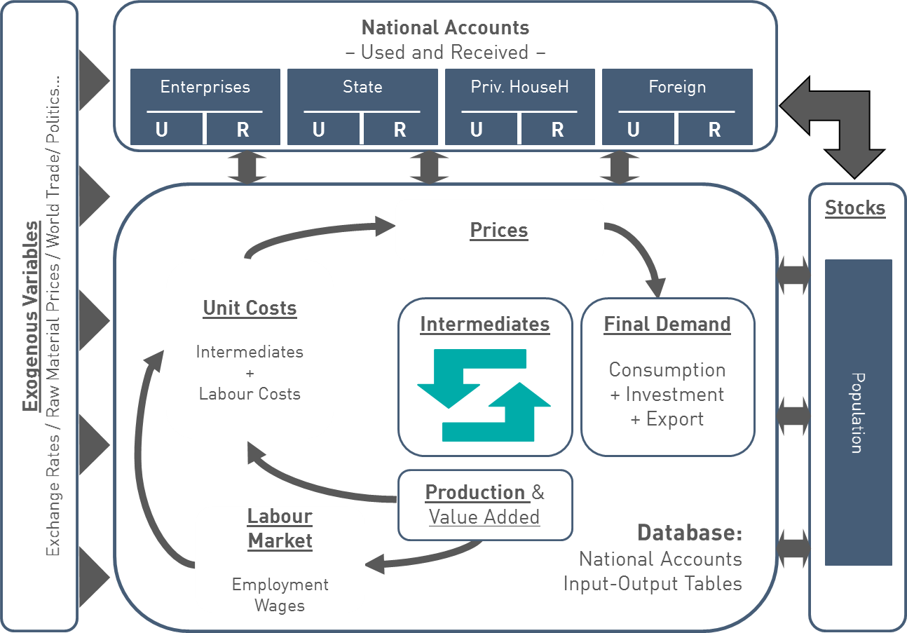
Methodology Overview
6
5
1
2
3
4

Slide 12
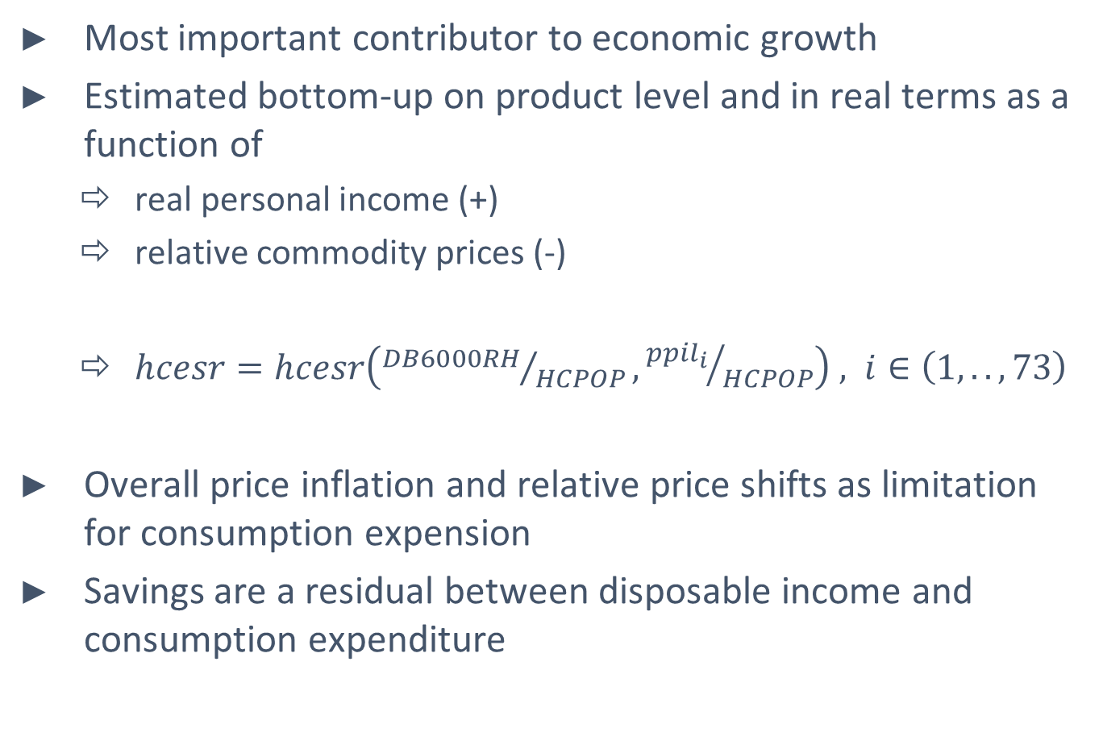
Private household consumption
1
Most important contributor to economic growth
Estimated bottom-up on product level and in real terms as a function of
real personal income (+)
relative commodity prices (-)
$hcesr=hcesr\left({DB6000RH}/{HCPOP},{{ppil}_{i}}/{HCPOP}\right) , i∈\left(1,..,73\right)$
Overall price inflation and relative price shifts as limitation for consumption expension
Savings are a residual between disposable income and consumption expenditure
Notes:
1-5: B#####: Buchungsnummer gem. Kontensystem
6: Verwendung (U); Aufkommen ®; Saldo (B)
7: Institutioneller Sektor (H Haushalt; G Staat; …)

Slide 13
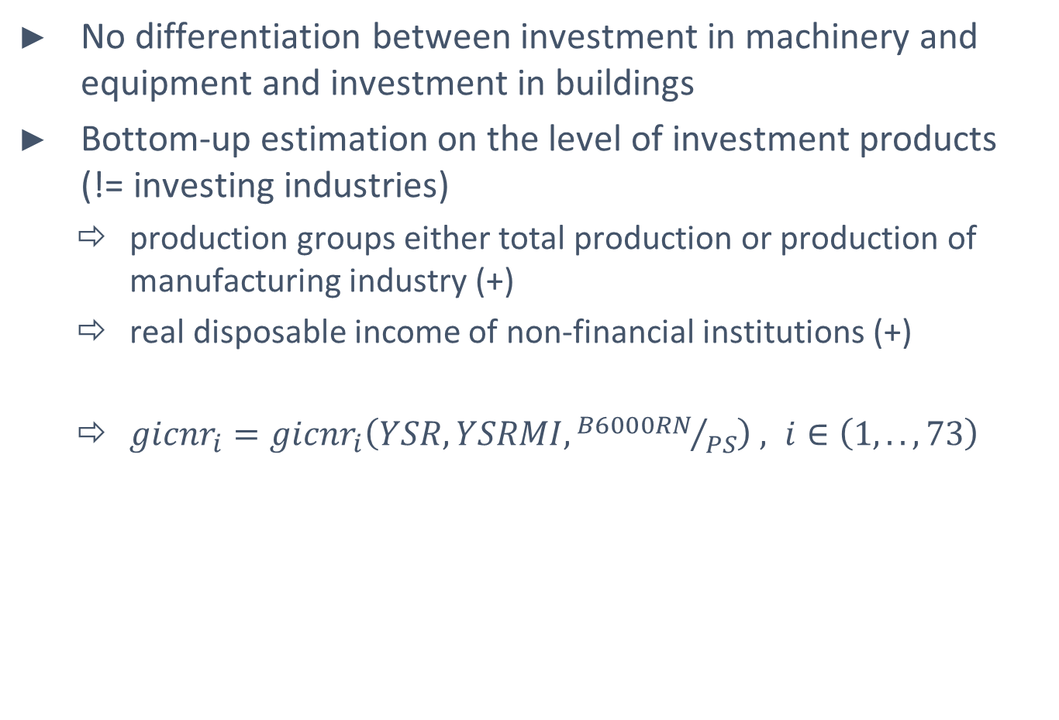
Gross fixed capital formation
2
No differentiation between investment in machinery and equipment and investment in buildings
Bottom-up estimation on the level of investment products (!= investing industries)
production groups either total production or production of manufacturing industry (+)
real disposable income of non-financial institutions (+)
${gicnr}_{i}={gicnr}_{i}\left(YSR, YSRMI,{B6000RN}/{PS}\right) , i∈\left(1,..,73\right)$

Slide 14
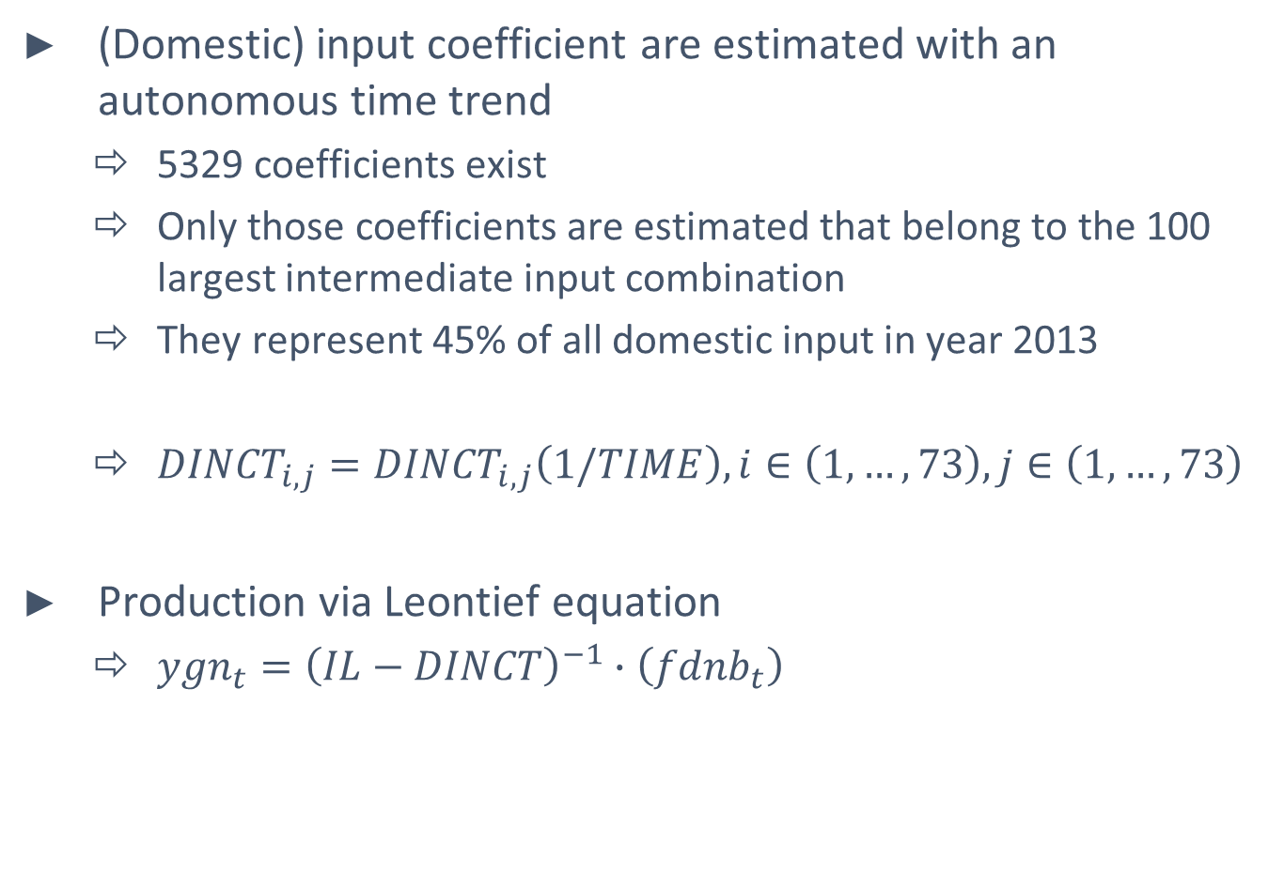
Intermediate transaction and production
3
(Domestic) input coefficient are estimated with an autonomous time trend
5329 coefficients exist
Only those coefficients are estimated that belong to the 100 largest intermediate input combination
They represent 45% of all domestic input in year 2013
${DINCT}_{i,j}={DINCT}_{i,j}\left(1/TIME\right),i∈\left(1,…,73\right), j∈\left(1,…,73\right)$
Production via Leontief equation
${ygn}_{t}={\left(IL−DINCT\right)}^{−1}∙\left({fdnb}_{t}\right)$
Notes:
Produktionsfunktionen: substitutional vs. Limitational
Substitutional: Produktionsfaktor kann durch einen anderen Produktionsfaktor ersetzt werden; Outputmenge ändert sich durch Änderung der Einsatzmenge eines Produktionsfaktors und gleichzeitiger Konstanz anderer Produktionsfaktoren
Cobb-Douglas: eine Erhöhung des Faktoreinsatzes bewirkt immer eine Erhöhung der Ausbringungsmenge
Limitational: Produktionsfaktoren stehen in einem bestimmten Verhältnis; der Output kann nur verändert werden, wenn alle Produktionsfaktoren sich ändern
Leontief (linear limitational: Produktionsfaktoren stehen in einem festen Verhältnis zueinander und zu einem festen Verhältnis zum Ausstoß (Output) eines Betriebes
Gutenberg (nichtlinear limitational:

Slide 15
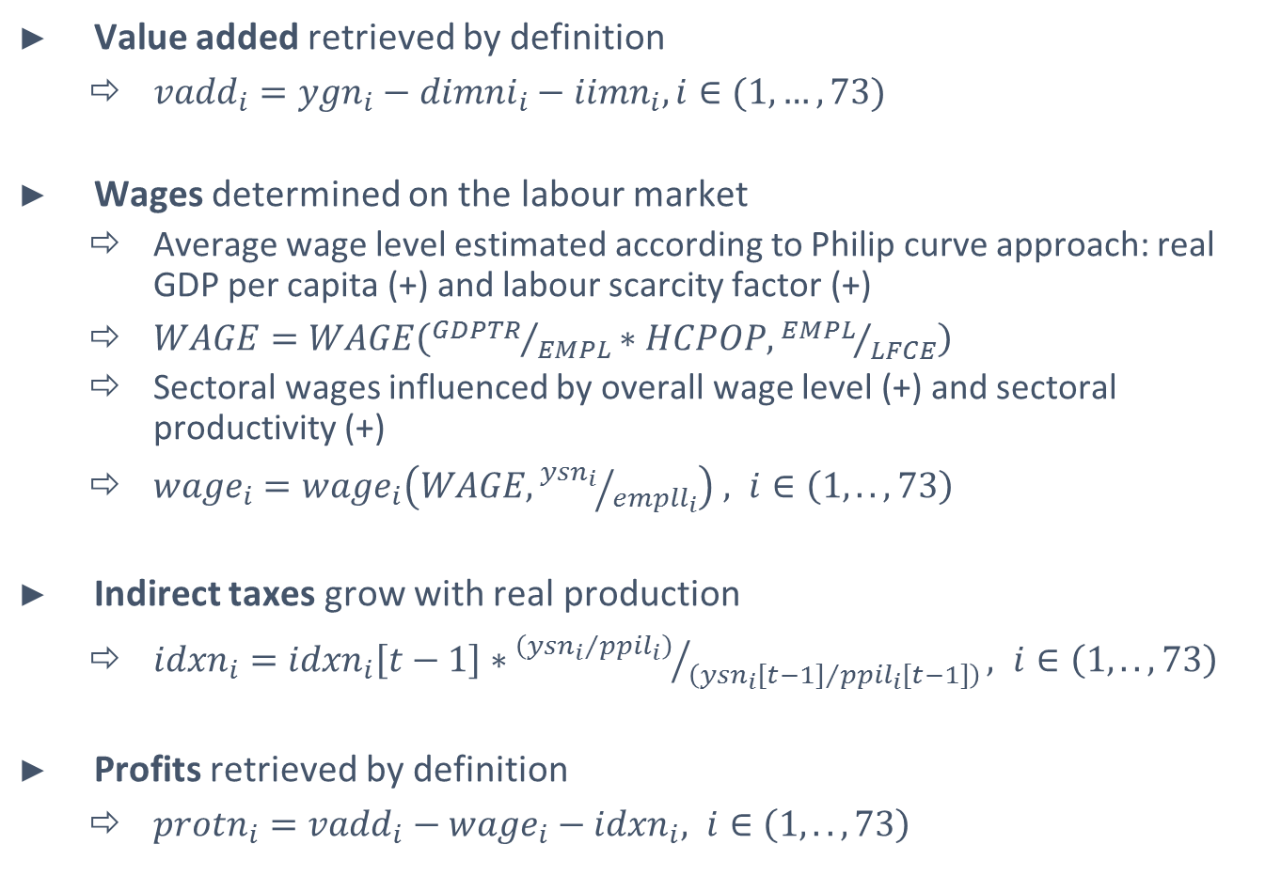
Primary inputs
4
Value added retrieved by definition
${vadd}_{i}={ygn}_{i}−{dimni}_{i}−{iimn}_{i}, i∈(1,…,73)$
Wages determined on the labour market
Average wage level estimated according to Philip curve approach: real GDP per capita (+) and labour scarcity factor (+)
$WAGE=WAGE\left({GDPTR}/{EMPL}∗HCPOP,{EMPL}/{LFCE}\right)$
Sectoral wages influenced by overall wage level (+) and sectoral productivity (+)
${wage}_{i}={wage}_{i}\left(WAGE,{{ysn}_{i}}/{{empll}_{i}}\right) , i∈\left(1,..,73\right)$
Indirect taxes grow with real production
${idxn}_{i}={idxn}_{i}\left[t−1\right]∗{\left({{ysn}_{i}}/{{ppil}_{i}}\right)}/{\left({{ysn}_{i}[t−1]}/{{ppil}_{i}[t−1]}\right)}, i∈\left(1,..,73\right)$
Profits retrieved by definition
${protn}_{i}={{vadd}_{i}−{wage}_{i}−idxn}_{i}, i∈\left(1,..,73\right)$
Notes:
Produktionsfunktionen: substitutional vs. Limitational
Substitutional: Produktionsfaktor kann durch einen anderen Produktionsfaktor ersetzt werden; Outputmenge ändert sich durch Änderung der Einsatzmenge eines Produktionsfaktors und gleichzeitiger Konstanz anderer Produktionsfaktoren
Cobb-Douglas: eine Erhöhung des Faktoreinsatzes bewirkt immer eine Erhöhung der Ausbringungsmenge
Limitational: Produktionsfaktoren stehen in einem bestimmten Verhältnis; der Output kann nur verändert werden, wenn alle Produktionsfaktoren sich ändern
Leontief (linear limitational: Produktionsfaktoren stehen in einem festen Verhältnis zueinander und zu einem festen Verhältnis zum Ausstoß (Output) eines Betriebes
Gutenberg (nichtlinear limitational:

Slide 16
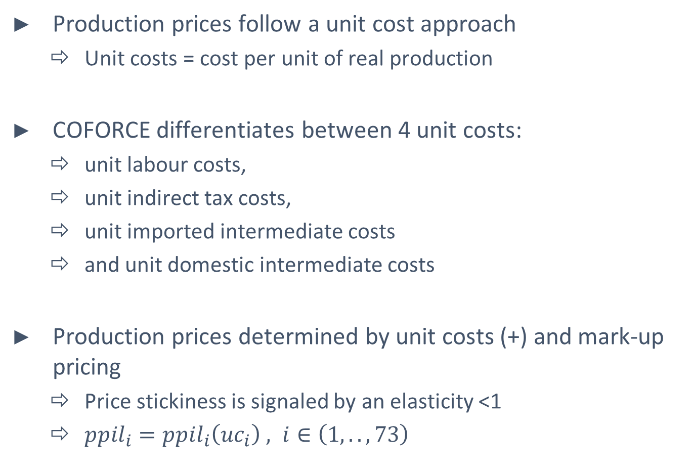
Modelling prices
5
Production prices follow a unit cost approach
Unit costs = cost per unit of real production
COFORCE differentiates between 4 unit costs:
unit labour costs,
unit indirect tax costs,
unit imported intermediate costs
and unit domestic intermediate costs
Production prices determined by unit costs (+) and mark-up pricing
Price stickiness is signaled by an elasticity <1
${ppil}_{i}={ppil}_{i}\left({uc}_{i}\right) , i∈\left(1,..,73\right)$

Slide 17
System of National Accounts
6
SNA shows the origin, its reallocation and use of income by institutional sectors
Economic activities are dedicated to different phases of economic cycle (functional tansaction)
(i) production,
(ii) income generation,
(iii) income distribution,
(iv) use of income
(v) capital accumulation.
The forecasting modell combines IOT and SNA to a consistent booking system
The linkages are among others production, value added, intermediate demand and income
“Used” elements of SNA are estimated, “received” items are defined according to the accounting system and under consideration of the rest of world

Slide 18
Outcome

Slide 19
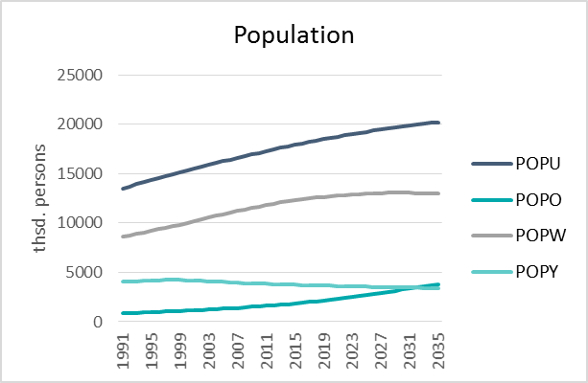
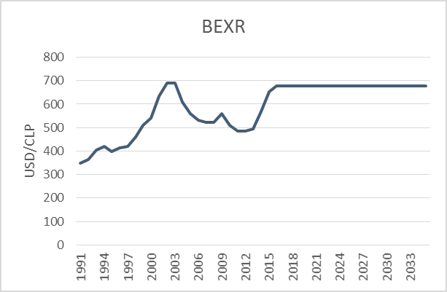
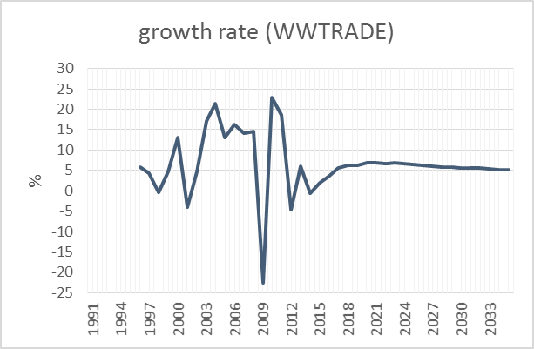
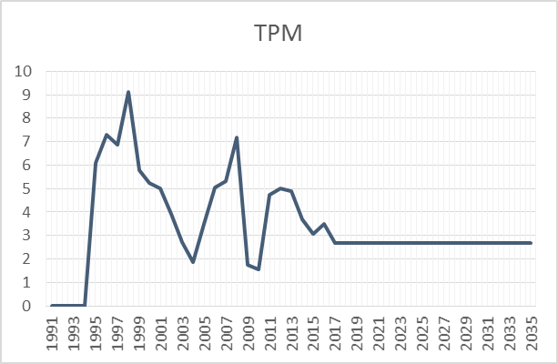
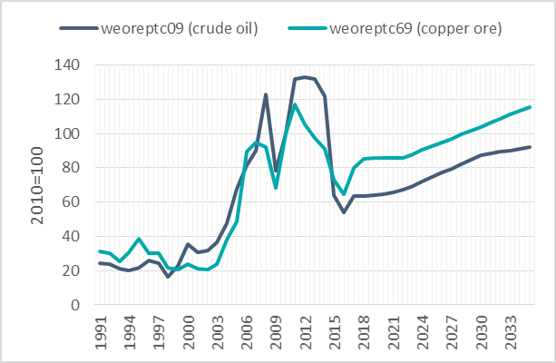
Main assumptions
Constant population POPU increase. Accelerating increase of older population POPO
Exchange rate BEXR remains constant
World trade growth WWTRADE in average >5%
Main refinancing interest rate TPM remains constant
Raw material prices increase constantly

Slide 20
GDP and components
Until 2035, average growth rate can be increased.
Mainly driven by a constantly high demand of private households.
This can be explaned by the growing population.
Chile’s foreign trade balance will turn positive only temporarly
 | 2005-2010 | 2010-2015 | 2015-2020e | 2020-2025e | 2025-2030e | 2030-2035e
Gross domestic product | 3,8 | 4,7 | 2,3 | 2,9 | 3,0 | 3,1
Private consumption | 5,6 | 5,4 | 3,3 | 3,3 | 3,4 | 4,1
State consumption | 5,2 | 3,9 | 2,8 | 2,1 | 1,8 | 1,3
Investment | 6,4 | 4,7 | 2,0 | 3,4 | 3,1 | 2,8
Exports | 0,9 | 1,8 | 2,3 | 3,6 | 2,9 | 2,9
Imports | 7,9 | 1,5 | 3,1 | 3,0 | 3,2 | 4,1

Slide 21
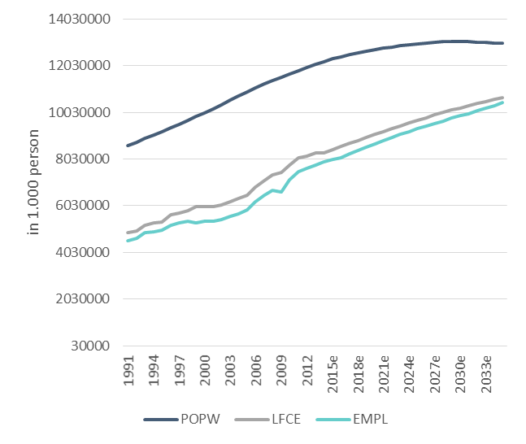
Labour market
Positive growth perspective are transmitted to the labour market
Gap between labour force and labour demand declines → labour becomes more scarce

Slide 22
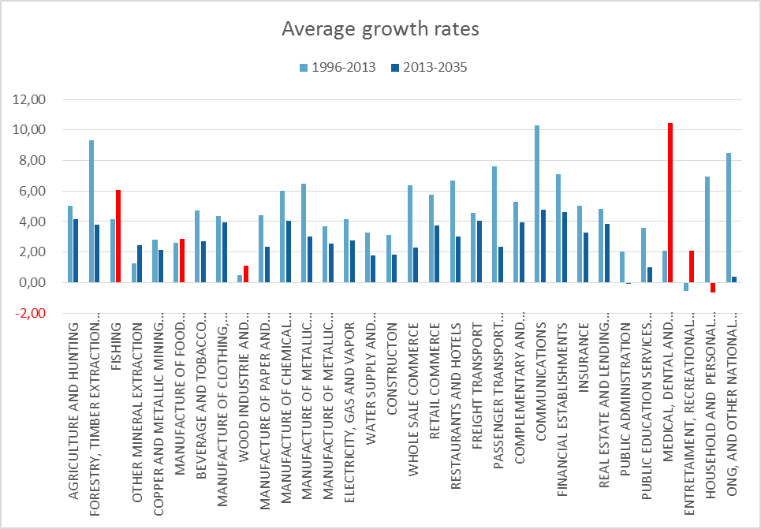
Structural development
Real production
In average, growth slower than in the past
Except for some sectors; especially for „medical, dental and sanitation services” a much higher growth path is expected

Slide 23
Next steps adhead

Slide 24
Next steps ahead
COFORCE on national level finalized
but: update on new data possible
depends on resources (personell, time) but may be sensible
some improvements in modelling approach to be considered
include volume of work on labour market to account better for part-time work
...
Next step ahead: regionalization of COFORCE
the how of regionalization still open
depends on data availability

Slide 25

Contact person
Anke Mönnig
T +49 (0) 40933 - 210 E moennig @ gws-os.com
Deputy head of Economic and Social Affaires

Slide 26
www.gws-os.com
Gesellschaft für Wirtschaftliche Strukturforschung mbH Heinrichstr. 30
49080 Osnabrück
Tel + 49 (0) 541 40933-210
Fax + 49 (0) 541 40933-110 moennig @ gws-os.com
+49 (0) 541 40933-100

