Slide 1
Predicting cyclist traffic in Paris
Camille Epitalon-de-Guidis
Sarah Mayer

Slide 2
I. Data Preprocessing
II. Model Selection
III. Model Improvement
IV. Results

Slide 3
I. Data Preprocessing
Missing Data
Merging external data
Encoding choices
II. Model Selection
III. Model Improvement
IV. Results

Slide 4
I. Data Preprocessing
Missing Data
Merging external data
Encoding choices
II. Model Selection
III. Model Improvement
IV. Results

Slide 5
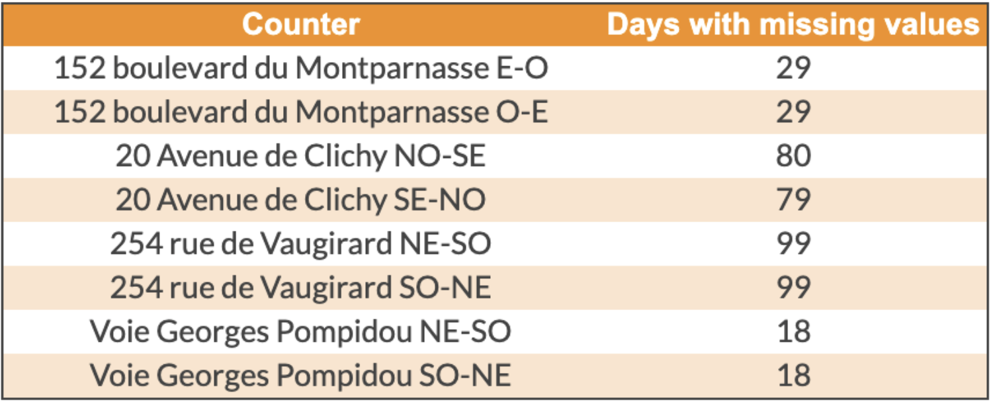
Missing Data in log_bike_count
By plotting the number of bikes by day over the year for each counter, we discovered that 8 of them had a huge number of “0” values in the bike_count and log_bike_count features. More intriguing, those null values would last over several following days (Fig. 1) in the training paquet.
Number of days without counting bikes by counter
Over the 343 days present in the training paquet, 66% of them have at least one counter with bike_count set to 0 during the whole day.
I. Data Preprocessing

Slide 6
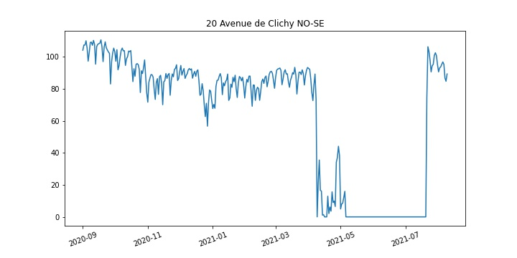
Missing Data in log-bike-count
We decided to create a first model to approximate the actual bikes circulation on these counters during the bugging period in order to enrich the training dataset and therefore to improve the precision of the end prediction model.
Initial log_bikes_count per day for 20 Avenue de Clichy NO-SE
I. Data Preprocessing

Slide 7
Missing Data in log-bike-count
We decided to create a first model to approximate the actual bikes circulation on these counters during the bugging period in order to enrich the training dataset and therefore to improve the precision of the end prediction model.
Initial log_bikes_count per day for 20 Avenue de Clichy NO-SE
Process
First, we had to reformat the data to well predict the missing values: 1 row per date and hour with the log_bike_count for each counter.
Then, we looped over our the bugging counter to:
Split the dataset between rows with unjustified null values and other ones
Train a Ridge regression model
Predict the missing values.
I. Data Preprocessing

Slide 8
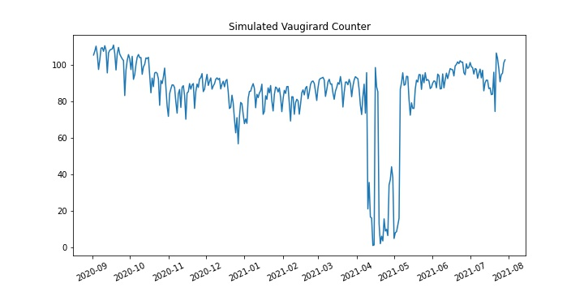
Missing Data in log-bike-count
We decided to create a first model to approximate the actual bikes circulation on these counters during the bugging period in order to enrich the training dataset and therefore to improve the precision of the end prediction model.
Initial log_bikes_count per day for 20 Avenue de Clichy NO-SE
Process
First, we had to reformat the data to well predict the missing values: 1 row per date and hour with the log_bike_count for each counter.
Then, we looped over our the bugging counter to:
Split the dataset between rows with unjustified null values and other ones
Train a Ridge regression model
Predict the missing values.
Final log_bikes_count per day for 20 Avenue de Clichy NO-SE
I. Data Preprocessing

Slide 9
I. Data Preprocessing
Missing Data
Merging external data
Encoding choices
II. Model Selection
III. Model Improvement
IV. Results

Slide 10
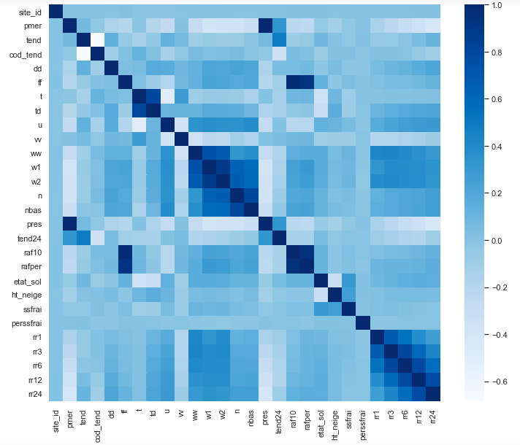
Correlation
Discarding all the variables from the external_dataset with too much missing data, we then evaluated the correlation between the remaining ones.
I. Data Preprocessing

Slide 11
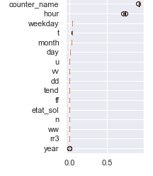
Feature importance
Considering the feature_importance graph and the meaning of each variable, we first decided to only keep the temperature and humidity features (ie. ‘t’ and ‘u’).
We then built our first model on the 7 following variables : counter_name, day, weekday, t, month, day, u.
I. Data Preprocessing

Slide 12
Additional adjustments
We added several other conditions on our data to make sure we kept only the significative part on which we could extract a trend:
The two packages to spot holidays in Paris
We decided to import the 2 following packages as the cyclist behaviour may change on those typical days.
SchoolHolidayDates
JoursFeries
I. Data Preprocessing

Slide 13
Additional adjustments
We added several other conditions on our data to make sure we kept only the significative part on which we could extract a trend:
The two packages to spot holidays in Paris
We decided to import the 2 following packages as the cyclist behaviour may change on those typical days.
SchoolHolidayDates
JoursFeries
After testing the importance of these new feature, we decided to eliminate them.
As an element of interpretation, we thought they may not be representative of the trend, as thus don’t increase our prediction
I. Data Preprocessing

Slide 14
Additional adjustments
We added several other conditions on our data to make sure we kept only the significative part on which we could extract a trend:
The two packages to spot holidays in Paris
COVID Impact
We decided to import the 2 following packages as the cyclist behaviour may change on those typical days.
SchoolHolidayDates
JoursFeries
Intuitively, we reckon adding the quarantine and curfews biases to our model would be valuable as those COVID measures did impact our daily behaviours. After looking for packages, we decided to manually generate lockdown and curfews periods and add them to our training dataset.
After testing the importance of these new feature, we decided to eliminate them.
As an element of interpretation, we thought they may not be representative of the trend, as thus don’t increase our prediction
I. Data Preprocessing

Slide 15
Additional adjustments
We added several other conditions on our data to make sure we kept only the significative part on which we could extract a trend:
The two packages to spot holidays in Paris
COVID Impact
We decided to import the 2 following packages as the cyclist behaviour may change on those typical days.
SchoolHolidayDates
JoursFeries
Intuitively, we reckon adding the quarantine and curfews biases to our model would be valuable as those COVID measures did impact our daily behaviours. After looking for packages, we decided to manually generate lockdown and curfews periods and add them to our training dataset.
After testing the importance of these new feature, we decided to eliminate them.
As an element of interpretation, we thought they may not be representative of the trend, as thus don’t increase our prediction
Same as with the holidays, adding those variables did not turn out to improve our model score.
We chose not to add them. You can still find it in our python file, in the function merge_covid_data().
I. Data Preprocessing

Slide 16
I. Data Preprocessing
Missing Data
Merging external data
Encoding choices
II. Model Selection
III. Model Improvement
IV. Results

Slide 17
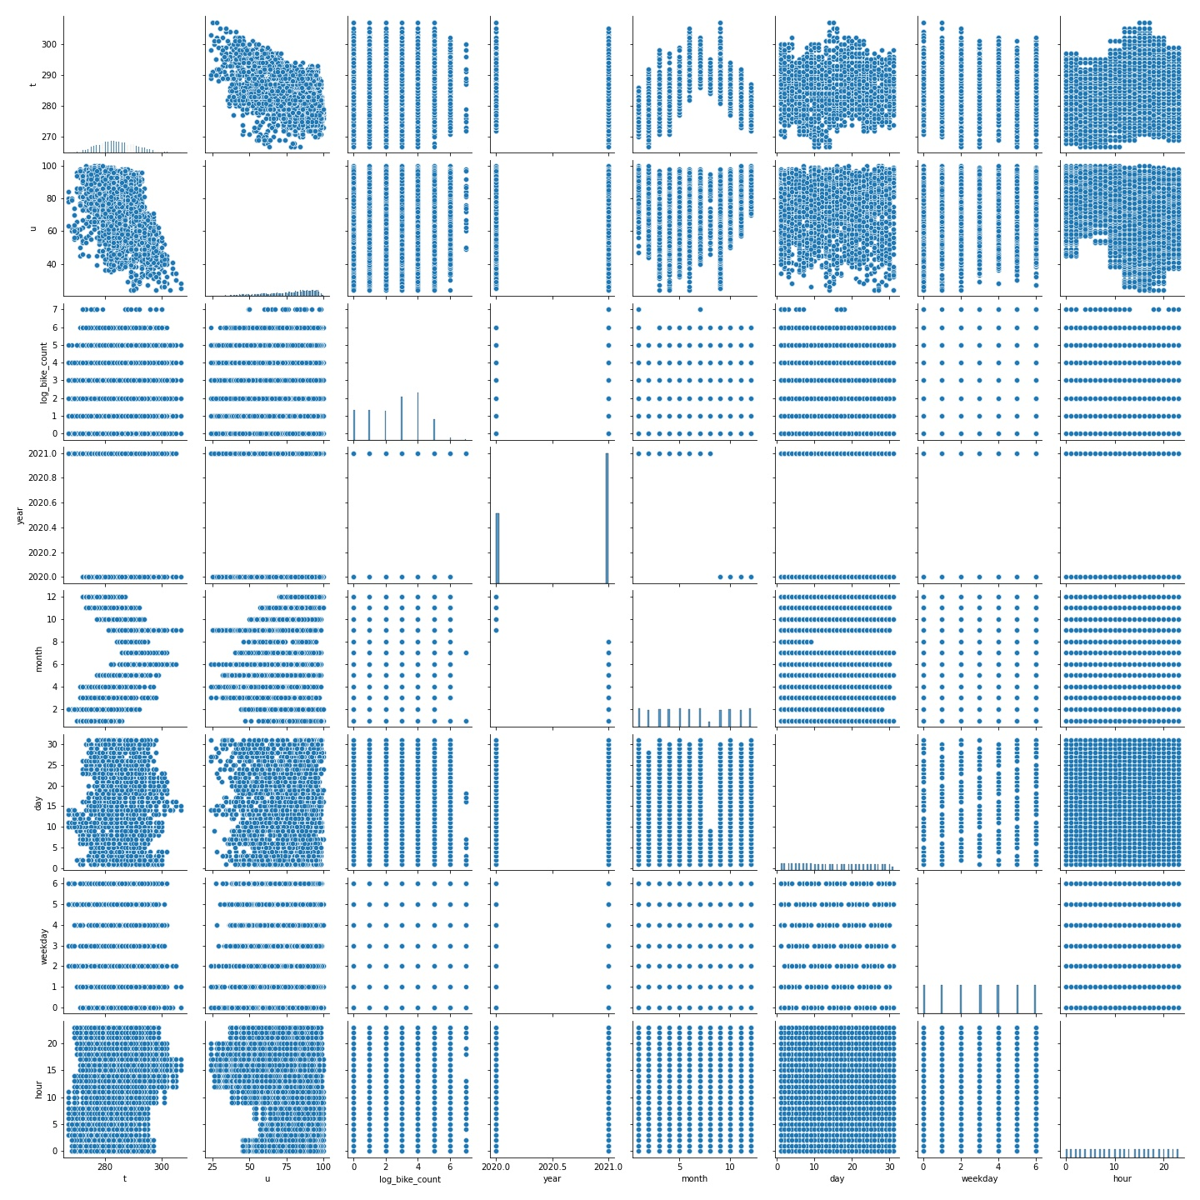
Linearity & Encoding choice
Doing pariplots, it was straight forward that the relation between variables was not linear.
I. Data Preprocessing

Slide 18
Linearity & Encoding choice
Doing pariplots, it was straight forward that the relation between variables was not linear.
Date variables (hour, day, weekday, month, year):
As we opted for a non linear model (a tree-based one), we used a StandardScaler for all the numeric features (ie temperature, humidity and hour, day, weekday, month and year), even if the impact of the scaling is very light on the final RMSE.
I. Data Preprocessing

Slide 19
Linearity & Encoding choice
Doing pairplots, it was straight forward that the relation between variables was not linear.
Date variables (hour, day, weekday, month, year):
As we opted for a non linear model (a tree-based one), we used a StandardScaler for all the numeric features (ie temperature, humidity and hour, day, weekday, month and year), even if the impact of the scaling is very light on the final RMSE.
Categorical variables (counter_name, site_name):
We decided to use a OneHotEncoder, based on our results (better than OrdinalEncoder).
I. Data Preprocessing

Slide 20
I. Data Preprocessing
II. Model Selection
III. Model Improvement
IV. Results

Slide 21
Models
Initially, we decided to test the whole set of models we had already used in our different courses, to discard the poorest ones and keep the ones with the best RMSE (using cross-validation) and training time (both being computed on a Jupyter notebook).
Model | RMSE | Training time
Ridge Regressor | 1.55± 0.122 | 1.471
Random Forest Regressor | 1.24± 0.229 | 259.222
Lasso | 1.62± 0.105 | 1.694
XGBoost | 1.18± 0.22 | 61.186
ElasticNet | 1.61± 0.106 | 1.313
HistGradientBoostingRegressor | 1.16± 0.23 | 19.022
LightGBM | 1.16± 0.226 | 14.292
II. Model Selection

Slide 22
Models
Initially, we decided to test the whole set of models we had already used in our different courses, to discard the poorest ones and keep the ones with the best RMSE (using cross-validation) and training time (both being computed on a Jupyter notebook).
Model | RMSE | Training time
Ridge Regressor | 1.55± 0.122 | 1.471
Random Forest Regressor | 1.24± 0.229 | 259.222
Lasso | 1.62± 0.105 | 1.694
XGBoost | 1.18± 0.22 | 61.186
ElasticNet | 1.61± 0.106 | 1.313
HistGradientBoostingRegressor | 1.16± 0.23 | 19.022
LightGBM | 1.16± 0.226 | 14.292
Assuming there was no linearity, and dealing with time-series data, we decided to discard all linear models and to opt for regression trees.
After some research and many tests, we identified 3 models to best predict these time series:
Prophet : fitted when time-series is the central factor. However, “countername” being the most important factor, this model was not appropriated.
XGBoost : This model is well appropriated for datasets composed of a mixture of categorical and numeric features.
LightGBM : As we are in the case of a non linear model (as shown previously), those models seemed appropriated.
After many iterations, we got our best results with LightGBM and decided to stick to it.
II. Model Selection

Slide 23
I. Data Preprocessing
II. Model Selection
III. Model improvement
Parameters tuning
Feature engineering
IV. Results

Slide 24
I. Data Preprocessing
II. Model Selection
III. Model improvement
Parameters tuning
Feature engineering
IV. Results

Slide 25
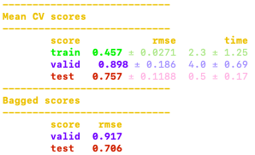
Parameters Tuning
Tuning the parameters turned out to be a very time consuming part of our work, the idea being to increase the accuracy of the model while preventing high variance or overfitting problems.
With the parameters set by default, the model provides the following RMSE :
III. Feature Engineering

Slide 26
Parameters Tuning
Tuning the parameters turned out to be a very time consuming part of our work, the idea being to increase the accuracy of the model while preventing high variance or overfitting problems.
With the parameters set by default, the model provides the following RMSE :
Using GridSearchCV, we started by min_data_in_leaf. Then we tuned other ones (reg_alpha, min_child_samples, etc).
By raising the hyperparameter n_estimators and num_leaves, we drastically reduced the RMSE of the model, but it has cost: the training and validation time both increased.
III. Feature Engineering

Slide 27
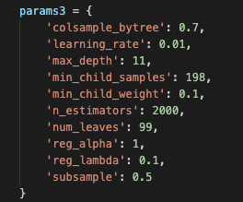
Parameters Tuning
Tuning the parameters turned out to be a very time consuming part of our work, the idea being to increase the accuracy of the model while preventing high variance or overfitting problems.
With the parameters set by default, the model provides the following RMSE :
Using GridSearchCV, we started by min_data_in_leaf. Then we tuned other ones (reg_alpha, min_child_samples, etc).
By raising the hyperparameter n_estimators and num_leaves, we drastically reduced the RMSE of the model, but it has cost: the training and validation time both increased.
The best set we found is the following :
III. Feature Engineering

Slide 28
I. Data Preprocessing
II. Model Selection
III. Model improvement
Parameters tuning
Feature engineering
IV. Results

Slide 29
Cos/Sin transformations
Polynomial combinations
Idea
Encode the time-related variables
(ie hour, month, day) with cos and sin
Raise the date/hour features to the power of 2 and 3
Purpose
Represent the time circularity and avoid considering time as linear.
Represent the interaction between features multiplying the variables together.
Results
We chose the LightGBM model, and it builds its split rules according to one feature at a time. This means that this model fails to process these two features simultaneously whereas the cos/sin values are expected to be considered as one single coordinates system.
Not considered in our final model
After some iterations, we failed in improving the RMSE.
Not considered in our final model
III. Feature Engineering

Slide 30
I. Data Preprocessing
II. Model Selection
III. Model Improvement
IV. Results

Slide 31
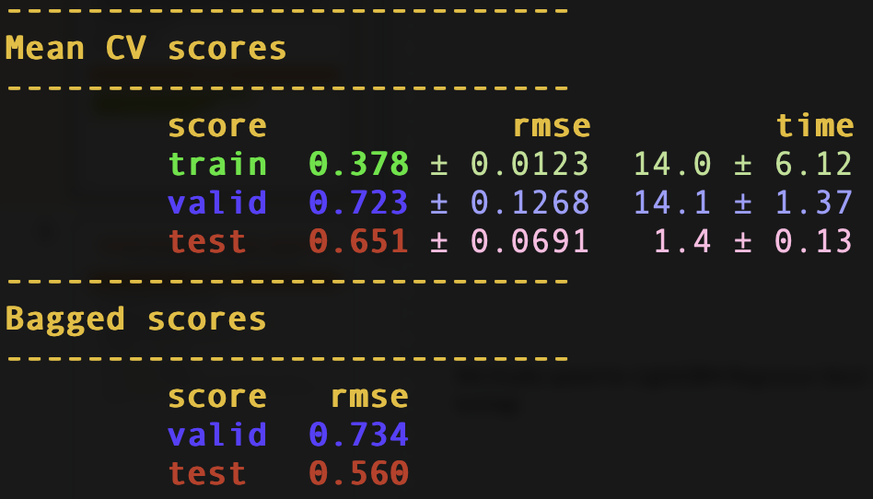
Final RMSE
The final model is available on the ramp platform, under the submission name: “pantac_sur_tarmac19” and the team “ceptln”.
It gives the following outputs:
RMSE: 0.731
Train time: 161.27 sec
Validation time: 374.28 sec

