Slide 1

OAR
Optical Alphabet Recognition
using Logistic Regression

Slide 2
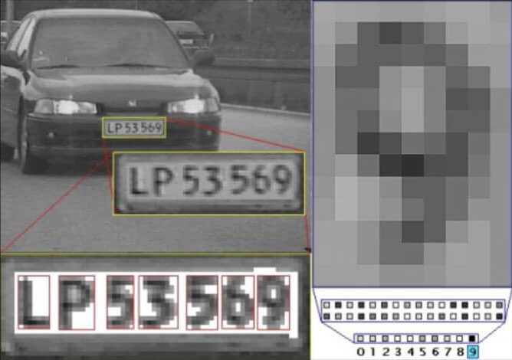
Problem Inputs & Outputs
The problem this project addresses is processing readable images to identify capital-letter English Characters.
Inputs: pixel data from images of characters to be identified
Outputs: a probability that the image depicts one of the English alphabet letters in the set of {A, B, C, D, E, F, G, H, I, J, K, L, M, N, O, P, Q, R, S, T, U, V, W, X, Y, Z}
Page 2/8

Slide 3

Goal Statements
Given part of the program is creating a classification model there are two sets of goal statements. Given the initial dataset for each label (alphabet letter):
GS1: Calculate the predicted values of known input character using the sigmoid function
GS2: Train weights and biases by maximizing gradient of Log Likelihood function
Then after the model has been built the goal shifts:
GS3: Calculate the predicted values of unknown character using the sigmoid function
GS4: Calculate Log Likelihood function and display label that is most likely the character depicted in the image.
Notes:
Goal is only after model is built. Remove the function names for more abstraction.

Slide 4
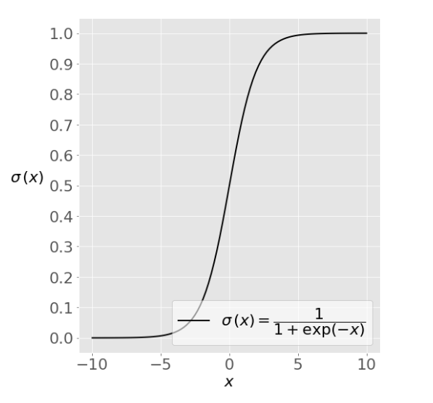
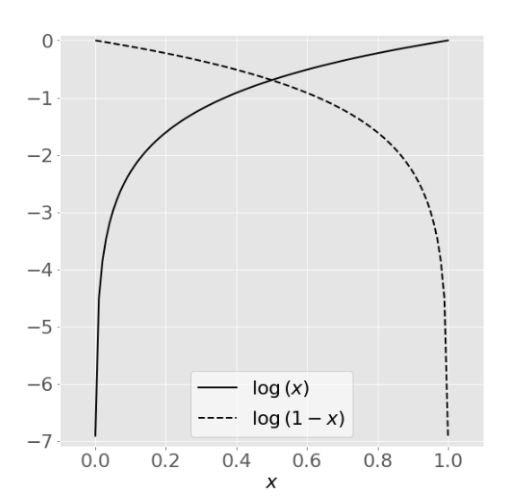
Example Calculations and Models
Sigmoid Function
Useful for classification since its value is either close to zero or one
Natural Logarithm Function
Used for basis of Log Likelihood function

Slide 5
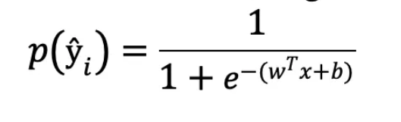

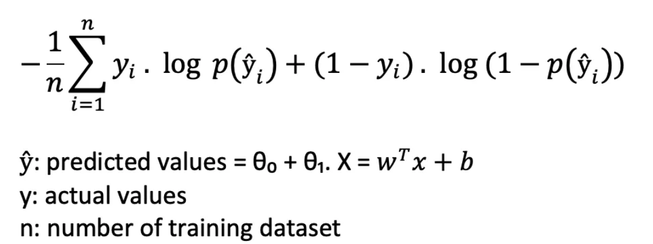
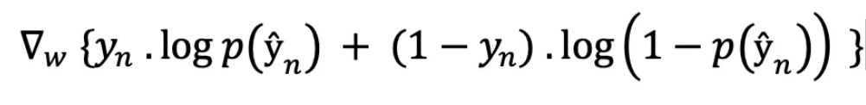


Example Calculations and Models Cont’d
Log-Likelihood Function with sigmoid function used as basis for the predicted value (label)
x is the input data in these equations
Predicted value sigmoid made up of weights & biases. Compute the gradient to train these weights and biases to be more accurate for predictions

Slide 6


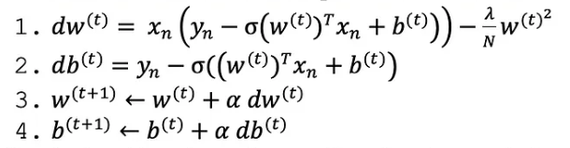
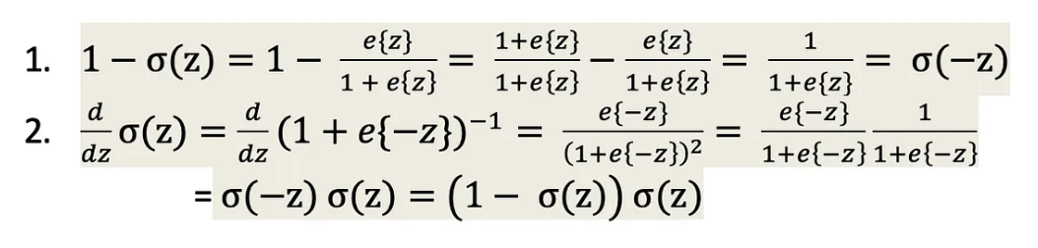
Example Calculations and Models Cont’d
Math for the predicted weights & biases can be simplified using identities of sigmoid function
The gradient calculations simplify to:
db =
Training is then executed as:
And the LLF is tested after every training round to test with the updated variables.

Slide 7
Assumptions
A1: Pre-classification calculation, image processing (image flattening, data standardization etc.) is performed by supporting libraries
A2: If the computed confidence of the output is less than 50% the program will return a “No Confidence” output
A3: The dataset for training will only contain labels of capital letter characters, and an even spread of every label to be trained.
A4: Test input images will be in the form of .jpeg files.
A5: The program will be built in python for access to useful supporting libraries, and for convenience
Notes:
letters have to be properly oriented. Input characters have to be rotated to be correct before input. Assumption 5 isn’t a real assumption. Assumption 4 is more of a constraint. Assumption 2 is a design decision.

Slide 8

THANKS FOR LISTENING
Questions, Comments, or Concerns?

