Slide 1

OAR
Optical Alphabet Recognition
using Logistic Regression

Slide 2

DEMO

Slide 3
Quick Recap on Logistic Regression
Binary Classification Algorithm… to implement for entire alphabet 26 different models were generated
Usually used to classify labels with 10 or less features… some scaling had to be done to make this usable (makes training a bit less precise, harder to achieve high confidence results)
Very susceptible to overfitting, and must be run over many epochs to get decent results
Fairly easy to implement from scratch and understand from a beginner’s perspective

Slide 4
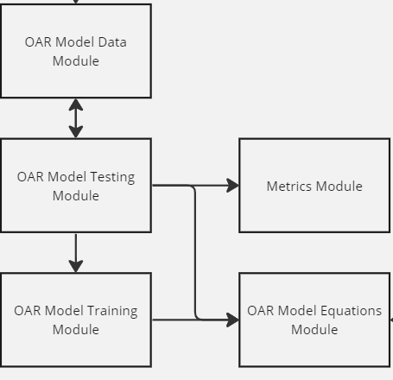
Training & Testing

Slide 5
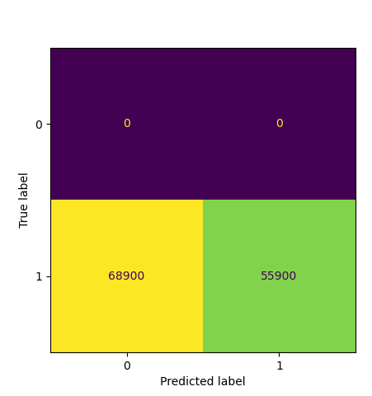
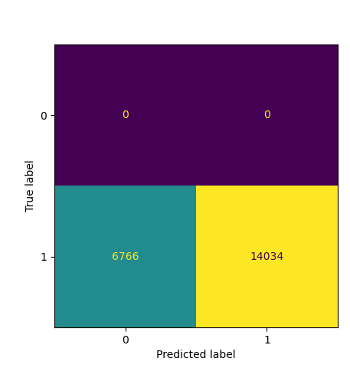
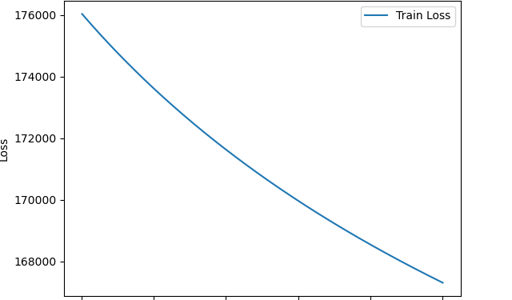
Model Performance
Train Overall
Test Overall
5/9

Slide 6
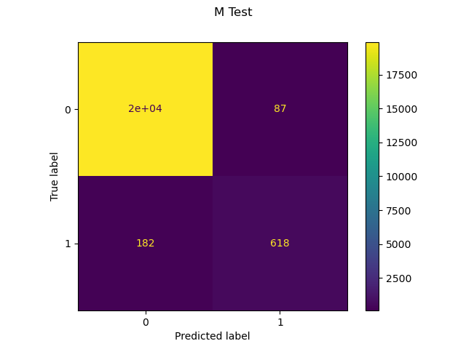
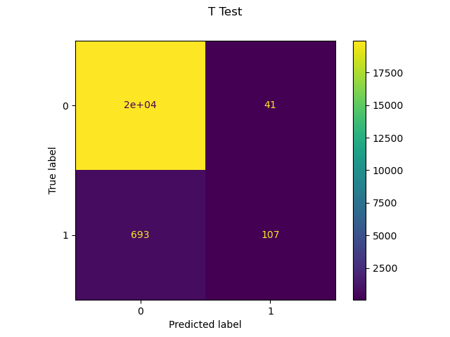
Model Performance Cont’d
Each model is very good at predicting true negatives, also typically low amounts of false positives… some stats on the test data performance:
Best Accuracy (Letter M) = 98.7%
Worst Accuracy (Letter T) = 96.4%
Overall Accuracy (From Last Slide) = 67.4%
Best Misclassification (Letter M) = 1.3%
Worst Misclassification (Letter A) = 3.7%
Overall Misclassification (From Last Slide) = 32.5%
Best Precision (Letter M) = 87.6%
Worst Precision (Letter A) = 55.3%
6/9

Slide 7
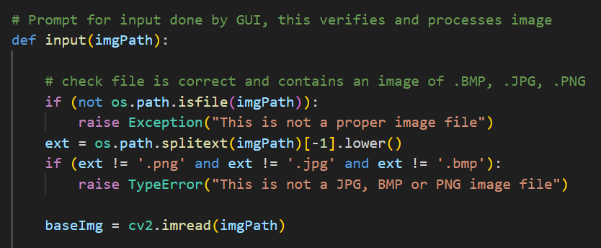
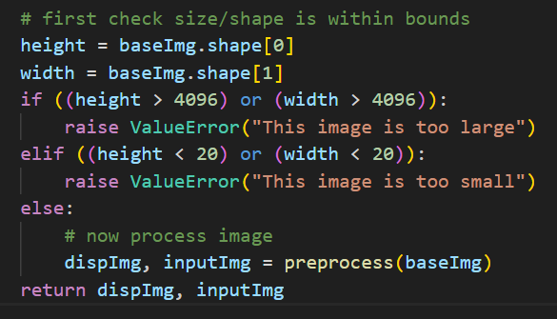
OAR Input
7/9

Slide 8
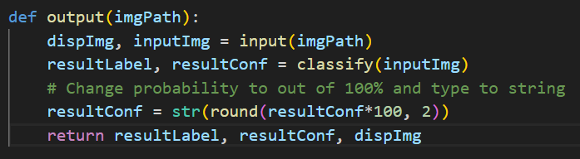
OAR Output

Slide 9

THANKS FOR LISTENING
Questions, Comments, or Concerns?

