Slide 1

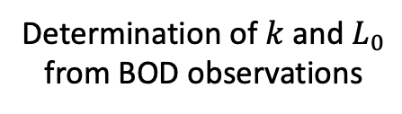


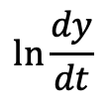

Determination of $k$ and $L_{0}$ from BOD observations
$$ln(kL_{0})$$
$$ln\frac{dy}{dt}$$
$$k$$
$$1$$
$$t$$

Slide 2


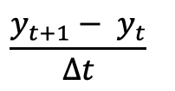
Idealized oxygen utilization curve
$$y$$
$$\frac{y_{t+1}− y_{t}}{Δt}$$
Best fit
$$t$$

