Slide 1
Berkeley Robotics Platform/Board
October 1st 2008
Slides by Bart Muthuswamy and Winthrop Williams
mbharat@cory.eecs.berkeley.edu
winthrop@esg.eecs.berkeley.edu

Slide 2
Overview
Goal: Design a board that is targeted towards robotics
Criterion:
  We should demonstrate a reference design that cannot be implemented on existing boards without using significant mods
  Ease of programming
Discuss feature set of two platforms:
  Altera DE3
  Xilinx ML505
Based on discussion above, come up with a feature set for our platform:
  Hardware (Bart)
  Software (Winthrop)

Slide 3
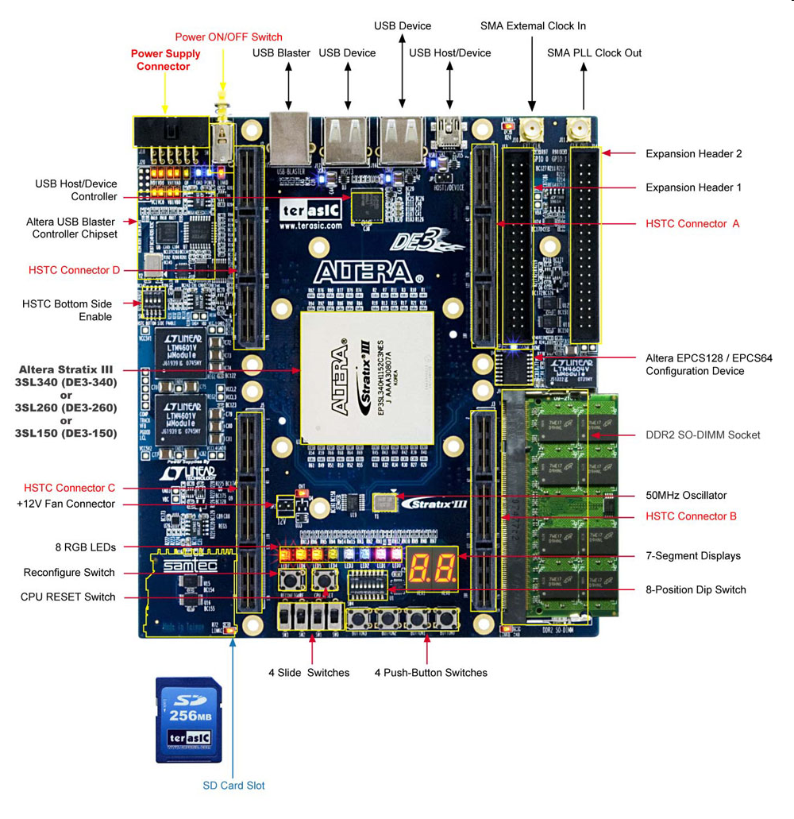
Altera DE3
Feature set:
1. Stratix FPGA.
a. I/O:
i. DE3-340: 340
2. Expansion capability:
a. Boards:
i. A/D
ii. D/A
iii. LCD display
iv. Audio
v. Video
Questions:
a. Boards:
i. Processor board
ii. Motor driver board
iii. Wireless board
iv. Other bus interface
(I²C etc.)
b. Mechanical stability

Slide 4
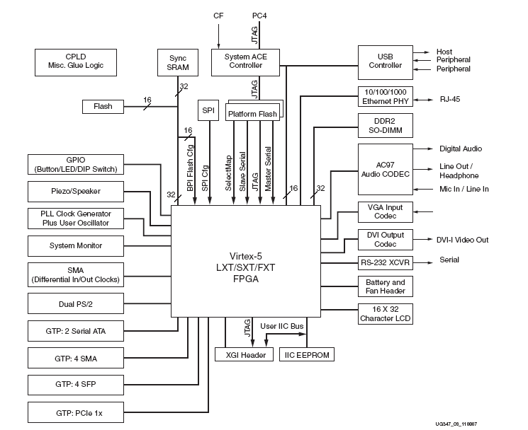
Xilinx ML505
Feature set:
1. Virtex-5 SX/LX/FX FPGA
a. I/O:
2. Expansion capability:
a. MGT (Multigigabit Transcievers)
Questions:
a. Peripherals
i. Processor
ii. Motor driver iii. Other bus interface
(I²C etc.)
iv. A/D and D/A
v. Wireless

Slide 5
Our board:
Should be a mix of Altera and Xilinx:
  ML505 base design
    Mods to the base design (TO DO list)
      LOTS of I/O
      Separate Processor
      Have TWO FPGAs: One LX (size), One SX (DSP)
      A/D and D/A
      Motor driver(s)
      NTSC video in
      Firewire
      Wireless
      Other bus (I²C) interface
      Altera’s expansion headers
        Make sure we keep GB/s throughput
EASE OF PROGRAMMING: TOOLSET IS WHERE WE WILL WIN!

Slide 6
Software (Winthrop)
Development Sequence:
  Scripts + Quick Ref.
  Identifier Parse & Replace
  Compatibility Checks
  Editing:
    Textual
    Graphical
    Spreadsheet
    Database
  Web browser Interface
in source code
?
in object code

Slide 7
Software (Winthrop, contd.)
Models of Computation
  Discrete Event & CSP
  Synchronous Data Flow & Process Networks
  Finite State Machine/Modal Models
  Continuous Time
Glue Components
  Queue, Timeout

Slide 8
Questions
Synchronous/Asynchronous?
  At what level?
Arbitration
Parallelism
Mission creep?

