Slide 1
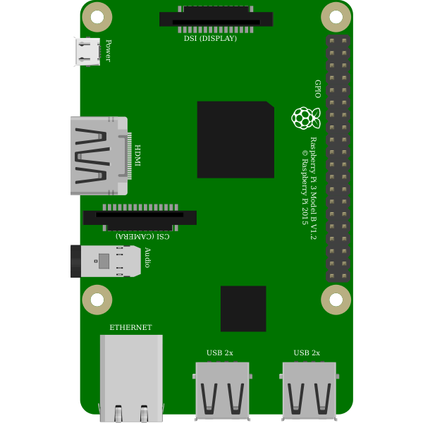

Slide 2
1
2
3
4
5
6
7
8
GND COM

Slide 3
Relay 1
Relay 2
GND
Relay 3
IN1
IN2
IN3
Relay 4
IN4
IN5
Relay 5
IN6
IN7
IN8
Relay 6
VCC
Relay 7
Relay 8

Slide 4
Relay 1
5V
1
Relay 2
GND
2
GND
3
IN1
Relay 3
4
IN2
IN3
Relay 4
5
IN4
6
IN5
Relay 5
GPIO6
IN6
7
IN7
IN8
Relay 6
8
VCC
GND COM
Relay 7
Relay 8

Slide 5
Relay 1
5V
1
Relay 2
GND
2
GND
+
IN1
Relay 3
-
3
IN2
4
IN3
Relay 4
5
IN4
6
IN5
Relay 5
GPIO6
IN6
7
IN7
IN8
Relay 6
8
VCC
GND COM
Relay 7
Relay 8

