Slide 1
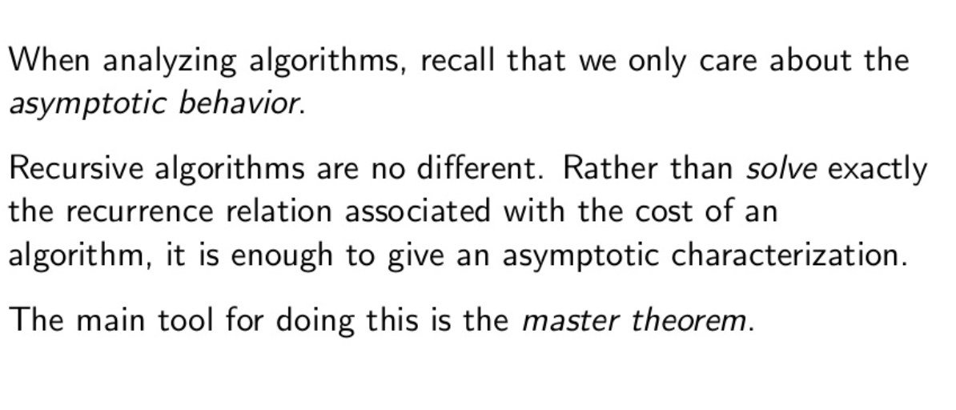
Master’s Theorem

Slide 2
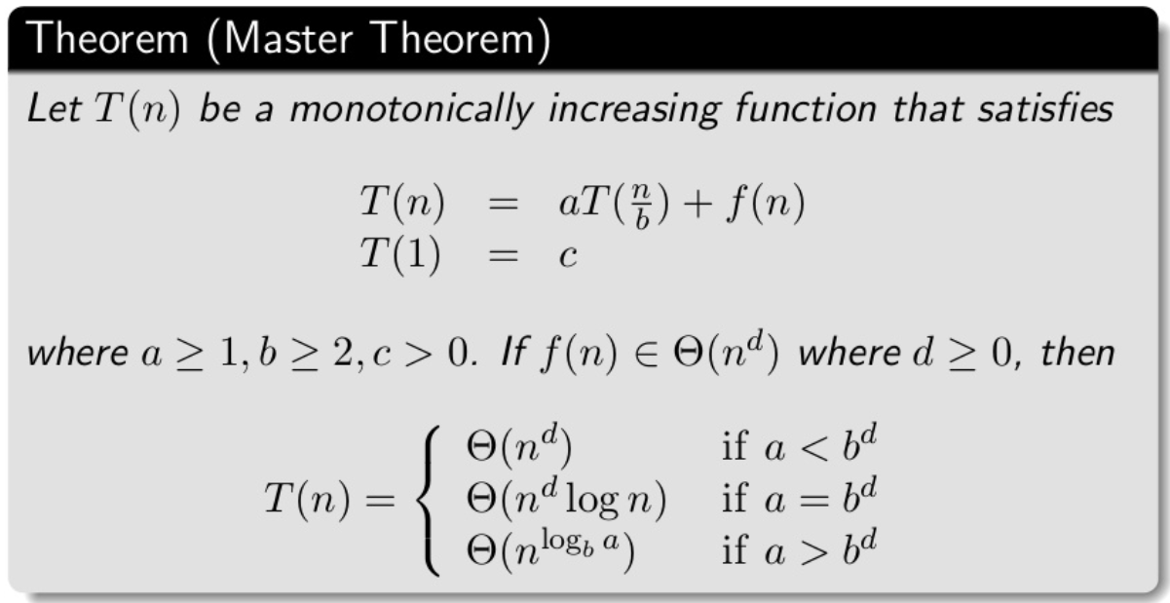
Master’s Theorem

Slide 3
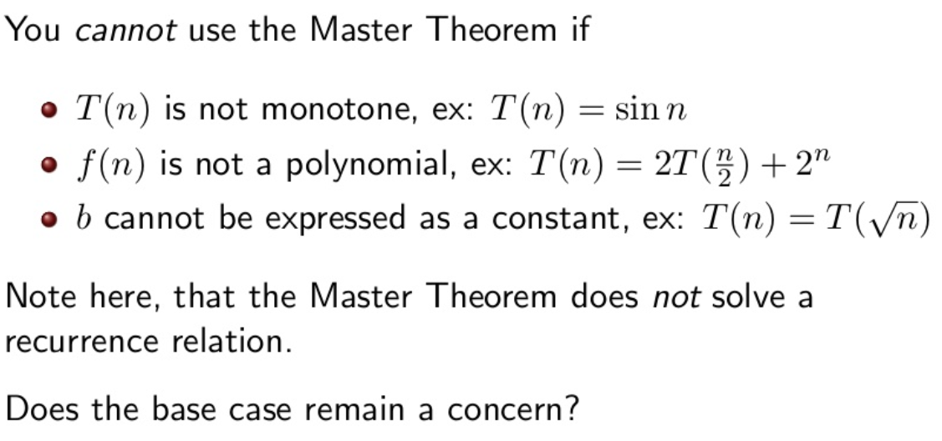
Master’s Theorem

Slide 4
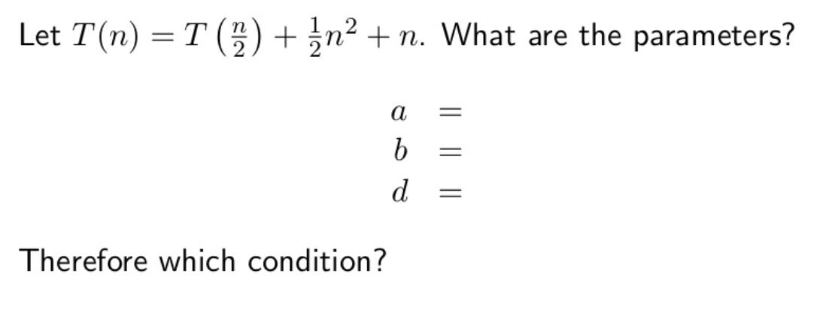
Master’s Theorem

Slide 5
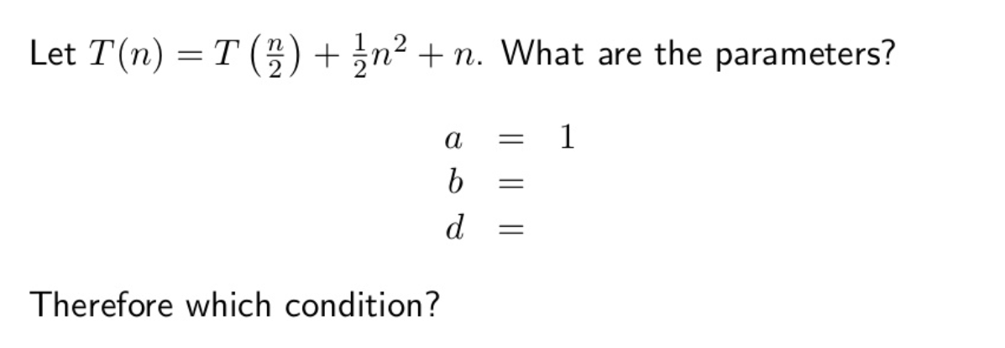
Master’s Theorem

Slide 6
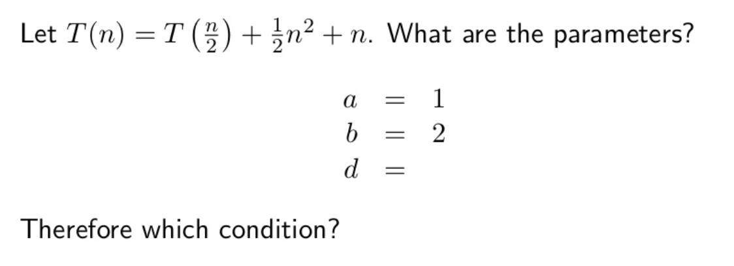
Master’s Theorem

Slide 7
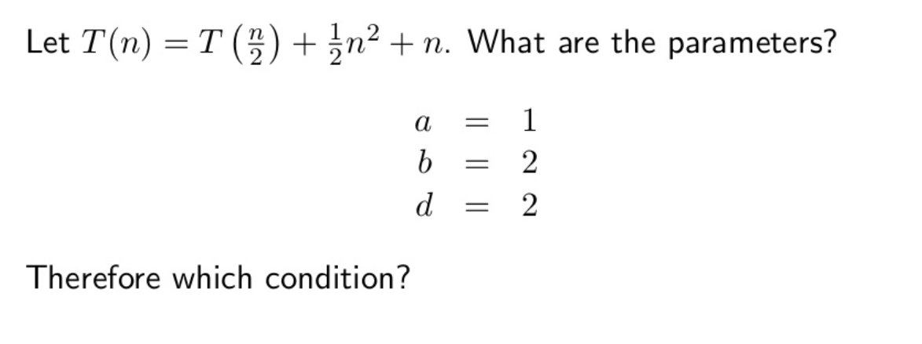
Master’s Theorem

Slide 8
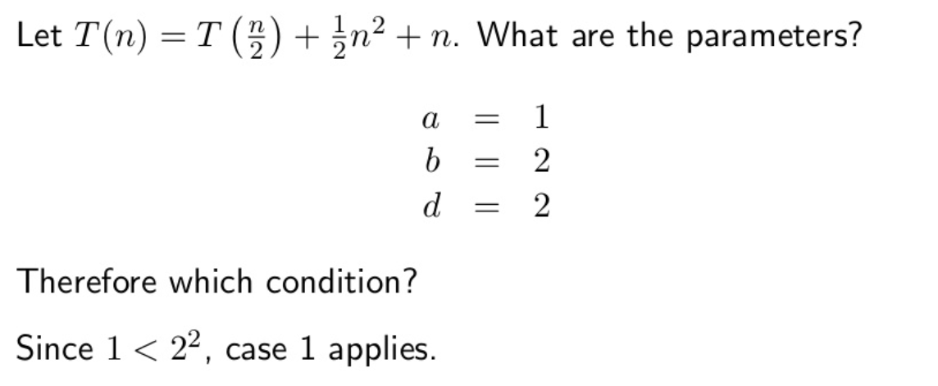
Master’s Theorem

Slide 9
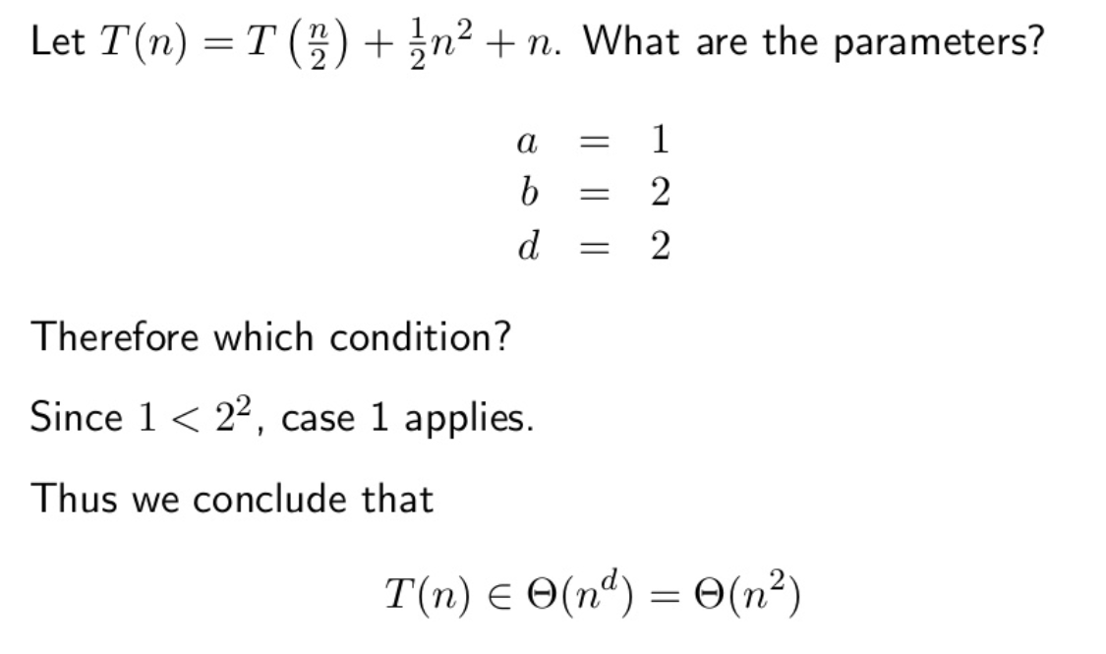
Master’s Theorem

Slide 10
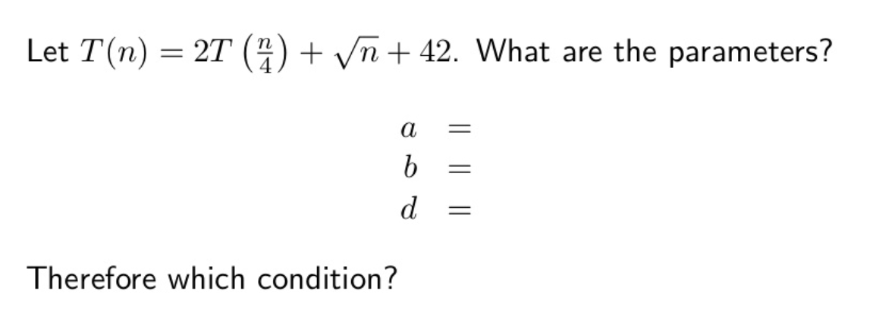
Master’s Theorem

Slide 11
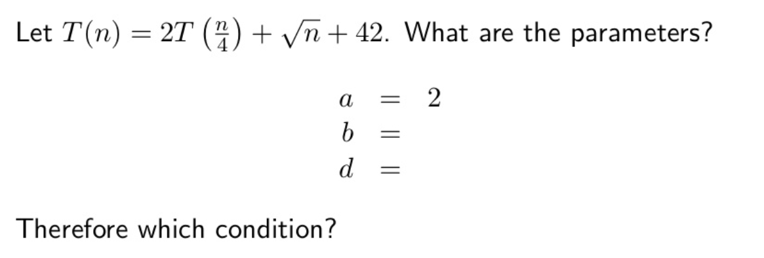
Master’s Theorem

Slide 12
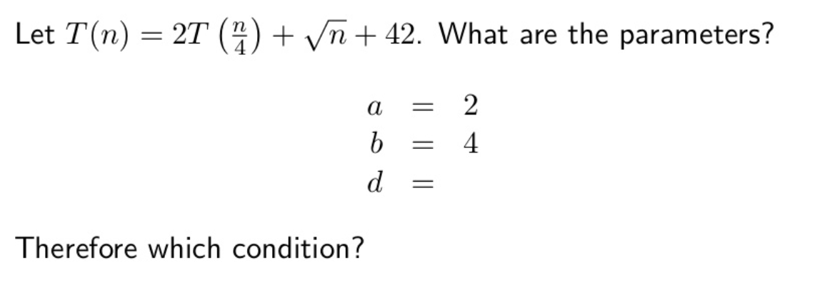
Master’s Theorem

Slide 13
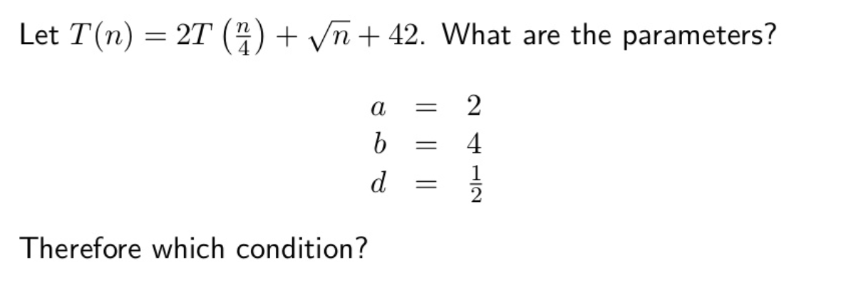
Master’s Theorem

Slide 14
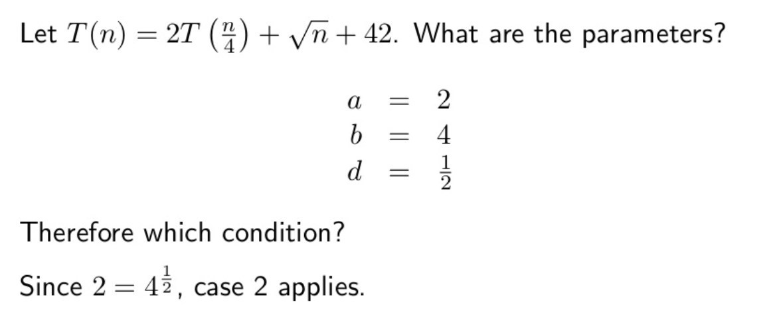
Master’s Theorem

Slide 15
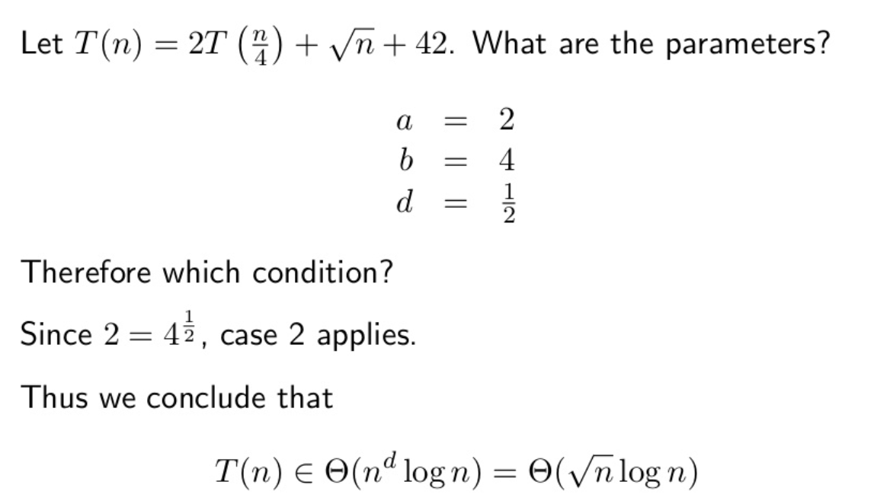
Master’s Theorem

Slide 16
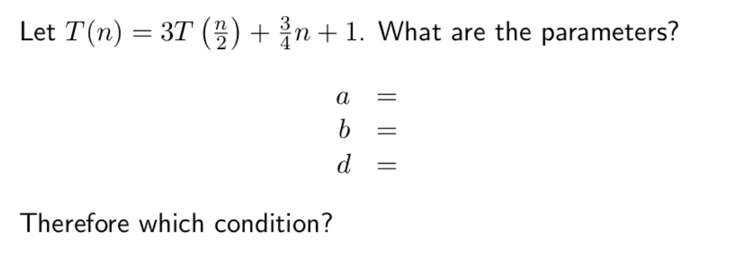
Master’s Theorem

Slide 17
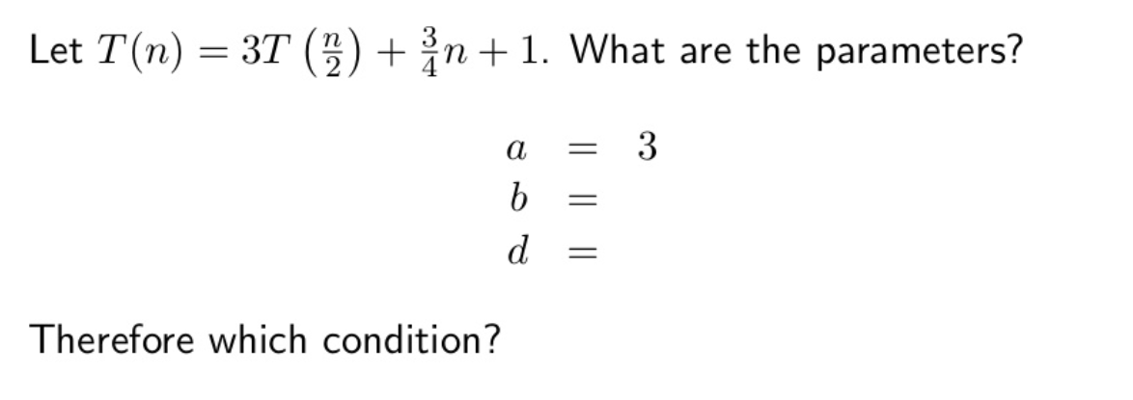
Master’s Theorem

Slide 18
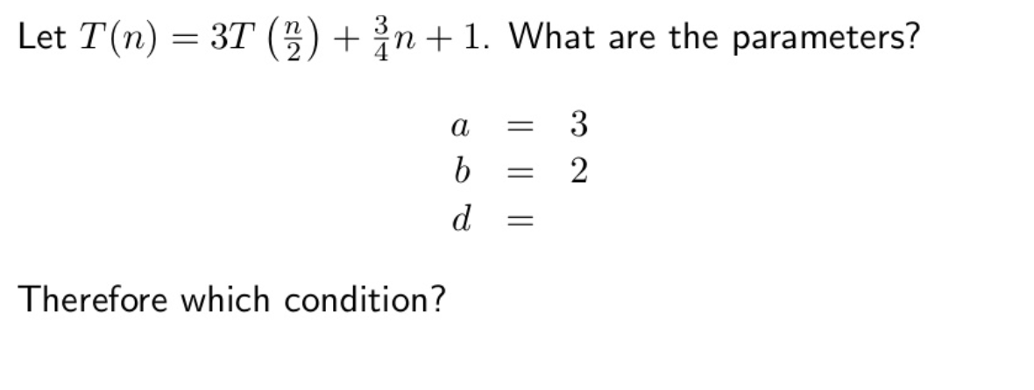
Master’s Theorem

Slide 19
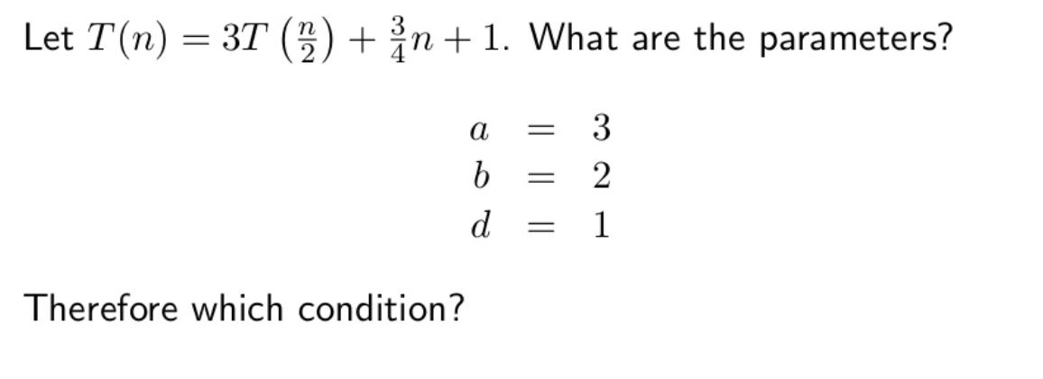
Master’s Theorem

Slide 20
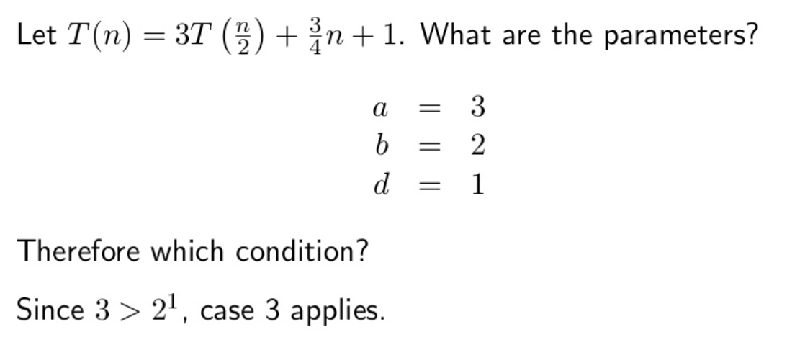
Master’s Theorem

Slide 21
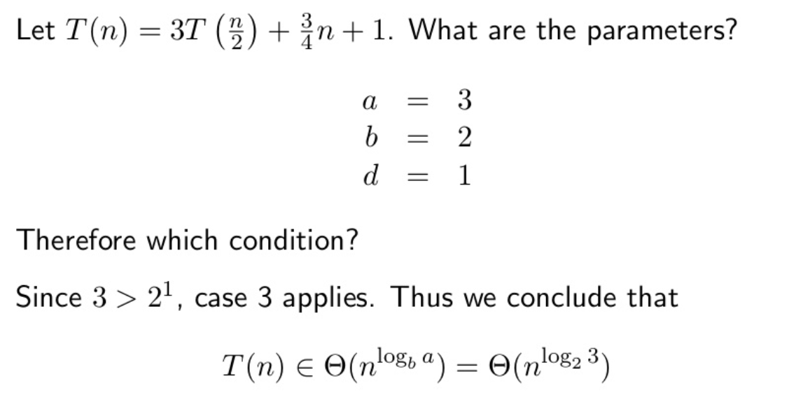
Master’s Theorem

Slide 22
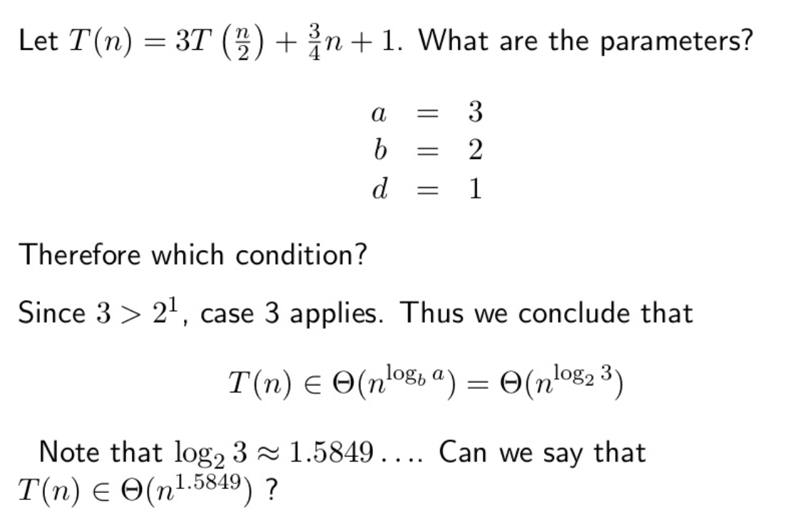
Master’s Theorem

Slide 23
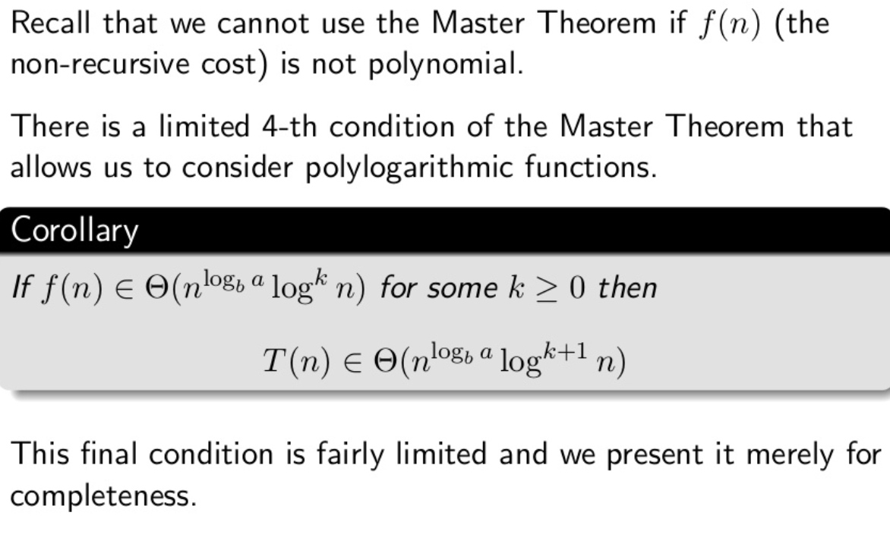
Master’s Theorem

Slide 24
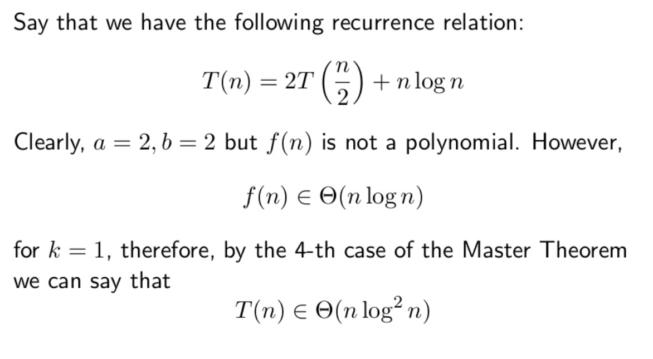
Master’s Theorem

