Slide 1
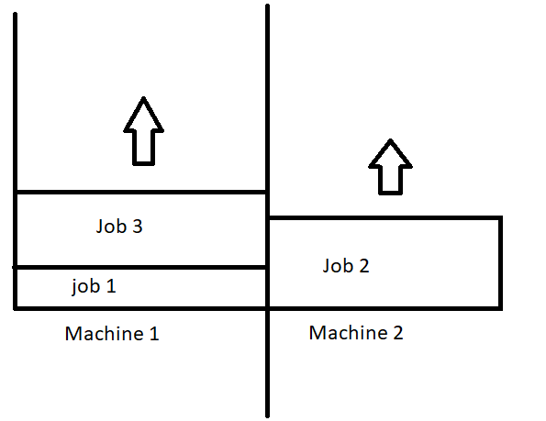
2-Machine Makespan
Goal. Given 2-Machines and a set of jobs S={j_{1,} j_{2,} j_{3,}…,j_{n}} distribute the jobs amongst the 2-machines to arrive at the earliest possible completion time.
Scenario:
You are sitting at work. It’s late and you want to make sure you can get home as soon as possible. The only thing stopping you from a good nights rest is 10 jobs.
The Good News: The Jobs require no effort from you. The machines will do all the work. You simply have to decide which machine handles which job and in which order.
The Bad News: The jobs take a fixed amount of time to complete, and you can’t leave until the last job finishes.
We need to create an algorithm that will make sure to send us home as soon as possible! Let’s be greedy and see what we can come up with.
1

Slide 2
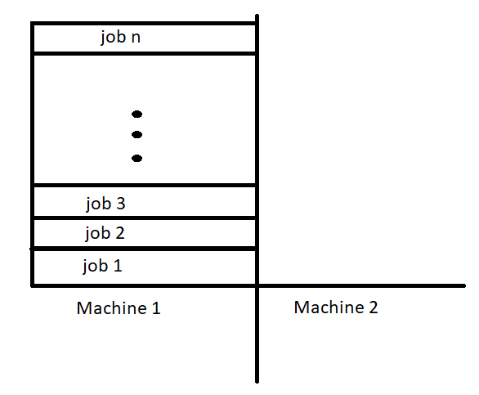
2-Machine Makespan
Attempt #1: - Given n jobs S={j_{1,} j_{2,} j_{3,}…,j_{n}}, let’s put all the jobs on Machine 1!
The “Who needs 2-Machines?” solution.
Is this Optimal? – Although we greedily place all the jobs on machine 1, this clearly isn’t a viable solution.
The problem with this approach: Leaving machine 2 idle is a bad idea as it can definitely reduce the time. Measuring optimality in this instance isn’t even worth it.
2

Slide 3
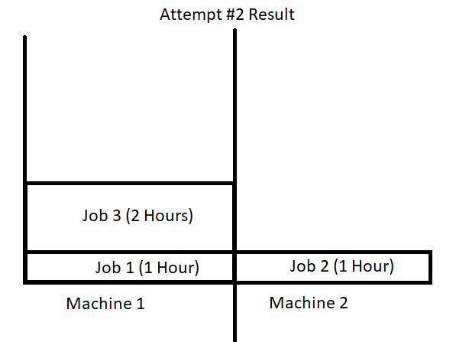
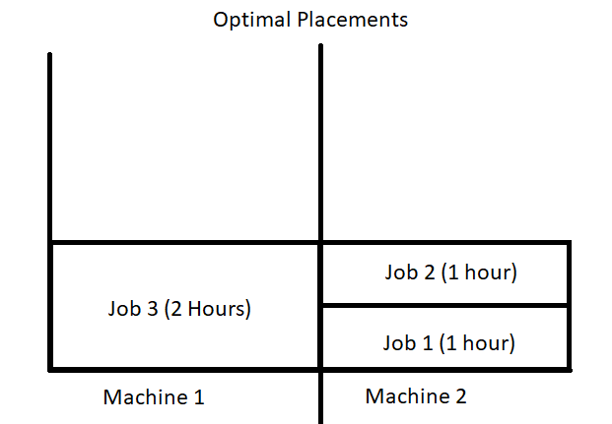
2-Machine Makespan
Attempt #2: - Given n jobs S={j_{1,} j_{2,} j_{3,}…,j_{n}}, Sort the jobs in order from least time to complete to longest time to complete, then place the next available job on the machine with the least amount of work.
Let’s start with an example of 3 jobs:
S = { 1,2,1}
First: We sort it:
S = {1, 1, 2}
Then we need place the job on the machine with the least work.
(In the event of a tie, our tie breaker will be machine 1) So let’s put the first job on machine 1.
Next: We put job 2 on Machine 2 since it has the least amount of work.
Finally, we place the last job on Machine 1 (as we have a tie) we end up with the result of the picture on the right (top).
We should check now for optimality. If we take the jobs by hand and align them ourselves we see we can actually do better than our algorithm and get all jobs to finish in 2 hours between the 2 machines. This means we can do better!

Slide 4
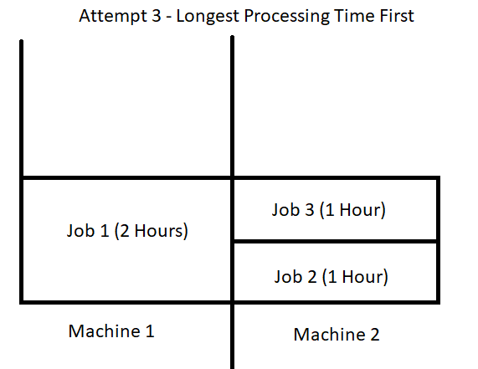
2-Machine Makespan
Attempt #3: - Given n jobs S={j_{1,} j_{2,} j_{3,}…,j_{n}}, Sort the jobs from largest to smallest and assign jobs to machine with least work
- Everything remains the same from Attempt #2, but this time we are going to do our sort differently. We are going to sort it from largest to smallest.
Let’s start with an example of 3 jobs: (same as before)
S = { 1,2,1}
First: We sort it:
S = {2, 1, 1}
Now Job 1 is 2 hours so this time it goes on Machine 1
Since Machine 2 is empty, it gets job 2
And since Machine 2 has less work than machine 1 it gets job 3!
One glance at the optimal placements shows we are optimal! But is this always the case?
-No. This algorithm has been proven to be at least 3/2 OPT (which means it cannot be worse than 1.5x the optimal solution). But it is not always optimal.
This algorithm is referred to as “LPT” (Longest Processing Time First) algorithm.

Slide 5
2-Machine Makespan
Algorithm
(Pseudocode)
----------------------------- //Sort the list of jobs from Largest to Smallest
for(int i=0; i<n; i++){
if(i=0){
// place first job on M1
}
else if(totalTimeM1 > totalTimeM2){
//Place job on M2
}else{
//Place Job on M1
}
}

Slide 6
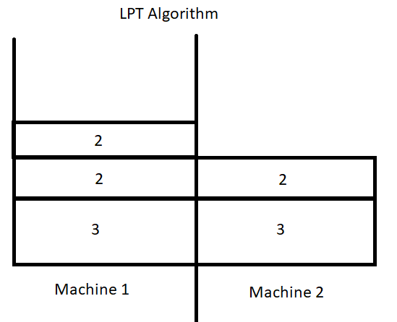
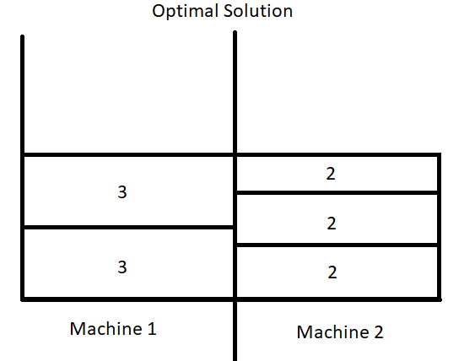
2-Machine Makespan
When does LPT Fail?
We have seen LPT succeed in solving a problem for us already, but if it’s not always optimal when does it fail?
Let’s take another example:
S= { 3, 2, 2, 2, 3}
First we sort the array from largest to smallest:
S= {3, 3, 2, 2, 2}
Then we run the algorithm:
Machine 1 gets 3
Machine 2 gets 3
Machine 1 gets 2
Machine 2 gets 2
Machine 1 gets 2
Let’s take a look on the right at LPT vs OPT solution→
Remember our rule, we place jobs on the machine with the least amount of work. In this instance we should have stacked both of the largest jobs on Machine 1. So the algorithm may not be perfect, but it is the closest we can get greedily supplying jobs to the machines!

Slide 7
2-Machine Makespan
Online Vs. Offline Algorithms
Our final topic is Online Vs. Offline Algorithms. What we have actually seen so far would be classified as offline algorithms which can be defined as follows:
Offline Algorithm: Is given the whole problem data from the beginning and is required to output an answer which solves the problem at hand.
A good example of this is slide 5, notice how we have all the jobs and they length from the start? Knowing this information before trying to solve the problem makes this problem an offline algorithm.
Next up we need to define an online algorithm:
Online Algorithm: Is an algorithm that can process its input piece-by-piece in a serial fashion, i.e., in the order that the input is fed to the algorithm, without having the entire input available from the start.
Let’s look back to slide 5 again and see how we can make this an Online Algorithm. If we remove the list of Jobs and say “We don’t know how many jobs we have or time to complete them, we will only know what they are when the jobs arrive.” then the algorithm is online.
This means… we cannot sort the jobs. Since we cannot sort the Jobs like in the LPT algorithm, We can still place the jobs on the machines with the least amount of work.
This means we can only guarantee the online version of this algorithm can never be more than 2-OPT (or 2x worse than optimal solution.)

