Slide 1
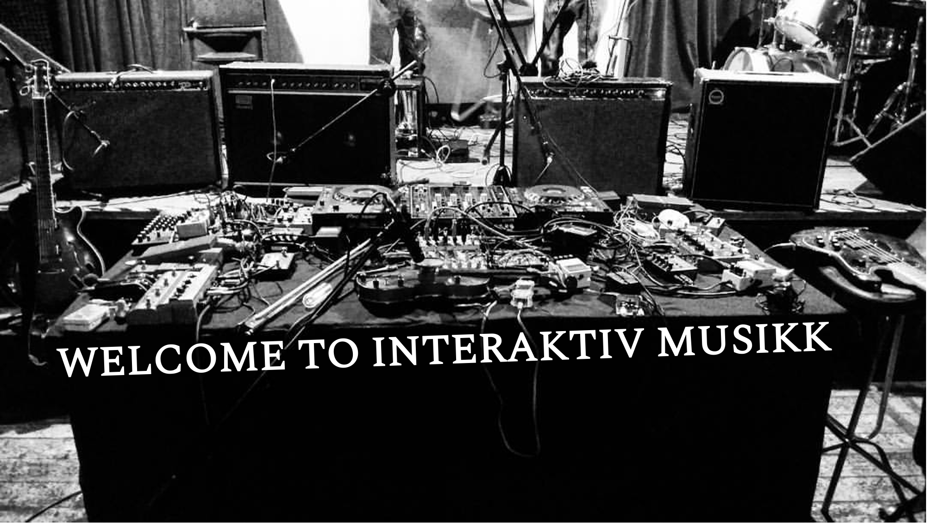
Spring 2022
WEEK 3

Slide 2
Department of Musicology
Spring 2022
Interactive Music
SYLLABUS
INSTRUCTORS: Çağrı Erdem, Qichao Lan
TIME: Tuesday 09:15–10:00 and Friday 12:15–14:00
LOCATION: ZEB, Seminarrom 2
WEEKLY SCHEDULE
WEEK 1 Introduction: Microphones, tools, effects, and noise
WEEK 2 Analogue Synthesis 1: Main concepts and parameters
WEEK 3 Analogue Synthesis 2: Sound sources and processors
WEEK 4 Collaborative performance and Live Coding
WEEK 5 Digital Synthesis 1: Introduction to Pure Data
WEEK 6 Digital Synthesis 2: Basics, oscillators, and filtering
WEEK 7 Digital Synthesis 3: Audio effects
WEEK 8 Digital Controllers 1: MIDI
WEEK 9 Digital Controllers 2: Sensors and mapping
WEEK 10 Ensemble 1: Composition and improvisation
WEEK 11 Ensemble 2: Final concert preparation
COURSE DESCRIPTION: This course provides students with knowledge and skills in designing, building, and performing with various musical instruments and interactive music systems. Students learn the basics of sound synthesis, gain hands-on experience on hardware synthesizers, digital controllers, and audio programming, explore new methods for musical expression and produce artistic works for electroacoustic music ensembles.

Slide 3

Notes:
Musical instrument digital interface.
Early 80s: Manufacturers had their own proprietary standards to synchronize instruments
Then (1982) standardized means of synchronizing electronic musical instruments manufactured by different companies

Slide 4
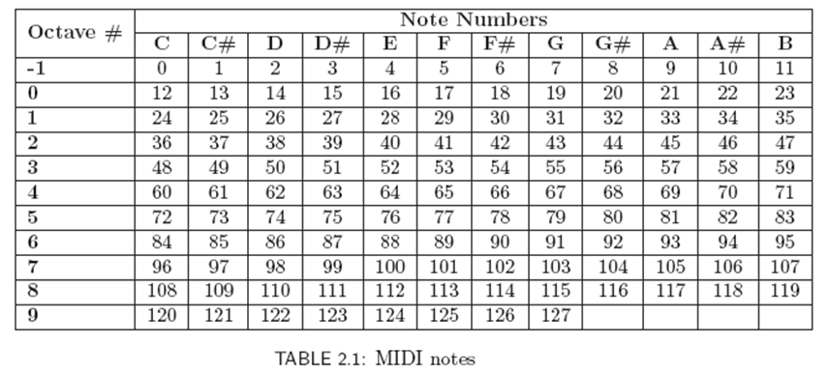

Slide 6
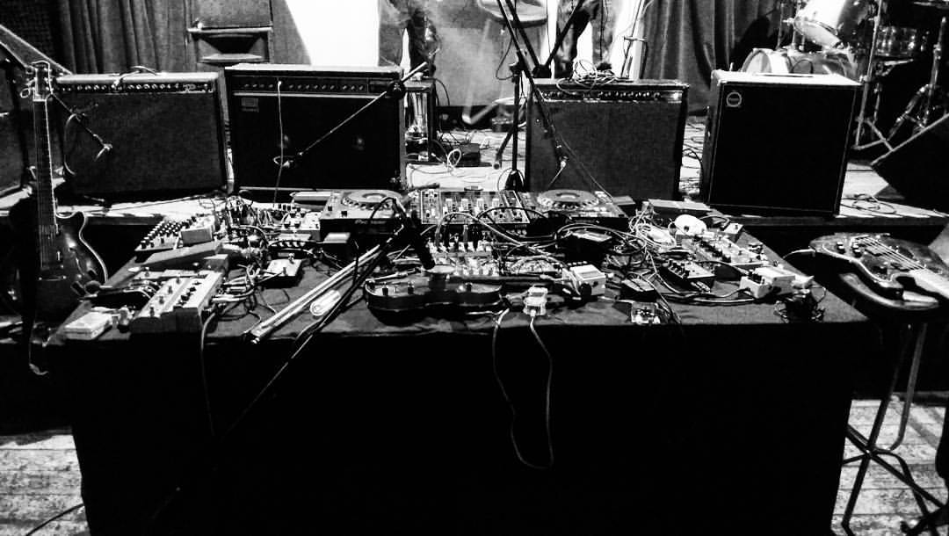
That’s all, folks ☺

