Slide 1
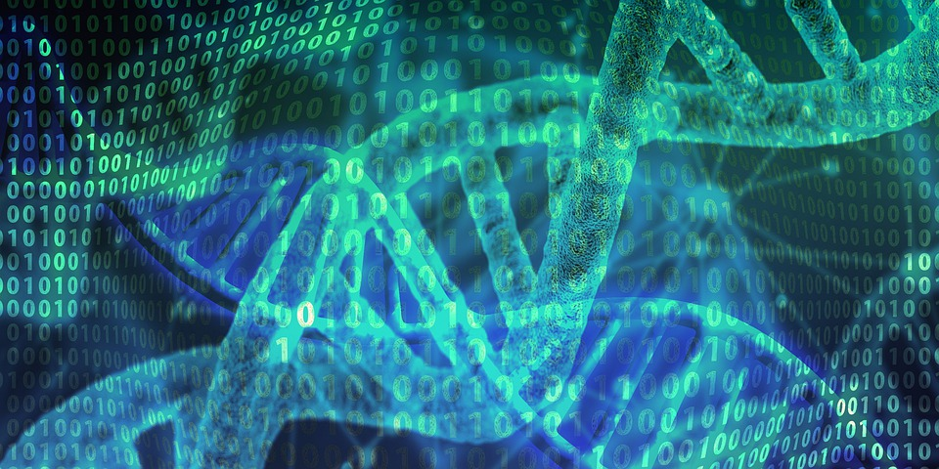
Morality of Gene Enhancement
Sarah Baca

Slide 2
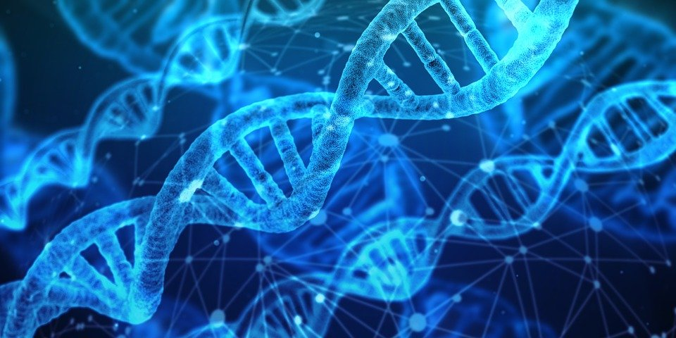
Gene Therapy
vs. Gene Enhancement?

Slide 3

Key Bioethical Conflicts
Autonomy of the child vs. autonomy of the parent
beneficence of the child vs. autonomy of the parent

Slide 4
Genetically enhancing children is immoral because it promotes self-doubt in future generations and disrupts child development, erodes the role of the parent and the child’s ability to actualize self-growth, and overrides individual will and supposed “procreative autonomy.”

Slide 5
Encourages unhappiness and uproots the foundations of healthy development
Sandel argues that genetic enhancement corrupts the parent-child relationship → subverts what William F. May’s refers to as “openness to the unbidden” (Sandel).
Parents will view their child as a vessel for perfection
Disturbs the balance between “accepting love” and “transforming love” (Sandel)
Mars the uniqueness and “humility” of the parent-child relationship (Sandel)
An even greater moral implication of this:
Destroys a child’s ability to be happy with themselves
Children will be taught that their natural self is deficient and that it is necessary to be enhanced

Slide 6
Will impair a parent’s role in their child’s life and the child’s ability to actualize their own self-growth
Parents will increasingly turn to genetic enhancement and thus, will lose their ability to perform their role as a parent
Genetic modifications are a more assured solution, making parents more likely to use modifications rather than attempting to solve perceived difficulties with traditional parenting → disassociate parents from their children
As a result, children will not properly learn how to approach self-improvement without the aid of medical interventions.
Teaches children that improvement comes from outside sources rather than from within

Slide 7
Societal need will begin overpowering individual autonomy
Have previously attempted to approach the issue of genetic enhancement similarly to Sandel → my previous objections have been raised under the assumption that all would have access to genetic enhancement and without recognizing the historical ties to eugenics
Old eugenics vs. “liberal eugenics” → the new movement does not include state coercion and is market driven, therefore ensuring “procreative autonomy” (Savulescu)
However, the market defining these choices does not mean autonomy is being respected
The market is molding society → parents will craft children that meet societal needs
Individual autonomy will be overpowered by the needs of society

Slide 8
Genetic enhancement is immoral
Neither parents, nor children will benefit
Parents will see their children as vessels for perfection, disrupting a child’s ability to love themselves for who they are
Parents will be robbed of their role in their child’s life and children will not be properly taught how to seek or accomplish self-growth without the use of genetic modification
The market will subjugate individual will
Savulescu’s claimed “procreative autonomy” will lose meaning as parents will be forced to mold their children in society’s desired image.

Slide 9
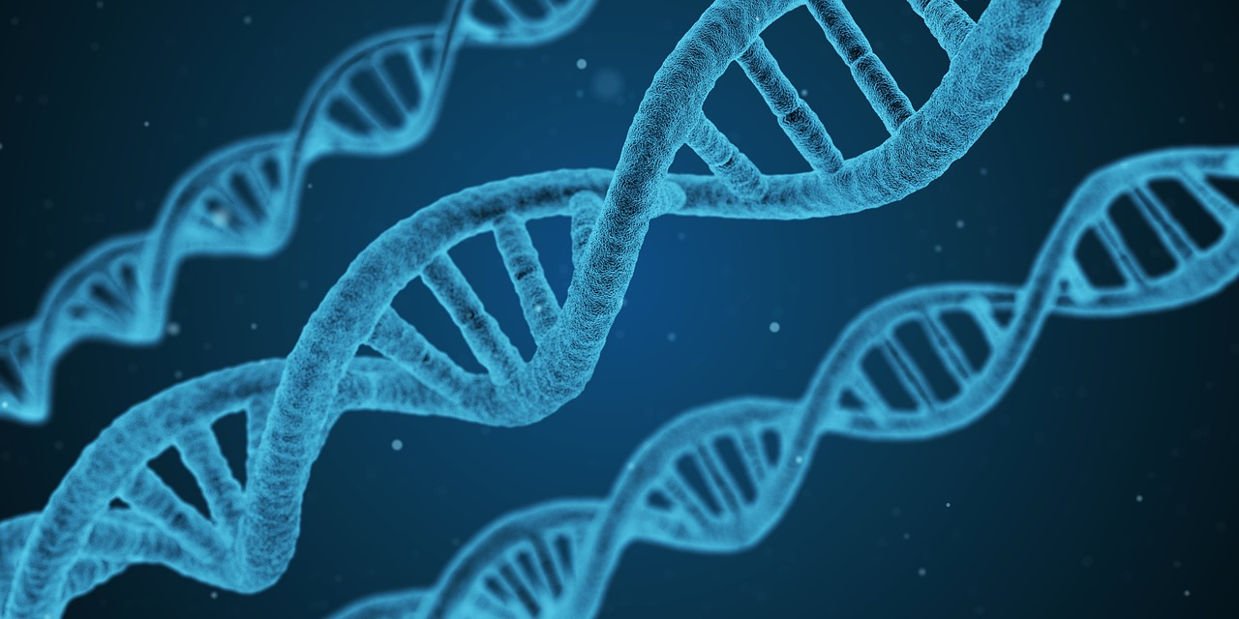
Works Cited
Sandel, Michael. “The Case Against Perfection.” The Atlantic, April 2004,
https://www.theatlantic.com/magazine/archive/2004/04/the-case-against-perfection/302927/ Accessed 11 November 2021.
Savulescu, Julian. “Genetic Interventions and the Ethics of Enhancement.” Bioethics:
Principles, Issues, and Cases, edited by Lewis Vaughn, Oxford University Press, 3rd ed, 2020, pp. 624-636.

