Slide 1
Chess Game
Group 3: Ethan, victor, megan, matthew

Slide 2


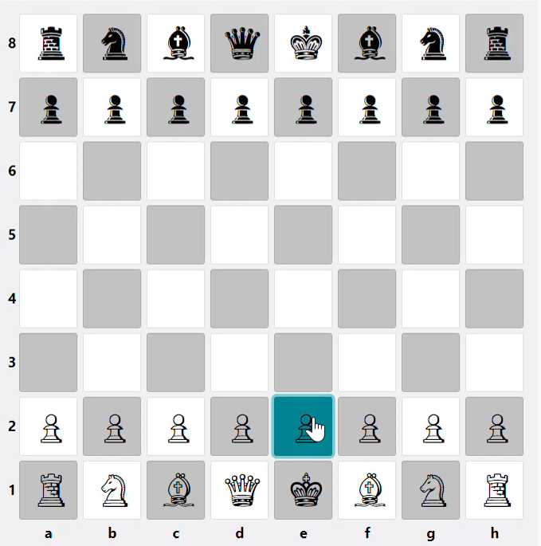
Piece Movement
Select a piece.
The legal moves for that piece will be highlighted in light-blue.
Select one of the highlighted squares to move the piece.
To cancel a selection, either click on the selected piece, or a non-highlighted square.

