Slide 1
OXHACK
RoadWatch
Using historical evidence to rank which Brooklyn street blocks are most likely to receive a pothole report next week, so a fixed inspection budget is focused where it is most likely to be needed
23,448
0.9%
71,609
Brooklyn street blocks to choose from
of block-weeks get a pothole report (test period)
Brooklyn 311 pothole reports since 2020
Retrospective evaluation on public NYC and NOAA data. Predicts 311 reports, not confirmed defects. Not a live municipal deployment.
Notes:
Cities have far more streets than inspectors. Brooklyn has 23,448 street blocks, and in a typical week fewer than one in a hundred gets a pothole report. RoadWatch asks: can historical evidence show which blocks are most likely to get one next week, so a fixed inspection budget goes where it is needed?

Slide 2
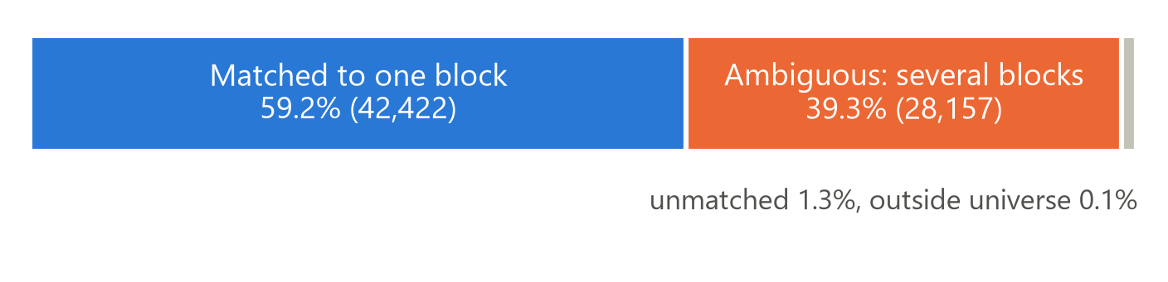
DATA COLLECTION
Real public data, with messy locations
NYC 311 service requests (Socrata API)
71,609 Brooklyn pothole reports, Jan 2020 – Oct 2026
Where was the pothole? Matching 311 reports to blocks
NYC street centerline (official)
23,448 eligible blocks · 2,617 km · lanes, width, truck and bike routes
Ambiguous reports: most name an intersection (23,824 of 28,157), so a report could belong to any of its candidate blocks, typically 4.
Missing locations: 5,567 extra pothole requests had no usable borough or street; 111 were recovered with evidence.
Unknown, not zero: in 23 of 355 weeks too many reports were unlocatable, so those weeks are excluded rather than treated as 'no report'.
NOAA GHCN-D, Central Park
daily temperature, rain and snow · 2,577 days
Also ingested for checks, not used by the model: pavement ratings (135,776 rows) and DOT work orders (110,830 rows).
RoadWatch · OxHack
Source: outputs/stage3/matching_diagnostics.json, label_diagnostics.json; outputs/stage7/reproducibility.json
2
Notes:
We used only real public data: over seventy-one thousand Brooklyn pothole reports from NYC 311 since 2020, the city's official street centreline for block shapes and road attributes, and NOAA weather. The hard part is location: thirty-nine percent of reports name an intersection or a vague stretch of street, so they could belong to several blocks, typically four.

Slide 3
PROCESSING
From raw downloads to point-in-time features
1 Validate and archive
Raw API responses kept unchanged with sha256 checksums; row counts checked against the server. An offline rebuild reproduced 8/8 tables byte-for-byte.
2 Match to blocks
Street names and coordinates place each report on a block; ambiguous reports keep every candidate.
3 Label each block-week
Positive, negative or unknown (8.3 million block-weeks). Unknown weeks are never counted as zero.
4 Point-in-time features
38 features per block, built only from data published before the forecast date.
What the model is allowed to know when it ranks blocks on forecast Monday t
t − 14 days
label history only for weeks that have fully matured
t − 2 days
311 reports published
target: a report in [t, t + 7 days)
t − 5 days
NOAA weather published
t (Monday)
worklist issued
RoadWatch · OxHack
Source: Stage 2–4 reports; outputs/stage7/reproducibility.json; outputs/stage4/feature_definitions.md
3
Notes:
Every download is archived unchanged with checksums and validated, and an offline rebuild reproduces every table byte for byte. Reports are matched to blocks by street names and coordinates; ambiguous ones keep all their candidates. Weeks with too many unlocatable reports are marked unknown, never zero. And every feature is point-in-time: only 311 data published two days before the forecast, and weather from five days before.

Slide 4
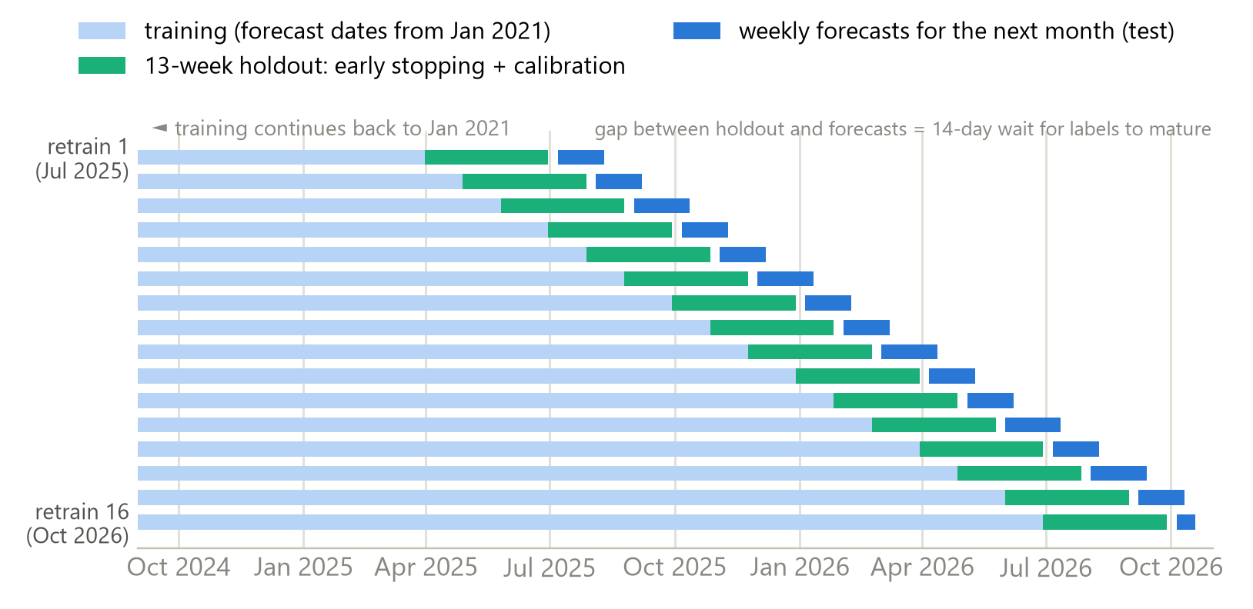
PREDICTION
LightGBM ranks blocks, tested by replaying history
LightGBM: gradient-boosted decision trees over 38 features: recent report history (decayed counts, days since last report), neighbouring blocks, and static road attributes (length, lanes, width, truck and bike routes).
Output: a score that ranks all blocks for the next 7 days. Ranks, not reliable probabilities.
Baselines: historical rate (share of the last 52 matured weeks with a report), recency (decayed report count) and random order.
No peeking: model and features chosen on Jan–Jun 2025 validation weeks and frozen before any test prediction.
Walk-forward backtest: 16 monthly retrains, each trained only on the past
RoadWatch · OxHack
Source: data/processed/stage4/models/primary__LGBM/metadata.json; data/processed/stage4/selection.json
4
Notes:
The model is LightGBM: gradient-boosted trees over 38 features, including recent report history, neighbouring blocks and road attributes like length and lanes. To test it honestly, we replayed history: sixteen monthly retrains from July 2025, each trained only on the past. The main comparison is a historical-rate baseline, which ranks blocks by how often they have been reported before.

Slide 5
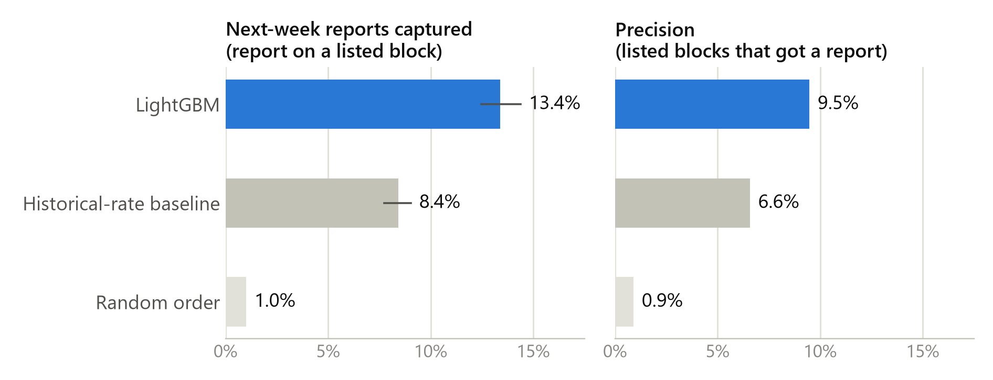
EVIDENCE
Strict LightGBM beats the historical-rate baseline
Measured improvement
Precision: 9.5% vs 6.6%; paired 95% CI +2.3 to +3.4 pp.
Report capture: 13.4% vs 8.4% (random 1.0%).
Target definition matters
Strict single-block target: each report counts on exactly one block (ambiguous reports: a fixed pseudo-random pick).
Multi-block target: every candidate block counts. Its precision (16.4%) answers an easier question; it is not a better model.
Top 1% list = 235 blocks per week, 67 held-out weeks (Jul 2025 – Oct 2026). Lines = 95% confidence intervals (week-level bootstrap).
RoadWatch · OxHack
Source: outputs/stage4/test_results.csv, bootstrap_comparisons.json; outputs/stage5/capture_definitions.csv (CIs). 67 test weeks, 16,855 reports
5
Notes:
Across 67 held-out weeks with a 235-block list, LightGBM caught 13.4 percent of next week's reports, against 8.4 for the historical rate and 1 percent for a random list. Precision rose from 6.6 to 9.5 percent: a gain of 2.3 to 3.4 points, with 95 percent confidence. That is the strict target, where each report counts on exactly one block.

Slide 6
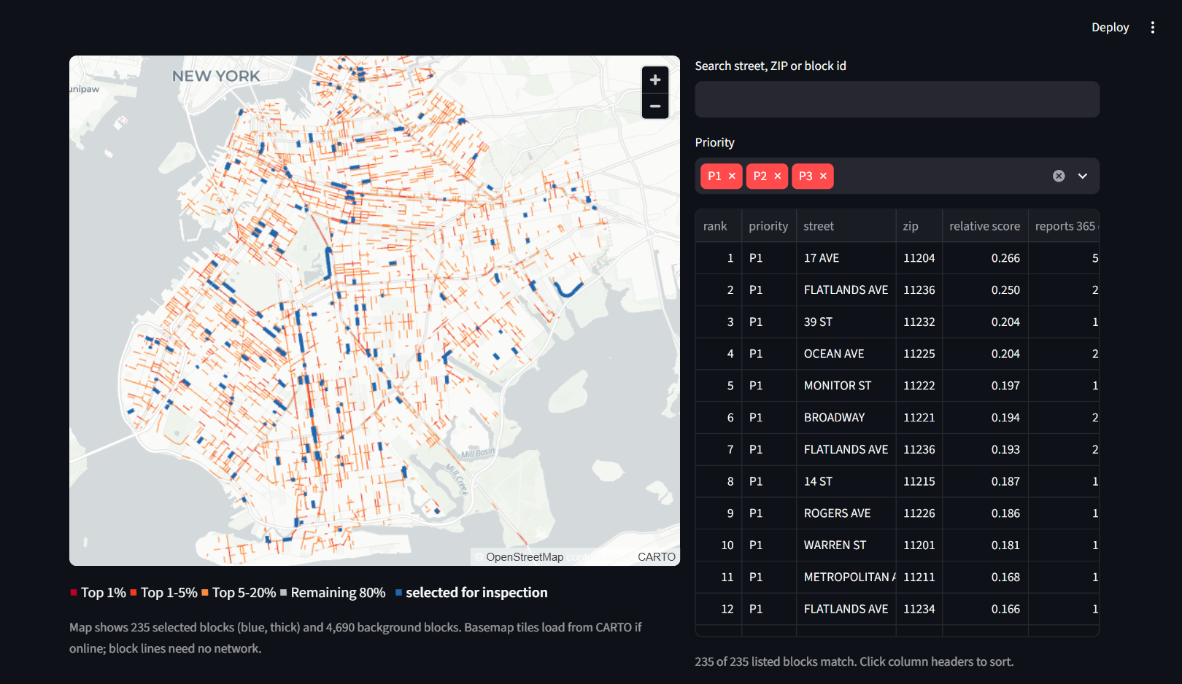
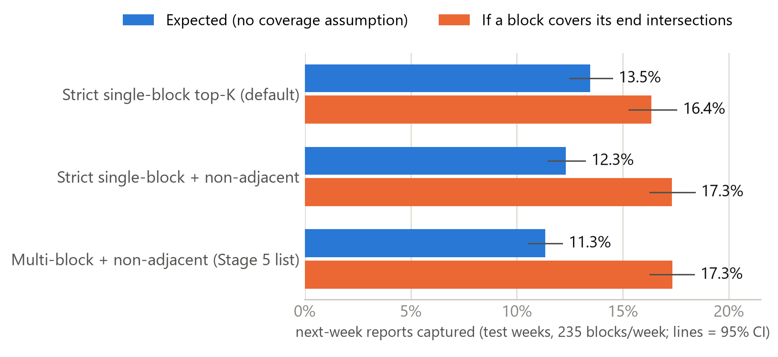
DECISION-MAKING
From ranks to a capacity-limited inspection worklist
1 Capacity: K = 0.5% / 1% / 2% of 23,448 blocks = 118 / 235 / 469, or custom.
2 Rank: take the top K blocks by this week's score.
3 Explain: priority tier, report history, model drivers, map.
4 Act: inspect (not repair); export CSV or GeoJSON.
Which list is best depends on what an inspection covers
The non-adjacent alternative was proposed after test-period results were seen, so its advantage is a hypothesis, not a confirmed result.
RoadWatch · OxHack
Source: Live dashboard, retrospective week 16 Mar 2026 (default strict top-K, 1%); outputs/stage5/capture_definitions.csv
6
Notes:
Turning ranks into decisions is deliberately simple: choose a weekly capacity, here 235 blocks, and take the top-ranked ones. Let's see it in the dashboard.
[LIVE DEMO, 2:40–3:43: Presenter 2 switches to the dashboard]
This is the week of 16 March 2026, a retrospective example, not a live recommendation. The blue lines are the 235 blocks to inspect, ranked in the table.
If the budget doubles to 2 percent, the list grows to 469 blocks.
Every block shows its reasons: 17th Avenue had 59 reports naming it or its end intersections in the past year, 18 in the last month. That is evidence, not proof of a defect.
One subtlety: what counts as catching a report depends on what an inspection covers. If inspecting a block also covers its end intersections, spreading inspections across intersections looks best. Without that assumption the strict list wins, so it is our default.
*(optional)* That alternative was also proposed after we had seen test results, so we do not treat it as confirmed.

Slide 7
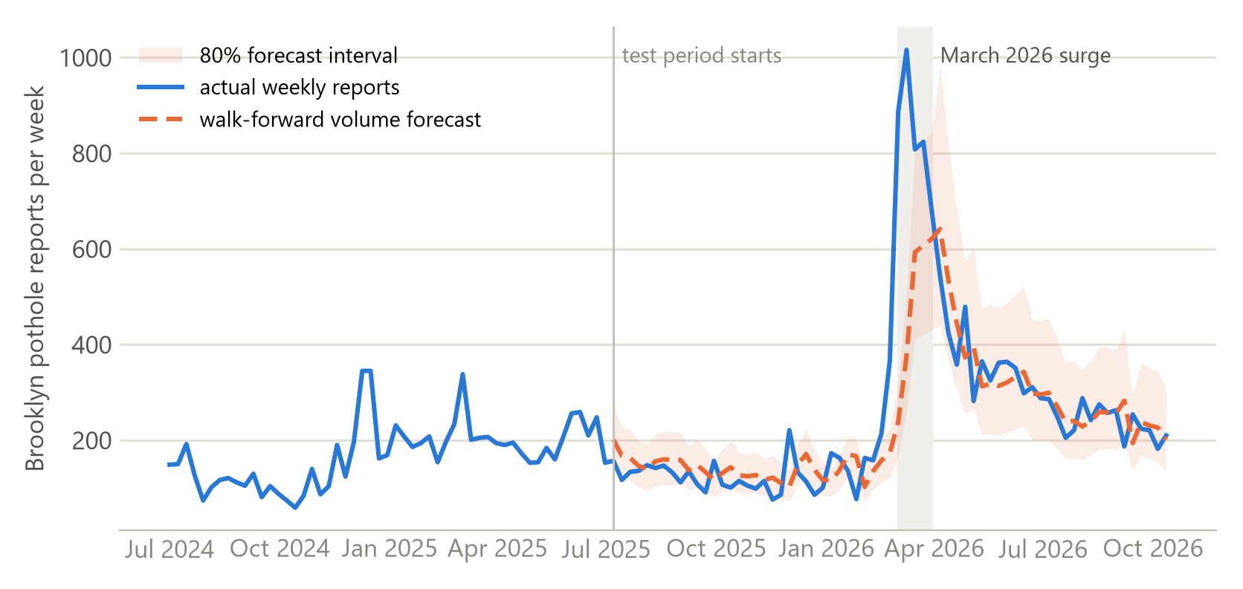
LIMITATIONS
What RoadWatch does not show (yet)
March 2026 surge: 843 reports per week, about 4× normal. The volume forecast fell 42% short; ranking still beat the baseline (12.9% vs 9.2% expected capture, only 5 weeks).
Weak volume forecasts: MAE 64.2 vs 64.1 for 'same as last week', so capacity stays a human decision.
Reports, not defects: no inspection outcomes; no failures prevented or money saved are claimed.
Reporting bias: reports track complaints; by ZIP they follow DOT work orders (rho 0.77) but not pavement ratings (rho −0.23).
Ambiguous locations: 44% of test-period reports have several candidate blocks.
RoadWatch · OxHack
Source: outputs/stage5/volume_forecast_results.json, capture_definitions.csv (March: 5 weeks), geographic_coverage.json
7
Notes:
Now the limits. In March 2026 reports roughly quadrupled. The ranking held up, but our weekly volume forecast fell 42 percent short, so capacity stays a human decision. We predict reports, not confirmed defects, and reports reflect who complains as well as road condition. We claim no savings and no failures prevented.

Slide 8
REAL-WORLD IMPROVEMENT
What it would take to deploy
Improvement | Data needed | How to implement | Success metric
Confirmed inspection outcomes | defect found / not found, severity, repair date | outcome columns in the exported worklist, joined back by block id each week | defects found per 100 inspections vs baseline list
Better intersection locations | GPS or photo with each 311 report | snap reports to the nearest block leg; learn which leg is usually at fault | share of reports on one block (now 59.2%)
Prospective shadow trial | future weeks after 12 Oct 2026 | freeze model and default list; score weekly without tuning | pre-registered capture and precision vs baseline
Costs and repair effectiveness | repair cost, crew time, re-report rate | randomised or alternating trial against current practice | cost per verified defect; only then any savings claim
Also planned: true publication timestamps, local traffic and road-condition data, surge-aware calibration, equity monitoring, and testing weather in the volume forecast (appendix A3).
RoadWatch · OxHack
Source: Proposals, not results. Full roadmap: appendix and technical manual
8
Notes:
To make this deployable, we need inspection outcomes to learn real defects, better intersection locations, and a prospective trial that freezes the model and scores future weeks. RoadWatch shows that public data can rank where to look first: honestly measured, and ready for a field test. Thank you.

Slide 9
APPENDIX A1
Capture under four definitions, 1% capacity (95% CI)
Test weeks | Fractional (expected) | Assigned block | Intersection-node | Any candidate
Strict single-block top-K (default) | 13.5% (12.5–14.5) | 13.4% (12.5–14.4) | 16.4% (15.3–17.5) | 17.0% (16.0–18.1)
Strict single-block + non-adjacent | 12.3% (11.5–13.2) | 12.3% (11.6–13.2) | 17.3% (16.3–18.4) | 18.3% (17.2–19.6)
Multi-block + non-adjacent (Stage 5 list) | 11.3% (10.6–12.1) | 11.2% (10.4–11.9) | 17.3% (16.3–18.4) | 18.5% (17.4–19.7)
Plain top-K multi-block | 12.8% (11.8–13.9) | 12.8% (11.8–13.9) | 15.5% (14.5–16.7) | 16.2% (15.2–17.4)
Historical-rate baseline | 8.4% (7.8–9.1) | 8.4% (7.7–9.0) | 10.8% (10.0–11.6) | 11.5% (10.5–12.4)
Validation weeks | Fractional (expected) | Assigned block | Intersection-node | Any candidate
Strict single-block top-K (default) | 9.7% (8.4–10.9) | 9.7% (8.4–10.9) | 13.2% (11.7–14.7) | 13.9% (12.5–15.4)
Strict single-block + non-adjacent | 9.0% (8.0–10.0) | 8.9% (7.9–10.0) | 13.8% (12.4–15.3) | 14.7% (13.1–16.1)
Multi-block + non-adjacent (Stage 5 list) | 8.3% (7.4–9.2) | 8.1% (7.3–9.0) | 13.9% (12.5–15.3) | 15.0% (13.4–16.4)
Plain top-K multi-block | 8.6% (7.4–9.5) | 8.4% (7.3–9.5) | 11.6% (10.2–12.9) | 12.3% (10.7–13.6)
RoadWatch · OxHack
Source: outputs/stage5/capture_definitions.csv (Stage 7); validation = Jan–Jun 2025, test = Jul 2025 – Oct 2026
9

Slide 10
APPENDIX A2
Why the non-adjacent 'gain' depends on an assumption
Multi-block non-adjacent list minus plain top-K (reports, test, 1%) | Any candidate | Assigned block | Fractional
Reports with one candidate block | +84 | +84 | +84
Ambiguous intersection reports | +275 | −321 | −291
Ambiguous blockface / other | +30 | −40 | −34
Total | +389 | −277 | −241
Disclosure
The non-adjacent rule was written after test-period top-K results existed. Its validation 'confirmation' was therefore not independent, and its advantage is treated as an unconfirmed hypothesis.
Default choice
Strict single-block top-K: best under expected capture and never worse than plain top-K under any definition (test, fractional +0.2 to +1.1 pp).
Never listing two blocks that share an intersection raises 'any candidate' capture (+2.3 pp) because one inspection is credited with every candidate block of an intersection report. Under expected (fractional) capture the same lists lose (−1.4 pp; paired 95% CI −2.1 to −0.9 pp).
RoadWatch · OxHack
Source: outputs/stage7_scratch_eval/decomposition_1pct.csv; outputs/stage5/capture_definitions.csv; docs/stage7_audit_report.md
10

Slide 11
APPENDIX A3
Improvement roadmap: data, implementation and evaluation
Improvement | Data needed | Proposed implementation | Evaluation metric
Inspection outcomes and severity | found / not found, severity, repair date per inspected block | outcome columns in exported worklists; retrain on verified defects | defects per 100 inspections; severity-weighted capture
Intersection location | GPS or photo per report; inspector GPS | snap to nearest block leg; learn leg from outcomes | share uniquely located; any-vs-fractional gap
Publication timestamps | daily API snapshots (:created_at, :updated_at) | scheduled ingest; measure per-record availability lag | lag distribution; backtest with true as-of data
Traffic, weather, road condition | traffic counts, more stations, pavement ratings | add point-in-time features; validation-only selection | paired change in precision@1% and AP
Surge handling and calibration | recent weekly totals | weekly recalibration; drift alert on predicted/observed | monthly calibration ratio near 1; Brier score
Reporting equity | community-board areas, independent condition data | coverage panel; optional minimum coverage per area | inspections and defects found per area
Weather in volume forecast | NOAA daily and forecast weather | extend the tested weather feature set; walk-forward | MAE vs 'same as last week' with paired CI
Repair effectiveness and cost | repair cost, crew time, re-reports, claims | randomised or alternating trial vs current practice | cost per verified defect; time to repair
RoadWatch · OxHack
Source: Proposals only; none of these outcomes has been measured
11

Slide 12
APPENDIX A4
Reproducibility and verification
• Offline rebuild from archived raw snapshots: 8/8 processed tables, 18/18 label outputs and 6/6 feature files byte-identical.
• Frozen LightGBM refits reproduce saved predictions exactly (maximum difference 0.0).
• Leakage review: 311 lag of 2 days and NOAA lag of 5 days are exact; labels and IDs never enter a model; model selection was frozen before the first test prediction.
• Automated pytest suite; every number in this deck is re-derived from saved files by scripts/final/verify_final.py.
• Dashboard checked in a real browser: downloads byte-identical to saved worklists; invalid input handled; map works offline without tiles.
RoadWatch · OxHack
Source: outputs/stage7/reproducibility.json; outputs/final/verification/
12

